Slide 1
8 Solutions Lab
Using chemical properties to identify an unknown solution

Slide 2
Procedure – Step 1: Determining chemical properties of 8 known solutions
Trouble viewing? Click
on this link:
https://youtu.be/gyK20etbAHY

Slide 3
Procedure – Step 2: Using chemical properties of 8 known solutions to determine the identity of 7 unknown solutions
Trouble viewing? Click
on this link:
https://youtu.be/QZGtM-hnujI

Slide 4
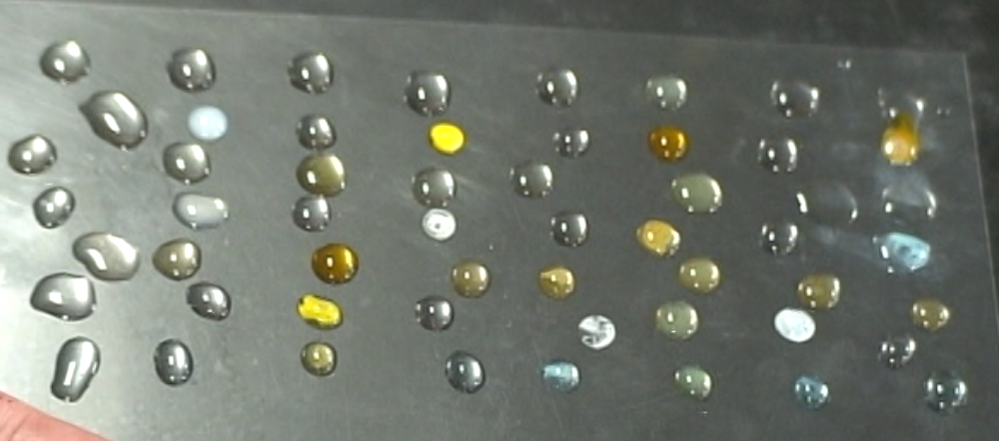
Results: Unknown Set #1

Slide 5
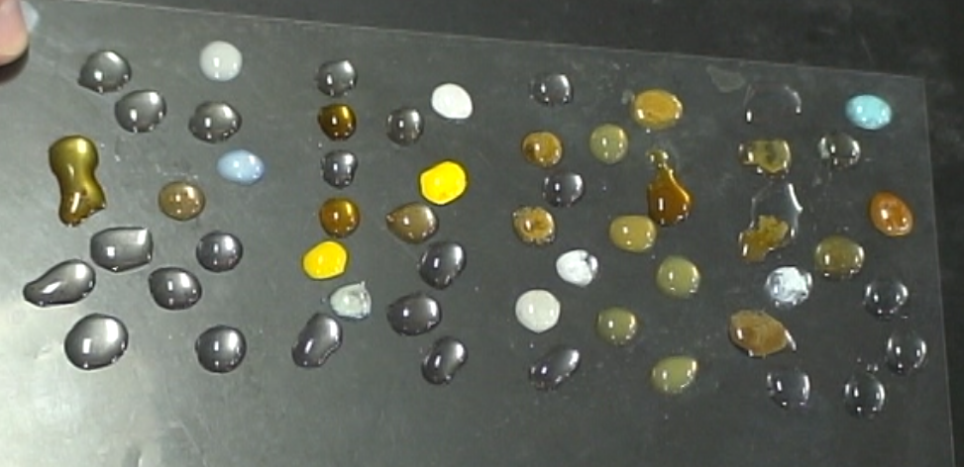
Results: Unknown Set #3

