Slide 1
How Significant Is It?
Lab using significant figures in science

Slide 2
The lab sheet

Slide 3
Instructions/overview

Slide 4
Station #1

Slide 5
Station #2

Slide 6
Station #3

Slide 7
Station #4

Slide 8
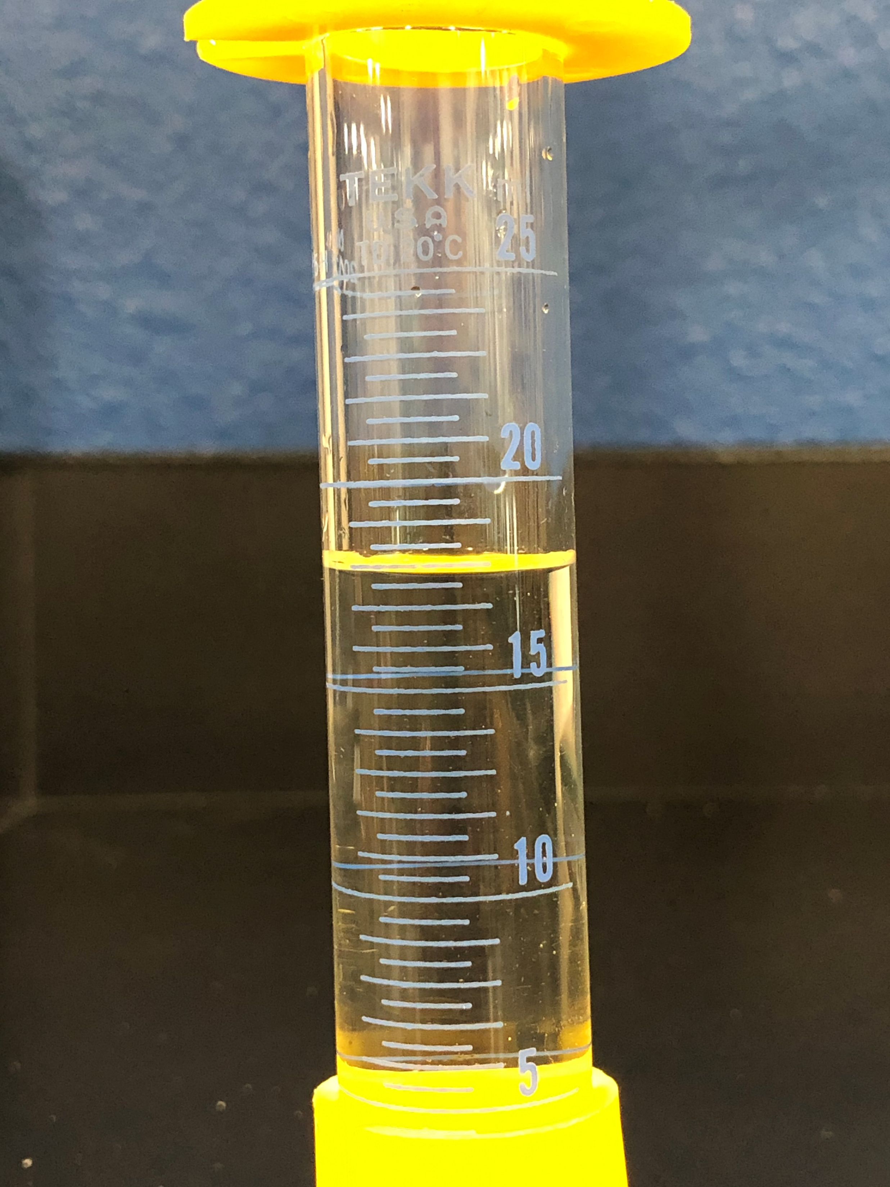
Station #5
Find the volume in mL.

Slide 9
Station #6
Find the volume. Be careful on this one! Be sure to ask yourself: what decimal level do I know FOR SURE? Every 100’s? Every 10’s? Every 1’s?

Slide 10
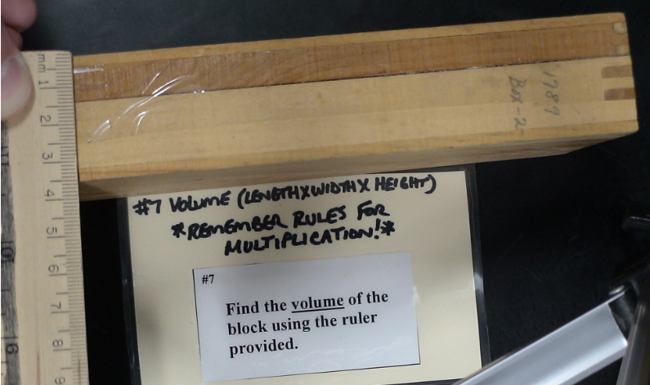
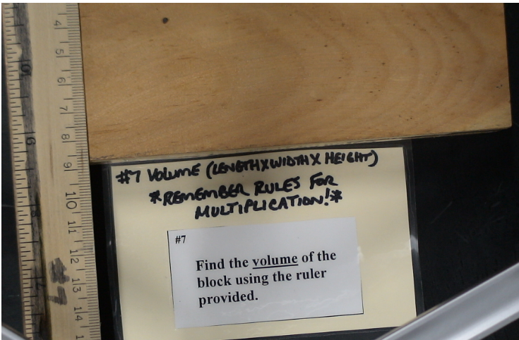
Station #7
Length
Height
Width

Slide 11
Station #8
Width
Length

Slide 12
Station #9

Slide 13
Station #10

Slide 14
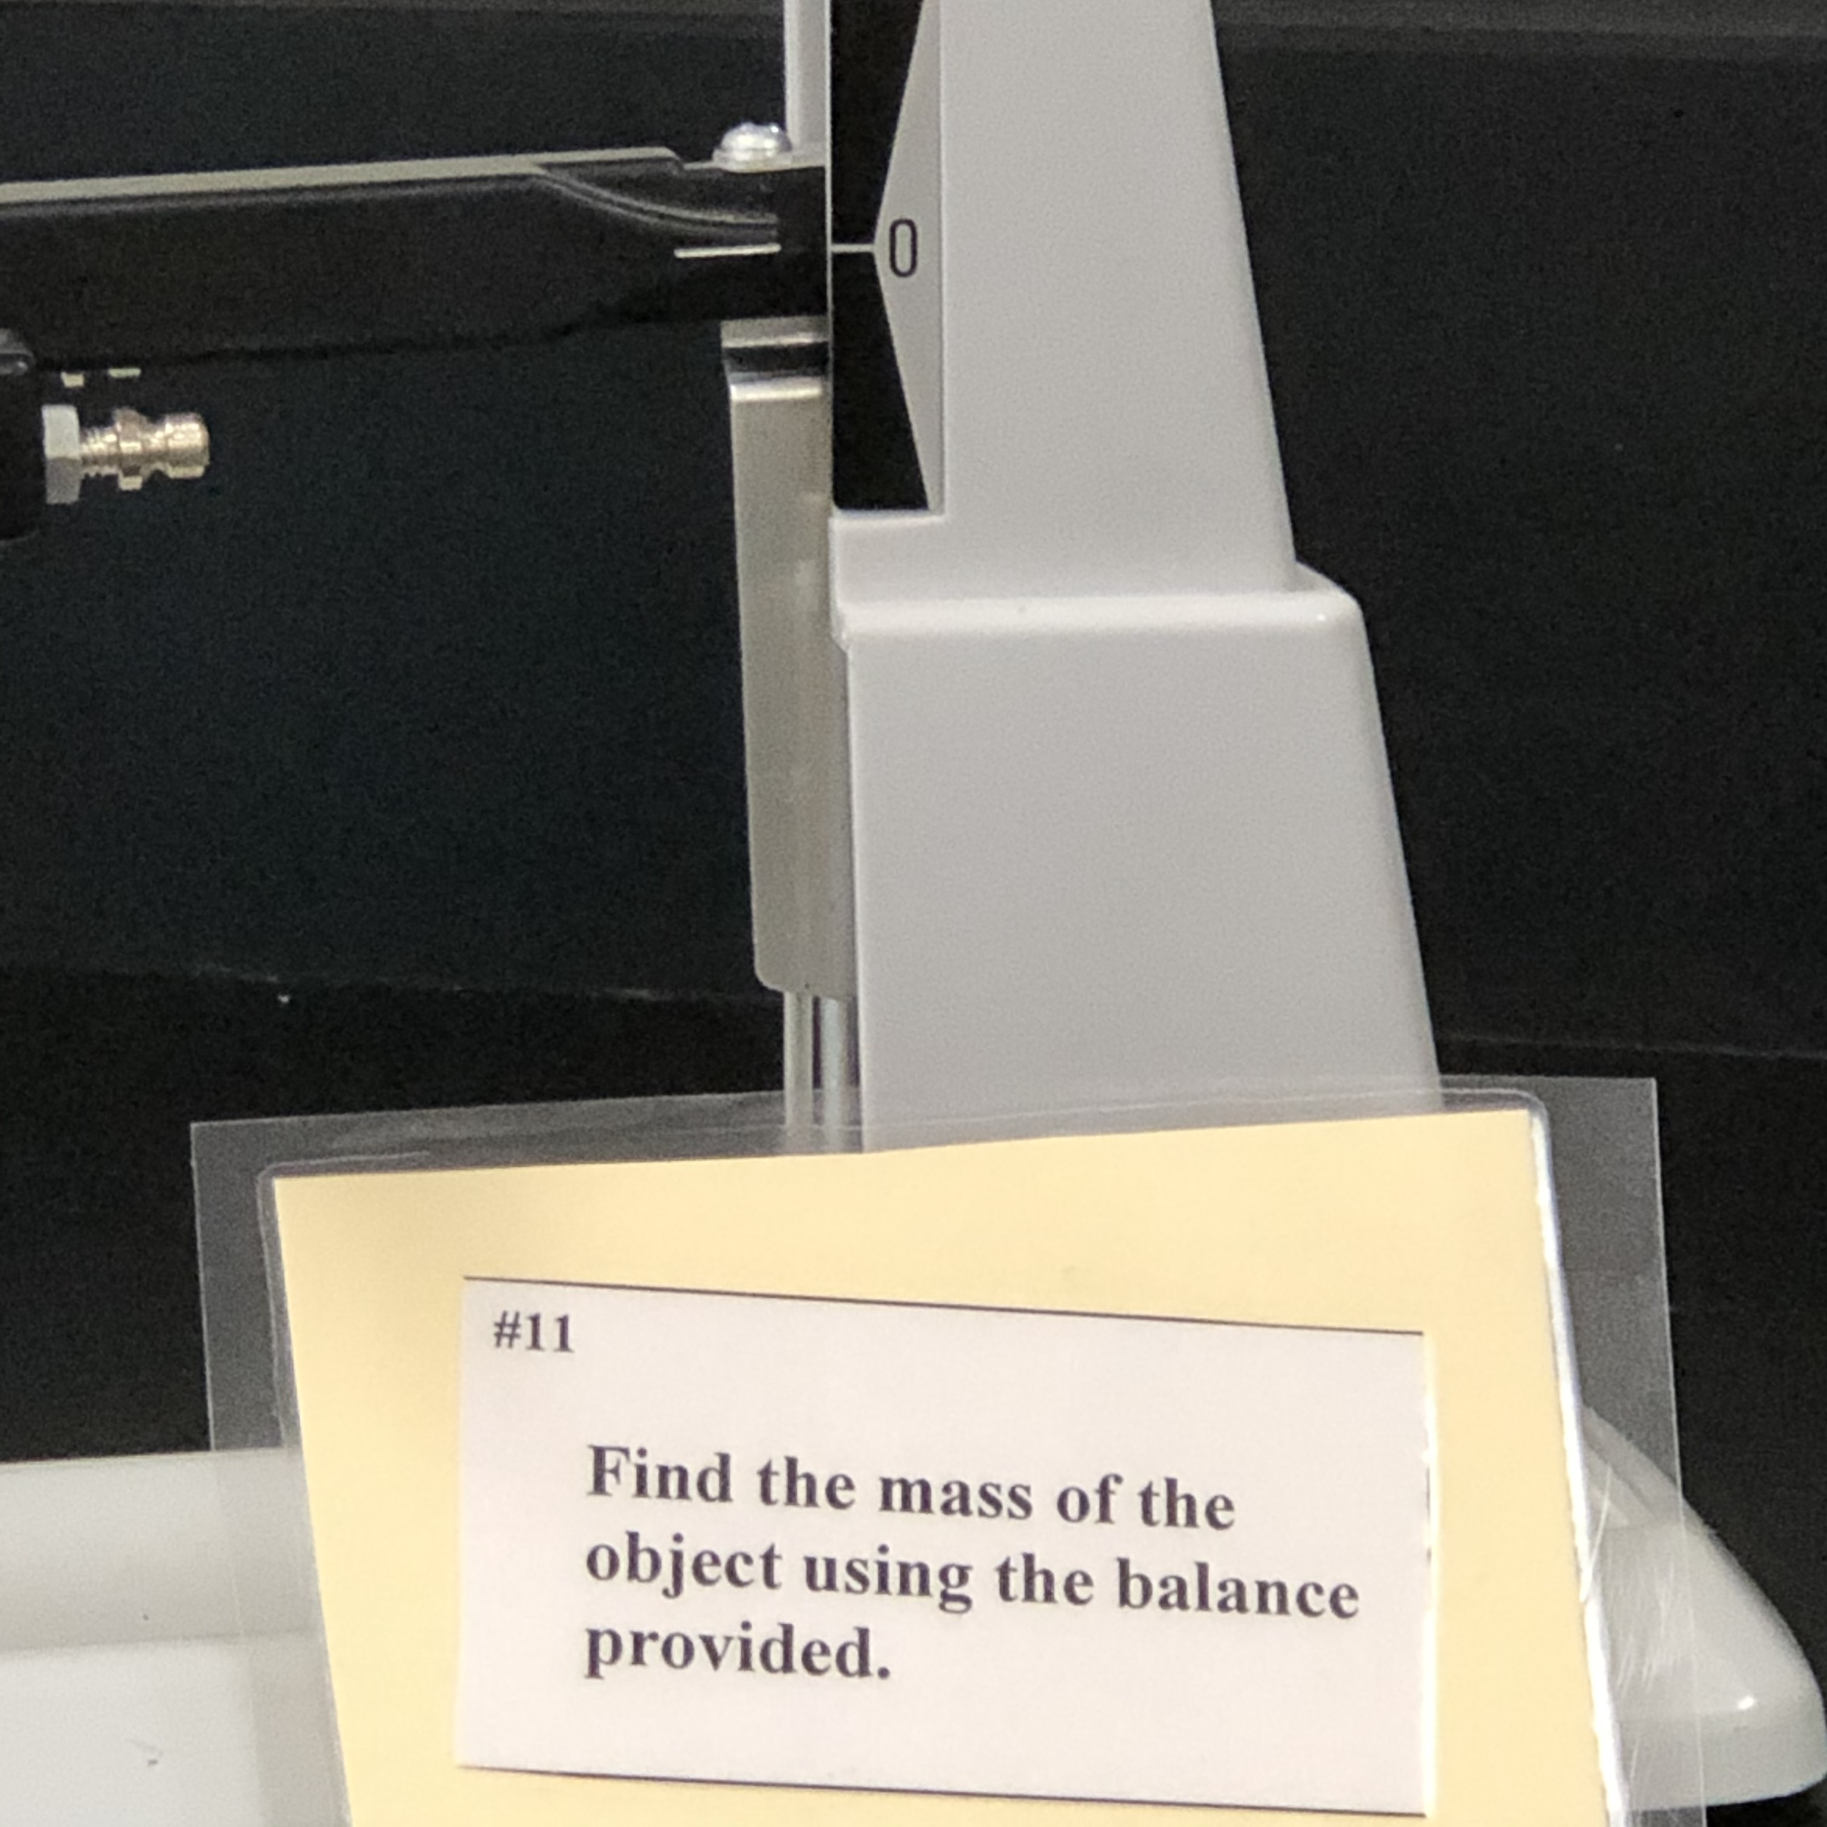
Station #11
Find the mass in grams.

Slide 15
Station #12
What is the temperature?
Thermometer is in Celsius

