Slide 1
Bone naming and parts identification
Appendicular skeleton

Slide 2
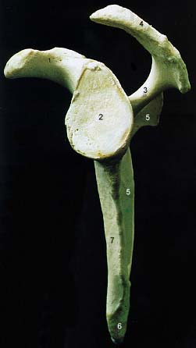
Scapula
Acromion process
Coracoid process
Notch
Spine

Slide 3
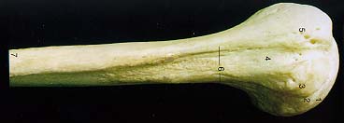
Humerus
Neck
Head

Slide 4
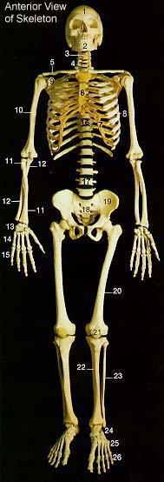
Ulna
Olecranon process
Coronoid process
Semilunar notch

Slide 5
Radius

Slide 6
Carpals
Name from thumb to pinky (regardless of supine or prone position)
Proximal row:
scaphoid
lunate
triquestrum
pisiform
Distal row:
trapezium
trapezoid
capitate
hamate

Slide 7
Metacarpals and phalanges
Proximal
Middle
Distal

Slide 8
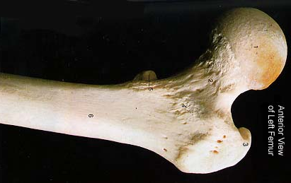
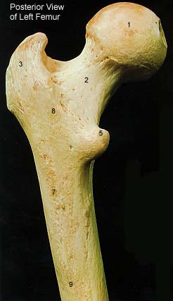
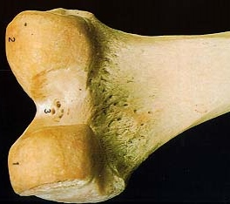
Femur
Medial condyle
Head
Neck
Lateral condyle
Trochanters

Slide 9
Patella

Slide 10
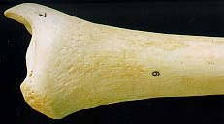
Tibia
Medial condyle
Medial malleolus
Anterior crest
Lateral condyle

Slide 11
Fibula
Lateral malleolus

Slide 12
Tarsals, metatarsals, phalanges
Proximal
Middle
Distal

