Slide 1
Bone naming and parts identification
Axial skeleton

Slide 2
Hyoid

Slide 3
Vertebra with rib
Body
Anterior arch
Posterior arch
Spinous process
Transverse process

Slide 4
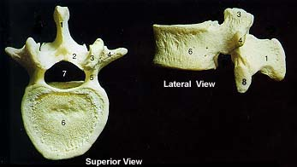
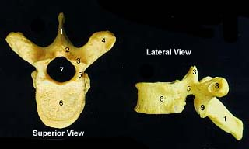
Types of vertebrae
Cervical Thoracic Lumbar
Bifid
process
Transverse foramen

Slide 5
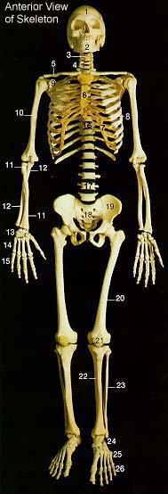
Clavicle
Clavicle

Slide 6
Ribs
True
False
Floating

Slide 7
Sternum
Manubrium
Body
Xiphoid
process

Slide 8
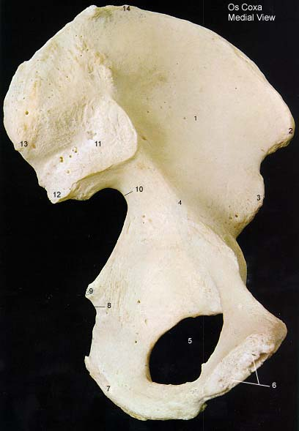
Os coxae (not pelvis!)
Lateral side Medial side
Crest
Ilium
Crest
Fossa
Pubis
Ischium

Slide 9
Sacrum and coccyx

