Slide 1
Bone naming and parts identification
Skull structures

Slide 2
Parietal bone

Slide 3
Frontal bone
Glabella

Slide 4
Supraorbital margin (region)
Supraorbital foramen (hole)

Slide 5
Temporal bone

Slide 6
Parts of temporal bone
Zygomatic process
Auditory meatus
Mastoid process
Styloid process

Slide 7
Back of head
Occipital bone
External Occipital Crest

Slide 8
Zygomatic bone
Infraorbital foramen (hole)

Slide 9
Zygomatic BONE
Temporal PROCESS

Slide 10
Don’t confuse BONE from PROCESS! Order: T, Z, T, Z
Zygomatic BONE
Temporal
BONE
Zygomatic
PROCESS
Temporal PROCESS

Slide 11
Maxilla
Vomer

Slide 12
Palatine bones

Slide 13
Parts of the mandible
Condyle
Notch
Ramus
Mental foramen
Symphysis
Angle
Body

Slide 14
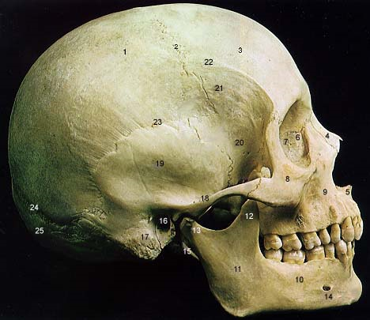
Sphenoid
Lacrimal
Zygomatic
Maxilla
Nasal
Ethmoid

Slide 15
Sagittal
suture
Coronal
suture

Slide 16
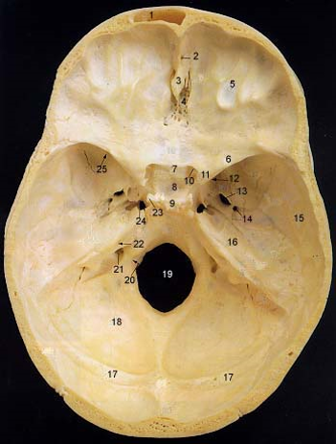
Carotid
canal
Jugular
foramen
Foramen
magnum

