Slide 1
Cat Muscles

Slide 2
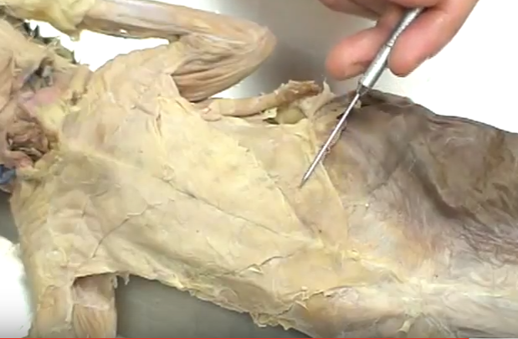
Xiphihumeralis

Slide 3
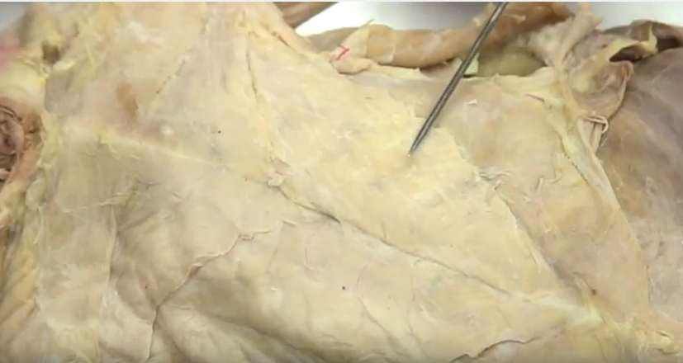
Pectoralis Minor

Slide 4
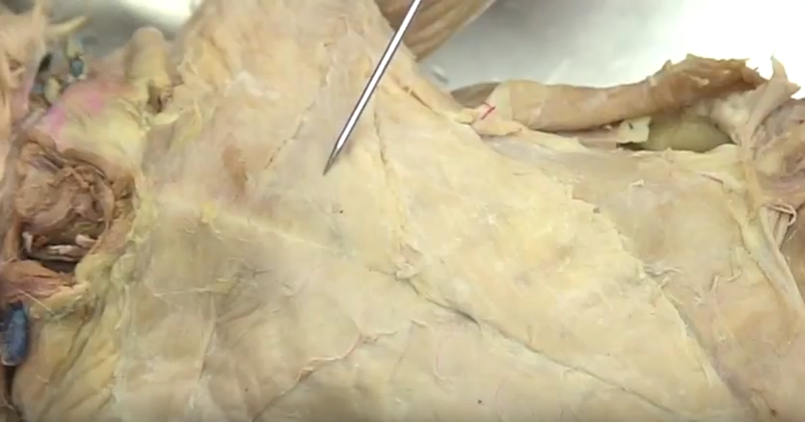
Pectoralis Major

Slide 5
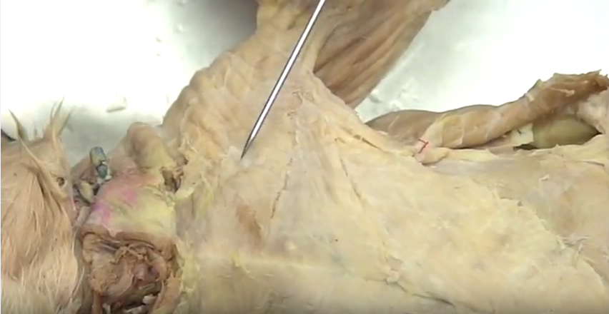
Pectoantebrachialis

Slide 6
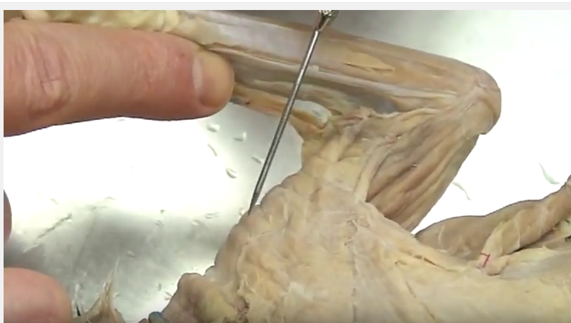
Deltoid – medial side

Slide 7
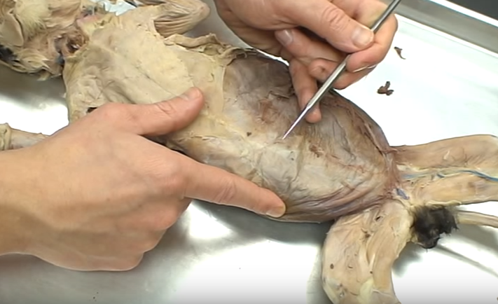
Rectus Abdominus

Slide 8
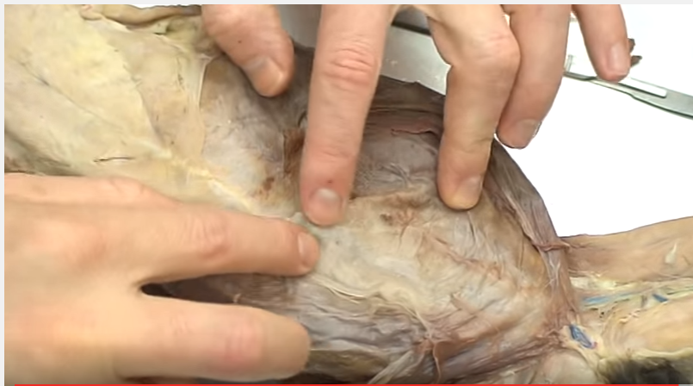
Rectus Abdominus – either side of linea alba

Slide 9
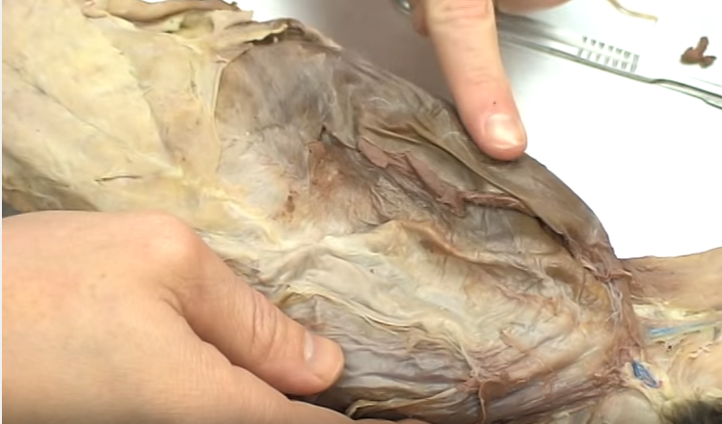
External Obliques

Slide 10
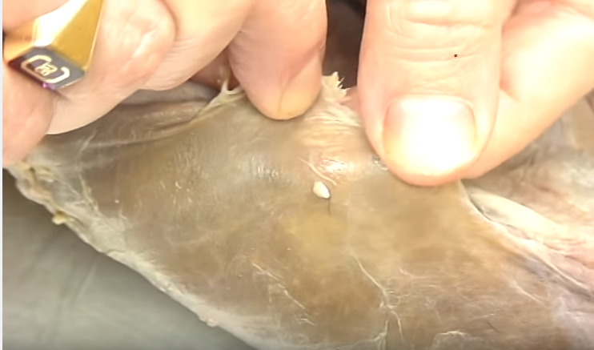
External Oblique - closeup

Slide 11
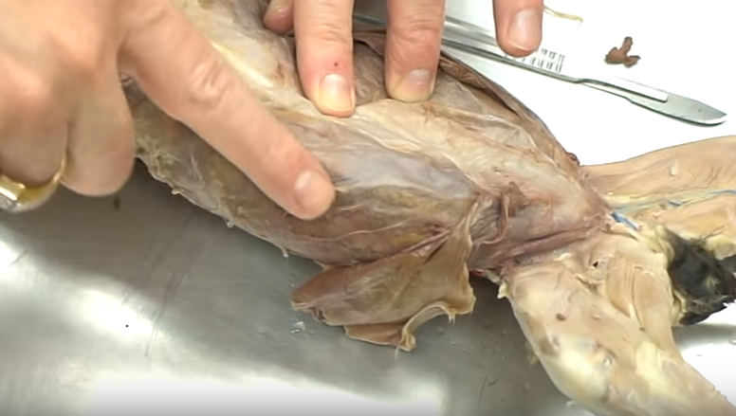
Internal Oblique – under External Oblique

Slide 12
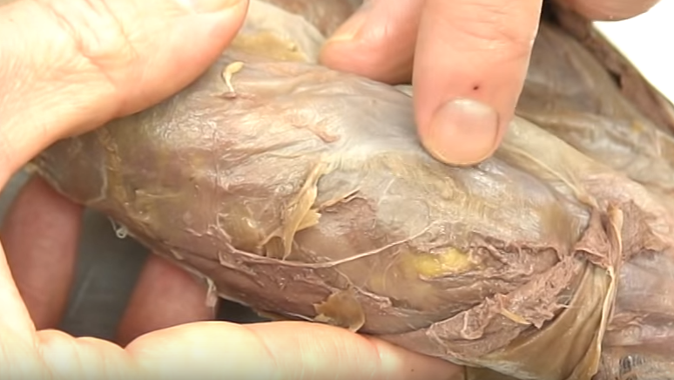
Transversus Abdominus – under external and internal obliques

Slide 13
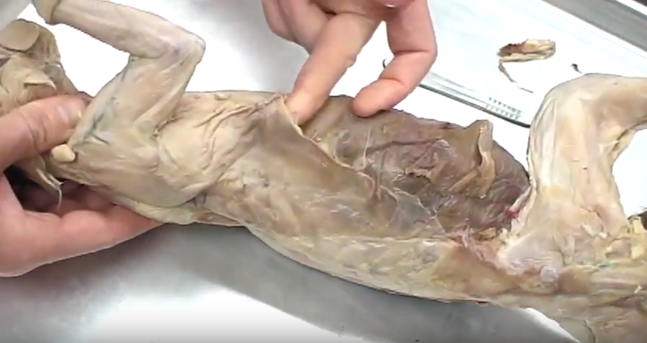
Latissimus Dorsi

Slide 14
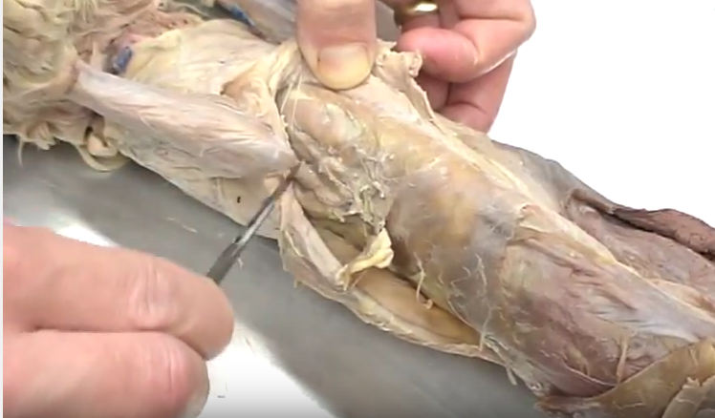
Serratus Anterior – under xiphihumeralis & latissimus dorsi

Slide 15
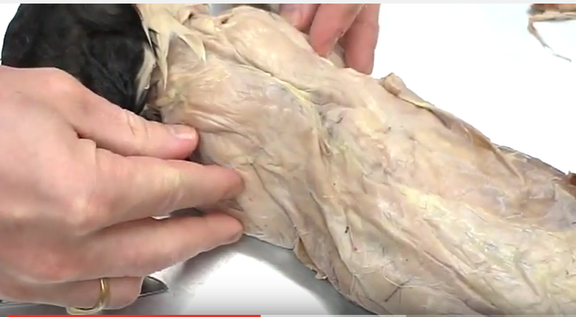
Trapezius

Slide 16
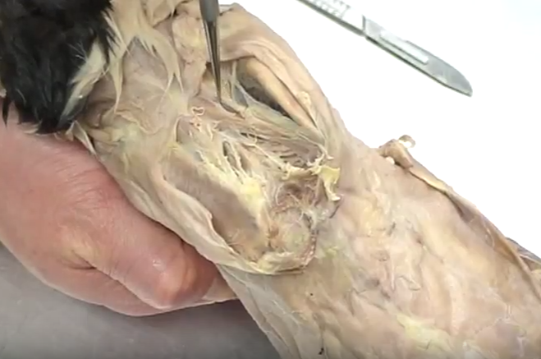
Rhomboideus – between scapula under trapezius

Slide 17
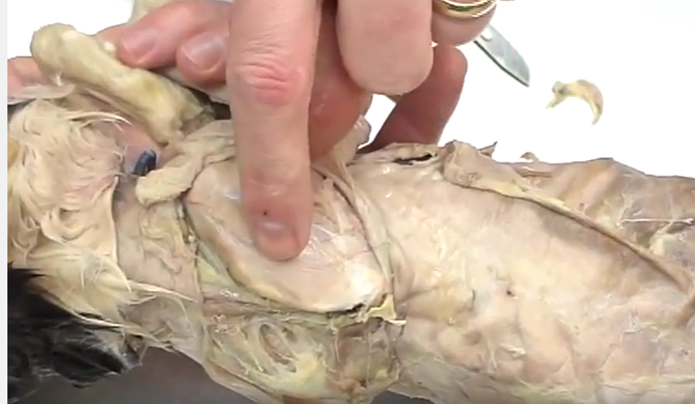
Supraspinatus - under trapezius

Slide 18
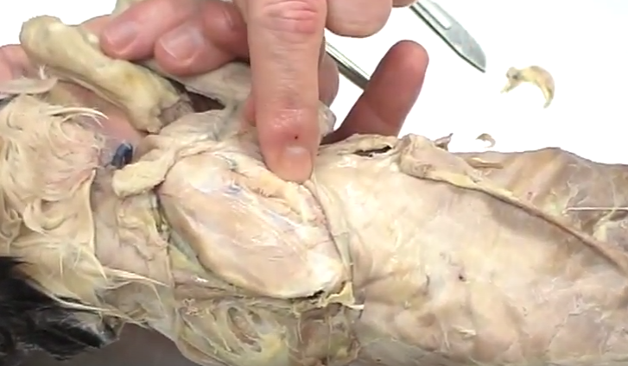
Infraspinatus – below scapular spine, beneath trapezius

Slide 19
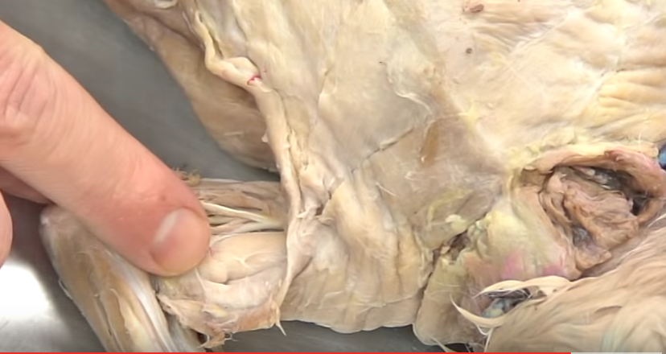
Biceps Brachii – under pectoral muscles, medial side of upper arm

Slide 20
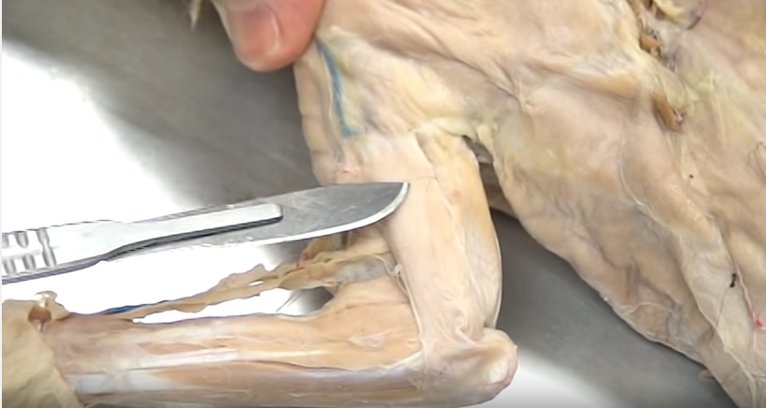
Triceps Brachii – Lateral side

Slide 21
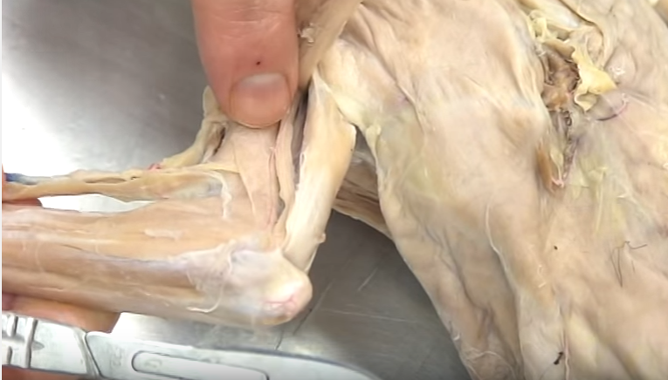
Brachialis – under lateral side of triceps brachii

Slide 22
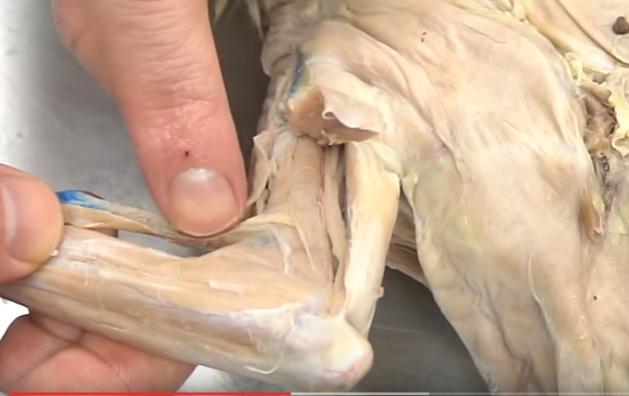
Brachioradialis – lateral side of arm

Slide 23
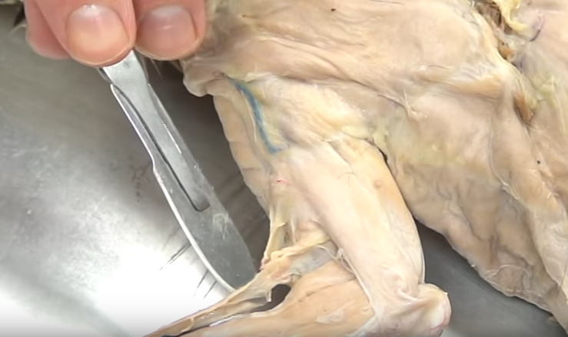
Brachioradialis – coming off brachialis

Slide 24
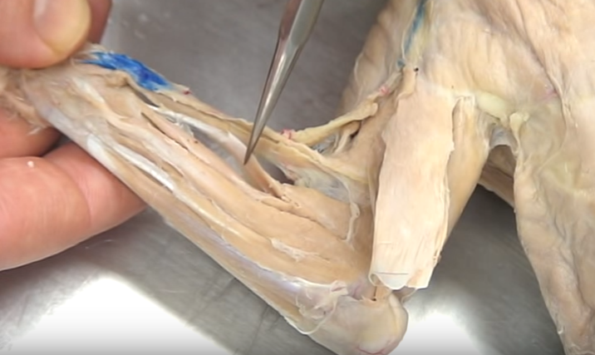
Extensor Carpi Radialis Longus

Slide 25
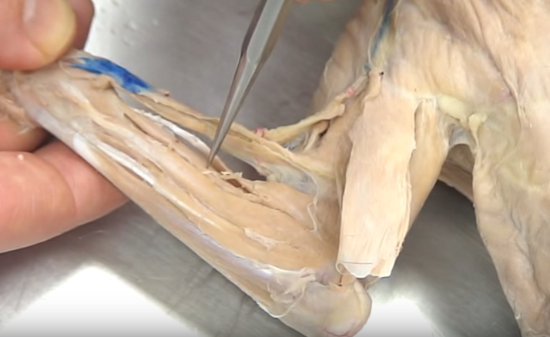
Extensor Carpi Radialis Brevis

Slide 26
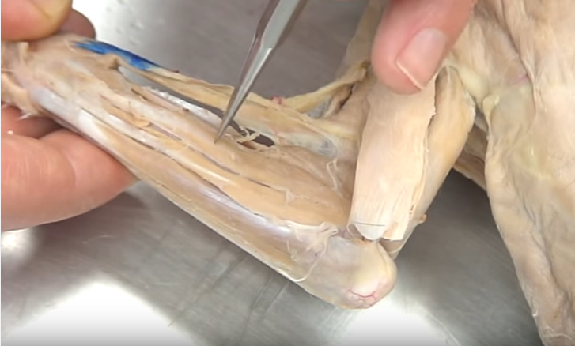
Extensor Digitorum Communis

Slide 27
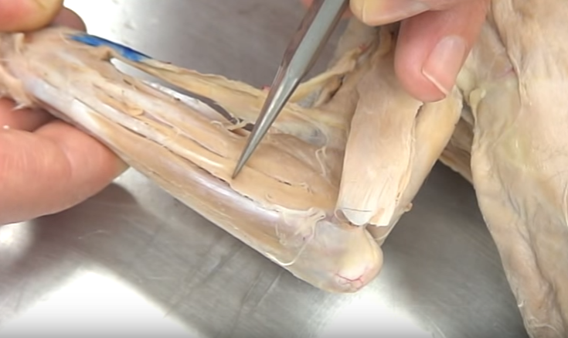
Extensor Digitorum Lateralis

Slide 28
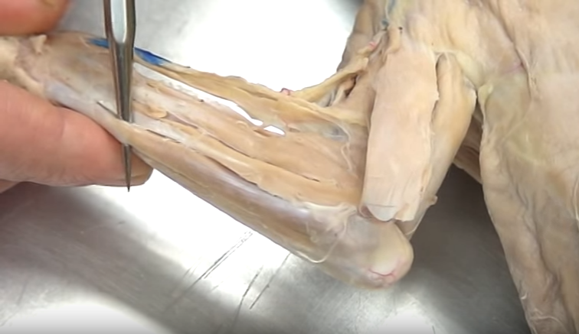
Extensor Carpi Ulnaris

Slide 29
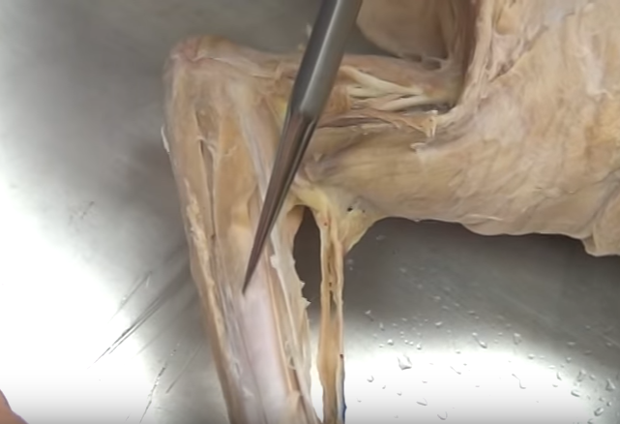
Palmaris Longus – medial side of forearm

Slide 30
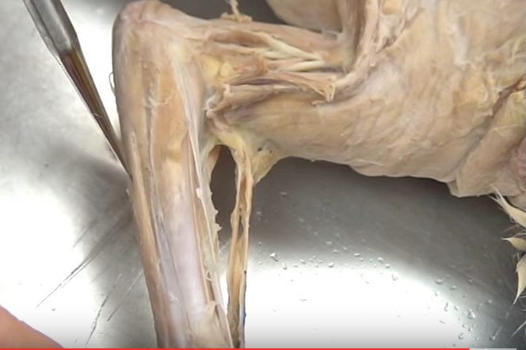
Flexor Carpi Ulnaris – medial side of forearm

Slide 31
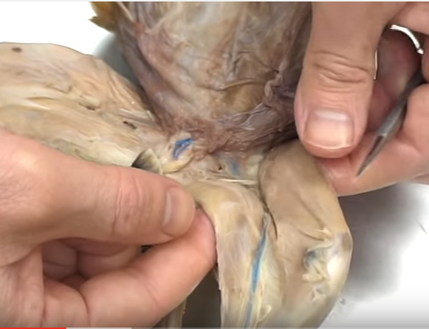
Medial side of leg: Gracilis Sartorius

Slide 32
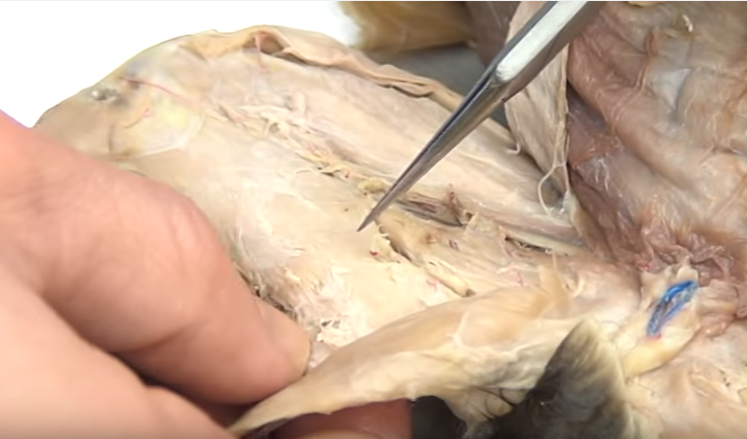
Semimembranosus – under gracilis on medial side of leg

Slide 33
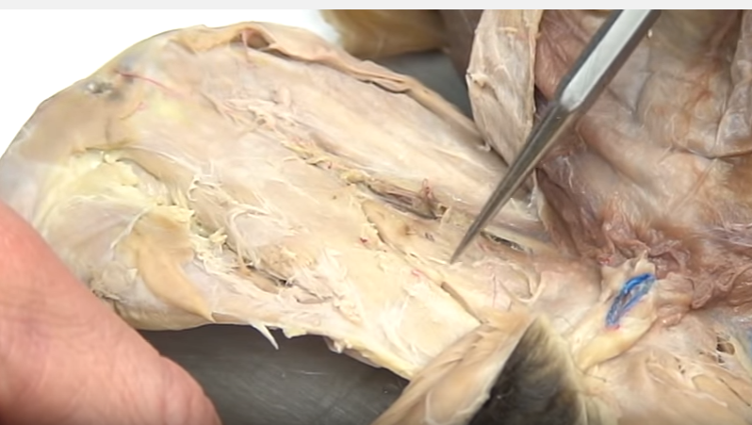
Adductors – under gracilis, medial side of lower leg

Slide 34
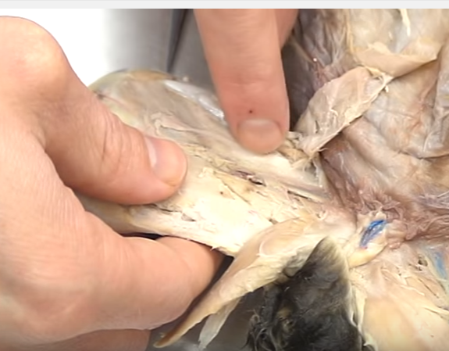
Vastus Medialis (under sartorius)

Slide 35
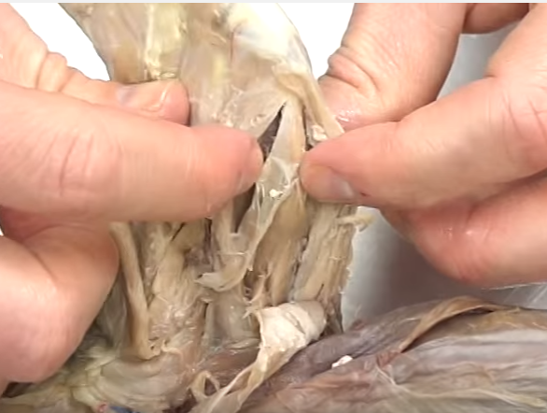
Vastus Medialis Rectus Femoris

Slide 36
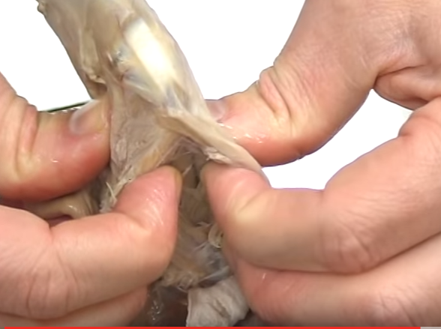
Vastus Intermedius Vastus Lateralis

Slide 37
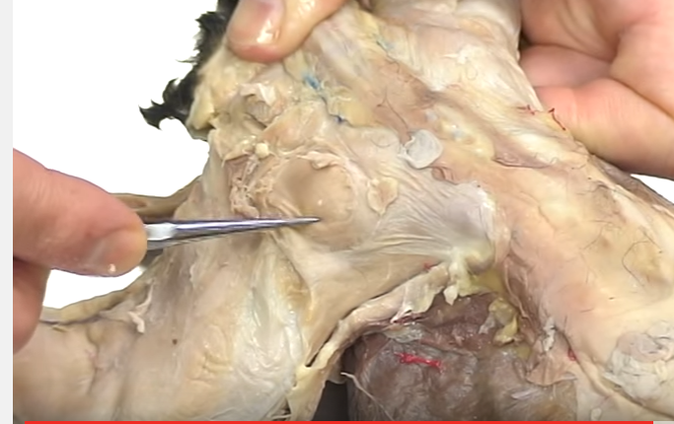
Gluteus Medius

Slide 38
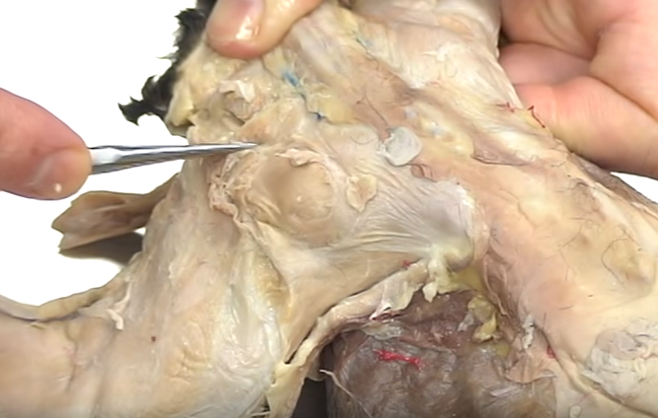
Gluteus Maximus

Slide 39
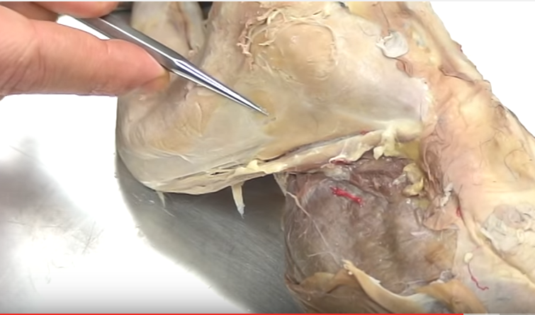
Tensor Fascia Latae

Slide 40
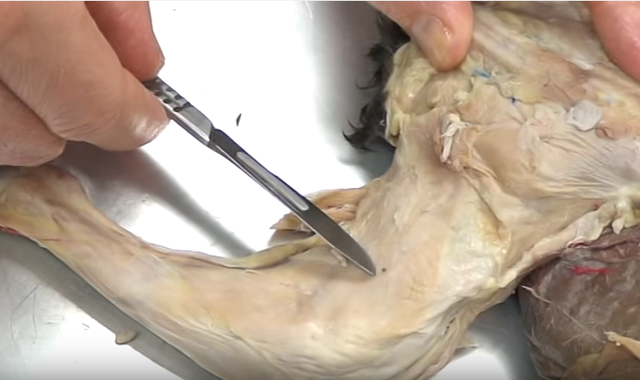
Biceps Femoris – lateral side of lower leg

Slide 41
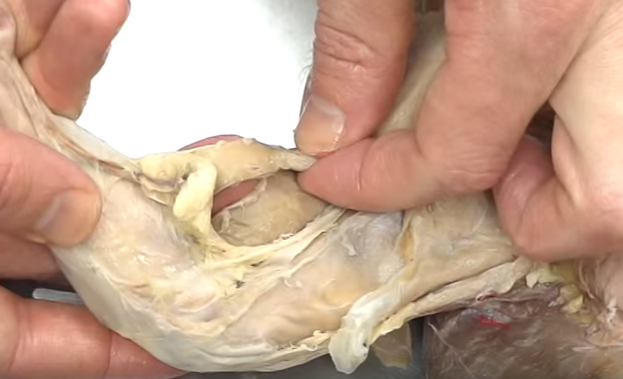
Semitendonosus – under biceps femoris on lateral side of leg

Slide 42
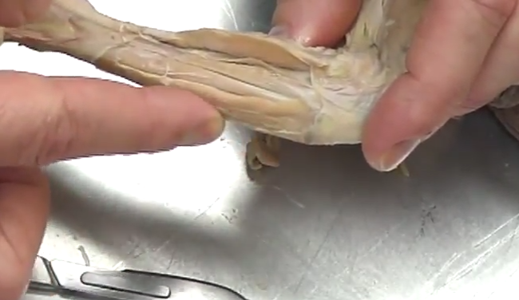
Tibialis Anterior

Slide 43
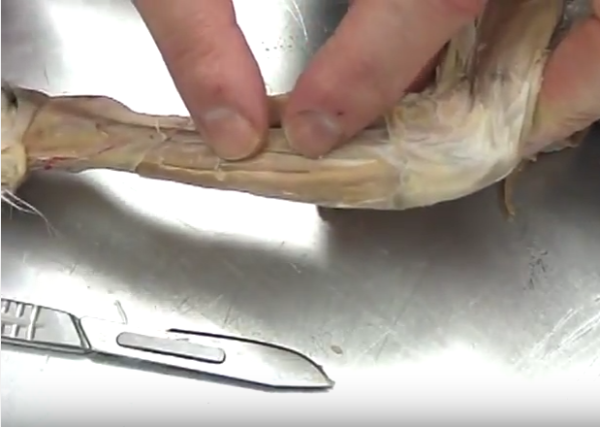
Extensor Digitorum Longus

Slide 44
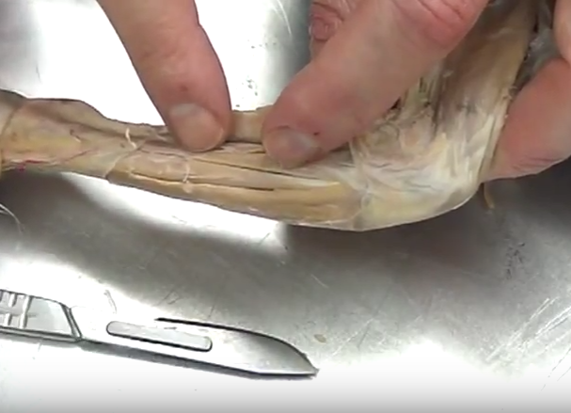
Peroneus Longus (also called Fibularis Longus)

Slide 45
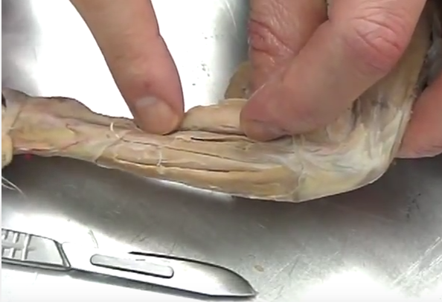
Soleus

Slide 46
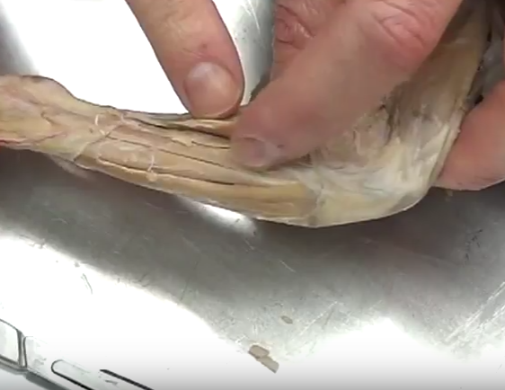
Gastrocnemius

