Slide 1
External Structures

Slide 2
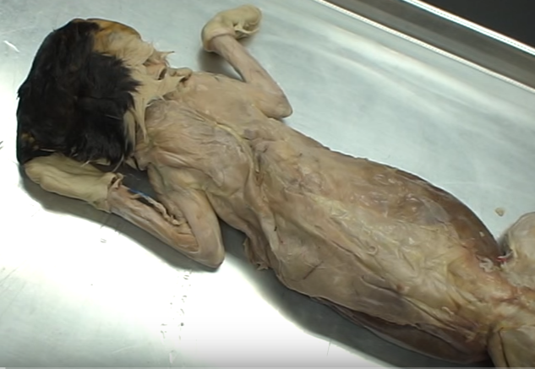
Dorsal Region (Back)

Slide 3
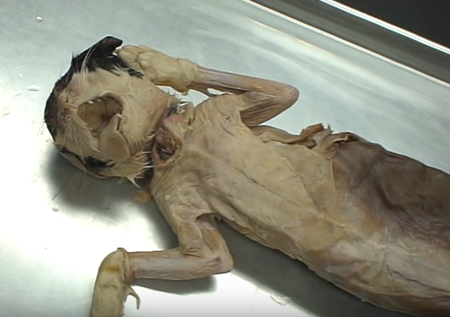
Ventral Region (Front)

Slide 4
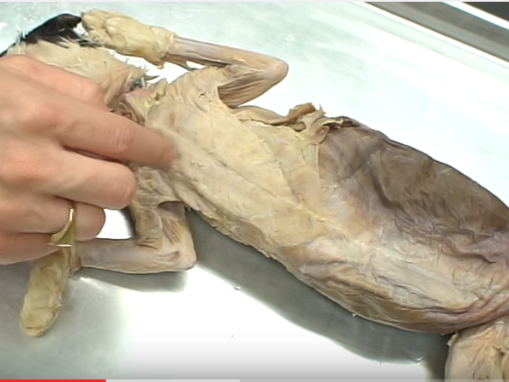
Thoracic Region (Chest)

Slide 5
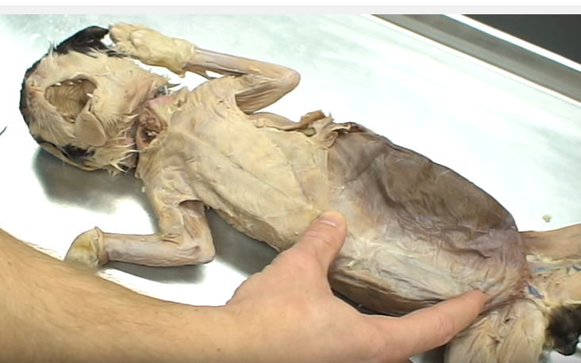
Abdominal Region

Slide 6
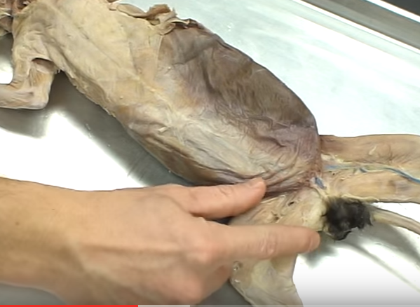
Pelvic Region

Slide 7
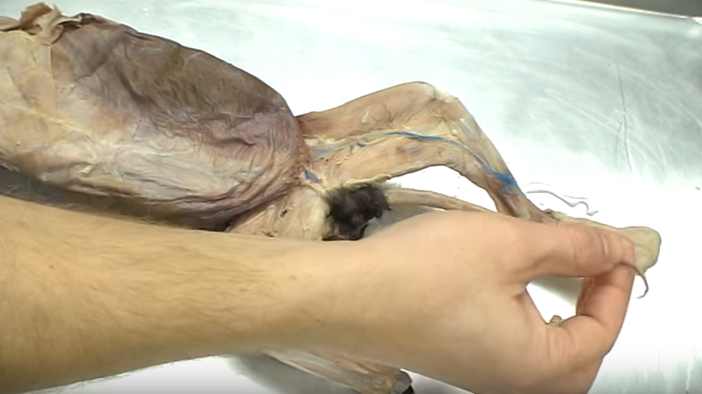
Caudal Region (Tail)

Slide 8
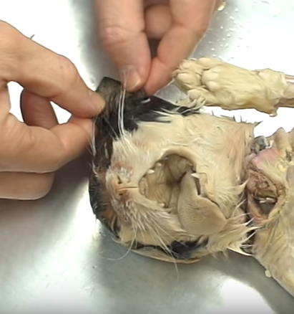
Pinnae
(Ears)

Slide 9
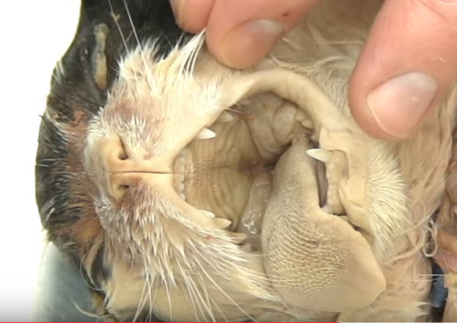
Vibrissae (Whiskers)

Slide 10
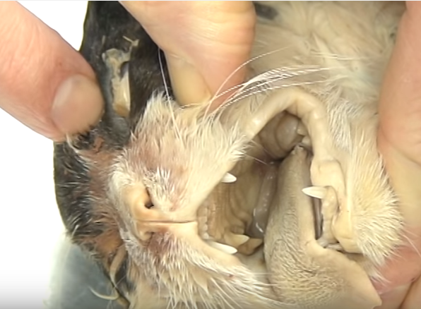
Superior Palpebra (Upper Eyelid)

Slide 11
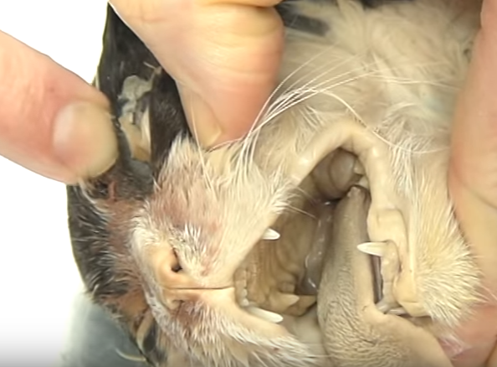
Nictitating Membrane (Third Eyelid)

Slide 12
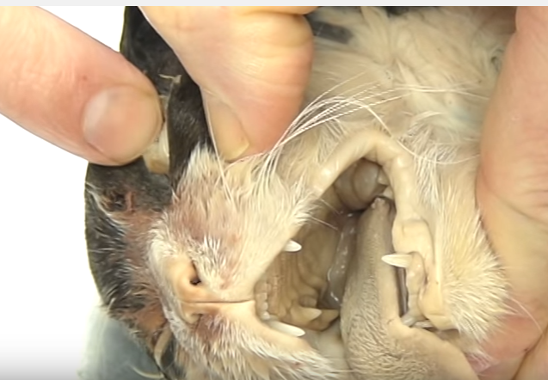
Inferior Palpebra (Lower Eyelid)

Slide 13
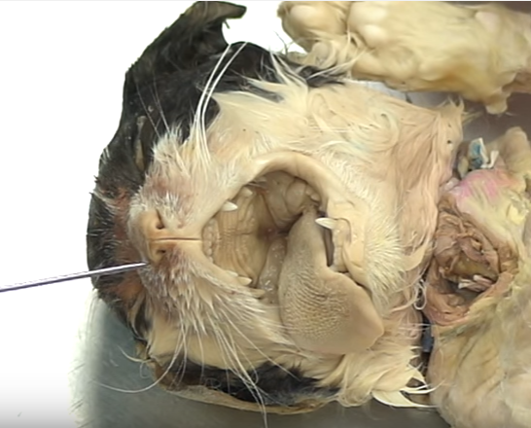
External Nares (Nostrils)

Slide 14
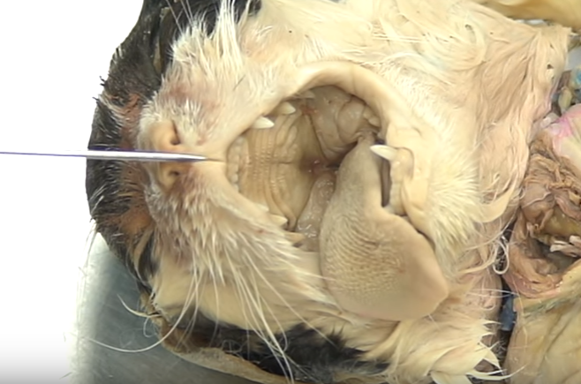
Philtrum (Split Lip)

Slide 15
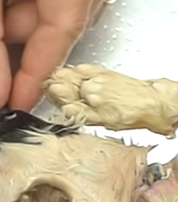
Tori/Torus (Foot Pads)

