Slide 1
Cat Skeleton

Slide 2
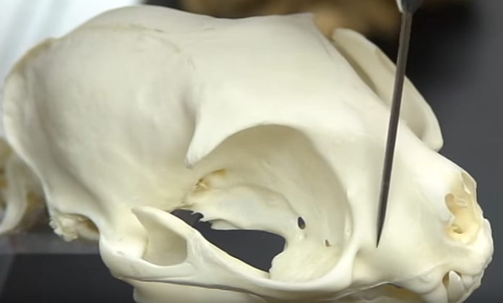
Maxilla

Slide 3
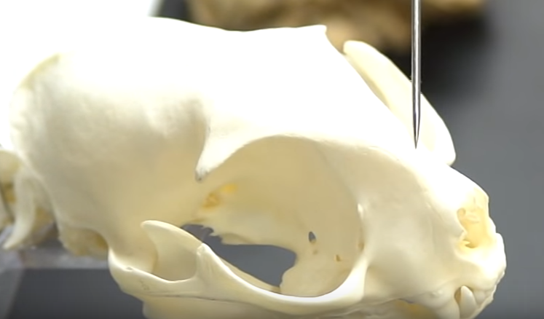
Nasal Bone

Slide 4
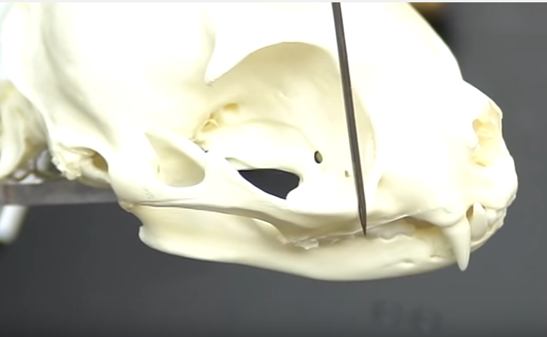
Zygomatic Bone

Slide 5
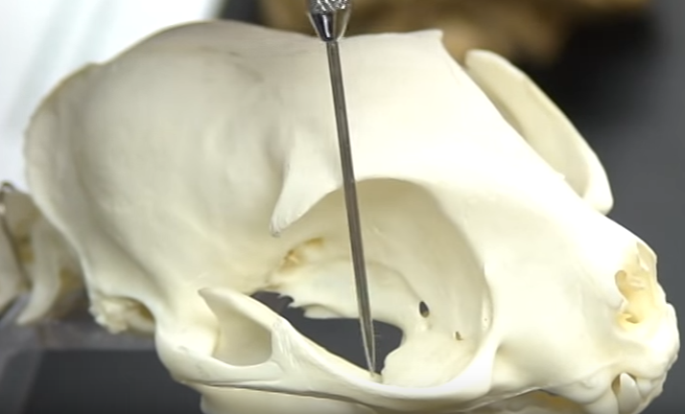
Temporal Process (of the zygomatic bone)

Slide 6
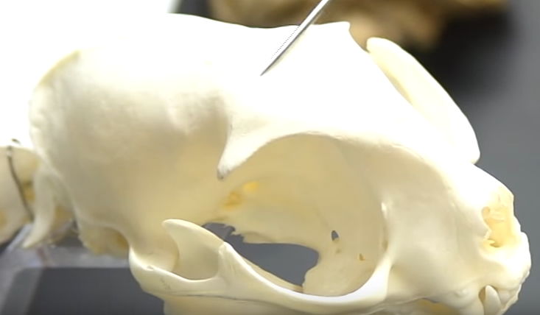
Frontal Bone

Slide 7
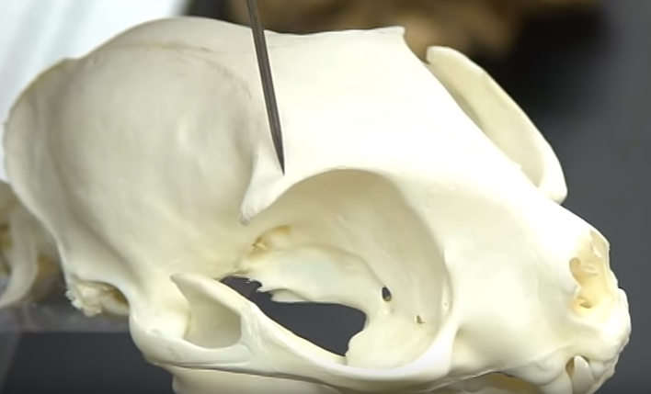
Frontal Process

Slide 8
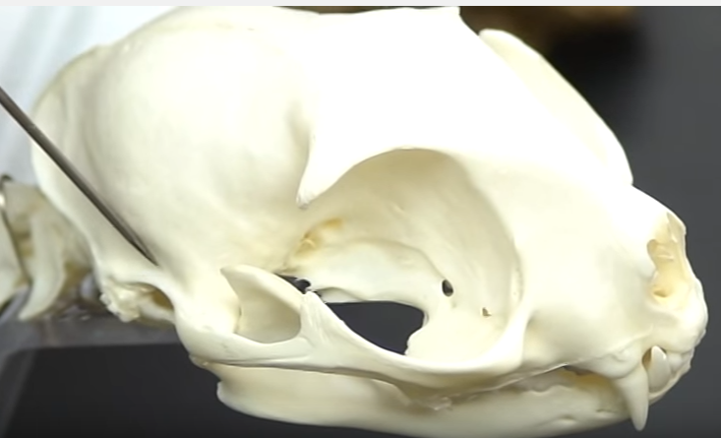
Temporal Bone

Slide 9
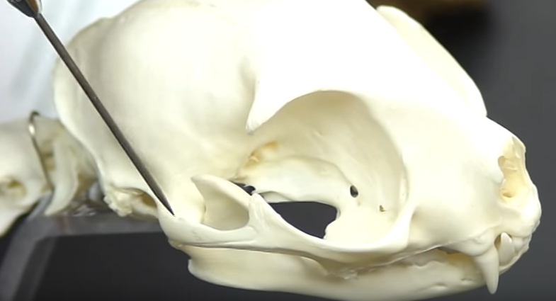
Zygomatic Process (of the temporal bone)

Slide 10
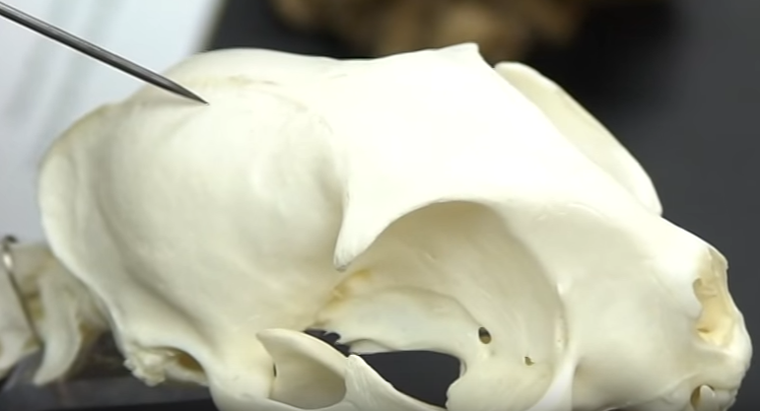
Parietal Bone

Slide 11
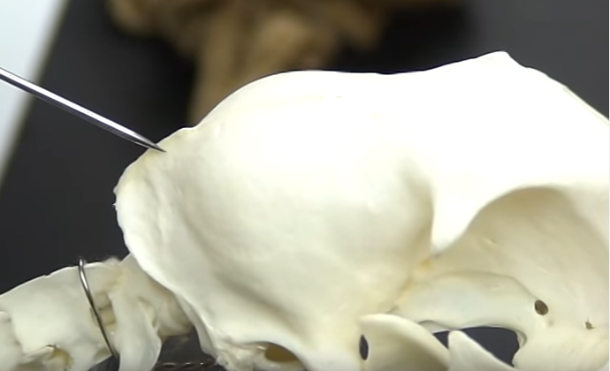
Sagittal Crest

Slide 12
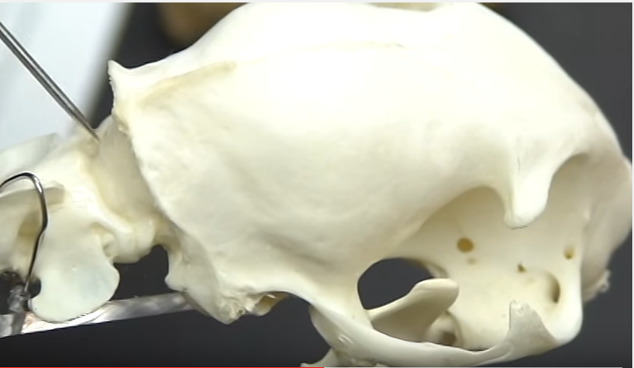
Occipital Bone

Slide 13
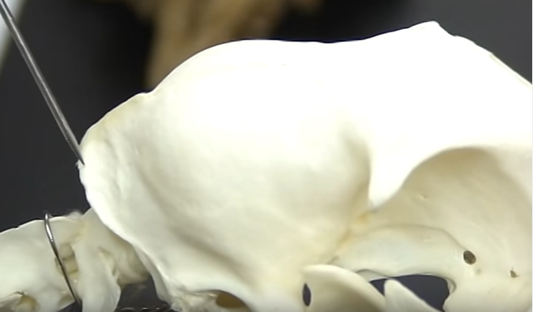
Occipital Crest

Slide 14
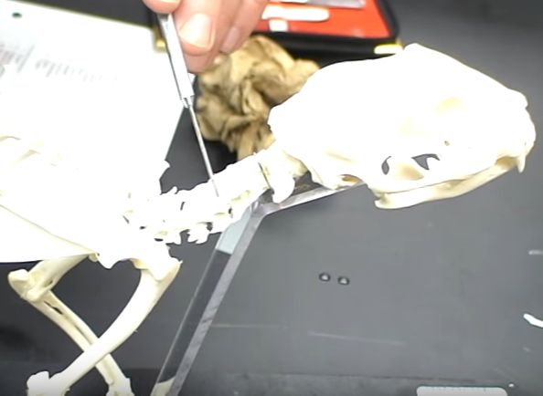
Cervical Vertebrae (neck)

Slide 15
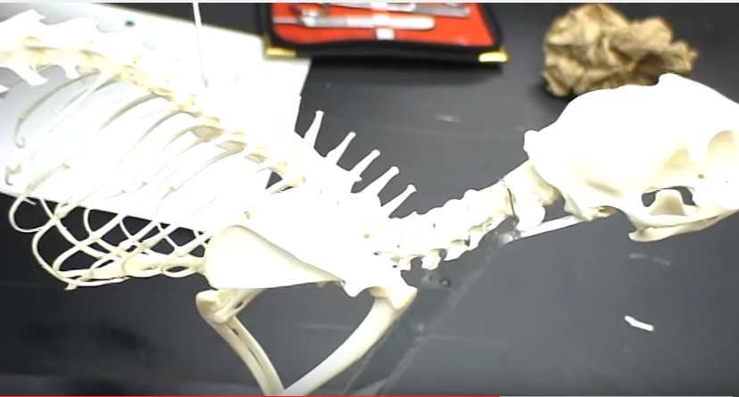
Thoracic Vertebrae (ribs attach)

Slide 16
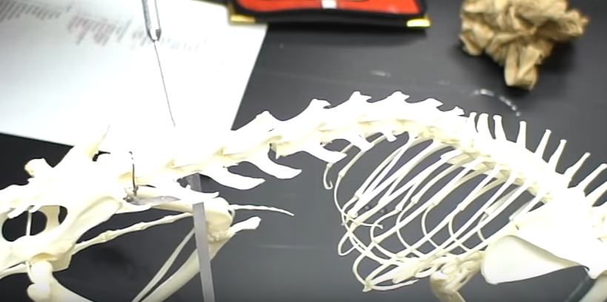
Lumbar Vertebrae

Slide 17
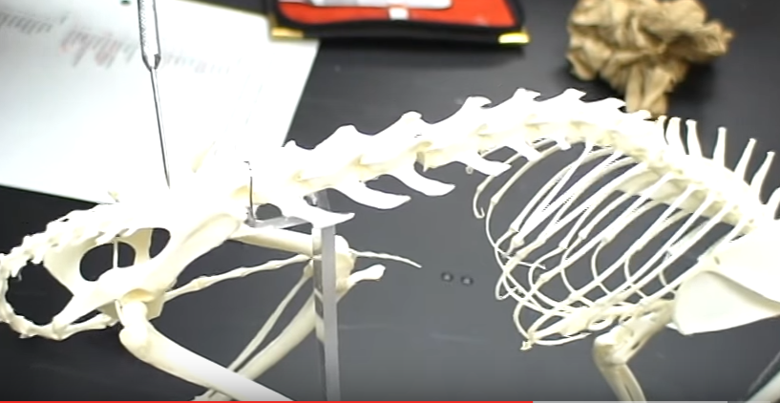
Sacrum (between 2 halves of ox coxae)

Slide 18
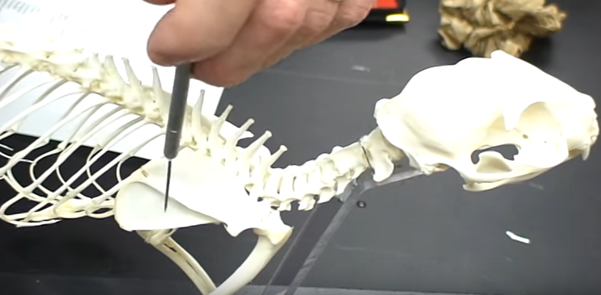
Scapula

Slide 19
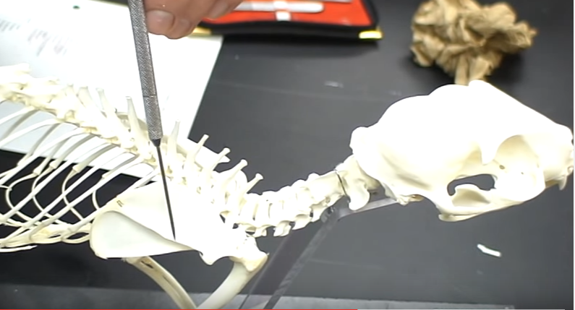
Scapular Spine

Slide 20
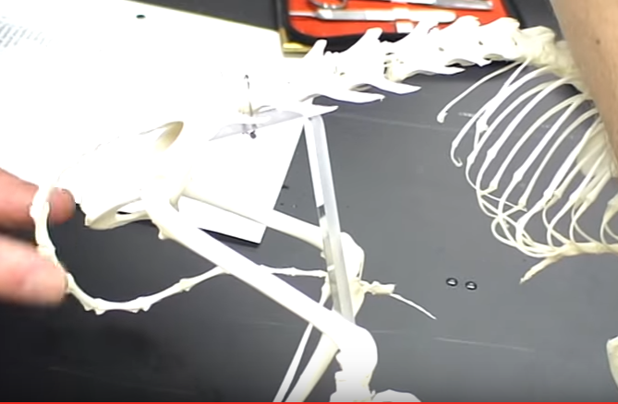
Caudal Bones (Tail)

Slide 21
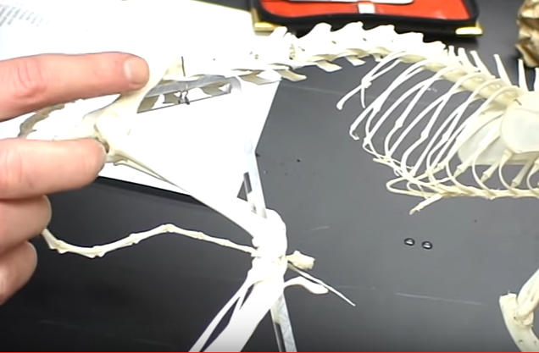
Ilium

Slide 22
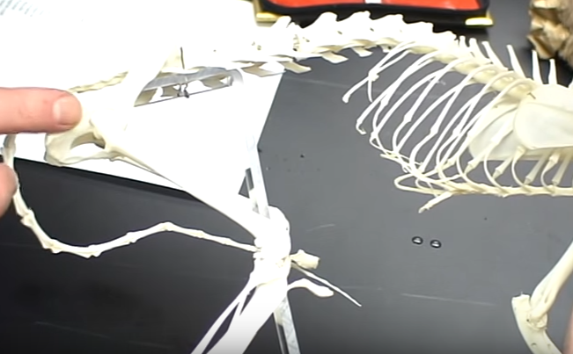
Ischium

Slide 23
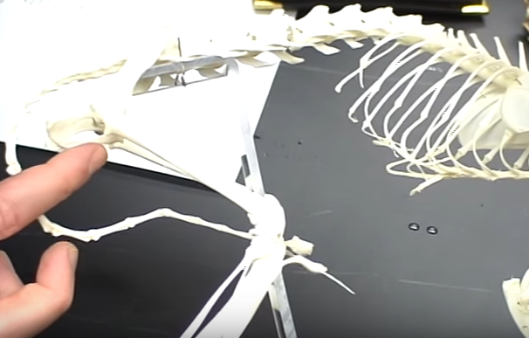
Pubis

Slide 24
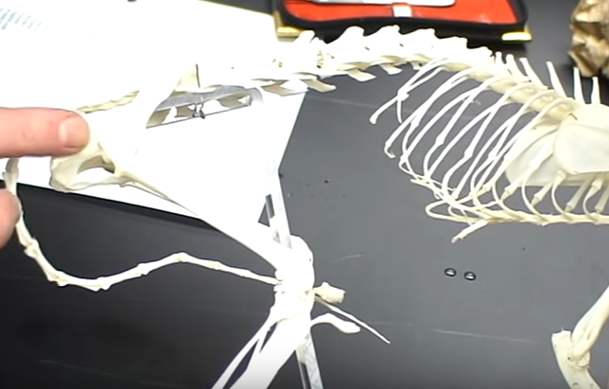
Os (or Ox) Coxae: Ilium, Ischium, & Pubis

