Slide 1
Accessory Organs

Slide 2
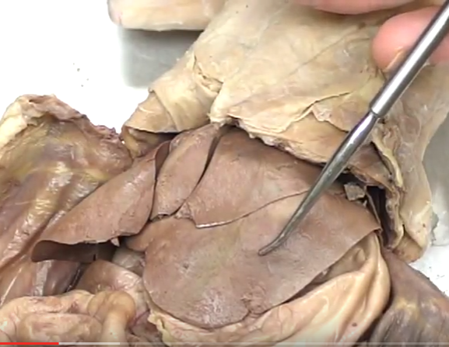
Left Lateral Lobe of Liver

Slide 3
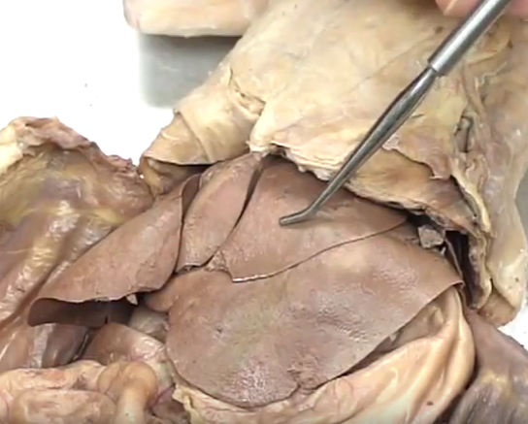
Left Medial Lobe of Liver

Slide 4
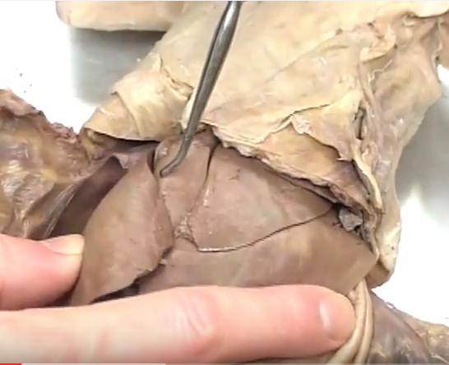
Quadrate Lobe of Liver

Slide 5
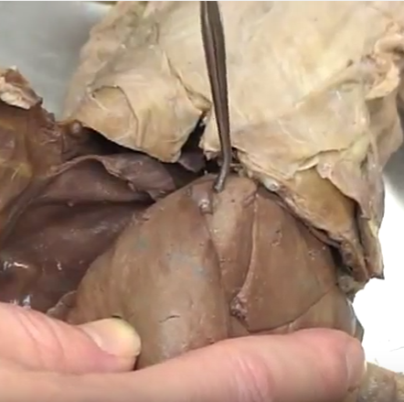
Gall Bladder (usually larger and green)

Slide 6
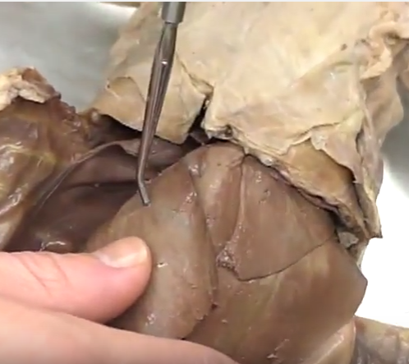
Right Medial Lobe of Liver

Slide 7
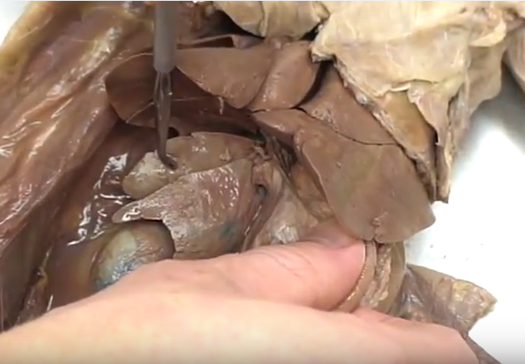
Right Lateral Lobe of Liver (lift the medial lobe to see it better)

Slide 8
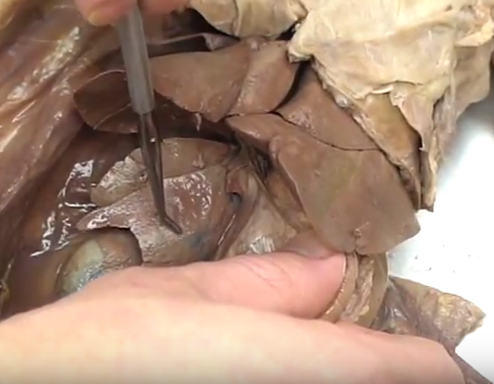
Caudate Lobe of Liver (lift the medial lobe to see it better)

Slide 9
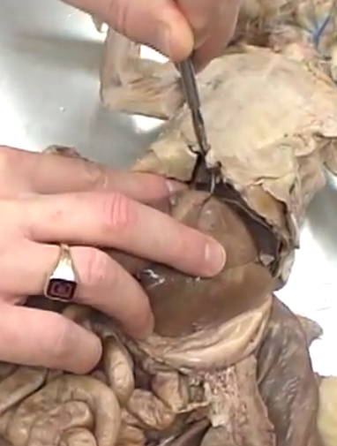
Round and Falciform Ligaments (found in the frenulum between liver and diaphragm)

Slide 10
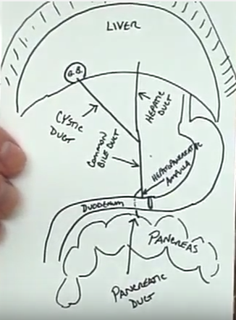
Accessory Organs: Ductwork

Slide 11
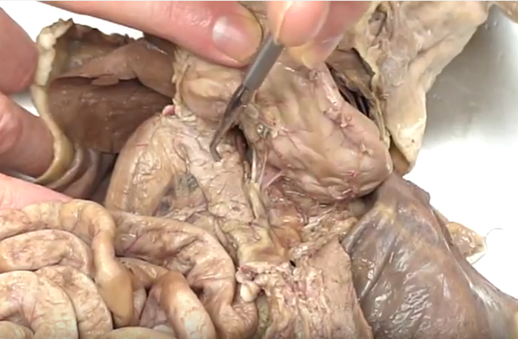
Pancreas (lift up the stomach to see it better – embedded in the mesentery alongside duodenum)

Slide 12
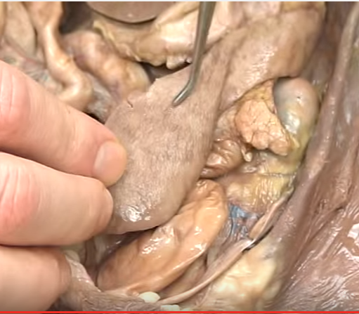
Spleen (follows left side under stomach)

