Slide 1
GI Tract Dissection

Slide 2
Greater Omentum
Greater omentum function: stores fat & seals off infections to the GI tract

Slide 3
General Layout of Esophagus & Stomach

Slide 4
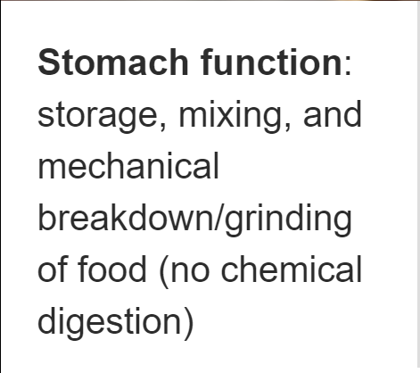
Stomach

Slide 5
Greater Curvature of Stomach (region)

Slide 6
Lesser Curvature of Stomach (region)

Slide 7
Pylorus (Pyloric Sphincter)

Slide 8
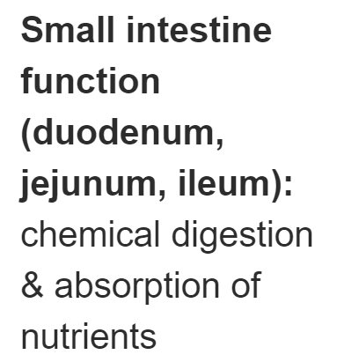
Duodenum

Slide 9
Jejunum (as it comes off duodenum)

Slide 10
Ileum (as it meets large intestine)

Slide 11
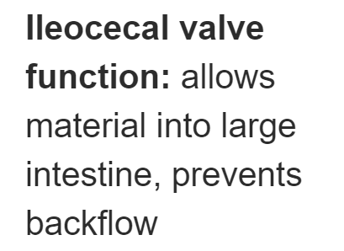
Ileocecal Valve

Slide 12
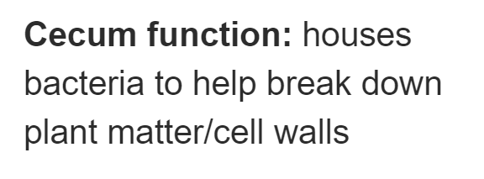
Cecum (Caecum)

Slide 13
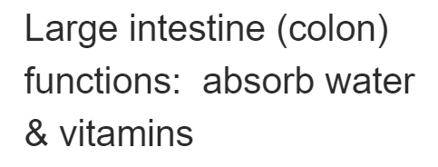
Ascending Colon

Slide 14
Transverse Colon

Slide 15
Descending Colon

