Slide 1
Mouth Anatomy

Slide 2
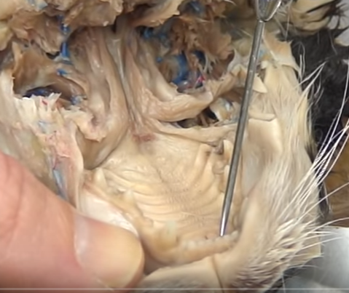
Incisors

Slide 3
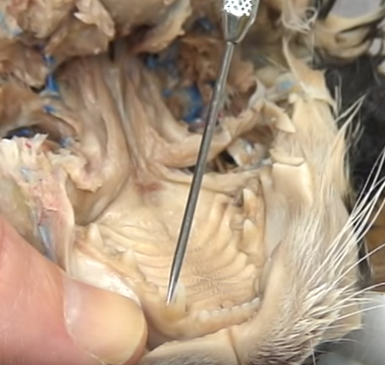
Canines

Slide 4
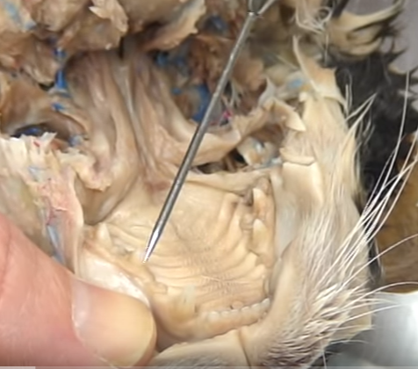
Premolars

Slide 5
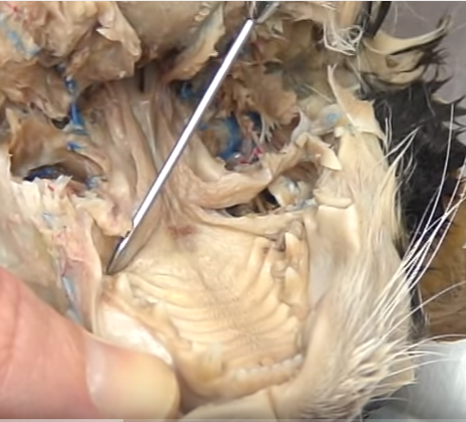
Molars

Slide 6
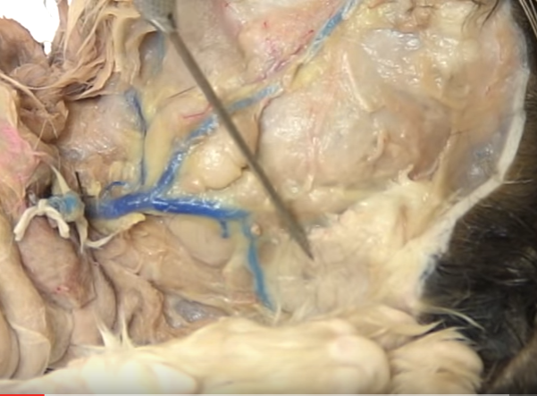
Parotid Gland

Slide 7
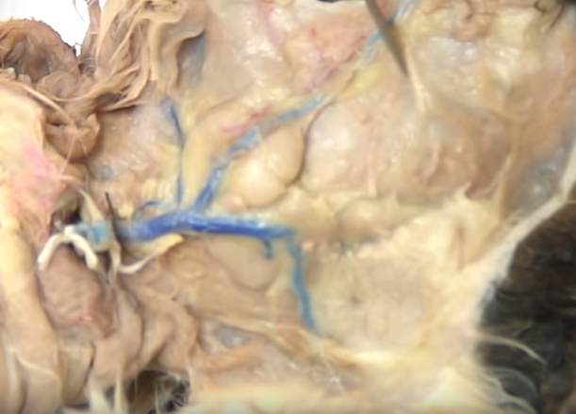
Parotid Duct

Slide 8
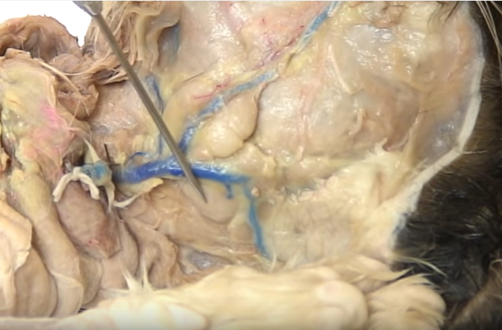
Submandibular Gland

Slide 9
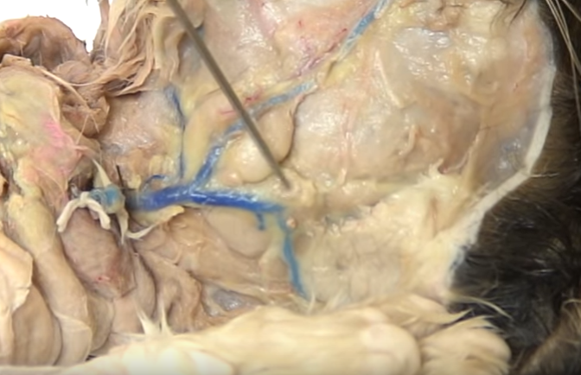
Sublingual Gland

Slide 10
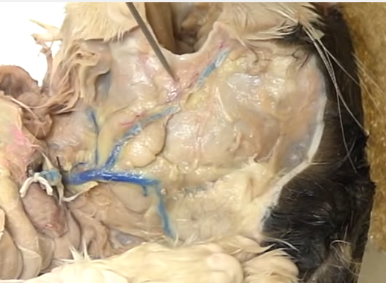
Molar Gland

Slide 11
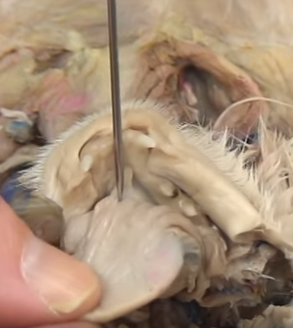
Lingual Frenulum

Slide 12
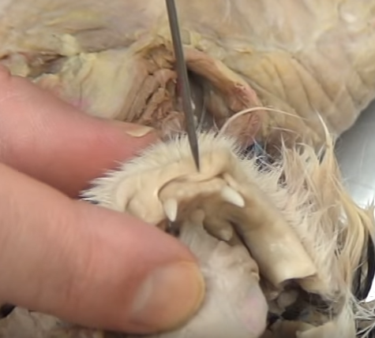
Labial Frenulum

Slide 13
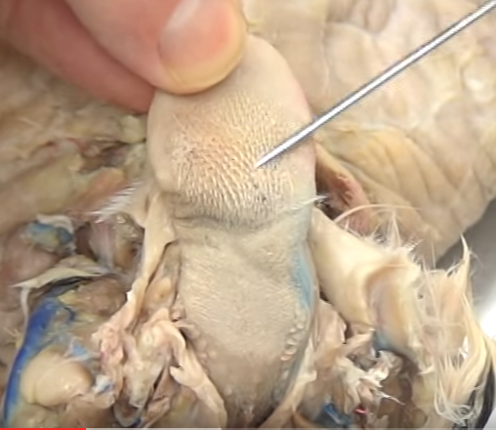
Filiform Papillae

Slide 14
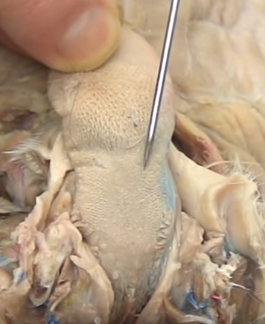
Fungiform Papillae

Slide 15
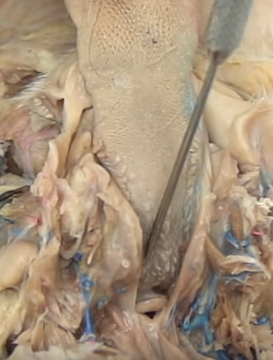
Vallate Papillae

Slide 16
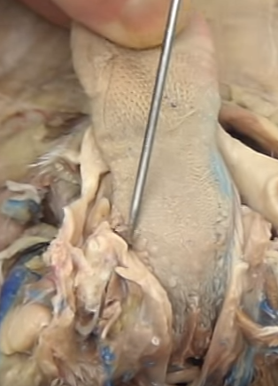
Foliate Papillae

Slide 17
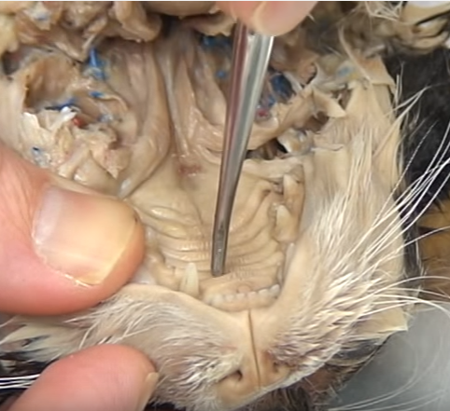
Oropharynx Region

Slide 18
Hard Palate (structure)/Rugae (ridges)

Slide 19
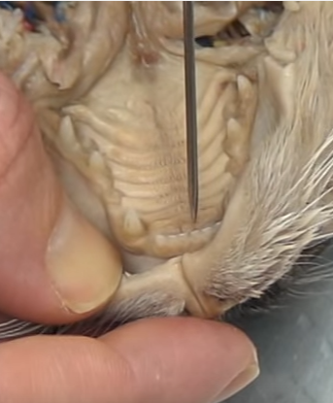
Incisive Ducts (holes)

Slide 20
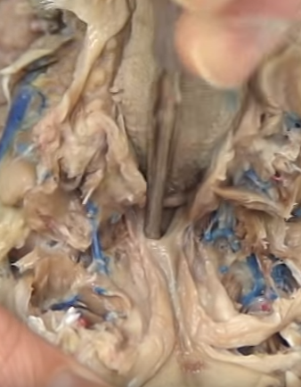
Nasopharynx Region

Slide 21
Soft Palate

Slide 22
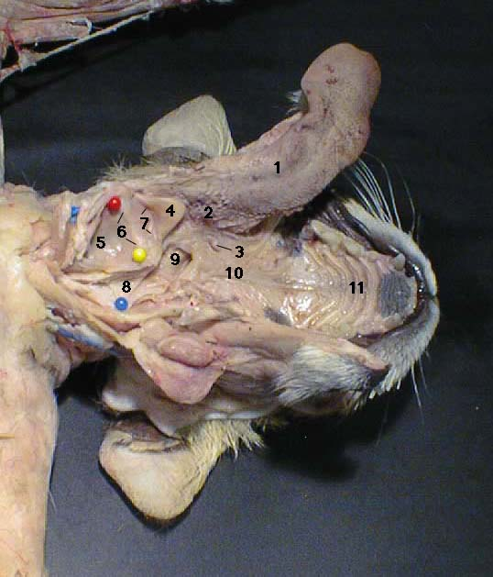
Palatine Tonsils

Slide 23
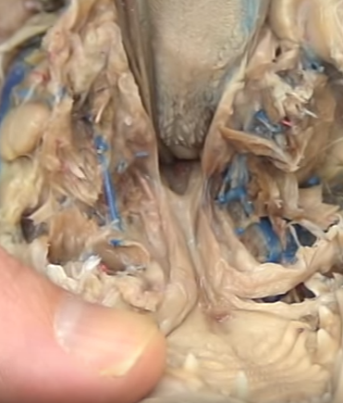
Laryngopharynx Region

Slide 24
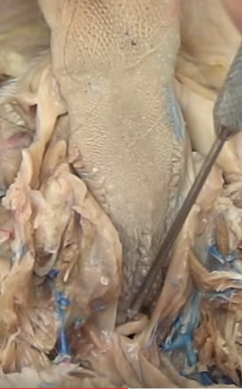
Epiglottis (flap)

Slide 25
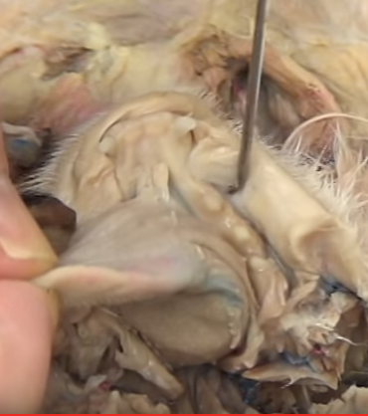
Vestibule (pouch between lips and gums)

