Slide 1
Lower Arteries Dissection

Slide 2
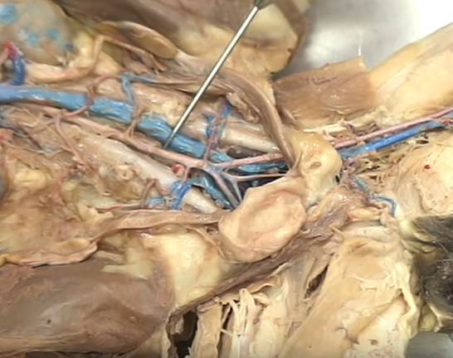
Abdominal Aorta

Slide 3
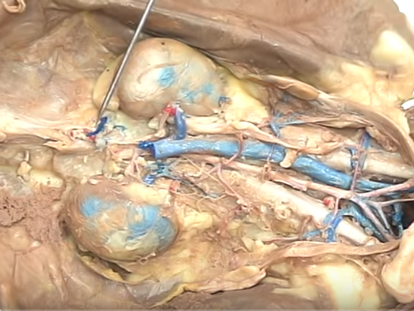
Adrenolumbar

Slide 4
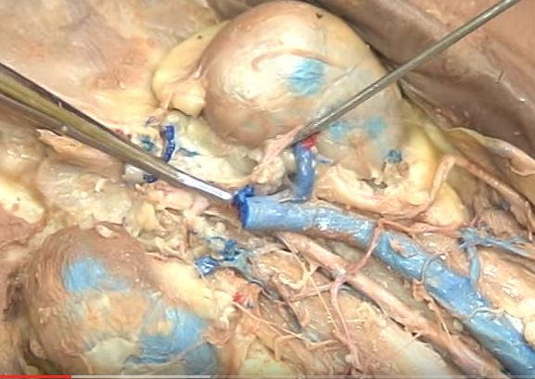
Renal

Slide 5
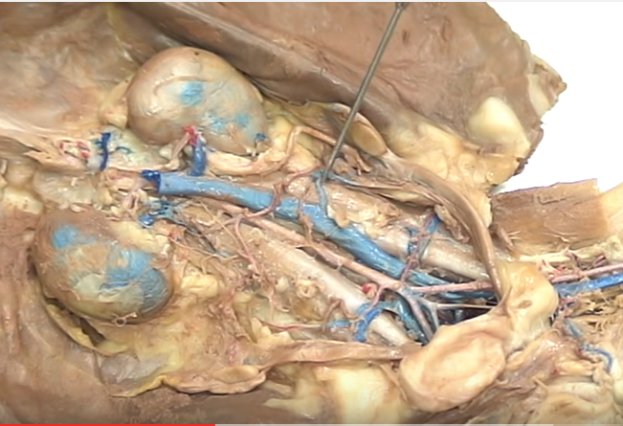
Genital

Slide 6
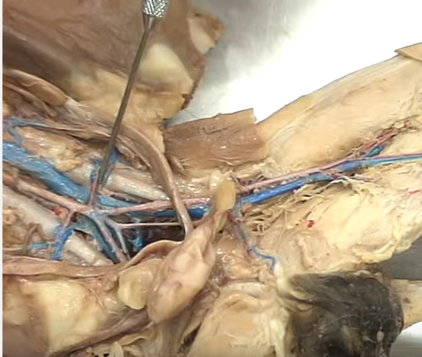
Iliolumbar

Slide 7
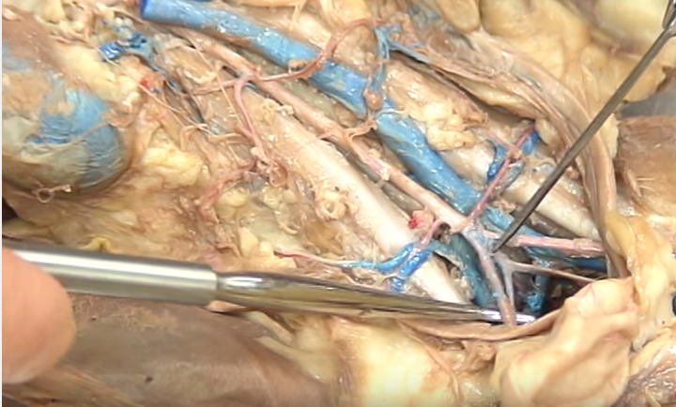
External Iliac

Slide 8
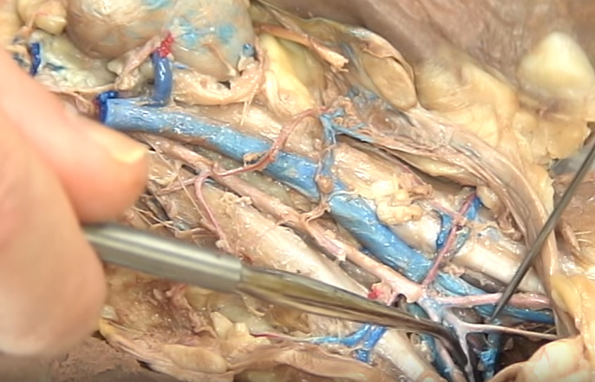
Internal Iliac

Slide 9
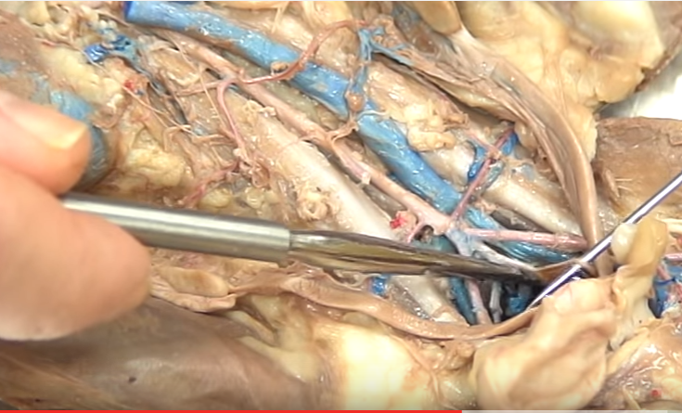
Inferior & Superior Gluteals

Slide 10
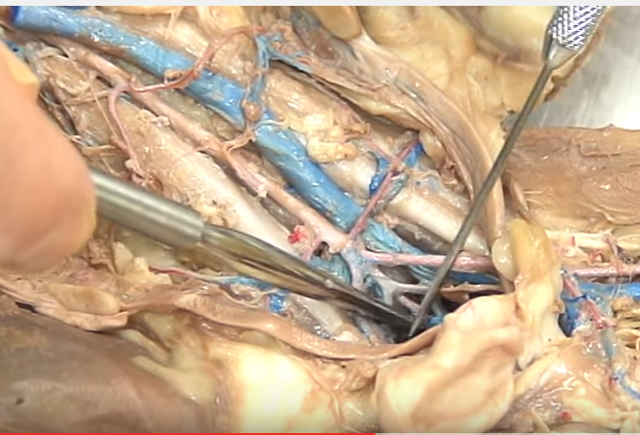
Caudal

Slide 11
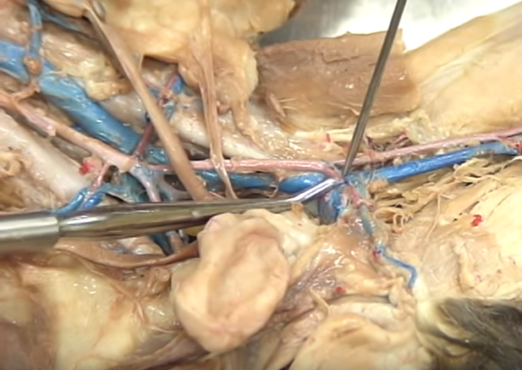
Deep Femoral

Slide 12
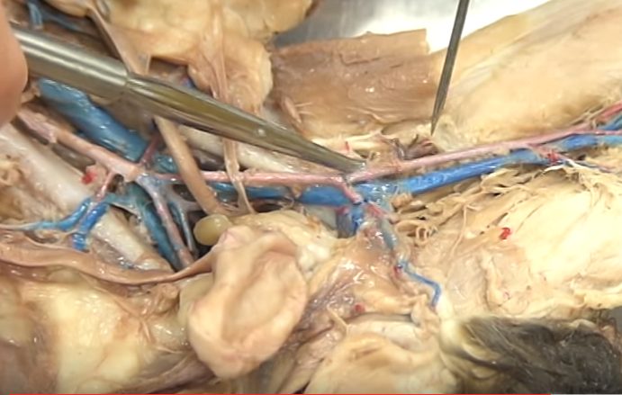
Lateral Femoral Circumflex

Slide 13
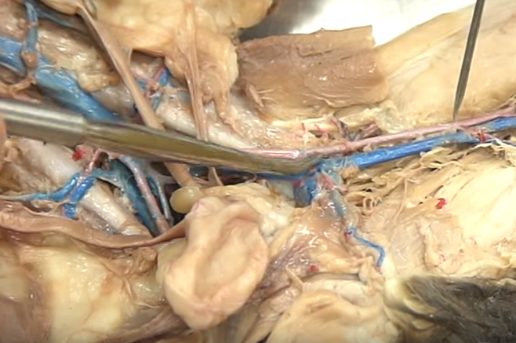
Femoral (after deep femoral)

Slide 14
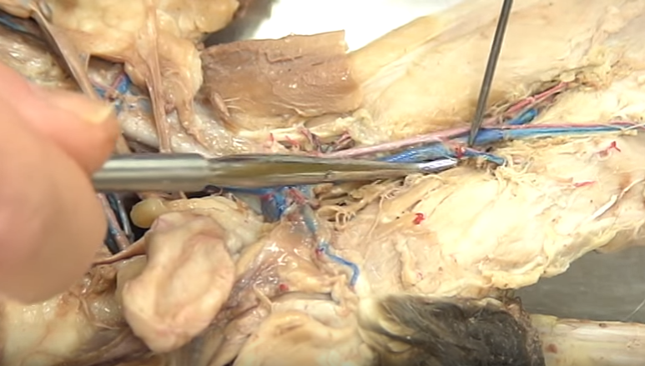
Muscular

Slide 15
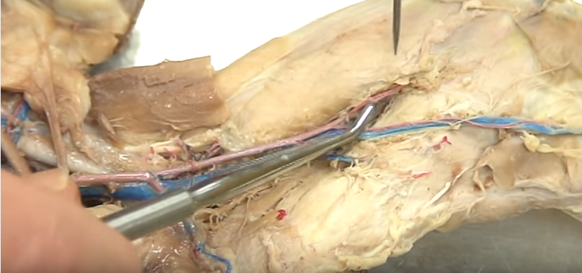
Articular

Slide 16
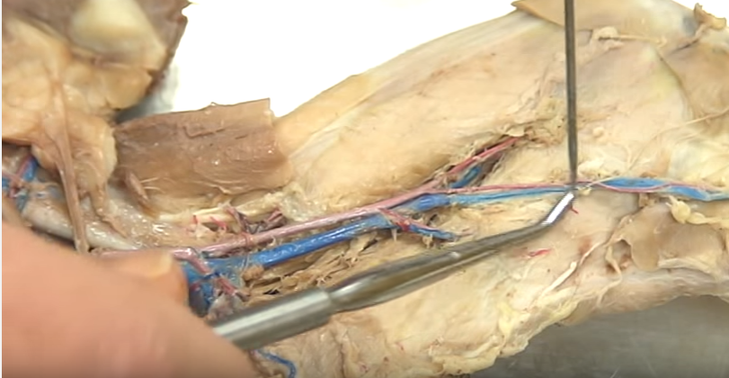
Saphenous

