Slide 1
Upper Arteries Dissection

Slide 2
Brachiocephalic

Slide 3
Left Subclavian

Slide 4
Right Subclavian

Slide 5
Right Left Common Carotids

Slide 6
Internal Mammary

Slide 7
Long Thoracic

Slide 8
Vertebral

Slide 9
Costocervical

Slide 10
Thyrocervical

Slide 11
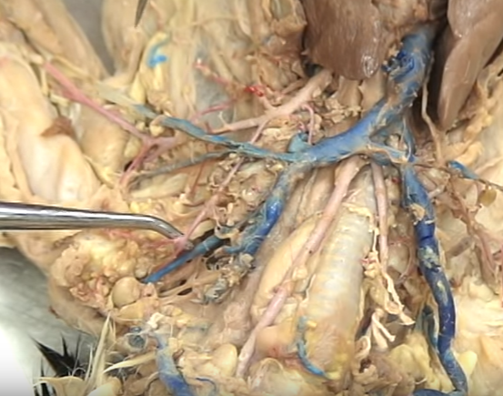
Transverse Scapular

Slide 12
Subscapular (follow the vein!)

Slide 13
Axillary (after subsclapular)

Slide 14
Anterior Humeral Circumflex

Slide 15
Brachial

Slide 16
Radial (thumb side) Ulnar (pinky side)

