Slide 1
Heart Dissection Internal Structures

Slide 2
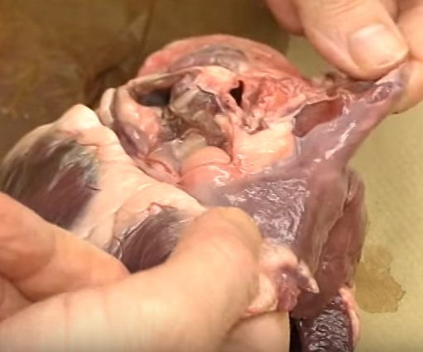
Superior & Inferior Vena Cava (as they enter Right Atrium)

Slide 3
Right Atrium

Slide 4
Right Ventricle

Slide 5
Musculi Pectinati

Slide 6
Tricuspid Valve

Slide 7
Chordae Tendonae

Slide 8
Papillary Muscle (anchoring Chordae Tendonae)

Slide 9
Moderator Band (don’t need to know, but you were probably wondering…)

Slide 10
Trabeculae Carne

Slide 11
Left Ventricle Wall

Slide 12
Bicuspid Valve

