Slide 1
External Heart Structures

Slide 2
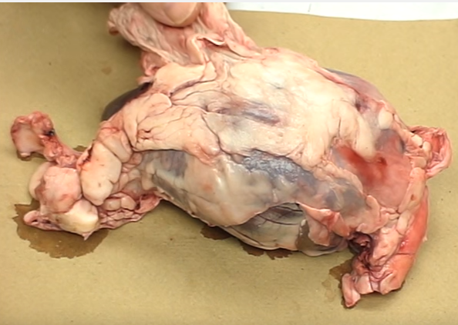
Pericardium

Slide 3
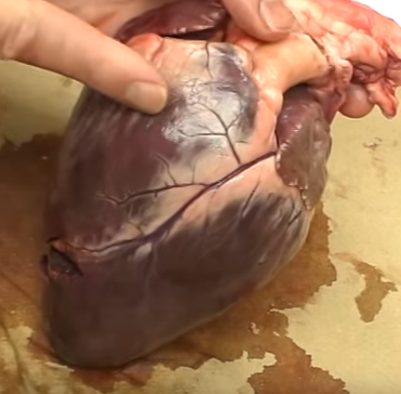
Base of Heart

Slide 4
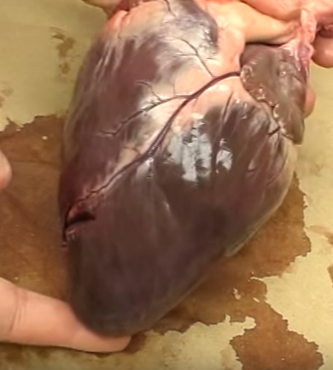
Apex of Heart

Slide 5
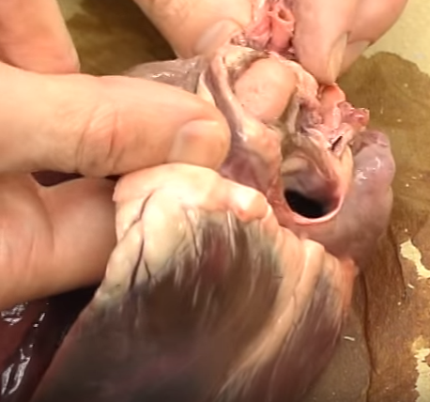
Pulmonary Trunk/Veins as they enter the Left Atrium

Slide 6
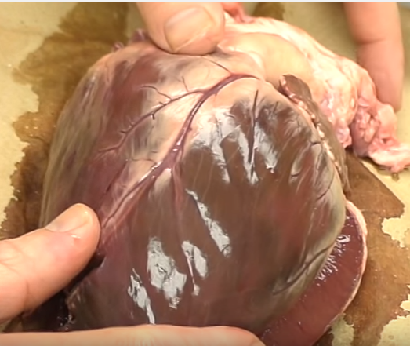
Aorta as it leaves the Left Ventricle

Slide 7
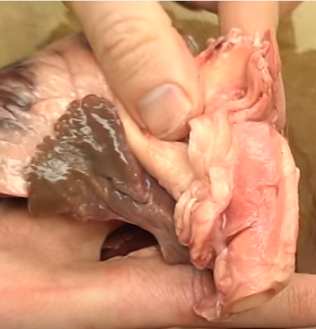
Brachiocephalic Aorta

Slide 8
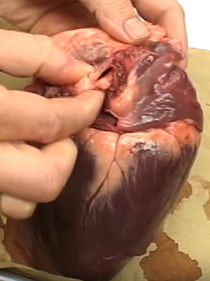
Ligamentum Arteriosum tissue

Slide 9
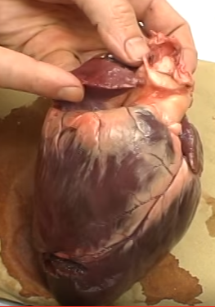
Atrioventricular Groove

Slide 10
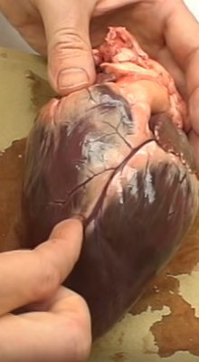
Interventricular Groove

Slide 11
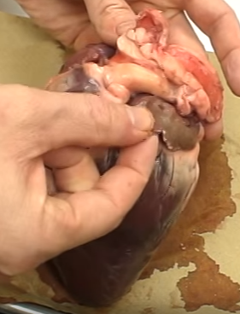
Auricle (flap)

