Slide 1
Brain Dissection

Slide 2
Cerebrum: conscious thought & memory, personality

Slide 3
Gyrus: high ridges to increase surface area

Slide 4
Sulcus: valleys to increase surface area

Slide 5
Midbrain: connects cerebellum & cerebrum for transfer into long-term memory

Slide 6
Cerebellum: balance & coordination center

Slide 7
Olfactory Lobe: nerves for sense of smell

Slide 8
Optic Chiasm (Chiasma): where optic nerves cross

Slide 9
Hypophysis (Pituitary Gland) – sits over Mammilary Body: hormone secretion

Slide 10
Mammillary Body (resides inside the slit): primal emotions & homeostasis

Slide 11
Pons – more superficial than Medulla Oblongata: distributes sensory information to appropriate regions of brain for processing

Slide 12
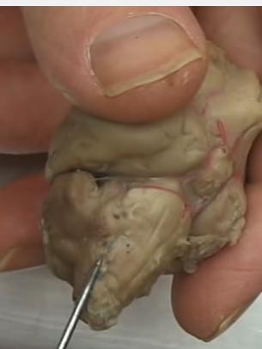
Medulla Oblongata (a bit further back from Pons): controls vital body functions like throat reflexes, heart rate, breathing

Slide 13
Dura Mater: tough outer protective membrane

Slide 14
Pia Mater – thin innermost membrane on brain surface

