Slide 1
Female Reproductive System Dissection

Slide 3
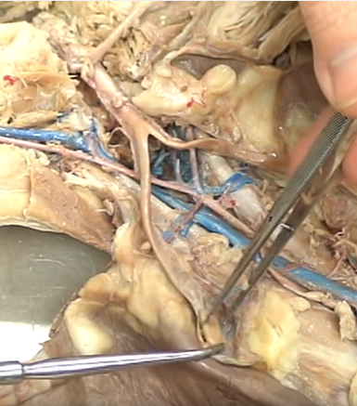
Ovary: makes and stores eggs

Slide 4
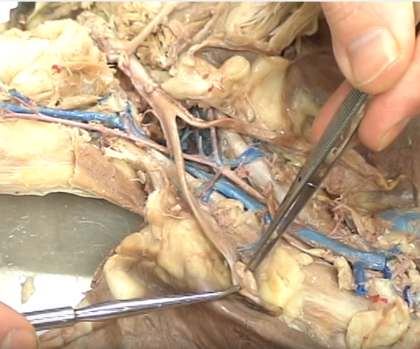
Fimbrae: finger-like structures that “catch” the egg and funnels into the uterine tube/oviduct

Slide 5
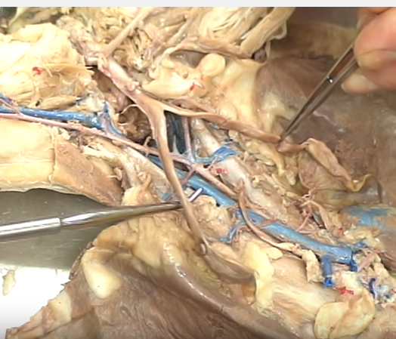
Uterine Tube/
Oviduct/
Fallopian Tube: carries egg to uterus

Slide 6
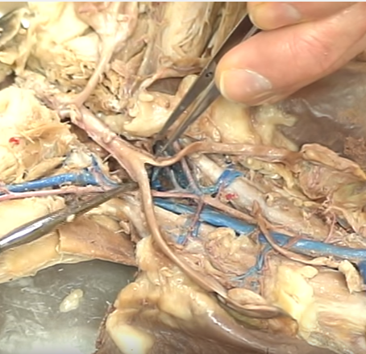
Horns of Uterus: where uterine tubes connect to the uterus itself

Slide 7
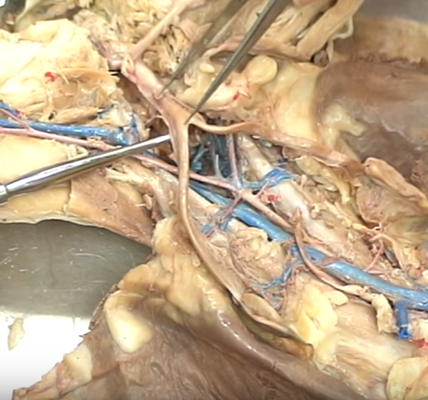
Uterus: where the fertilized egg implants for gestation/ development

Slide 8
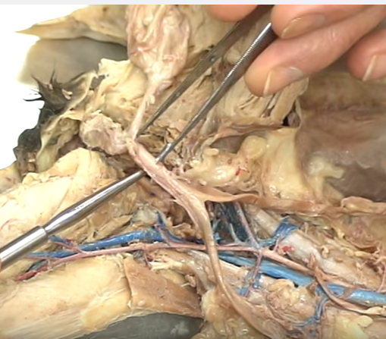
Cervix: muscle constriction that serves to keep developing fetus in the uterus

Slide 9
Urinary Bladder: stores urine

Slide 10
Urethra: brings urine to the outside

Slide 11
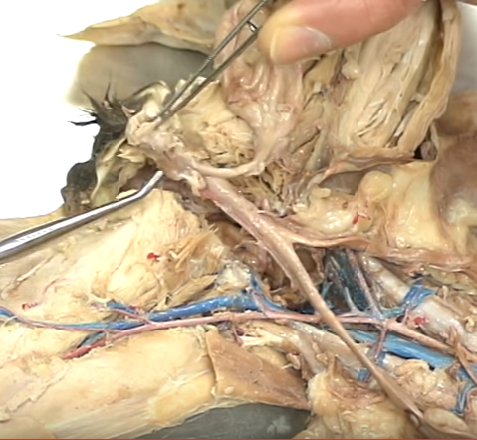
Vagina: receives the penis for copulation

