Slide 1
Male Reproductive System Dissection

Slide 3
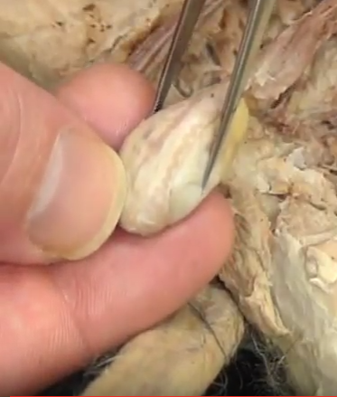
Teste: makes sperm cells

Slide 4
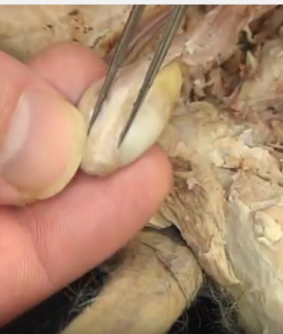
Epididymis:
Stores and matures sperm cells.

Slide 5
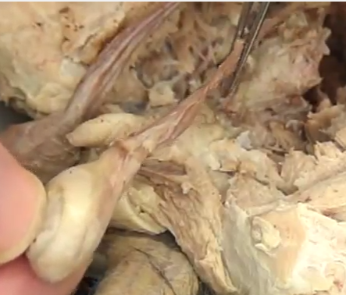
Vas Deferens/spermatic cord: carries sperm to the urethra
(vas deferens refers to the blood vessels as well)

Slide 6
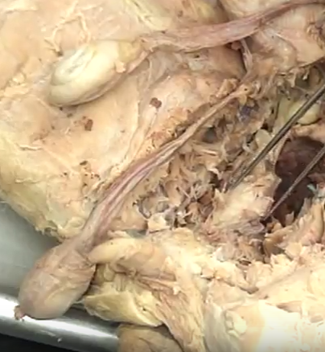
Prostate Gland:
Adds seminal fluid to the sperm

Slide 7
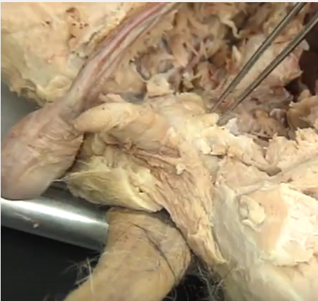
Bulbourethral Gland: adds seminal fluids & is point where vas deferens fuses with urethra

Slide 8
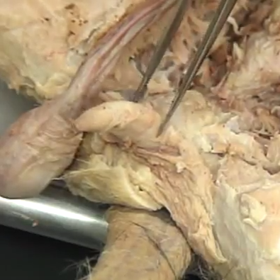
Penis: organ for reproduction & urinary system
*must include both on the test!

