Slide 1
Bonding & Hybridization
Unit 2 Notes

Slide 2
Chapter 8, Section 1: Types of bonds & modeling
Bond: a force that holds atoms together
Ionic bond: a transfer of electrons to produce stability – typically from a metal to a nonmetal
Na –
Cl –
Bond energy: energy needed to break a bond (also referred to as lattice
energy)
Coulomb’s law: E = 2.37 X 10⁻¹⁹ J – nm (Q₁ ∙ Q₂) r²
EX 1: NaCl EX 2: CaCl₂

Slide 3
Chapter 8, Section 1: Types of bonds & modeling
Covalent bonding: sharing of electrons to produce stability
EX 3: H₂O
Electronegativity: the ability to attract valence electrons (how much they like to take e⁻ in)
The type of bond formed is calculated using a percent ionic character
% ionic character = A-B X 100%
A

Slide 4
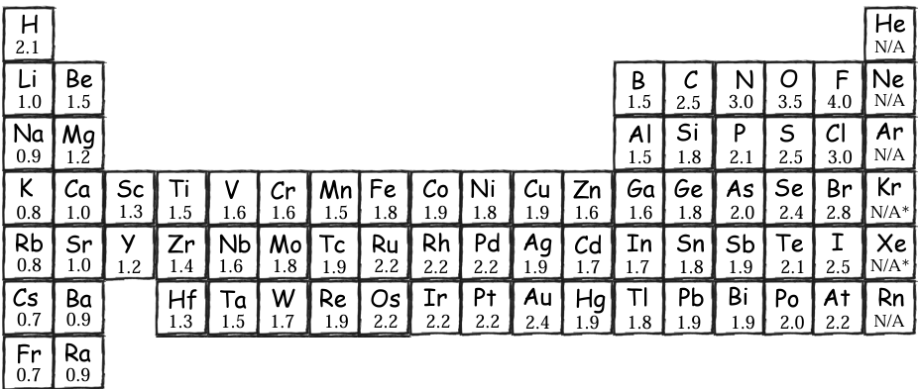
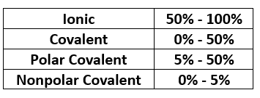
Chapter 8, Section 1: Types of bonds & modeling
Pauling’s Electronegativity Values
EX 1: NaCl
EX 2: CaCl₂
EX 3: H₂O

Slide 5
Chapter 8, Section 1: Types of bonds & modeling
COVALENT BONDING
The idea of the covalent bond was first suggested by the American physical chemist G.N. Lewis in 1916. He pointed out that the electron configuration of the noble gases appears to be a particularly stable one. Lewis suggested that nonmetal atoms, by sharing electrons to form an electron pair bond, can acquire a stable noble gas structure.
TERMS:
Valence electrons:
Lewis structure:
Bonding pairs of electrons:
Unshared pairs of electrons:

Slide 6
Chapter 8, Section 1: Types of bonds & modeling
Rules for writing Lewis structures
1. Sum all the valence electrons in the molecule.
2. Use a pair of electrons to form a bond between each pair of bonded atoms.
3. Arrange all the other electrons to satisfy the octet (or duet) rule.
Draw the Lewis structure for the following:
H₂O
CO₂
CN⁻
C₂H₆

Slide 7
Chapter 8, Section 1: Types of bonds & modeling
Resonance forms: In certain cases, the Lewis structure does not adequately describe the properties of the ion or molecule that it represents. Sometimes bonds in molecules alternate between single and double bonds. This gives more than one correct Lewis structure that are referred to as resonance forms.
Draw the Lewis structure of the following and any resonance structures
SO₂
NO₃⁻
COCl₂

Slide 8
Chapter 8, Section 1: Types of bonds & modeling
Properties of Resonance
1. Resonance forms do not imply different kinds of molecules with electrons shifting eternally between them. There is only one type of SO₂ molecule; its structure is intermediate between those of the two resonance forms drawn for sulfur dioxide.
2. Resonance can be anticipated when it is possible to write two or more Lewis structures that are about equally plausible. In the case of the nitrate ion, the three structures are equivalent. One could, in principle, write many other structures, but none would put an octet around each atom.
3. Resonance forms differ only in the distribution of electrons, not in the arrangement of the atoms.
EX: A – B – C B – A – C (not the same)

Slide 9
Chapter 8, Section 1: Types of bonds & modeling
Assignment #1: 1-3

Slide 10
Chapter 8, Section 2: Formal charge & exceptions to the rule
Formal charge: Often it is possible to write two different Lewis structures for a molecule, differing in the arrangement of the atoms, that is A – A – B or A – B – A. Correct arrangement can be determined by the formal charge – which follows the following equation:
C_{f} = X – (Y + Z/2)
X = the number of valence e⁻ in the free atom, which is equal to the last
digit of the group number in the periodic table. Y = The number of unshared e⁻ owned by the atom in the Lewis
structure.
Z = The number of bonding e⁻ shared by the atom in the Lewis
structure.

Slide 11
Chapter 8, Section 2: Formal charge & exceptions to the rule
EX 4: Methanol (CH₃OH) has two possible Lewis structures. Calculate the formal charge on the C and O and determine the most probable Lewis structure of methanol.
Ordinarily the more likely Lewis structure is the one which 1) the formal charges are as close to zero as possible, and 2) any negative formal charge is located on the most electronegative atom.
EX 5: Use formal charge to determine the correct Lewis structure of SO₄²⁻
EX 6: Given the three Lewis structures for XeO₃ (an explosive compound), which is the most appropriate according to the formal charges?

Slide 12
Chapter 8, Section 2: Formal charge & exceptions to the rule
Exceptions to the octet rule
1. The second row elements C, N, O, and F should always be assumed to obey the octet rule.
2. The second row elements B and Be often have fewer than eight electrons around them in their compounds. These electron deficient compounds are very reactive.
EX 7: BF₃
BeCl₂

Slide 13
Chapter 8, Section 2: Formal charge & exceptions to the rule
3. The second row elements never exceed the octet rule, since their valence orbitals (2s and 2p) can accommodate only 8 electrons.
4. Third row and heavier elements often satisfy the octet rule but can exceed the octet rule by using their empty valence orbitals.
EX 8: ClF₃
ICl₄⁻
I₃⁻ (triiodide ion)

Slide 14
Chapter 8, Section 2: Formal charge & exceptions to the rule
When writing the Lewis structure for a molecule, satisfy the octet rule for the atom first. If electrons remain after the octet rule has been satisfied, then place them on the elements having available d orbitals (elements in Period 3 or beyond).

Slide 15
Chapter 8, Section 2: Formal charge & exceptions to the rule
Assignment #2: 1-8

Slide 16
Chapter 8, Section 2: Formal charge & exceptions to the rule
Bonding practice problems 1-3
Quiz: Covalent bonding

Slide 17
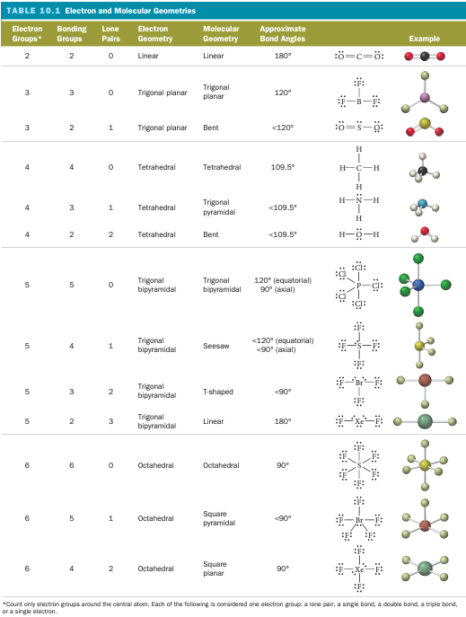
Chapter 8, Section 3: VSEPR theory
Molecular Geometry – Valence Shell Electron Pair Repulsion Theory (VSEPR)
Says the valence electron pairs surrounding an atom repel one another. Consequently, the orbitals containing those electron pairs are orientated to be as far apart as possible.
Affects molecule characteristics like
Polarity
Bond angles

Slide 18
Chapter 8, Section 3: VSEPR theory
EX 9: For the following determine: a) the Lewis structure b) molecular geometry c) bond angles d) polarity
BF₃ SCN⁻
CH₄ NO₃⁻
NH₃ CF₂Cl₂
H₂O

Slide 19
Chapter 8, Section 3: VSEPR theory
Assignment #3: 1-6

Slide 20
Chapter 8, Section 4: Hybridization
Atomic Orbitals – Hybridization
For a covalent bond to form, unpaired electrons must be matched up. When this doesn’t happen, the atom must hybridize orbitals to form bonds.
Be
B
C

Slide 21
Chapter 8, Section 4: Hybridization
Types of hybridization
sp³ hybridization
sp² hybridization
sp hybridization
sp³d hybridization
sp³d² hybridization
If sum of σ and unshared e⁻ pair on core atom is : | Hybridization is:
2 | sp
3 | sp²
4 | sp³
5 | sp³d
6 | sp³d²

Slide 22
Chapter 8, Section 4: Hybridization
EX 10: Give the hybridization of
carbon in CH₃Cl
phosphorous in PH₃
sulfur in SF₄
EX 11: State the hybridization of nitrogen and the number of sigma and pi bonds in the following
NH₃
NO₂⁻
N₂
If sum of σ and unshared e⁻ pair on core atom is : | Hybridization is:
2 | sp
3 | sp²
4 | sp³
5 | sp³d
6 | sp³d²

Slide 23
Chapter 8, Section 4: Hybridization
Molecular orbital (M.O.) Model: describes the location of e⁻ in molecules
Atomic orbital model:
M.O. model:
EX 12: Draw the M.O. model of the following molecules and give the bond order of each
H₂ Li₂
H₂⁻ Be₂
He₂ B₂

Slide 24
Chapter 8, Section 4: Hybridization
Assignment #4: 1-6

Slide 25
Chapter 8, Section 4: Hybridization
Quiz: Lewis structures
Assignment: Take-home quiz

Slide 26
Chapter – Unit wrap-up
Practice exercises
Chapter MC questions
NMSI Super Problems

