Slide 1
Chemical Kinetics
Unit 13 Notes

Slide 2

Chapter 12, Section 1: Differential rate law
Differential Rate Law – the rate law that expresses how the rate depends on concentration
[ ] vs Rate * Calculated when t = 0
From the following equation and information
A B
a) Write the expression for
the rate law Rate = K [A]^{n}
b) Determine the order of the reaction
c) Calculate the value of K
[A]_{o} | Initial rate of the reaction (moles/liter∙sec)
0.35 | 7.20 X 10⁻⁴
0.70 | 2.90 X 10⁻³
1.05 | 6.45 X 10⁻³

Slide 3
Chapter 12, Section 1: Differential rate law
2. Determine the rate law, solve for the order of the reaction and the value of the rate constant.
C + D + E Products
Rate = K [C]^{X} ∙ [D]^{Y} ∙ [E]^{Z}
Reaction | [C_{o}] | [D_{o}] | [E_{o}] | Initial rate (moles/liter∙sec)
1 | 0.400 | 0.300 | 0.560 | 7.14 X 10⁻⁴
2 | 0.100 | 0.500 | 0.200 | 4.55 X 10⁻⁵
3 | 0.100 | 0.200 | 0.200 | 4.55 X 10⁻⁵
4 | 0.400 | 0.300 | 0.750 | 1.28 X 10⁻³
5 | 0.100 | 0.300 | 0.560 | 3.57 X 10⁻⁴

Slide 4
Chapter 12, Section 1: Differential rate law
The reaction between bromate ions and bromide ions in an aqueous solution is given by the equation: BrO₃⁻_{(aq)} + 5 Br⁻_{(aq)} + 6 H⁺_{(aq)} 3 Br_{2(l)} + 3 H₂O_{(l)}
The following table gives the results of 4 experiments
Calculate the rate law and the value of K for this reaction.
Reaction | [BrO₃⁻] | [Br⁻] | [H⁺] | Initial rate (moles/liter∙sec)
1 | 0.10 | 0.10 | 0.10 | 8.0 X 10⁻⁴
2 | 0.20 | 0.10 | 0.10 | 1.6 X 10⁻³
3 | 0.20 | 0.20 | 0.10 | 3.2 X 10⁻³
4 | 0.10 | 0.10 | 0.20 | 3.2 X 10⁻³

Slide 5
Chapter 12, Section 1: Differential rate law
Assignment #1: Problems 1-4

Slide 6
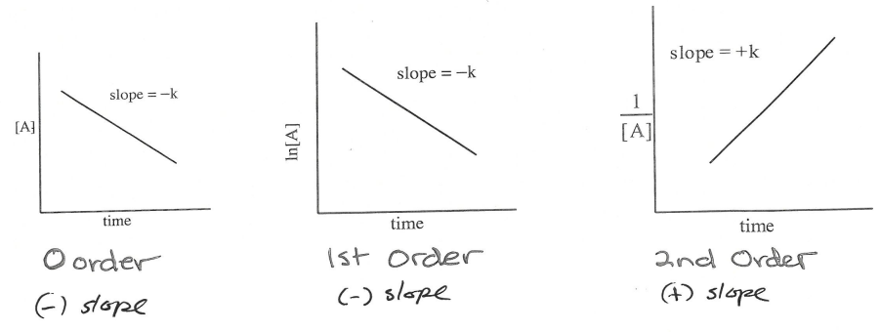
Chapter 12, Section 2: Integrated rate law
Integrated Rate Law – where the differential rate law expresses rate as a function of reaction concentration at an instant in time (hence an instantaneous rate); integrated rates express the reactants and concentration as a function of time.
TABLE 12.6: Summary of the Kinetics for Reactions of the Type aA → Products That Are Zero, First, or Second Order in [A]
ln = ([A]₀/[A]) = kt
 | Zeroth Order | First Order | Second Order
Rate Law: | Rate = k | Rate = k[A] | Rate = k[A]²
Integrated Rate Law: | [A] = - kt + [A]₀ | ln[A] = -kt + ln[A]₀ | 1/[A] = kt + 1/[A]₀
Plot Needed to Give a Straight Line: | [A] versus t | ln[A] versus t | 1/[A] versus t
Relationship of Rate Constant to the Slope of Straight Line: | Slope = -k | Slope = -k | Slope = k
Half-Life: | t_{1/2} = [A]₀/2k | t_{1/2} = 0.693/k | t_{1/2} = 1/k[A]₀

Slide 7
Chapter 12, Section 2: Integrated rate law
Problems
1. All radioactive elements have nuclei which follow 1st order rate laws when decaying. Radon decays to polonium according to the following equation:
²²²Rn ²¹⁸ Po + 4 He
The first order rate constant for decay is 0.181/days. If you begin with a 5.28-gram sample of pure ²²²Rn, how much time will be left after 1.96 days? 3.82 days?
1st order = ln ([A]₀/[A] = K ∙ t

Slide 8
Chapter 12, Section 2: Integrated rate law
2. A certain 1st order reaction has a half-life of 20.0 minutes.
a) Calculate the rate constant for this reaction.
b) How much time is required for this reaction to be 75% complete?
3. Radioactive copper-64 decays by 1st order kinetics with a half-life of 12.8 days.
a) What is the value of K in sec⁻¹?
b) A sample contains 28.0 mg of ⁶⁴Cu. How many decays will be produced in the first second?

Slide 9
Chapter 12, Section 2: Integrated rate law
A chemist obtains a fresh sample of ⁶⁴Cu and measures its radioactivity. She then determines that to do the experiment she has in mind, the radioactivity cannot go below 3% of the initial measured value. How long does she have to do the experiment?

Slide 10
Chapter 12, Section 2: Integrated rate law
5. Butadiene reacts to form its dimer according to the following equation:
2 C₄H_{6(g)} C₈H_{12(g)}
1) What is the reaction order in C₄H₆
2) What is the value of the rate constant for the reaction?
3) What is the half-life of the reaction under the conditions of this experiment?
Time (± sec) | [C₄H₆] (mol/L)
0 | 0.01000
1000 | 0.00625
1800 | 0.00476
2800 | 0.00370
3600 | 0.00313
4400 | 0.00270
5200 | 0.00241
6200 | 0.00208

Slide 11
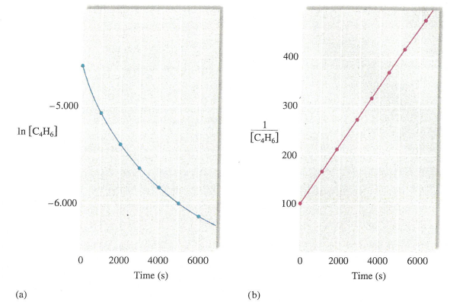
Chapter 12, Section 2: Integrated rate law
Answer:
1) To decide whether the rate law for this reaction is 1st or 2nd order, we must see whether the plot of ln[C₄H₆] versus time is a straight line (2nd order). The data necessary to make these plots are as follows:
t (s) | 1/[C₄H₆] | ln[C₄H₆]
0 | 100 | -4.605
1000 | 160 | -5.075
1800 | 210 | -5.348
2800 | 270 | -5.599
3600 | 320 | -5.767
4400 | 370 | -5.915
5200 | 415 | -6.028
6200 | 481 | -6.175
The resulting plots are shown below. Since the ln[C₄H₆] versus t plot (figure a) is not a straight line, the reaction is not first order. The reaction is, however second order, as shown by the linearity of the 1/[C₄H₆] and x = t. Thus the slope of the line can be expressed as follows:
Rate = - Δ[C₄H₆]/Δt = k[C₄H₆]²

Slide 12
Chapter 12, Section 2: Integrated rate law
Answer:
2) For a second-order reaction, a plot of 1/[C₄H₆] versus t produces a straight line of slope k. In terms of the standard equation for a straight line, y = mx + b, we have y = 1/[C₄H₆] and x = t. Thus the slope of the line can be expressed as follows: Slope = Δy/Δx = Δ(1/[C₄H₆])/Δt
Using the points at t = 0 and t = 6200, we can find the rate constant for the reaction:
k = slope = (481-100) L/mol / (6200 – 0)s = 381/6200 L/mol ∙ s = 6.14 X 10⁻² L/mol ∙ s
3) The expression for the half-life of a second-order reaction is: t_{1/2} = 1/k[A]₀
In this case k = 6.14 X 10⁻² L/mol ∙ s (from part 2) and [A]₀ = [C₄H₆]₀ = 0.01000 M (the concentration at t = 0). Thus
t_{1/2} = 1/(6.14 X 10⁻² L/mol ∙ s)(1.000 X 10⁻² mol/L) = 1.63 X 10³ s

Slide 13
Chapter 12, Section 2: Summarizing rate laws
Rate Laws: A summary
*There are two types of rate laws.
1. The differential rate law (often called simply the rate law) shows how the rate of a reaction depends on concentrations.
2. The integrated rate law shows how the concentrations of species in the reaction depend on time.
*Because we typically consider reactions only under conditions where the revers reaction is unimportant, our rate laws will involve only concentrations of reactants.
*Because the differential and integrated rate laws for a given reaction are related in a well-defined way, the experimental determination of either of the rate laws is sufficient.
*Experimental convenience usually dictates which type of rate law is determined experimentally.
*Knowing the rate law for a reaction is important mainly because we can usually infer the individual steps involved in the reaction from the specific form of the rate law.

Slide 14
Chapter 12, Section 2: Integrated rate law
Example problem #33
Assignment #2: Problems 1-5
Quiz: Rate laws
Pre-lab: Crystal violet reaction
Lab: Crystal violet reaction

Slide 15
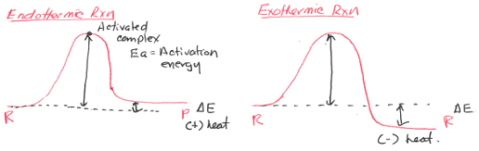
Chapter 12, Section 3: Modeling kinetics
A model of chemical kinetics
Facts about rates of chemical reactions 1) The more concentrated the reactants, the faster the reaction. 2) The higher the temperature, the faster the reaction.
Collision Theory – explains why chemical reactions take place 1. Molecules must move toward each other. 2. Molecules must hit with proper orientation 3. Molecules must hit with sufficient energy. 4. Molecules will separate after the reaction occurs.

Slide 16
Chapter 12, Section 3: Modeling kinetics
Activation Energy (E_{a}) – energy needed to start chemical reactions
In(K) = -E_{a} (1/T_{k}) + InA R = 8.3145 J/K-mol
R A = frequency factor (diff. for all reactions)
Activation energy at 2 temperatures
In[K₂/K₁] = E_{a}/R ∙ (1/T₁ – 1/T₂)
The gas-phase reaction between methane and diatomic sulfur is given by the equation
CH_{4(g)} + 2 S_{2(g)} → CS_{2(g)} + 2 H₂S_{(g)}
At 550⁰C the rate constant for this reaction is 1.1 L/mol∙sec, and at 625⁰C the rate constant is 6.4 L/mol∙sec. Using these values, calculate E_{g} for this reaction.

Slide 17
Chapter 12, Section 3: Modeling kinetics
Solution:
The relevant data are shown in the following table:
Substituting these values into the equation gives:
ln (6.4/1.1) = (E_{g}/8.3145 J/K∙mol) ∙ (1/823 K – 1/898 K)
Solving for E_{g} gives:
E_{g} = [(8.3145) ln (6.4/1.1)]/(1/823 - 1/898)
E_{g} = 1.4 X 10⁵ J/mol
k (L/mol ∙s) | T (⁰C) | T (K)
1.1 = k₁ | 550 | 823 = T₁
6.4 = k₂ | 625 | 898 = T₂

Slide 18
Chapter 12, Section 4: Reaction mechanisms
Reactions Mechanisms - For reaction mechanisms to be plausible:
The sum of the steps must give the overall reaction.
The rate law derived from the mechanism must agree with the observed mechanism (from experimental data).
EX 1: 2 NO + O₂ 2 NO₂ Rate = k[NO]²
Elementary step 1 2 NO N₂O₂ Slow
Elementary step 2 N₂O₂ + O₂ Fast
Overall reaction:
Rate law:

Slide 19
Chapter 12, Section 4: Reaction mechanisms
EX 2: NO₂ + CO NO + CO₂ Rate = k[NO₂]²
Elementary step 1 NO₂ + NO₂ NO + NO₃ Slow
Elementary step 2 NO₃ + CO NO₂ + CO₂ Fast
Overall reaction:
Rate law:

Slide 20
Chapter 12, Section 4: Reaction mechanisms
EX 3: H₂ + 2 NO N₂ + H₂O Rate = k[NO]²[H₂]
Is this a plausible mechanism?
Elementary step 1 H₂ + NO H₂O + N Slow
Elementary step 2 N + NO N₂ + O Fast
H₂ + O H₂O Fast
Overall reaction:
Rate law:

Slide 21
Chapter 12, Section 4: Reaction mechanisms
EX 4: Mechanism: Br₂ 2 Br Fast
Br + H₂ HBr + H Slow
Br₂ + H HBr + Br Fast
2 Br Br₂ Fast
Overall reaction:
Rate law:

Slide 22
Chapter 12, Section 4: Reaction mechanisms
Assignment #3: Problems 1-5

Slide 23
Chapter 12 – Unit wrap-up
NMSI problems: Integrated laws
Review MCs
NMSI problems: Rates & mechanisms
Review problems

