Slide 1
Unit 0 Notes: General Review
AP Chemistry

Slide 2
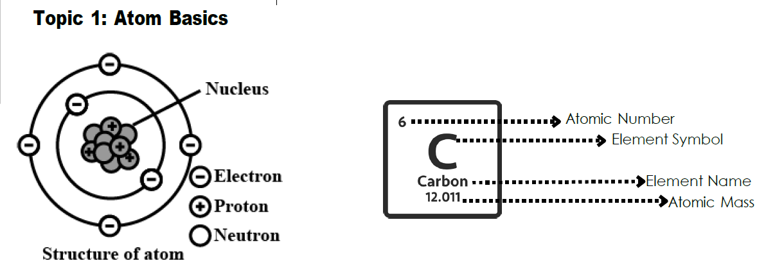
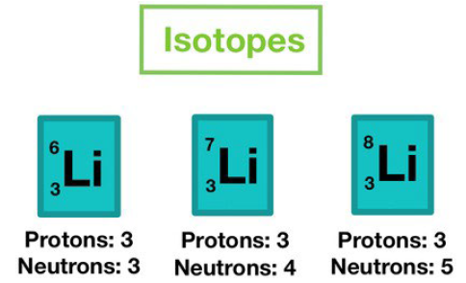
Atom review
Unit 0, Section 1
Mass # vs, Atomic #
Finding # of particles
Ions: + or –
Isotopes

Slide 3
Significant Figures – measured + 1 more decimal level!
Unit 0, Section 1
Rules:
1) Non-zeros are significant
2) Leading zeros are placeholders, not signif.
3) “Trapped” zeros are signif.
4) “Trailing” zeros after a decimal are signif.
5) Anything in a conversion or counted objects are signif.
Math:
1) Multiply/divide: round to least # of sig
figs
2) Add/subtract: round to least accurate
decimal level
WHY???
Chemistry is such a detailed subject, the
slightest bits make a huge difference in
product.

Slide 4
Significant Figures = tools of the trade
Unit 0, Section 1
Beaker
Erlenmeyer flask
Graduated cylinder
Volumetric Pipette
Volumetric flask
Buret
REMEMBER: Each of these, we read one decimal level past the markings!

Slide 5
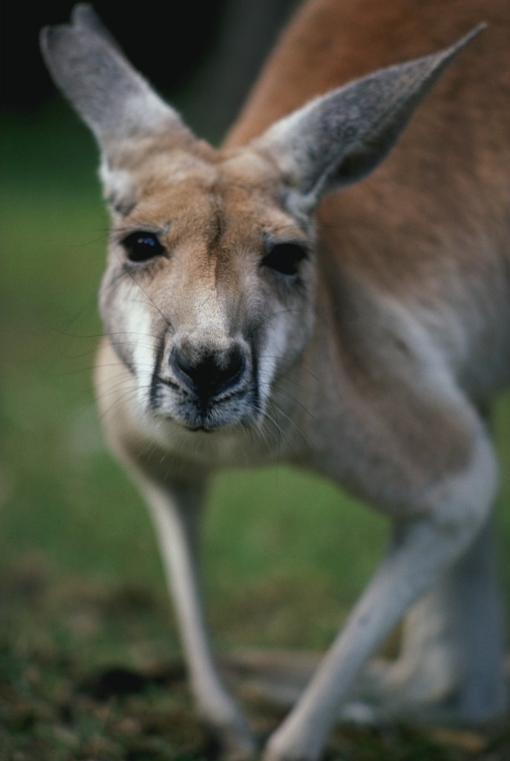
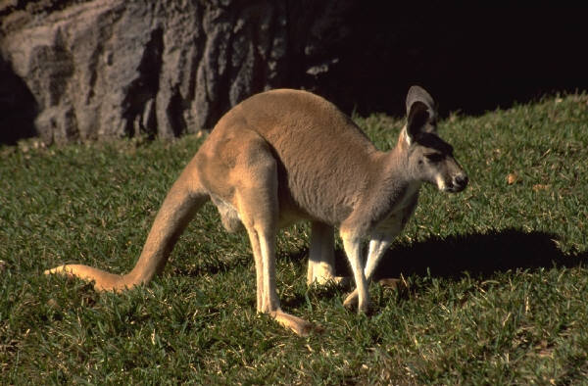
Metric System
Unit 0, Section 1
**Other conversions in your reference sheet!**
Kanga r o o s | Hopp I ng | Down t h e | Mounta i n | Dr inking | Choco l ate | mi l k

Slide 6
Periodic Table Orientation
Unit 0, Section 1
Periods
Groups/Families
Metals/Nonmetals
General Ionic trends
Cations
Anions

Slide 7
Bonding & compound formation
Unit 0, Section 1
Form bonds to satisfy the octet (stable)
AP Chemistry = “becomes more thermodynamically favorable”
Ionic – metal, transfers electrons (swap, drop, reduce)
Cations – lose e⁻; becomes + charge
Anions – gain e⁻; becomes – charge
Binary: Element + -ide Ex: Lithium sulfide → Li₂S
Transition metal = Roman numeral Ex: Iron (II) chloride → FeCl₂
Ternary: Element + polyatomic ion Ex: Calcium phosphate → Ca₃(PO₄)₂
Acids: Binary: Hydro___ic acid Ex: Hydrochloric acid → HCl
Ternary: -ic = -ates; -ous = -ites Ex: Sulfuric → H₂SO₄; Sulfurous → H₂SO₃

Slide 8
Bonding & compound formation
Unit 0, Section 1
Form bonds to satisfy the octet (stable)
AP Chemistry = “becomes more thermodynamically favorable”
Covalent – nonmetals, shares electrons (prefixes tell #s)
Polar – large differences in electronegativity
Nonpolar – small/no difference in electronegativity
Ex: NH3

Slide 9
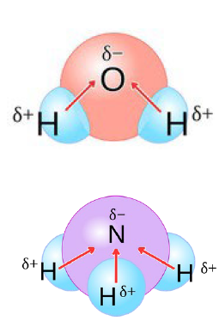
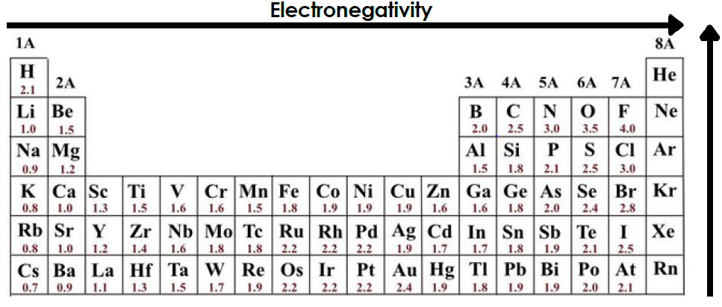
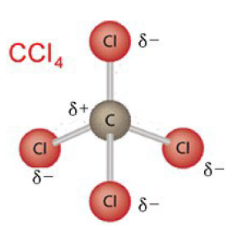
Polarity & Electronegativity
Unit 0, Section 1
Electronegativity – tendency for an atom to attract e⁻
Polarity – e⁻ more dominant on one bonded atom than the other (dipole moment)
Nonpolar – no dipole moments
No difference in
electronegativity OR
Evenly distributed differences (symmetrical)

Slide 10
Your assignment: Unit 0 packet (submit online!)
Unit 0, Section 1
Atomic structure (p⁺, e⁻, n⁰)
Significant figures & rounding with math functions
Metric system & conversions using dimensional analysis
Periodic table trends
Basic compound naming/writing
YOU WILL NEED TO DO SOME INDEPENDENT REVIEW TO COMPLETE THIS!

Slide 11
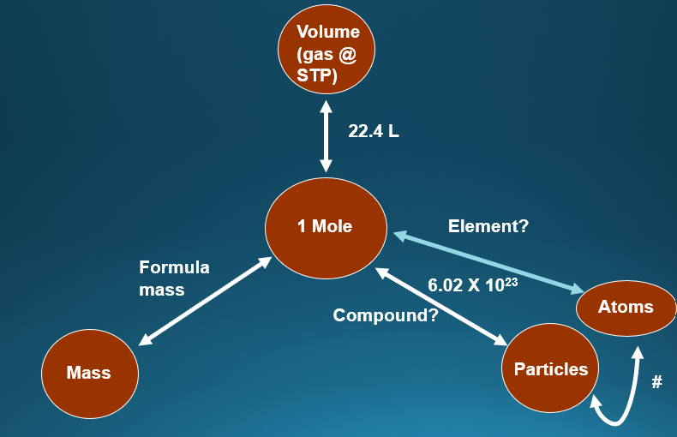
Mole & Mole conversions
Unit 0, Section 2

Slide 12
Mole conversion examples: particles
Unit 0, Section 2
1 mole = 6.02 X 10²³ representative units (Avagadro’s number)
Particles:
Element – atoms
Compound
Ionic – formula units (f.units)
Covalent – molecules (molec.)

Slide 13
Mole conversion examples: particles
Unit 0, Section 2
EX: How many moles of magnesium is 1.25 X 10²³ atoms of magnesium?
EX: How many atoms in 1.5 moles of zinc?
EX: How many atoms in 2.12 mol of propane (C₃H₈ )?

Slide 14
Mole conversions: formula mass
Unit 0, Section 2
Gram atomic mass = atomic mass unit (amu) = 1 mole
SO₃
(NH₄)₂CO₃

Slide 15
Mole conversion examples: mass
Unit 0, Section 2
EX: How many grams are in 9.45 moles N₂O₃?
EX: How many moles are in 92.2 g of iron (III) oxide?
EX: How many atoms in 2.12 grams of propane (C₃H₈ )?

Slide 16
% composition
Unit 0, Section 2
% mass of an element = grams of element/grams of compound
EX: 8.20g Mg combines with 5.40g oxygen to form a compound. What is the % composition of that compound?

