Slide 1
Electrochemistry
Unit 5 Notes

Slide 2
Chapter 16, Section 1: Voltaic Cells
What is electrochemistry?
Introductory lab

Slide 3
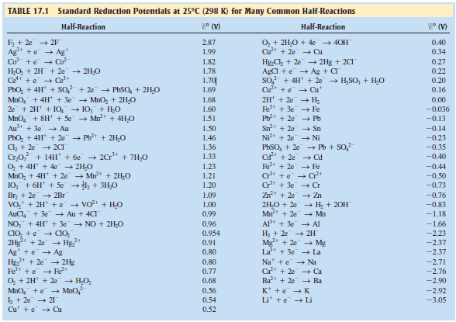
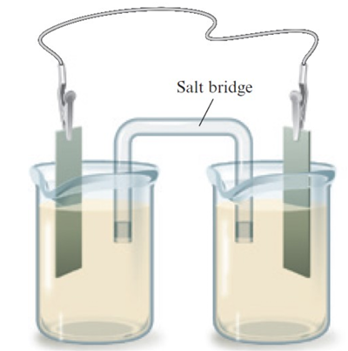
Chapter 16, Section 1: Voltaic Cells
Electrochemistry – interconversions of electrical and chemical energy
2 types of electrochemical cells
1. Voltaic – spontaneous reactions generate electrical energy
2. Electrolytic cells – electrical energy brings about nonspontaneous reaction
Voltaic Cells
Oxidation – (more +) anode
Reduction – (more -) cathode

Slide 4
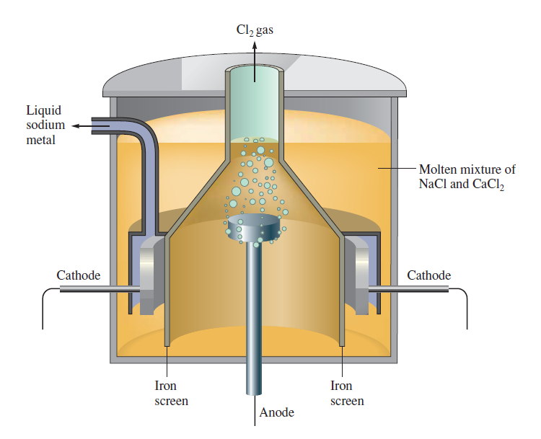
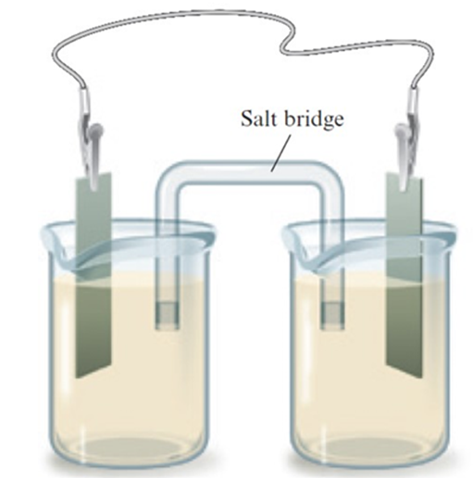
Chapter 16, Section 1: Voltaic Cells
EX 1: When chlorine gas is bubbled through a water solution of NaBr a spontaneous reaction occurs:
Cl_{2(g)} + 2 Br⁻_{(aq)} → 2 Cl⁻_{(aq)} + Br_{2(l)}
This reaction can serve as a source of electrical energy in a voltaic cell.
a) Draw the voltaic cell.
b) What is the cathode reaction? Anode reaction?
c) Which way do the e⁻ move in the external circuit?
d) Which way do the anions move? Which way do the cations move?

Slide 5
Chapter 16, Section 1: Voltaic Cells
EX 2: Do the same as before for the following reaction:
Zn_{(s)} + 2 H⁺_{(aq)} → Zn²⁺_{(aq)} + H_{2(g)}
Summary of voltaic cells
Voltaic cells consist of two half-cells. They are joined by an external electrical circuit through which electrons move and a salt bridge through which ions move.
Each half-cell consists of an electrode dipping into a water solution. If a metal participates in the cell reaction, either as a product or a reactant, it is ordinarily used as the electrode; otherwise an inert electrode such as platinum is used.
3. In one half-cell, oxidation happens at the anode and reduction occurs at the cathode.

Slide 6
Chapter 16, Section 1: Voltaic Cells
Assignment #1: Problems 1-4

Slide 7
Chapter 16, Section 2: Voltaic Cells - Voltages
Standard voltages
Standard voltage – current flow is zero ions and molecules in solution at standard conditions (1 M for solutions, 1 atm for gases)
Zn-H⁺ cell as an example
You need two half-cells to measure a voltage
EX 3: What is the E⁰_{red} for Cu²⁺ if E⁰ for Zn-Cu²⁺ is +1.101 V?

Slide 8
Chapter 16, Section 2: Voltaic Cells - Redox
Strength of oxidizing-reducing agents
Oxidizing agent (reduction) – gains e⁻
Reducing agent (oxidation) – releases e⁻
EX 4: Consider the following species in acidic solutions:
MnO₄⁻, I⁻, NO₃⁻, H₂S, F²⁺
Using the table of standard potentials:
a) Classify each of the these as an oxidizing and/or a reducing agent.
b) Arrange the oxidizing agents in order of increasing strength.
c) Arrange the reducing agents in order of increasing strength.

Slide 9
Chapter 16, Section 2: Voltaic Cells - Redox
To calculate the E⁰ from the E⁰_{red} and E⁰_{ox}
E⁰ = E⁰_{red} + E⁰_{ox}
EX 5: Using the table of standard potentials, calculate the E⁰ for a voltaic cell in which the reaction is:
2 Ag⁺_{(aq)} + Cd_{(s)} → 2 Ag_{(s)} + Cd²⁺_{(aq)}
2 general points
1. The calculated voltage, E⁰, is always a (+) quantity for a reaction taking place in a voltaic cell.
2. The quantities E⁰, E⁰_{red}, and E⁰_{ox} are independent of how the equation for the cell reaction is written. You never multiply the voltage by the coefficients of the balanced equation.

Slide 10
Chapter 16, Section 2: Voltaic Cells - Redox
Spontaneity of redox reactions
To determine whether a given redox reaction is spontaneous, apply a simple principle:
If the calculated voltage for a redox reaction is (+), the reaction will be spontaneous. If (-), the reaction will not be spontaneous.
EX 6: Determine if the following reactions are spontaneous.
a) Ni_{(s)} + Zn²⁺_{(aq 1 M)} → Ni²⁺_{(aq 1 M)} + Zn_{(s)}

Slide 11
Chapter 16, Section 2: Voltaic Cells - Redox
EX 6: Determine if the following reactions are spontaneous.
b) Ni_{(s)} + Cu²⁺_{(aq 1 M)} → Ni²⁺_{(aq 1 M)} + Cu_{(s)}
c) 2 Fe³⁺_{(aq)} + 2 I⁻_{(aq)} → 2 Fe²⁺_{(aq)} + I_{2(s)}
d) Fe_{(s)} will oxidize to Fe²⁺ by treatment of hydrochloric acid. (The H⁺ is only used because Cl⁻
cannot be reduced). Will this reaction occur?
e) Will a reaction occur when the following species are mixed in an acidic solution:
Cl⁻, Fe²⁺, Cr²⁺, I₂

Slide 12
Chapter 16, Section 2: Voltaic Cells - Redox
Assignment #2: Problems 1-4
Simulation: Electrochemical Cells – standard reduction potential

Slide 13
Chapter 16, Section 3: Voltaic Cells –
E⁰, G⁰, and K
Relations between Eº, G⁰, and K ΔG = Free energy (-ΔG is spontaneous)
K = equilibrium constant (K>1 is spontaneous)
E⁰ is a measure of the spontaneity of a cell reaction
EX 7: For the reaction:
3 Ag_{(s)} + NO₃⁻_{(aq)} + 4 H⁺_{(aq)} → 3 Ag⁺_{(aq)} + NO_{(g)} + 2 H₂O_{(l)}
Calculate:
a) G⁰
b) K

Slide 14
Chapter 16, Section 3: Voltaic Cells – E⁰, G⁰, and K
EX 8: Calculate E⁰, G⁰, and K for the reaction:
3 Mn²⁺_{(aq)} + 2 MnO₄⁻_{(aq)} + 2 H₂O → 5 MnO_{2(s)} + 4 H⁺_{(aq)}
Assignment #3: Problems 1-4
Quiz: Electrochemical cells & E⁰, G⁰, and K values

Slide 15
Chapter 16, Section 4: Voltaic Cells - Nernst equation
Effect of concentration on voltage
We have only worked with standard voltages (E⁰) – (1 M solutions and
1 atm pressure).
When concentrations change, so does the voltage.
Direction in which voltage shifts is predicted when you realize cell voltage is directly related to reaction spontaneity.
Voltage increases when [ ] reactant increases or [ ] product decreases
Voltage decreases when [ ] reactant decreases or [ ] product increases
After time, voltage drops and becomes zero as redox reaction reaches equilibrium

Slide 16
Chapter 16, Section 4: Voltaic Cells - Nernst equation
Comparing cell voltage (E) to concentration
Nernst equation: E = E⁰ – (0.0257 V) ln Q Q = reaction quotient
n
E = E⁰ – (0.0592 V) log Q
n
EX 9: Consider a voltaic cell in which the following reaction occurs:
O_{2(g)} + 4 H⁺_{(aq)} + 4 Br⁻_{(aq)} → 2 H₂O_{(l)} + 2 Br_{2(l)}
Calculate the cell voltage (E) when O₂ = 1 atm and [H⁺] = [Br⁻] = 0.10 M

Slide 17
Chapter 16, Section 4: Voltaic Cells - Nernst equation
EX 10: Consider a voltaic cell at 25⁰ C in which the following reaction takes place:
2 H₂O_{2(aq)} + 6 H⁺_{(aq)} + 2 Au_{(s)} → 2 Au³⁺_{(aq)} + 6 H₂O
Calculate E⁰
Write the Nernst equation for the cell.
Calculate E when [Au³⁺] = 0.250 M, [H⁺] = 1.25 M, [H₂O₂] = 1.50 M

Slide 18
Chapter 16, Section 4: Voltaic Cells - Nernst equation w/ pH
EX 11: Consider a voltaic cell at 25⁰C in which the following reaction takes place.
3 O_{2(aq)} + 4 NO_{(g)} + 2 H₂O → 4 NO₃⁻_{(aq)} + 4 H⁺_{(aq)}
1) Calculate E⁰.
2) Write the Nernst equation for the cell.
3) Calculate E when [NO₃⁻] = 0.250 M, P_{NO} = 0.493 atm, P_{O2} = 0.315 atm, pH = 4.85.

Slide 19
Chapter 16, Section 4: Voltaic Cells - Nernst equation w/ pH
EX 12: Consider a voltaic cell in which the following reaction takes place.
2 NO₃⁻_{(aq)} + 3 H_{2(g)} → 2 NO_{(g)} + 2 OH⁻_{(aq)} + 2 H₂O
1) Calculate E⁰.
2) Write the Nernst equation for the cell.
3) Calculate E when [NO₃⁻] = 0.015 M, P_{NO} = 0.722 atm, P_{H2} = 0.237 atm,
pH = 9.50.

Slide 20
Chapter 16, Section 4: Voltaic Cells - Nernst equation
Use of the Nernst equation to determine ion concentration
In chemistry, the most important use of the Nernst equation lies in the experimental determination of the concentration of ions in solution. Suppose you measure the cell voltage, E, and know all but one species in the two half-cells. It should then be possible to calculate the concentration of that species using the Nernst equation.
EX 13: Consider a voltaic cell in which the reaction is:
Zn_{(s)} + 2 H⁺_{(aq)} → Zn²⁺_{(aq)} + H_{2(g)} E = 0.560 V
It is found that the voltage is +0.560 V when [Zn²⁺] = 1.0 M, pH₂ = 1.0 atm, what must be the concentration of H⁺ in the H₂-H⁺ half-cell?

Slide 21
Chapter 16, Section 4: Voltaic Cells - Nernst equation
Assignment #4: Problems 1-5
Pre-lab: Electrochemical Cells
Lab: Electrochemical Cells
Quiz: Electrochemistry

Slide 22
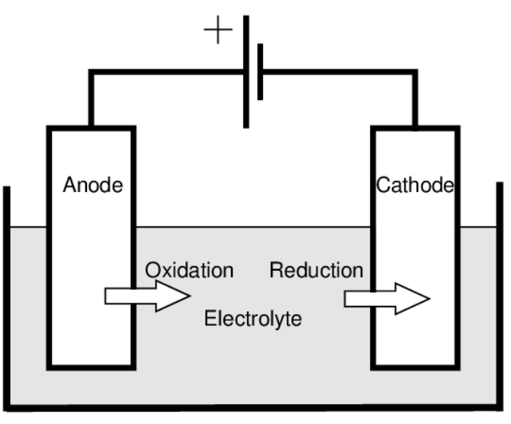
Chapter 16, Section 5: Electrolytic Cells
Electrolytic cells: A nonspontaneous redox reaction is made to occur by pumping electrical energy into the system
- Battery acts as an electron pump, pushing e⁻ into the cathode and removing them from the anode
- Electrolysis – process of pumping e⁻ in redox reaction

Slide 23
Chapter 16, Section 5: Electrolytic Cells
There is a simple relationship between the amount of electricity passed through an electrolytic cell and amounts of substance produced by oxidation and reduction at the electrodes.
Ag⁺_{(aq)} + e⁻ → Ag_{(s)}
Cu²⁺_{(aq)} + 2 e⁻ → Cu_{(s)}
Au³⁺_{(aq)} + 3 e⁻ → Au_{(s)}
You can deduce that:
1 mole e⁻ → 1 mole Ag (107.9 grams of Ag)
2 mole e⁻ → 1 mole Cu (63.55 grams of Cu)
1 mole e⁻ → 1 mole Au (197.0 grams of Au)

Slide 24
Chapter 16, Section 5: Electrolytic Cells
Terms
Coulomb (C): quantity of electrical charge (1 mole e⁻ = 9.648 X 10⁴ C)
Ampere (A): rate of current flow (1 A = 1 C/sec)
Joule (J): amount of electrical energy (1 J = 1 C – V)
Kilowatt hours (kWh): energy & time (1 kWh = 3.6 X 10⁶ J)
EX 14:Chromium metal can be electroplated from a water solution of potassium dichromate. The reduction half-reaction is:
Cr₂O₇²⁻_{(aq)} + 14 H⁺_{(aq)} + 12 e⁻ → 2 Cr_{(s)} + 7 H₂O_{(l)}
a) How many grams of chromium will be plated by 1.00 X 10⁴ C?
b) How long will it take to plate 1 gram of chromium using a current of 6.00 A?
c) If the applied voltage is 4.5 V, how many kilowatt hours of electrical energy are required to plate 1.00 grams of Cr?

Slide 25
Chapter 16, Section 5: Electrolytic Cells
Assignment #5: Problems

Slide 26
Chapter 16, Section 5: Electrolytic Cells
Video: Introduction to Electroplating
Pre-lab: Electroplating
Electroplating example problems
Lab: Electroplating with Copper

Slide 27
Chapter 16 – Unit wrap-up
NMSI problems
FRQ #1-4

