Slide 1
Acid-Base Equilibrium
Unit 9 Notes

Slide 2
Chapter 15, Section 1: Buffers
Common ion effect – The shift in equilibrium position that occurs because of the addition of an ion already involved in the equilibrium.
EX 1: Calculate the pH of the following solutions
a) 1.0 M HF K_{a} = 7.2 X 10⁻⁴
b) 1.0 M HF and 1.0 M NaF

Slide 3
Chapter 15, Section 1: Buffers
Buffered solution – a solution that resists a pH change when [OH⁻] or [H⁺] are added
- Weak acid and its salt
- Weak base and its salt
EX 2: Calculate the pH of a 0.50 M HC₂H₃O₂ and 0.50 M solution of NaC₂H₃O₂ buffer solution.
EX 3: Calculate the pH of the solution in the above example when 0.010 moles of NaOH are added.
EX 4: Calculate the solution of
a)500 mL of 0.250 M HCOOH and 0.100 M NaCOOH solution K_{a} = 1.8 X 10⁻⁴
b) the above solution with 10 mL of a 6.00 M NaOH solution

Slide 4
Chapter 15, Section 1: Buffers
Assignment #1: Problems 1-4

Slide 5
Chapter 15, Section 2: Henderson-Hasselbalch equation
Henderson-Hasselbalch equation – used to solve buffer problems
pH = pK_{a} + log [A⁻]
[HA]
EX 5: Calculate the pH of a 0.75 M lactic acid (HC₃H₅O₃) and 0.25 M sodium lactate (NaC₃H₅O₃) solution.
K_{a} = 1.4 X 10⁻⁴ using Henderson-Hasselbalch
EX 6: Using Henderson-Hasselbalch, calculate the a) pH of a 0.50 M HC₂H₃O₂ and 0.50 M solution of NaC₂H₃O₂ buffer solution. Then b) when 0.010 moles of NaOH are added.
EX 7: Calculate the pH of a solution that results when 0.10 moles of HCl is added to 1.0 liter of a 0.25 M NH₃ and 0.40 M NH₄Cl. (K_{b} = 1.8 X 10⁻⁵)

Slide 6
Chapter 15, Section 2: Henderson-Hasselbalch equation
Last one: You prepare a buffer solution of 0.323 M NH₃ and (NH₄)₂SO₄. What molarity of (NH₄)₂SO₄ is necessary to have a pH of 8.6? The K_{b} for NH₃ is 1.8 X 10⁻⁵.
Assignment #2: Problems 1-4

Slide 7
Chapter 15, Section 3: Strong Acid-Strong Base Titrations
Titrations and pH curves
Titration – reaction of an acid and base
The process of an acid-base titration is often monitored by plotting the pH of a solution being analyzed as a function of the amount of titrant added. Such a plot is called a pH curve or titration curve.

Slide 8
Chapter 15, Section 3: Strong Acid-Strong Base Titrations
Strong acid-strong base titration
50.0 mL of 0.200 M HNO₃ and add 0.100 M NaOH
No added NaOH
10 mL of NaOH added
20 mL (total) NaOH
d) 50 mL (total) NaOH
e) 100 mL (total) NaOH
f) 150 mL (total) NaOH
At end point there is a dramatic change.
Before – large [H⁺], [OH⁻] has little pH change
At the end point – small [H⁺], [OH⁻] makes a large change in pH

Slide 9
Chapter 15, Section 3: Strong Acid-Strong Base Titrations
Assignment: Strong Acid-Strong Base Titration
Lab Simulation
Pre-Lab: Strong Acid-Strong Base Titration
Lab: Strong Acid-Strong Base Titration
Conclusion questions

Slide 10
Chapter 15, Section 4: Weak Acid-Strong Base Titrations
Titrations of weak acids-strong bases
50.0mL of 0.100 M HC₂H₃O₂ add 0.10 M NaOH K_{a} = 1.8 X 10⁻⁵
No added NaOH
10 mL of NaOH added
25 mL (total) NaOH
40 mL (total) NaOH
e) 50 mL (total) NaOH
f) 60 mL (total) NaOH
g) 75 mL (total) NaOH

Slide 11
Chapter 15, Section 4: Weak Acid-Strong Base Titrations
Assignment: Weak Acid-Strong Base Titration
MC review questions

Slide 12
Chapter 15, Section 5: Solubility equilibrium K_{sp}
Solubility equilibrium K_{sp}
K_{sp} – solubility constant and is used to predict solubility
Write the expression for K_{sp} for the following salts
a) SrCrO₄
b) Ag₂CrO₄
c) Ca₃(PO₄)₂

Slide 13
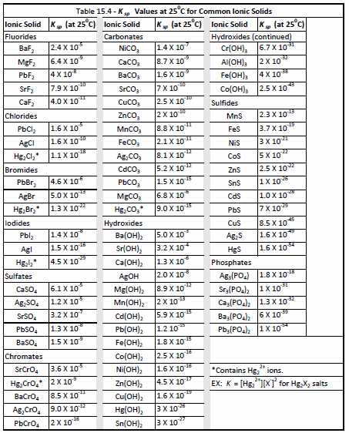
Chapter 15, Section 5: Solubility equilibrium K_{sp}
The K_{sp} values for some common ionic solids can be found on page 738. It can also be calculated using the concentration of the salt. Calculate the K_{sp} for the following salts.
a) 2.0 X 10⁻⁴ M CuBr solution
b) 1.0 X 10⁻¹⁵ M Bi₂S₃ solution
The common ion effect also is an issue with solubility as it is with acids and bases. Calculate the solubility of the following salts
a) Ag₂CrO₄ K_{sp} = 9.0 X 10⁻¹²
b) Ag₂CrO₄ in 0.100 M AgNO₃
c) CaF₂ K_{sp} = 4.0 X 10⁻¹¹
d) CaF₂ in 0.025 M NaF

Slide 14
Chapter 15, Section 5: Solubility equilibrium K_{sp}
K_{sp} and precipitate formation – K_{sp} values can be used to make predictions as to whether or not a precipitate will form when two solutions are mixed.
Q – reaction quotient – Calculated like K_{sp} Q > K_{sp} precipitate forms
Q < K_{sp} precipitate does not form
Q = K_{sp} saturated solution

Slide 15
Chapter 15, Section 5: Solubility equilibrium K_{sp}
Will a precipitate form when 0.0030 M Na₂CrO₄ solution is mixed with a solution of 0.0060 M Sr²⁺?
Will a precipitate form when 0.200 liters of 0.0060 M Sr(NO₃)₂ is mixed with 0.800 liters of 0.040 M K₂CrO₄?

Slide 16
Chapter 15, Section 5: Solubility equilibrium K_{sp}
K_{sp} and water solubility
One way to establish equilibrium between a slightly soluble solid and its ions is to stir the solid with water to form a saturated solution. The solubility of the solid, s, in moles/liter is related to the solubility product constant, K_{sp}.
EX 8: BaSO₄
EX 9: Calculate the solubility BaF₂ in
a) moles/liter
b) grams/liter

Slide 17
Chapter 15, Section 5: Solubility equilibrium K_{sp}
K_{sp} and the common ion effect
Calculate the solubility of BaSO₄
a) by itself
b) when added to 0.10 M Na₂SO₄
Selective precipitation
One way to separate two cations (+) in a water solution is to add an anion (-) that precipitates out one of the cations. This is knowns as selective precipitation.
EX 10: A solution contains Mg²⁺ and Na⁺ ions. What is needed to remove the ions from the solution?

Slide 18
Chapter 15, Section 5: Solubility equilibrium K_{sp}
EX 11: A solution contains 0.10 M Mg²⁺ ions and 0.10 M Ba²⁺ ions, and you would like to precipitate them by adding CO₃²⁻ ions. Using the following information: BaCO₃ (K_{sp} = 2.6 X 10⁻⁹) and MgCO₃ (K_{sp} = 6.8 X 10⁻⁶), calculate a) which ion will precipitate first and b) in what concentrations.
EX 12: A flask contains a solution of 0.10 M Cl⁻¹ and 0.010 M CrO₄²⁻. When AgNO₃ is added:
a) Which anion, Cl⁻ or CrO₄²⁻, will precipitate first?
b) What percentage of the first anion has been precipitated when the second anion starts to precipitate?

Slide 19
Chapter 15, Section 5: Solubility equilibrium K_{sp}
Assignment #5: Problems 1-3

Slide 20
Chapter 15– Unit wrap-up
Review problems
NMSI problems

