Slide 1
Write This, Not That! on the AP Chemistry Exam
Compiled by: Nora Walsh FJ Reitz High School, Evansville, IN Sources: Released Free-Response Questions with Samples and Commentary/Chief Reader Reports AACT Webinars: Lessons Learned from AP Chemistry Exam
All practice problems are taken from previous AP Chemistry Exams and are property of the College Board. *IPE stands for International Practice Exam. *FRQ stands for free response question and are the questions publicly released from the exam.
Updated April 15th, 2024

Slide 2
My biggest pieces of advice to get all your points!
Show all work!
  If you don’t show work, you don’t earn credit
  Label units and plug in actual values for variables – it helps readers see your process
Justify your answers using chemical principles!
  Don’t use definitions, they won’t help
  Don’t restate the prompt as your reason
  If it says “justify” and you do not, you’ll probably earn no points
Read the question and answer THAT question
  If it says “using the data above”, you must reference the actual data in your answer
  If it says “include units”, you must include units
Make it to the end!
  Jump around in the exam – do the questions you feel best about first
  Don’t give up on a whole FRQ if the early parts are hard for you – the questions often change topic in the middle

Slide 3
Table of Contents
For All Questions
Unit 1: Atomic Structure and Properties
Unit 2: Molecular and Ionic Compound Structure and Properties
Unit 3: Intermolecular Forces and Properties
Unit 4: Chemical Reactions
Unit 5: Kinetics
Unit 6: Thermodynamics
Unit 7: Equilibrium
Unit 8: Acids and Bases
Unit 9: Applications of Thermodynamics

Slide 4
For All Questions
Write This… | …Not That! | Rationale
Handwriting that is clear, legible, dark enough and large enough to be scanned and read by someone who doesn’t know you | Messy, illegible, light, tiny writing that cannot be read | Answers deemed illegible by a reader and the table leader will earn no points on corresponding parts/questions – remember all papers are SCANNED
Variables that are clearly denoted and appropriately used | Variables that are incorrectly represented | Variables have specific meaning and must be correctly denoted/abbreviated; case matters for many variables: M (not m) for molarity, K (equilibrium constant) vs k (rate constant) m is meters, not minutes, moles or molarity, etc.
Numerical answers that are supported by work | Numerical answers on their own | Work is required to be shown in order for points to be earned
Abbreviations that are generally accepted (M, min, s, IMF, LDF, etc.) | Abbreviations that are not generally accepted/ are incorrect/ change the meaning (ex: mol for molecule, CL instead of Coulomb’s Law, etc) | Abbreviations still must convey the correct information; if in doubt, define or avoid them – don’t create ambiguity in an answer by using an abbreviation
Answer the specific question first, then “justify”, “explain” etc. | Burying the answer in the text of the response | Make it easy to follow your answer and give you points
Answers that are concise and direct | Burying the answer in a long response | Make it easy to follow your answer and give you points
Names of specific elements and compounds, “reactants”, “products”, etc. | “it” | Ambiguous

Slide 5
For All Questions (cont.)
Write This… | …Not That! | Rationale
Symbols that match that in a provided key for a diagram | Making up symbols for a diagram | Use the provided key to ensure that you are clear in your answer (ref 2023 #5b)
A justification or explanation when it is requested as part of the question | Only the answer without supporting it | Justification/explanation required to earn point
“mass”, “volume”, etc. | “size” | Be specific to indicate understanding
References to specific data or graphs when prompted to “explain how the data…”, “using the table below…” or something similar | Generalizations about the data without specifically citing provided data or trials | Required to earn point (ref. 2023 #3b)
Elements that match the symbol given in the prompt | Elements that are do not match the symbol in the prompt | Be careful – some elements have similar symbols! (Ex: Cl and C) (ref. 2023 #1)
An answer with units if “include units” is stated in the problem | An answer without units | If “include units” is written in the prompt, correct unit is required to earn full points
Complete dimensional analysis/work with units | Incomplete dimensional analysis without units | Including units clearly shows intended work, and allows points for “implied” calculations to be earned
Values with units that match constants and that are the same throughout the equation | Values with units that do not match other values/constants | Values must be the same unit through an equation, for both constants and variables

Slide 6
For All Questions (cont.)
Write This… | …Not That! | Rationale
Answers expressed to the correct number of significant figures, based on data given in the problem | Answers with an incorrect number of significant figures or significant figures limited by molar mass, constants, etc. | 1 pt traditionally is assessed somewhere in the FR for significant figures (typically found in a laboratory data question)
Answers that only refer to substances/data included in the prompt | Answers with justifications based on situations or data that are not indicated in the prompt | Do not claim something happened that was not present in prompt– any valid assumptions would be stated
Analysis of given data in a thoughtful way that is based on chemical principals | Saying that data is wrong, that the data is impossible, calling the test writers liars, etc. | The AP Exam is never going to try to trick you- it will not give false or impossible data
Answers that refer to specific and correct glassware, used correctly (ex: buret rinsed then filled), and values read correctly from figures | Answers that use incorrect glassware for the task, particularly with regard to precision and/or misread figures of glassware | Glassware has different specialized uses, and should be appropriately referenced/used/read based on the task (ex. 2023 #4b)
Explanation of an application of usage of a term | Definition of a term | A definition is not required on the exam – an explanation of how this term applies is needed
An explanation of the reason behind an observation of phenomena. | Stating a law/rule or observation without explaining the chemical principles or phenomena behind the law/rule/trend. | Simply stating the end result without discussing the reason for that result does not fully answer the question. Evidence and reasoning must both be included. (ex. 2019 #4, 2023 #7c)
Using deductive reasoning to make conclusions or approximate values when the terms “estimate” or “justify” are in the prompt | Using long, time-intensive math reasoning when “calculate” is not indicated in the prompt | While correct calculations will earn credit, the loss in this type of answer is the amount of time spent on the calculations when an assessment without lengthy calculations can be done instead (ex: 2018 #2e-f, 2019 #3g)

Slide 7
For All Questions (cont.)
Write This… | …Not That! | Rationale
Answers that pay attention to the relative scale on graphs | Answers that make assumptions on the scale without examining data | Don’t assume that marked lines automatically are increments of 1, 10, etc. – use the data to determine the scale (ex. 2019 #5a)
Answers that make absolute comparisons (greater than 1, less than 1) | Answers that make vague comparisons (more, less) | If it is possible to justify an answer with values, do that to demonstrate that you understand the underlying principle ( C.R. 2023)
Write out the value of R (and all constants) in your work | Showing the variable instead of the value of the constant | The correct symbol used correctly will earn full points, HOWEVER – students that write out the value are more likely to use the correct value in their calculation (C.R.R. 2023)
Correct symbols or terms | Incorrect symbols | Be sure to use the correct < or >, if in doubt, use words instead (C.R.R. 2023)
Algebraic rearrangements that correctly follow order of operations and isolate the desired term | Incorrect algebra | Be careful to rearrange equations correctly – watch when to multiple/divide, and what is in numerator or denominator (ex. 2021 #3d, 2023 #5b, 2023 #7bii)
Answers that pay attention to the relative scale on graphs | Answers that make assumptions on the scale without examining data | Don’t assume that marked lines automatically are increments of 1, 10, etc. – use the data to determine the scale (ex. 2019 #5a)
Answers that make absolute comparisons (greater than 1, less than 1) | Answers that make vague comparisons (more, less) | If it is possible to justify an answer with values, do that to demonstrate that you understand the underlying principle ( C.R. 2023)

Slide 8
Unit 1: Atomic Structure and Properties
Write This… | …Not That! | Rationale
“period” | “shell” when referring to elements and their location on the Periodic Table | Elements are in a period, electrons are in a shell
Ion electron configurations that show electrons were removed from valence shell orbitals | Ion electron configurations that show electrons were removed from inner orbitals | Ions form by electrons being lost from the outermost shell; this may or may not be the electrons that were filled last in the electron configuration (ref. 2018 #3a)
Reference reasons for periodic trends (i.e. effective nuclear charge, Coulomb’s law, polarizability, etc.) | Stating the trend as the reason (“because it is to the left”, “because it is further down the periodic table”, etc.) | State the actual reason not the memory aid (Ref. 2021 #2h, 2022 #3b)
“Effective nuclear charge increases” | “It wants to have a full octet”; “it’s close to having a full octet” | State the actual reason not the memory aid
“It has a more polarizable cloud of electrons” | “It has more electrons”, “it has more mass”, “it has more surface area”, “it is bigger”, “it has more protons” | State the actual reason not the memory aid
“Electrons in higher energy levels are farther from the nucleus, resulting in a larger atom/ion.” | “More electrons/more energy levels makes the atom/ion bigger.” | Explanation of reason, not just statement of fact, required for point (Ref 2016 #1)
Using the difference in mass from given lab data to determine the mass of a desired product | Using lab data without removing the mass of species not in the desired product | Difference in mass is used to account for mass of filter paper, drying agent, unreacted starting material, etc. (Ref. 2021 #3b)

Slide 9
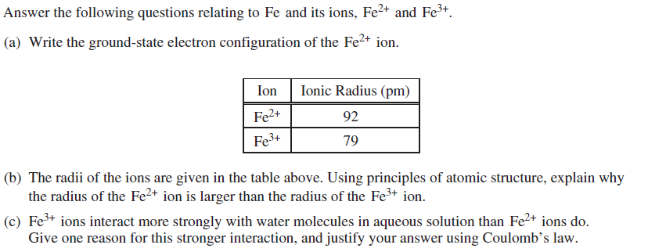
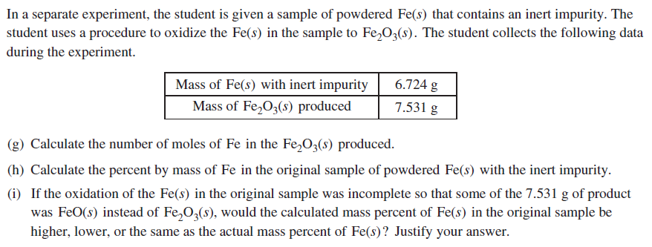
Unit 1 Practice Problem – 2018 FRQ #3
Parts d-f pertain to different units and were removed for this example

Slide 10
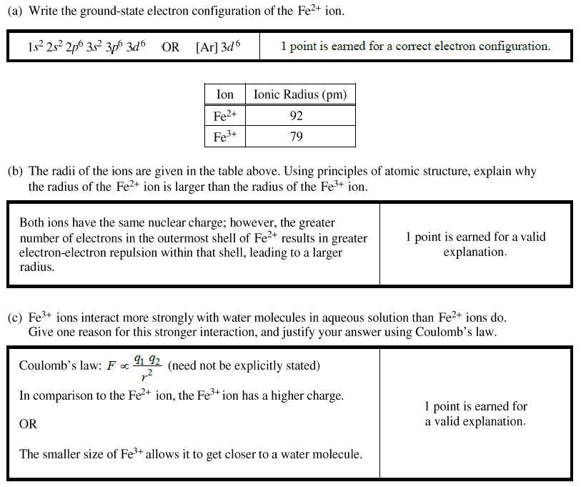
2018 FRQ #3 Scoring Guidelines and Things to Notice
Notice that this electron configuration is for an ion, and that the two electrons were lost from the valence shell (not the last filled shell)
Notice that the response references both ions but then the justification is in terms of the Fe²⁺ (because the prompt asks why the Fe²⁺ is larger)
Because you are told to justify using Coulomb’s law, the explanation will not be correct without referencing features of the law at play

Slide 11
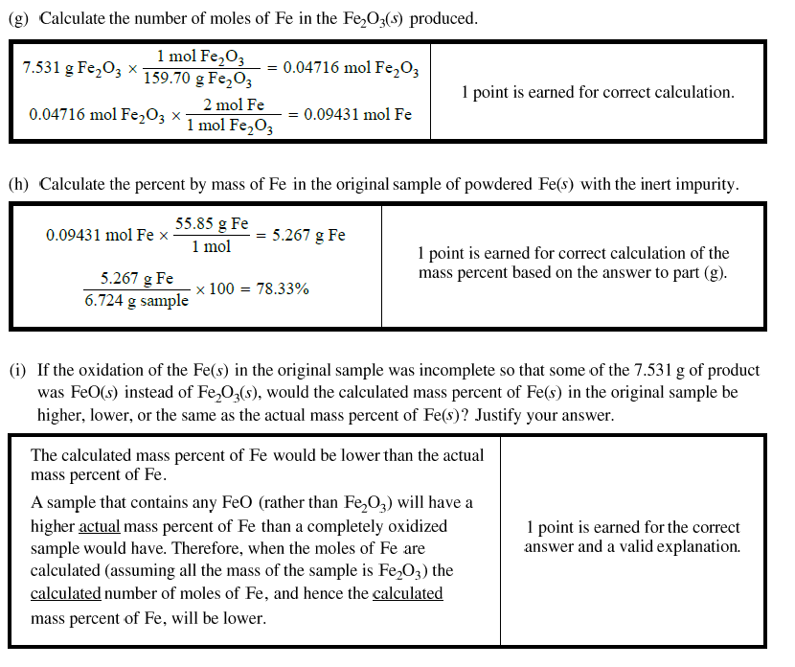
2018 FRQ #3 Scoring Guidelines and Things to Notice (cont).
Show all work and make it easy to follow by using units and math that has a logical progression on the page
Remember: no double jeopardy; using an incorrect answer from part g will still give the point here if this part is done correctly
Answer the question first: “lower”
Justify second. Notice that the point is not earned without the justification – it must be included.
Don’t let wording through you off – you don’t need to do anything with oxidation here, it’s all thinking about the impact of an leftover reactant on calculations in an experiment

Slide 12
Unit 2: Molecular and Ionic Compound Structure and Properties
Write This… | …Not That! | Rationale
Explaining properties of a solid/substance by discussing the components and bonds within | Attributing properties of a solid/substance to its type without explaining the structural reason | Structural features are required to justify properties of a substance (i.e. types of bonds, mobile charges, etc) (Ref. 2021 #6a)
“ionic compound” | “molecule” when discussing an ionic compound | A molecule is a covalent compound
“ions” | “atoms” when discussing ionic compounds | Ionic compounds contain ions – this shows the understanding that it is the charges that form the bond
“atoms” | “ions” when discussing covalent compounds | Covalent compounds do not contain ions
“Coulombic attraction” | “Opposites attract” | State the actual reason not the memory aid
Lewis structures that obey the octet rule | Lewis structures that violate the octet rule | Lewis structures must obey the octet rule, except in the case of expanded octets (Ref 2021 #1c)
Lewis structures that are complete with necessary lone pairs and/or resonance | Lewis structures that are missing lone pairs and/or resonance (if needed for correct structures) | Lewis structures are incorrect without necessary lone pairs/resonance
Multiple bonds when there are not enough valence electrons to satisfy the octet rule | Multiple bonds when the octet rule for the structure would have been satisfied without them | Multiple bonds are only needed when there are not enough valence electrons to satisfy the octet rule

Slide 13
Unit 2: Molecular and Ionic Compound Structure and Properties (cont.)
Write This… | …Not That! | Rationale
VSEPR geometry/hybridization that considers the 3D arrangement of atoms in a molecule | VSEPR geometry/hybridization that considers a molecule based on its 2D representation | VSEPR/hybridization are used to describe the 3D arrangement of atoms in a molecule; failing to recognize the difference between the way a Lewis structure is drawn and the way the actual molecule is arranged may lead to an incorrect analysis of structure (ref. 2018 #2d)
Molecular geometries that consider the impact of lone pairs on the overall geometry (i.e. molecular geometries) | Molecular geometries that treat lone pairs and bonding pairs the same (i.e. electron group geometries) | The molecular and electron group geometries are identical only if all electron groups are bonding (ref. 2023 #2di)

Slide 14
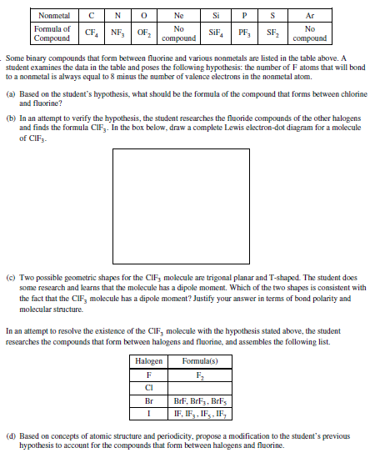
Unit 2 Practice Problem - 2014 IPE #5

Slide 15
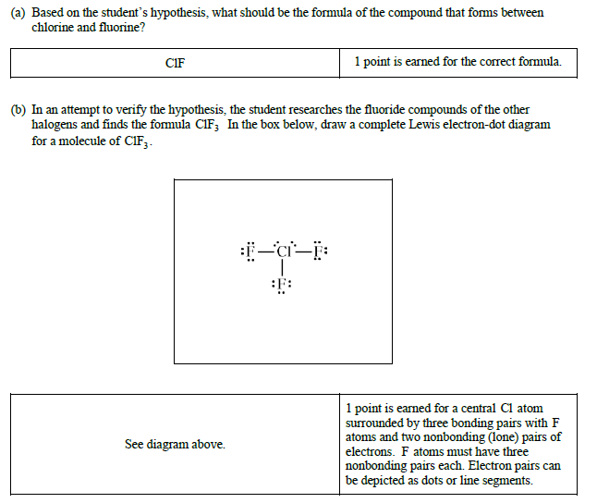
2014 IPE #5 Scoring Guidelines and Things to Notice
Be sure that your handwriting shows clearly that this is ClF with correct capitalization and order of the atoms
Be sure that you clearly denote the 3 bonds between the Cl and the 3 F atoms and that you fully complete the 3 lone pairs around EACH F atom and the 2 lone pairs on the Cl

Slide 16
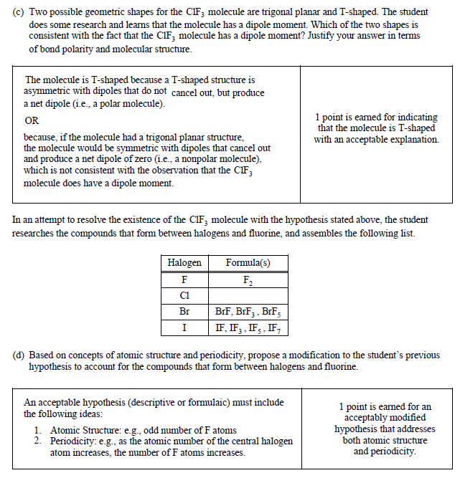
2014 IPE #5 Scoring Guidelines and Things to Notice (cont.)
Note that just saying “T Shaped” would not earn the point here – the correct geometry AND the justification are both needed
The prompt says “in terms of bond polarity and molecular structure” – in addition to the geometry, the dipoles must be referenced
The prompt says “based on concepts of atomic structure and periodicity” – both must be referenced to earn this point

Slide 17
Unit 3: Intermolecular Forces and Properties
Write This… | …Not That! | Rationale
Hydrogen bonding, dipole-dipole, London dispersion forces, etc. when asked to identify intermolecular forces | Ionic bonds, covalent bonds, metallic bonds when asked to identify intermolecular forces | Intermolecular forces are attractions between molecules; bonds are intramolecular forces (within molecules)
Discussion of ALL intermolecular forces when prompted to do so | Neglecting IMFs that may be weaker | If asked to state all IMFs, all points will not be earned if some of the IMFs are not stated (ref. 2018 #4a and 2019 #2c)
“Has hydrogen bonds between the molecules” | “Has hydrogen bonds” | Is unambiguous - Shows that you understand hydrogen bonds are not actually bonds
Electrical conductivity is a property of an ionic solution due to the charges on the dissociated ions | Electrical conductivity is due to the ionic precipitate, electrical conductivity is due to the water | Conductivity is due to the ability of a ion to carry charge; precipitate would not influence in solid form; pure water is non-conductive, (ref. 2019 #3e)
“Overcome intermolecular forces” | “break up” a solid/liquid, break covalent bonds | IMFs should be used to justify phase changes
Ion interactions when discussing ionic compounds | LDF’s when discussing ionic compounds | Ionic compounds have ions with whole charges, which dominate interactions
“Coulombic attraction” | “Opposites attract” | State the actual reason not the memory aid
Describe the process of overcoming intermolecular forces/polarity | “Like dissolves like” | State the actual reason not the memory aid
Identify specific intermolecular forces at play | “stronger intermolecular forces” | Shows your understanding of the particulate-level chemistry

Slide 18
Unit 3: Intermolecular Forces and Properties
(cont.)
Write This… | …Not That! | Rationale
Recognizing the difference in number of hydrogen bonding sites when comparing physical properties | Treating all species that form any amount of hydrogen bonds the same | The number of available hydrogen bonding sites impacts the physical properties (Ref 2022 #4b)
LDFs increase with an increasing number of electrons and therefore polarizability | LDFs increase with increasing size/mass | Increased number of electrons in an atom is what increases LDF; increased size is not the reason for increased strength of LDF
Intermolecular forces in discussing physical properties (MP, BP, solubility, etc): “Stronger intermolecular forces increase boiling point” | Intramolecular forces (“bonds”) in discussing physical properties: “Stronger covalent bonds increase boiling point” | Bonds are not broken and so intramolecular forces are not the determining factors for physical properties (phase changes, solubility) (ref. 2018 #4a, 2019 #2c, 2022 #4b)
Pressure is caused by the collision of gas particles with the walls of a container. | Pressure is caused by the collision of gas particles. | Unclear wording – implies pressure is caused by gas particles colliding with each other not with the container (ref. 2019 #4c)
Use R value with corresponding units to those used in work (and correctly report final unit) | R value with mismatched units | Units used in Ideal Gas Law must match units on the R value (ref. 2018 #4b and 2019 #2d)
Comparison of R_{f} values in chromatography | Comparison of absolute height of spots on chromatograms | Take into account a difference in the distance the solvent front travelled between different chromatograms (ref. 2017 #4)
Discussion of intermolecular forces between analyte molecules and stationary/mobile phases | Repulsions between analyte molecules and stationary/mobile phases | The movement in chromatography is determined by the attraction for the stationary/mobile phase (ref. 2017 #4)
“Solution” when an ionic compound is dissolved in water | “Liquid” instead of solution | An ionic compound dissolved in water is a solution, not a liquid (the word liquid indicates a molten compound) (ref. 2019 #3e)

Slide 19
Unit 3: Intermolecular Forces and Properties
(cont.)
Write This… | …Not That! | Rationale
Particle view diagrams with ions and polar molecules orientated in the correct direction relative to each other | Incorrectly oriented dipoles | Drawings must demonstrate understanding of interactions at the molecular level (ex. 2015 #4)
Solutions are prepared using volumetric flasks (most often), or most precise glassware provided in prompt | Solutions are prepared in beakers or graduated cylinders | Volumetric flasks are designed to make precise solutions and are only marked at 1 volume, they are filled so the bottom of the meniscus rests on the calibration mark after the solid has been completely dissolved (Ref. 2021 #3e, 2022 #3c)

Slide 20
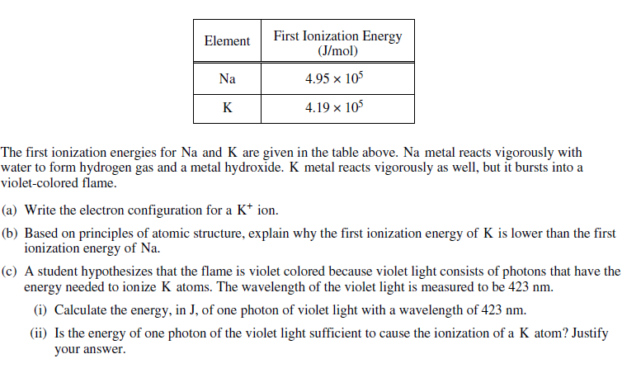
Unit 3 Practice - 2016 IPE #5

Slide 21
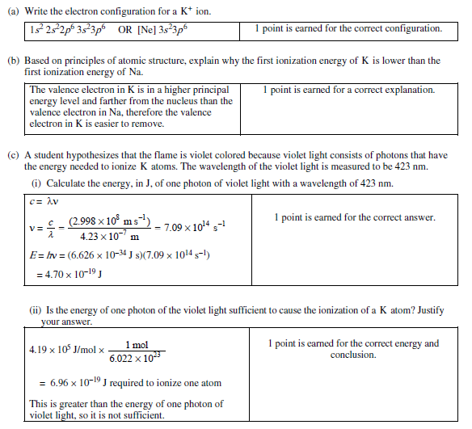
2016 IPE #5 Scoring Guidelines and things to notice
Because this is K+, the valence electron is absent
Both K and Na are mentioned, by using their symbol/name, and a comparison between the two is made
Units are noted in the work so that it is easy to follow
Correct units and sig figs are used – while not required to earn this particular point, they are often required
Units are noted in the work so that it is easy to follow
Notice that the math alone would not earn the point – the correct energy AND the application of the calculation to the conclusion are necessary

Slide 22
Unit 4: Chemical Reactions
Write This… | …Not That! | Rationale
Net ionic equations only containing species that change | Aqueous ionic compounds in their undissociated form, spectator ions | Including these is not a net ionic, it’s a molecular or complete ionic
Polyatomic ions that are shown as a compound with the correct charge in solution | Polyatomic ions that are broken down into elemental ions in solution | Polyatomic ions themselves do not dissociate in solution, they only dissociate from the other ion in an ionic compound
Net ionic equations with correct species, ionic charges and stoichiometric coefficients | Net ionic equations that contain incorrect formulas or ions without associated charges or that are not stoichiometrically balanced | Net ionic equations must correctly represent the ions and other species (ref. 2018 #6a, 2019 #3a, 2021 #1di)
Determination of the concentration of an analyte in a titration that takes into account the stoichiometry of the reaction | Applying M₁V₁=M₂V₂ as a blanket method for determining concentration at an end point if the stoichiometry is not 1:1 | While acid-base titrations are often 1:1, not all titrations (especially REDOX titrations) follow this stoichiometry; in situations that are not 1:1, the stoichiometric ratios must be accounted for in calculations (ref. 2018 #3e)
Justification of whether a species is oxidized/reduced by referencing oxidation numbers | A justification of oxidation/reduction that uses charge on an ion | Oxidation numbers are assigned to individual atoms in the reaction, and they are not automatically the same as the charge in a polyatomic ion (ref. 2019 #7a, 2022 #2a)
Particle view diagrams that pay respect to stoichiometric ratios | Ignoring stoichiometry in particle views | Must show ions dissociated with the correct ratios relative to the molecular formula/reaction that may be at play/limiting and excess reagents (ref. 2018 #2a, 2019 #3b, 2023 #7a)

Slide 23
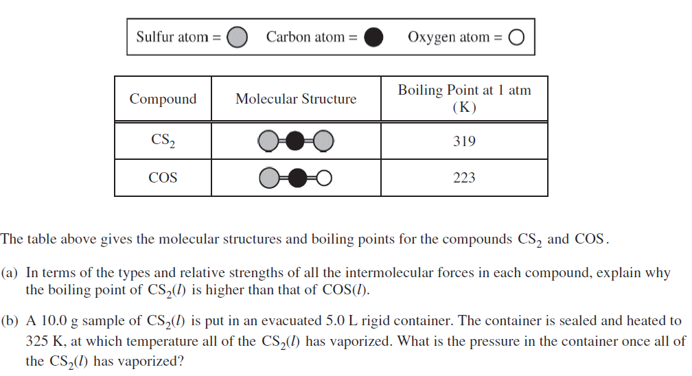
Unit 3-4 Practice – 2018 FRQ #4

Slide 24
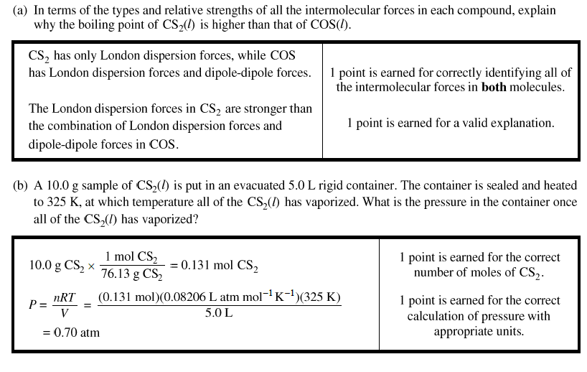
2018 FRQ #4 Scoring Guidelines and Things to Notice
Prompt states ALL intermolecular forces; first point is not earned without saying all IMFs for both molecules
In the explanation discuss the CS₂ relative to the COS – your answer should match the prompt
The point could be earned even if you combined the math into one entry in your calculator – units and labels are important so the reader can award you this implicit point
The answer must include units to be awarded the second point

Slide 25
Unit 5: Kinetics
Write This… | …Not That! | Rationale
A rate law based only on reactants | A rate law that includes products | Rate laws are based only on reactants
A rate law that includes the rate constant k as part of it | A rate law without k being included | Incomplete rate law if k is not included
Value of k with units | Value of k without units | Units required to earn point (Ref 2022 #5a)
Specific parts of the molecules that must collide in order for the reaction to occur | “Collision must occur in the correct orientation” | Show your understanding of the collision theory
A validation of a proposed mechanism by showing that the rate law matches the slow (rate-determining step) and the mechanism matching the overall stoichiometry for the reaction. | A justification of a mechanism just by saying “it matches the rate law” or “the intermediates cancel to give the overall process”. | The rate law must be discussed as matching the rate-determining step, and the overall stoichiometry should always match for any proposed mechanism – an understanding of the rate determining step must be demonstrated. (ref. 2019 #6b, 2022 #5b)
Recognizing that the half-life is constant for a first-order reaction | Failing to recognize that half-life is constant for a first order reaction | Half life is constant for first order reactions only and can be used to identify a first order of a reaction if given time versus concentration data

Slide 26
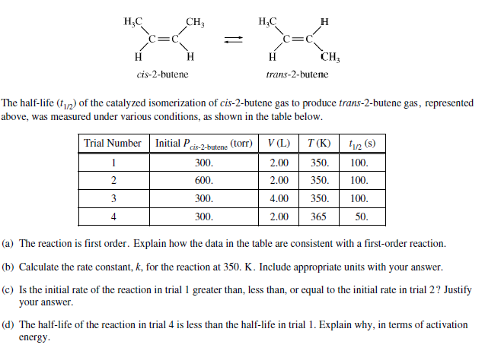
Unit 5 Practice – 2014 IPE #7

Slide 27
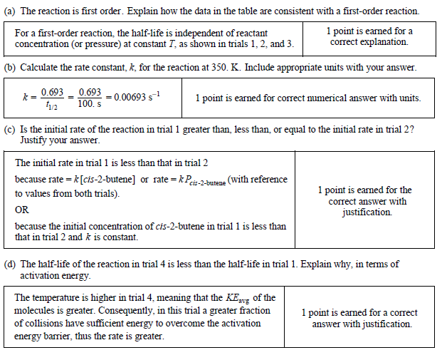
2014 IPE #7 Scoring Guidelines and Things to Notice
The answer needs to reference the data table so that it meets the requirements in the prompt.
The answer must include units to be awarded the point.
First answer the question by choosing one of the listed options (for trial 1).
Then justify
Both parts must be included in order for the point to be earned
The answer must be justified relative to activation energy – just stating the KE is greater will not be enough.

Slide 28
Unit 6: Thermodynamics
Write This… | …Not That! | Rationale
“Thermodynamically favorable”, “thermodynamically feasible” | “Spontaneous” | Preferred AP language
Values with correct signs | Values with incorrect signs | Necessary for correct calculations and determinations – watch signs based on bonds breaking/forming, heat flow in calorimetry indicated by temperature changes, signs that may change in application of Hess’ Law, etc.
Changing the sign of q_{system} when using the value of q for surroundings | Using the q_{system} value for calculations involving the surroundings without changing the sign | q_{system} = -q_{surroundings} (Ref. 2021 #3b)
Using values of q recognizing that it is the amount of energy absorbed/released during a thermodynamic change | Using values of q interchangeably as values of ΔH without taking the entire situation into account. | ΔH and q do not have identical meaning; ΔH is the enthalpy change for a reaction, q is the overall amount of heat exchanged ; Stoichiometric relationships, the component of the system being examined, etc. may influence how q should be manipulated to determine ΔH (ref. 2018 #1)
In using q=mcΔT for solutions, using mass of ENTIRE solution for m | Using mass of only one component of solution | When using q=mcΔT, the mass of the entire system being examined must be used
Using both q=mcΔT and heat of fusion/vaporation calculations for a situation in which a substance goes through both a phase change and a temperature change | Using only q=mcΔT for a situation in which a substance goes through both a phase change and a temperature change | When a substance experiences a temperature change and a phase change, the two quantities of heat are calculated separately and summed (Ref 2022 #1c)

Slide 29
Unit 6: Thermodynamics (cont.)
Write This… | …Not That! | Rationale
Use a thermometer to measure temperature values, and then subtract to find ΔT | Use a thermometer to measure ΔT | A thermometer doesn’t measure ΔT, it measures T values that can then be used to calculate ΔT (ref. 2019 #1e)
ΔH°=Σ(enthalpies of bonds broken) –Σ(enthalpies of bonds formed) when calculating ΔH°_{rxn} from bond energies | ΔH°_{rxn} = ΔH_{products} – ΔH_{reactants} when calculating ΔH°_{rxn} from bond energies | Applying the wrong formula will give an incorrect sign for the ΔH°_{rxn} (ref. 2017 #2b)
Multiplying bond energy values by stoichiometric factors as well as number of bonds in a molecule when calculating ΔH from bond energies | Only using number of bonds in a single molecule without taking stoichiometric factors into account | Stoichiometry factors represent the number of molecules taking part in the reaction, so number of bonds in a single molecule must be multiplied by this coefficient (ref. 2019 #2g)

Slide 30
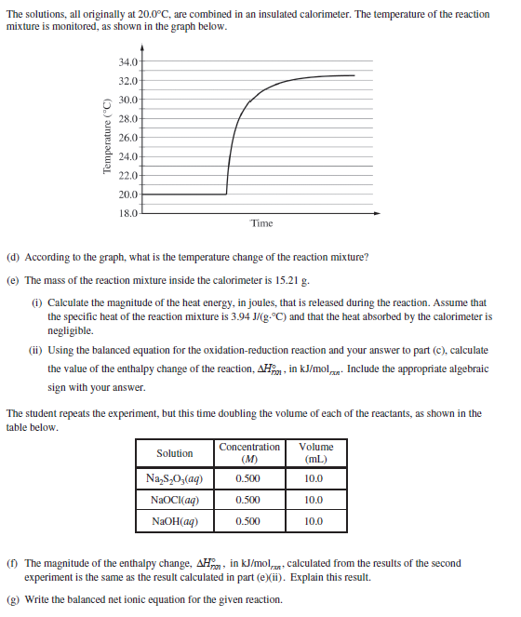
Unit 6 Practice – 2018 FRQ #1 (parts d-g)

Slide 31
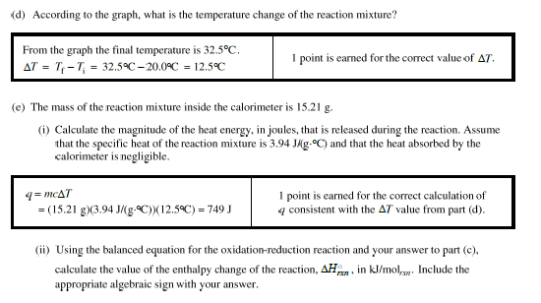
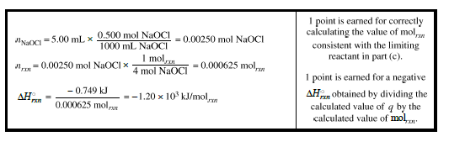
2018 FRQ #1 Scoring Guidelines and Things to Notice
Notice that there is no double-jeopardy – a wrong value from part (d) used correctly here earns point
Be sure work is represented so that all intermediate work can be recognized -even if you don’t stop to get an answer – so you can earn full points
Missing negative sign would not earn the point
Show work so that maximum points can be earned

Slide 32
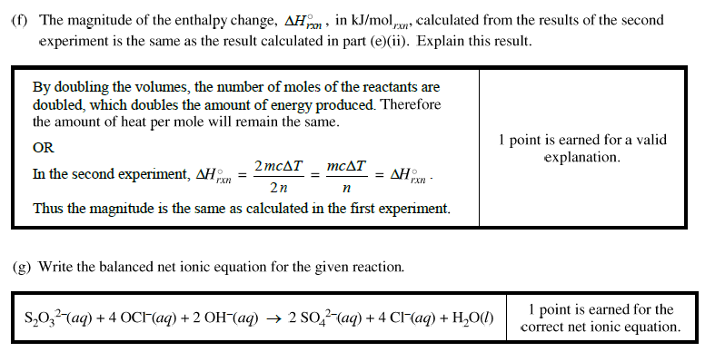
2018 FRQ #1 Scoring Guidelines and Things to Notice
Answer must be clear and easy to follow; also, both cause and effect are noted
Correct charges and stoichiometric factors must be included

Slide 33
Unit 7: Equilibrium
Write This… | …Not That! | Rationale
Beginning K expressions with K= | Not including K= at the beginning of a K expression | K expressions must begin with K= (Ref 2021 #1a)
Correct formulas (including charges!) for all species in equilibrium expressions | Substitutions, abbreviations, chargeless ions, other shorthand that may work out in calculations but does not represent the correct species | Equilibrium expressions must be written formally when requested
K expressions that include only aqueous and gases species | K expressions that include solid and liquid species (including water) | Solids and liquids are not included in K expressions (Ref 2021 #1a)
In K_{p} expressions: P_{species} | In K_{p} expressions: [species] | Concentration (which is indicated by brackets around the species) is not used in K_{p} - partial pressures are
K expressions with EITHER concentration “[ ]” or partial pressures “P” | K expressions that include both concentration “[ ]” and partial pressures “P” in the same expression | Equilibrium expressions are written for either concentration values or partial pressure values, not both at the same time in a single expression (ref. 2019 #2e)
K without units | K with units | K is a unitless constant
“K is greater than 1, indicating that the products are present in a higher concentration and therefore equilibrium lies to the right” | “K is large” | Use specific values to demonstrate understanding about the meaning of K relative to the equilibrium position (ref. 2017 #2d)

Slide 34
Unit 7: Equilibrium (cont.)
Write This… | …Not That! | Rationale
“Proceeds” | “Shift” – if equilibrium has not yet been established (i.e. a precipitate has not yet been formed when evaluating K_{sp}) | If equilibrium is not yet established, then it cannot “shift” – rxn will proceed in a certain direction until equilibrium is established
Calculations of K expressions that use concentrations/partial pressures at equilibrium | Calculations of K expressions that use initial concentrations/partial pressures | K values can only be calculated using equilibrium values; if initial values are given, an ICE table (or similar method) should be used to determine equilibrium values before calculating the K value (ref. 2018 #5b)
Using stoichiometric factors in ICE tables | Neglecting stoichiometry when calculating change in equilibrium scenarios | Stoichiometry ratios impact how much an initial value is changed during the establishment of equilibrium (ref. 2019 #2f)
“x has been assumed to be so small relative to the original concentrations that it can be ignored” | Nothing about why you ignore x to avoid quadratics | Show you understand why you are making the decision
Discussion of Q vs. K | “reduce the stress”, or “due to Le Châtelier’s Principle” | Preferred AP language-shows a deeper understanding of chemical principals (ref. 2018 #5c, 2022 #2g)
K_{sp} expressions that only contain the ions | K_{sp} expressions that contain or imply a species in the denominator | Solids and liquids are not included in equilibrium expressions
Answers that consider whether a new system has been created that will reach equilibrium or an established system at equilibrium is being disrupted | Assuming that all new conditions utilize Le Châtlier’s Principle | There is a difference between stressing an established equilibrium (Q vs K and Le Chat discussion) versus creating a new system that utilizes the same reaction (K calculations/ICE tables) (ref. 2023 #7c)

Slide 35
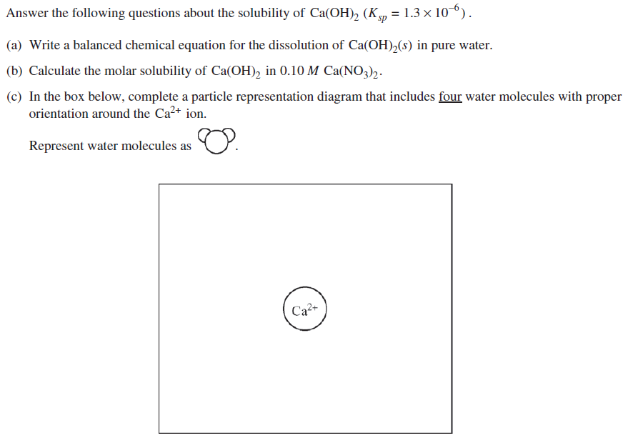
Unit 7 Practice – 2015 FRQ #4

Slide 36
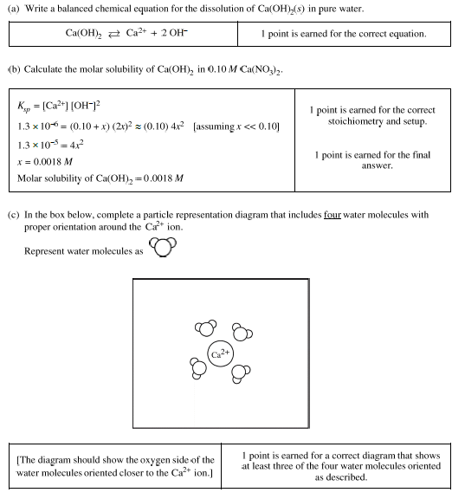
2015 FRQ #4 Scoring Guidelines and Things to Notice
Correct stoichiometry and charges must be included to earn the point
Show work so that maximum points can be earned – no work would not earn the first point
Be sure to pay attention to direction in prompt

Slide 37
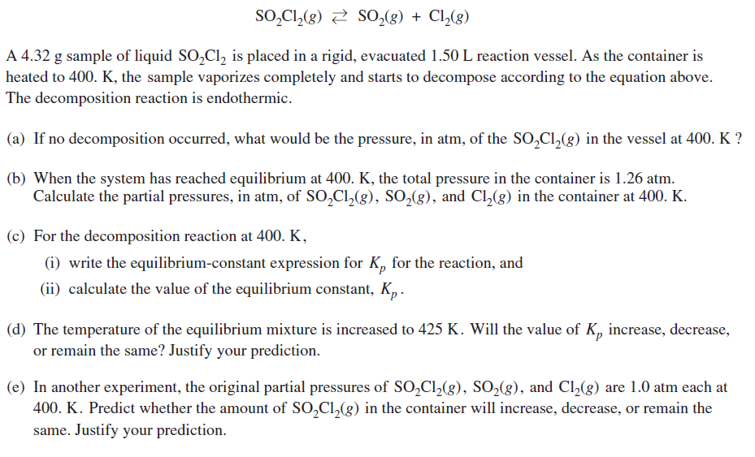
Unit 7 Practice – 2013 IPE #3

Slide 38
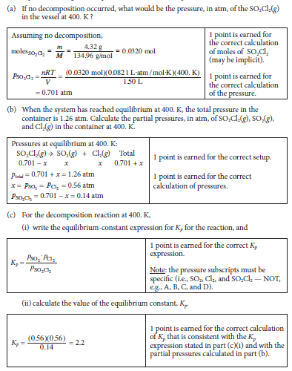
2013 IPE #3 Scoring Guidelines and Things to Notice
Show work so that maximum points can be earned – do not have to stop and show value of moles, but work must demonstrate process to calculate it
Again, SHOW ALL WORK
Be specific in responses, using proper names/formulas
Must use P notation here, NOT [ ]

Slide 39
Unit 8: Acids and Bases
Write This… | …Not That! | Rationale
“The solution is neutral when [H₃O⁺] = [OH⁻].” | “The solution is neutral when pH=7.” | True definition of neutral – neutral is only pH of 7 when K_{w} = 1.0 x 10⁻¹⁴ (at 298 K)
“The pH > 7 because the salt produced in the neutralization behaves as a base: A⁻ + H₂O HA + OH⁻ ” | “The pH > 7 because it’s a battle between weak acid and strong base and strong base wins.” | State the actual reason not the memory aid
HCl, HBr, HI, HClO₄, HNO₃ as strong acids | Any other acid as strong | These are the strong acids listed in the Course and Exam Description
K_{w} = K_{a} x K_{b} for a conjugate pair | K_{w} = K_{a} x K_{b} for an unrelated acid/base pair | This equation only holds true for conjugate acid-base pairs
A buffer system containing a weak acid and its conjugate base (or a weak base and its conjugate acid) | A buffer system that contains a strong acid or base; a buffer containing any acid/base with a common ion | A buffer results from the presence of a weak acid or base and its conjugate; a strong-strong system will neutralize without buffering
“This buffer has a higher buffering capacity because it contains a higher concentration of weak acid/base and its conjugate to react with added H⁺ or OH⁻ ions.” | “Higher volume of weak acid/base” | Buffering capacity is related to the presence of both the weak species and its conjugate.
Identifying a salt as making a good choice for a specified buffer because the pK_{a} is close to the desired pH for the buffer. | Identifying a salt as making a good choice for a specified buffer because the pK_{b} is close to the desired pH for the buffer. | An effective buffer is one in which is pKa of the weak acid is approximately equal to the target pH. (ref. 2019 #3h)
Answers that justify the relative concentrations of weak acid and conjugate base to the half-equivalence point on a titration curve | Answers that fail to recognize the importance of the half-equivalence point | Considering the position of a weak acid/strong base titration curve relative to the half-equivalence point can be used to deduce features of the titration because at this point pKa=pH and [WA]=[A-] (Ref 2022 1e)

Slide 40
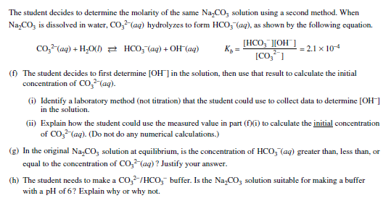
Unit 8 Practice – 2019 Operational #3 (parts f-h)

Slide 41
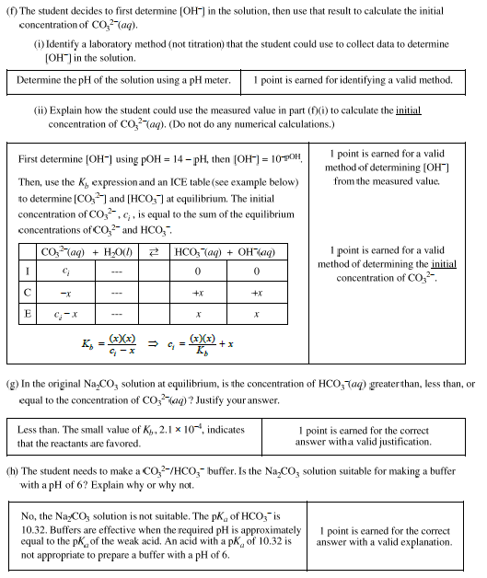
2019 Operational #3 Scoring Guidelines and Things to Notice
Show work so that maximum points can be earned – they must be able to see how you calculated [OH-]
Read the prompt carefully – this required initial, where often we are working with equilibrium values
A buffer is a good choice when the pK_{a} is close to the desired pH – be sure to discuss the pK_{a} not the pK_{b}

Slide 42
Unit 9: Applications of Thermodynamics
Write This… | …Not That! | Rationale
Reference number of molecules and phases when justifying a change in ΔS based on a reaction | Making vague references to “similar structures” or no justification | An increase in ΔS is due to an increase in number of gaseous products (ref. 2017 #2c)
Multiplying ΔS° values by stoichiometric factors when calculating ΔS°_{rxn} | Ignoring stoichiometry when calculating ΔS°_{rxn} | Correct application of the equation ΔS°_{rxn =} ∑ ΔS°_{products} - ∑ ΔS°_{reactants} (Ref. 2021 #2e, 2022 #2b)
Using consistent units when applying ΔG = ΔH-TΔS | Not having all 3 thermodynamic factors in the same unit (either kJ or J) | Units must be consistent when used in equations (Ref. 2022 #2cii)
Justify thermodynamic favorability in terms of both enthalpy and entropy | A thermodynamic favorability discussion referencing only enthalpy or entropy | Thermodynamic favorability depends on both ΔH and ΔS
Arrangement/Dispersions of matter or energy along with particle-level reasoning for explaining the sign of ΔS | Disorder, chaos | Disorder is the effect, not the cause, of an increase in entropy (ref. 2019 #1g)
ΔG determines thermodynamic favorability | Referencing ΔH or ΔS alone as determining thermodynamic favorability | All the thermodynamic properties contribute to favorability – hence using ΔG = ΔH-TΔS which takes all into account (ref. 2019 #1h)
Use of correct value of R with thermodynamic data (that corresponds to energy units) | R value that does not correspond to the units needed in the problem | Units of the R value must match those used in the problem, and correct units must be applied at the end, or the answer is incorrect (ref. 2018 #2b)

Slide 43
Unit 9: Applications of Thermodynamics (cont.)
Write This… | …Not That! | Rationale
“Ions flow through the salt bridge to maintain a charge balance in each half-cell.” | “Electrons flow through the salt bridge to equilibrate charge.” | Electrons do not flow through the salt bridge; ions flow through the salt bridge, electrons flow through the wire (ref. 2018 #6a)
Loss of mass of electrode is due to atoms of electrode going into solution as ions | Loss of mass of electrode is due to loss of electrons | Electrons have extremely small (negligible in this case) mass (ref. 2014 #3)
Discussion of Q vs. K for changes in cell potential after a change, or qualitative discussion of Nernst Equation | Discussion of Le Châtelier’s principle | An galvanic cell does not attain equilibrium while working – when it does, it stops producing current (is “dead”) (ref. 2014 #3)
An equation that is balanced with respect to both number of atoms and charge | An equation that is unbalanced in atoms, charge or both; an equation that shows electrons | Recognize that equations need to be balanced with respect to both atoms and charge – this means that half-reactions may need to multiplied by a coefficient to balance charge for the overall reaction, even if atoms are already balanced, and then the electrons on both sides cancel out and are not written (ref. 2018 #3d)
E° values that are positive for galvanic cells and negative for electrolytic cells | E° values that have the wrong sign | Galvanic cells are thermodynamically favorable as proceed as designed with a + E°, electrolytic cells are thermodynamically unfavorable with a - E° and require an external driving force (Ref. 2021#5b)
E° value not multiplied by stoichiometric factors | E° value that has been multiplied by a stoichiometric value | E° is intensive and therefore does not change if the half-cell is multiplied by a stoichiometric factor to balance charge (ref. 2018 #6b, 2022 3e)
Standard cell potential when discussing a REDOX reaction | Standard reduction potential when discussing a REDOX reaction | A redox reaction contains both oxidation and reduction; therefore the E° for the reaction is the sum of the standard reduction potentials of both the oxidation and reduction half-reactions

Slide 44
Unit 9: Applications of Thermodynamics (cont.)
Write This… | …Not That! | Rationale
When writing E°_{cell} for favorable redox reactions, one rxn must be reversed so that E°_{cell} is positive | An E°_{cell} that is negative for redox reactions that proceed in the forward direction | There has to be thermodynamic favorability, which depends on the E°_{cell}, in order for the rxn to work (ref. 2019 #2b)
Using the cell potential for E° in ΔG = -nFE° calculations | Using a half-cell potential for E° in ΔG = -nFE° calculations | This equation uses the full cell potential, not for a half-reaction (ref. 2018 #6b)
Performing calculations with mass and current (using Faraday’s constant) that account for the number of moles of electrons transferred | Performing calculations with mass and current (using Faraday’s constant) without considering the number of moles of electrons transferred | Stoichiometry between the moles of the target species and the moles of electrons transferred in the reaction must be included (Ref. 2021 #5c)

Slide 45
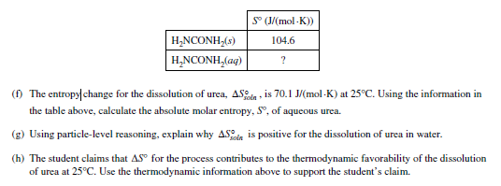
Unit 9 Practice – 2019 Operational #1 (parts f-h)

Slide 46
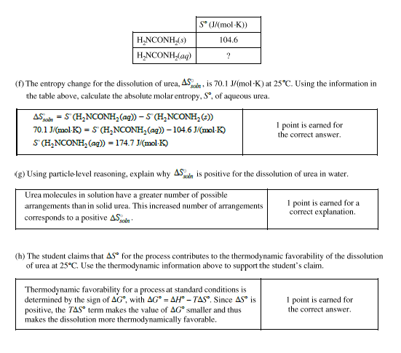
2019 Operational #1 Scoring Guidelines and Things to Notice
Make sure you do products-reactants
SHOW ALL WORK
Arrangement/Dispersions of matter or energy along with particle-level reasoning for explaining the sign of ΔS, not just staying “disorder increases” or “chaos increases”
ΔG determines thermodynamic favorability
Do not reference ΔH or ΔS alone as determining thermodynamic favorability

Slide 47
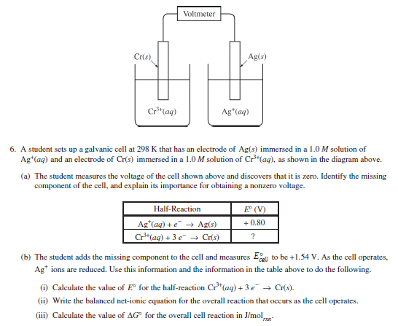
Unit 9 Practice – 2018 Operational #6

Slide 48
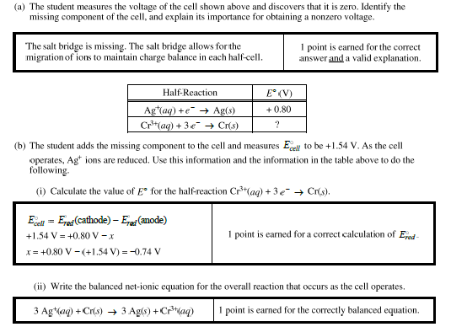
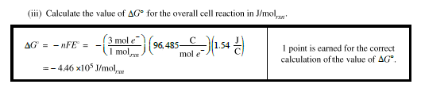
2018 Operational #6 Scoring Guidelines and Things to Notice
The point is not earned unless the missing component AND the importance are both included
REDOX equations must be balanced for both number of atoms AND number of electrons
The n is from the number of electrons transferred in the balanced equation
Use the cell potential for the entire cell (1.54), not for one of the half-reactions

