Slide 1


Slide 2
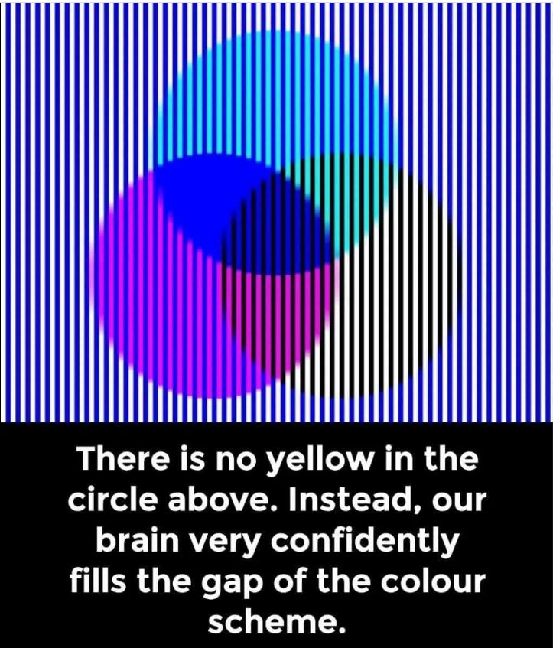

Slide 3
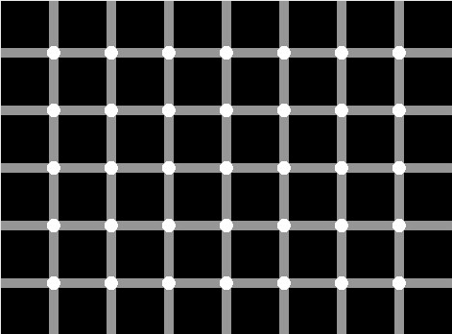

Slide 4
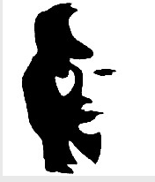

Slide 5
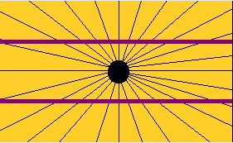

Slide 6
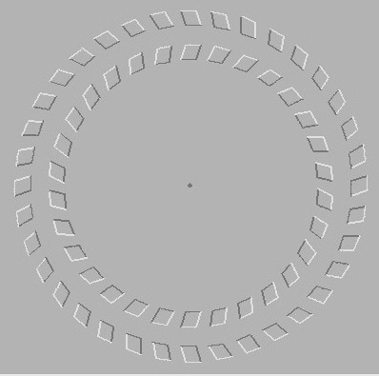

Slide 7
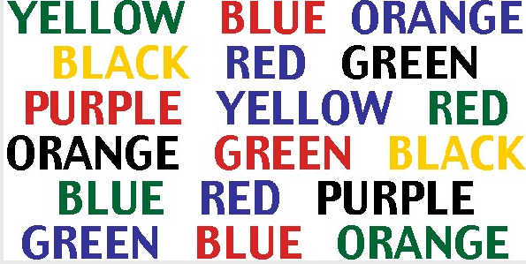

Slide 8
Yanny or Laurel?
https://www.theguardian.com/technology/2018/may/16/yanny-or-laurel-sound-illusion-sets-off-ear-splitting-arguments

