Slide 1

Mr. Johnson
Summer School
Chemistry 2026

Slide 2
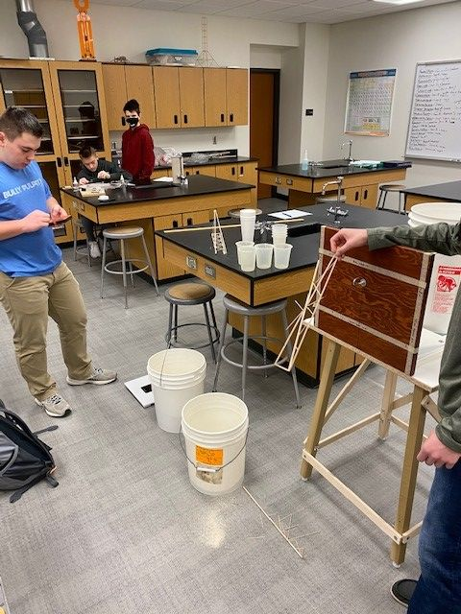
State Runner Up in Science Olympiad 2015, 2016, 2017, 2018, 2019, 2020, 2021, 2023;
State Champs 2022, 2024, 2025!
NSTA District IX Director: MN, ND, SD

Slide 3
Who is Mr. Johnson?
This is the start of my 28th year teaching in Bismarck.
It will be start of my 31st year of teaching.
I have taught at West Fargo High School, & Century High School. Chemistry, Biology, Anatomy, AP Chemistry.
I have 2 children: Mackenzie (Graduated Concordia – Chemistry, Biology; English); Riley (finished sophomore year @ Concordia – Chemistry & Biology)
My passions/hobbies are hunting, fishing, and my kids.

Slide 4

Welcome!
CHEMISTRY is an AWESOME Class! We will have a great time working together.
Classes start @ 7:30am and end at 1:30pm. Be on time & missing a day is like missing an entire 6-7 days during the regular school year.
All information will be on my LearnBPS site & it will be updated constantly!
We will have many labs & practice throughout the week. The class will cover most of what we cover in the regular school year. All supporting material is on LearnBPS!

Slide 5

What will Summer School look like?
Attendance is IMPORTANT; you are allowed 1 absence from summer school and then you are dropped.
Participate during lecture and labs. Don’t be afraid to ask questions or collaborate with the group.

Slide 6

How will I be graded?
I grade on total points. With that being said, it usually breaks down like this: 60% Tests & Quizzes; 20% Labs and Simulations; & 20% Homework.
Simulations might be videos, molecular modeling, PhET Simulations
Tests – you will see them listed online, but almost all of them are pencil/paper so I can grade the work.
Labs/Homework – online submissions, handouts, PDF’s

Slide 7

How can I succeed?
Have a great attitude! Attitude is everything.
Complete assignments on time and fully.
You WILL make mistakes – learn from them! Those mistakes will keep happening if you don’t address them.
Check LearnBPS, email every day.
Ask questions and be proactive! Be an ACTIVE participant in class and during labs.

