Slide 1
Atomic Structure
& Periodicity
Unit 1 Notes

Slide 2

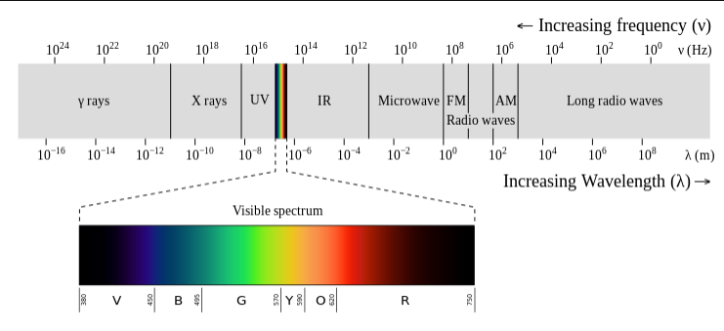
Chapter 7, Section 1: Energy of Electrons
Max Planck: Electromagnetic radiation follows equation E = h ∙ λ
  Energy (Joules) = Planck’s constant (6.63 X 10⁻³⁴) * frequency (Hz)

Slide 3
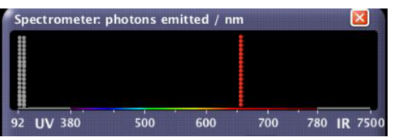
Chapter 7, Section 1: Energy of Electrons
Radiation moves at speed of light,
Energy can then be calculated by
Can then identify elements by energy emitted
c = λ ∙ v
c = 3.0 X 10⁸ m/sec
λ = wavelength
v = frequency
Planck’s equation
E = hv also E = h ∙ c
λ

Slide 4
Chapter 7, Section 1: Energy of Electrons
Emission spectrum lab

Slide 5
Chapter 7, Section 1: Energy of Electrons
EX 1: The blue color in fireworks is often achieved by heating copper (I) chloride (CuCl) to about 1200⁰C. Then the compound emits blue light having a wavelength of 450nm. What is the increment of energy (the quantum) that is emitted at 4.50 X 10² nm by CuCl?
EX 2: It takes 208.4 kJ of energy to remove 1 mole of electrons from an atom on the surface of rubidium metal. How much energy does it take to remove a single electron from an atom on the surface of solid rubidium? What is the maximum wavelength of light capable of doing this? What color range would this be?

Slide 6
Chapter 7, Section 1: Energy of Electrons
de Broglie used Einstein’s work (energy has mass) and surmised electron wavelengths:
  Smaller objects have larger wavelengths, larger objects have smaller wavelengths
EX 3: Compare the wavelength for an electron (mass = 9.11 X 10⁻³¹ kg) traveling at a speed of 1.0 X 10⁷ m/sec with that for a ball (mass = 0.10 kg) traveling at 35 m/sec.
λ = h (m ∙ velocity ∙ c)

Slide 7
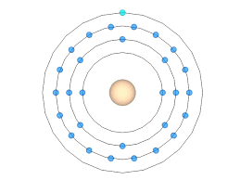
Chapter 7, Section 1: Energy of Electrons
Neils Bohr developed model for electron locations
As energy is added, e⁻ jumps levels & emits energy when collapses back to ground state.
EX 4: Calculate the energy evolved as an excited atom has an electron fall from n = 2 to n = 1. Calculate the wavelength of energy and the type of radiation needed to do this.
E _{electron} = - R_{H}
n²
R_{H} = Rydberg’s constant: 2.179 X 10⁻¹⁸ J

Slide 8
Chapter 7, Section 1: Energy of Electrons
Assignment #1: Problems 1-6

Slide 9
Chapter 7, Section 1: Energy of Electrons
Practice problems
Dr. Quantum video
Assignment: Take Home Quiz

Slide 10
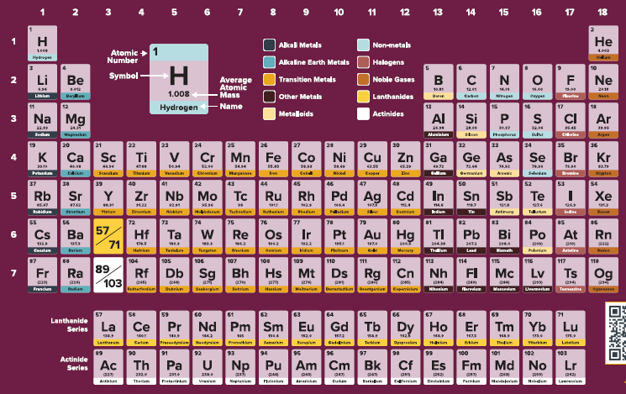
Chapter 7, Section 2: Location of Electrons
Electron configurations
Shell – an area where the electrons are located
Subshell – the shape of the area of the electrons
Orbital is a position in a subshell
EX 5: Draw electron configurations for the following atoms:
K
Sn
Cr
Ag
Pd

Slide 11
Chapter 7, Section 2: Location of Electrons
EX 6: Draw electron configurations for the following ions (atoms with a charge):
Ca
Se
Al
Cl

Slide 12
Chapter 7, Section 2: Location of Electrons
Quantum numbers
Principle quantum number (n): 1, 2, 3, 4… = shell
Angular quantum number (ℓ): 0 to n-1 = subshell
s = 0, p = 1, d = 2, f = 3
Magnetic spin quantum number (m_{ℓ}): = position in the orbital
s = 0
p = -1, 0, 1
d = -2, -1, 0, 1, 2
f = -3, -2, -1, 0, 1, 2, 3
Spin quantum number (s): +1/2 or -1/2 = spin of the electron

Slide 13
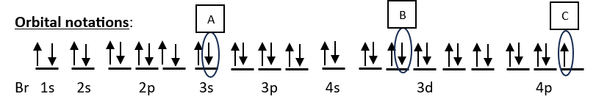
Chapter 7, Section 2: Location of Electrons
Pauli exclusion principle:
Br (Bromine) Atomic #35, Mass #80
Electron configuration notation: 1s²2s²2p⁶3s²3p⁶4s²3d¹⁰4p⁵
Quantum number set for A, B, and C?
EX: Assign quantum numbers for ALL the electrons in the Neon atom.

Slide 14
Chapter 7, Section 2: Location of Electrons
Assignment #2: Problems 1-10

Slide 15
Chapter 7, Section 2: Location of Electrons
Photoelectric spectrum (PES) video
NMSI handout
Assignment: Russ Mauer

Slide 16
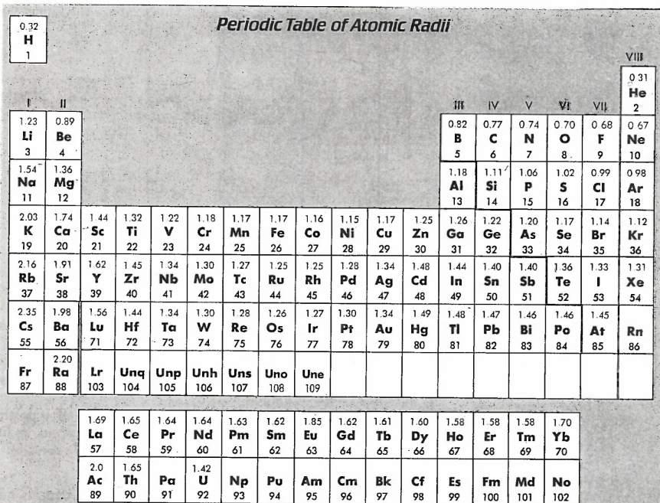
Chapter 7, Section 3: Periodicity
Atomic radii: smaller →, larger
Coulombs Law: U_{E} $∝$ q1*q2/d
Effective Nuclear Charge: the pull created by the protons in a nucleus
The size of ions
Anions
Cl: 1s²2s²2p⁶3s²3p⁵
Cl⁻: 1s²2s²2p⁶3s²3p⁶
Cations
Ca: 1s²2s²2p⁶3s²3p⁶4s²
Ca²⁺: 1s²2s²2p⁶3s²3p⁶4s⁰

Slide 17
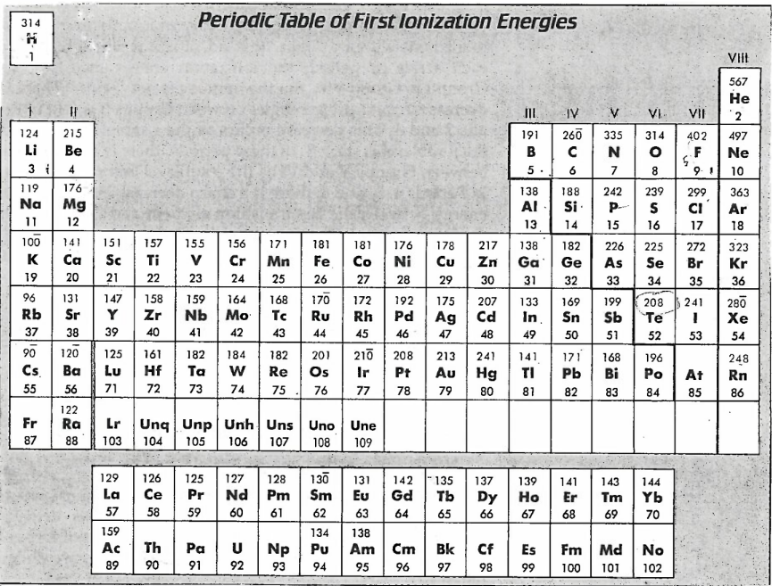
Chapter 7, Section 3: Periodicity
First Ionization Energy (energy required to give up electrons)
Increase →, decrease

Slide 18
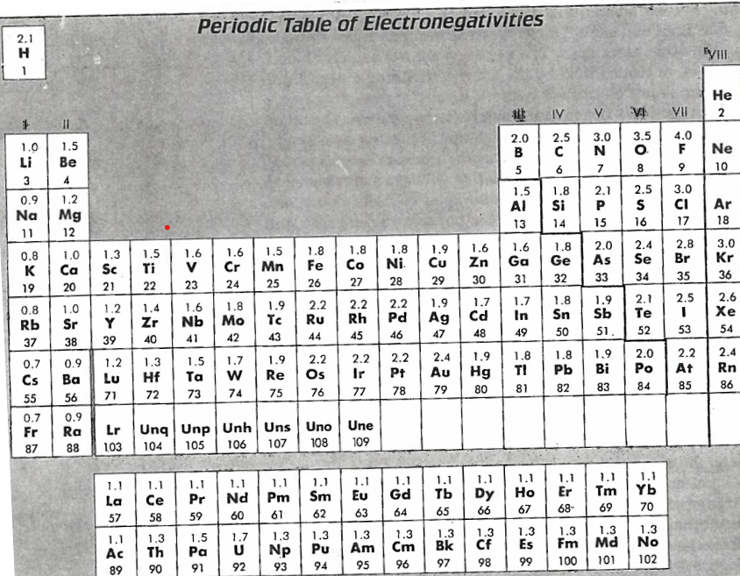
Chapter 7, Section 3: Periodicity
Electronegativity (force it exerts to take in electrons – “how much they like taking in electrons”)
Increase →, decrease

Slide 19
Chapter 7 – Unit wrap-up
Quiz: PES
NMSI problems
Review MCs

