Slide 1
Chapter 5
Histology (Tissues)

Slide 2
#1 Tissue Type
Epithelial Tissue

Slide 3
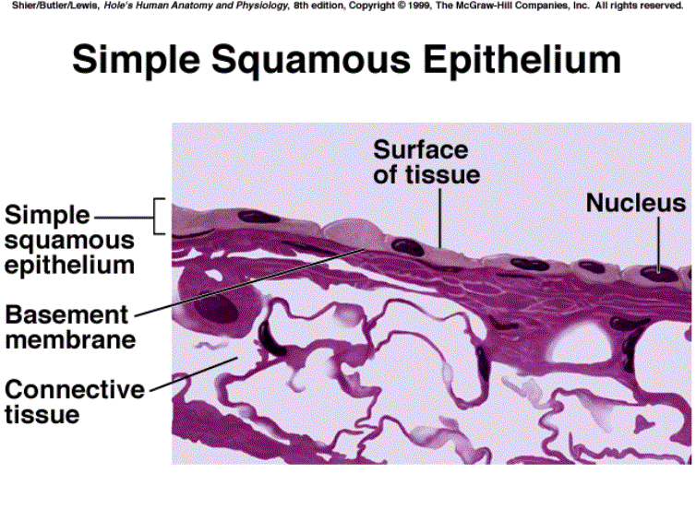

Slide 4
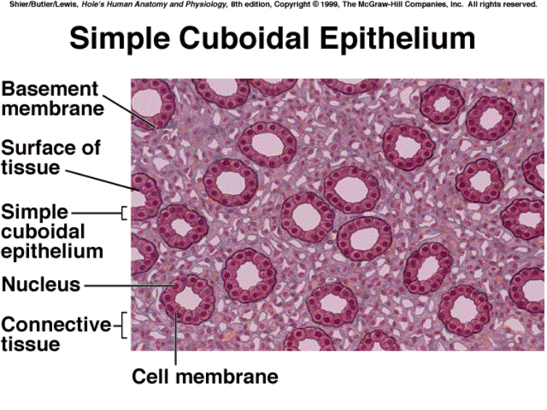

Slide 5
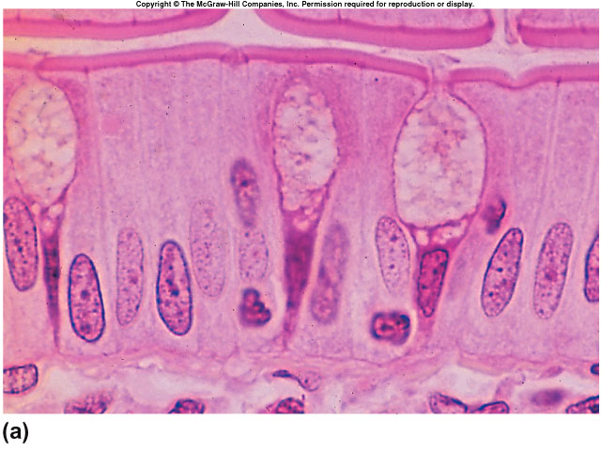

Slide 6
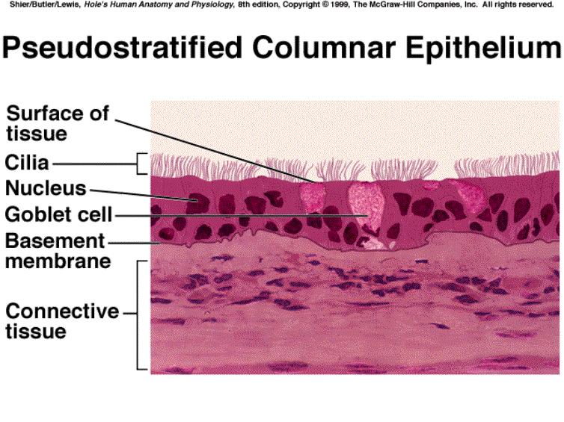

Slide 7
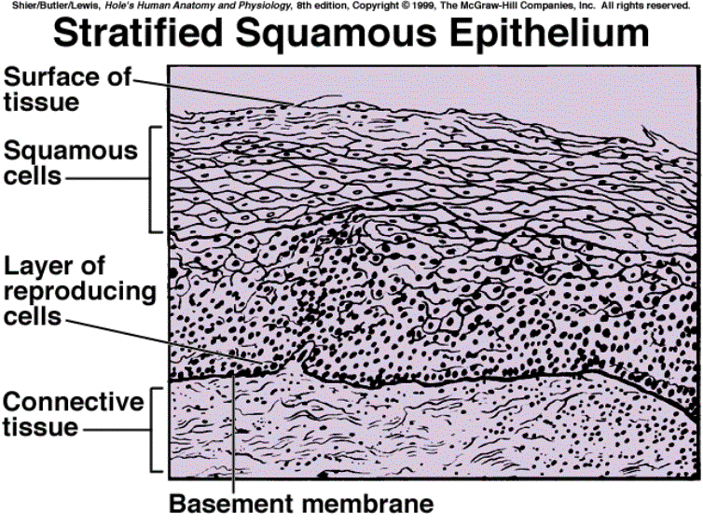
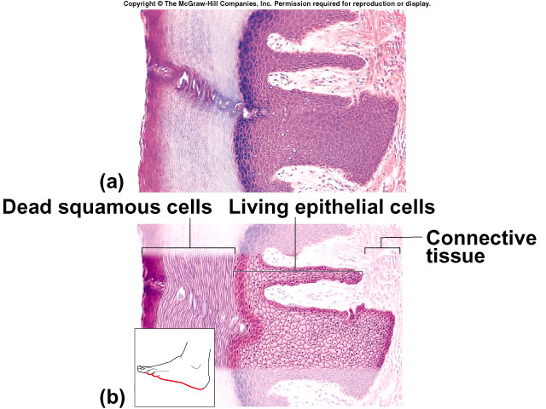

Slide 8
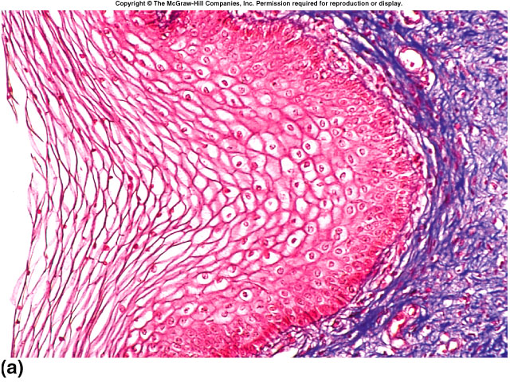

Slide 9
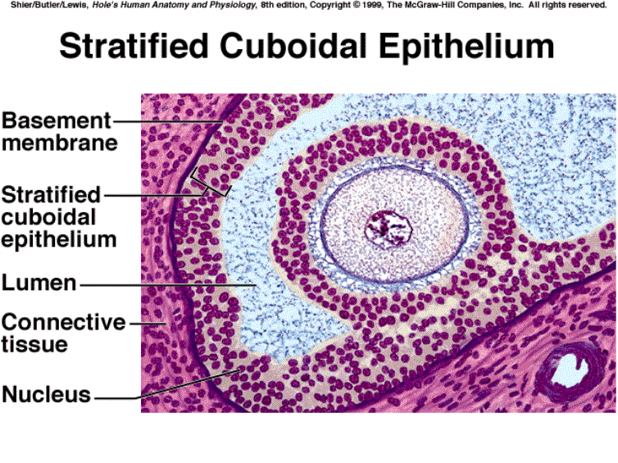

Slide 10
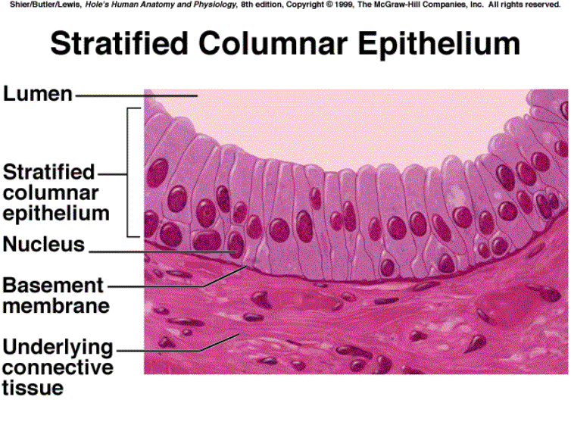

Slide 11
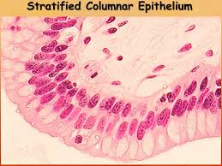

Slide 12
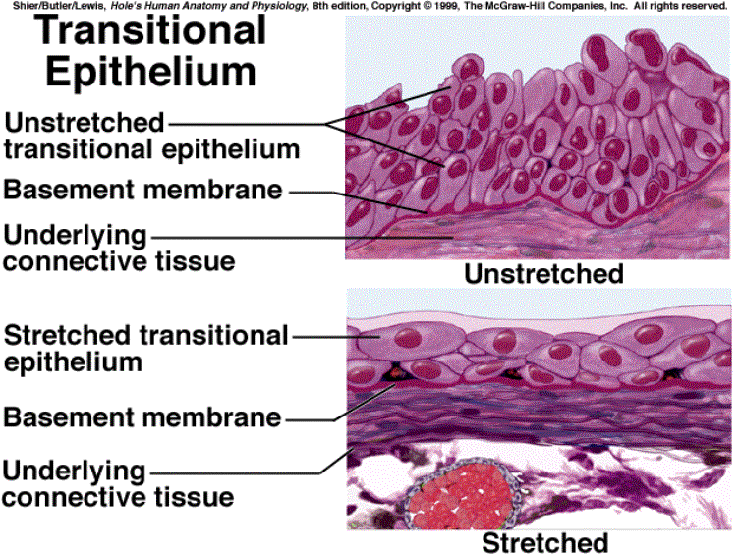

Slide 13
Endothelium
Mucous
Cutaneous
Serous
Visceral
Parietal

Slide 14
Glandular
Endocrine – into blood, entire body
Exocrine – into ducts, specific organ
Apocrine
Fill and overflow
Mammary glands
Holocrine
Fill and rupture
Acne (sebaceous oil glands)
Merocrine
Move substances out by exocytosis
Sweat glands, salivary glands

Slide 15
#2 Tissue Type
Connective Tissue
Mesenchyme
& Connective Proper

Slide 16
Connective Proper
Cartilage – Hyaline, Fibrocartilage, Elastic, Bone, and Blood

Slide 17
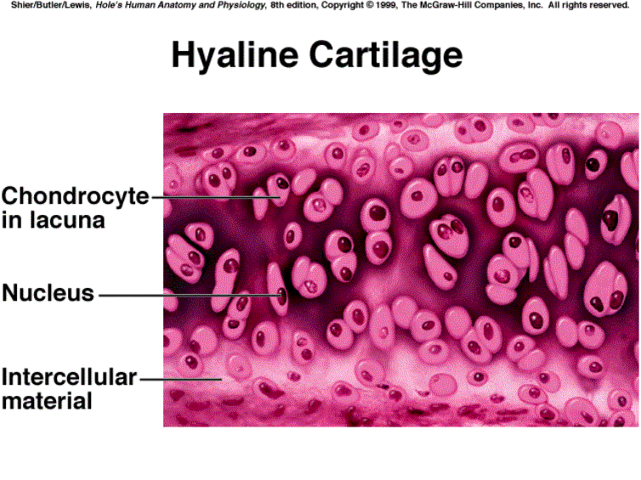


Slide 18
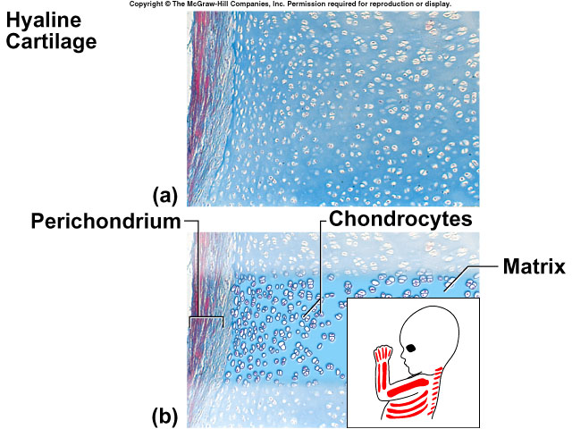

Slide 19
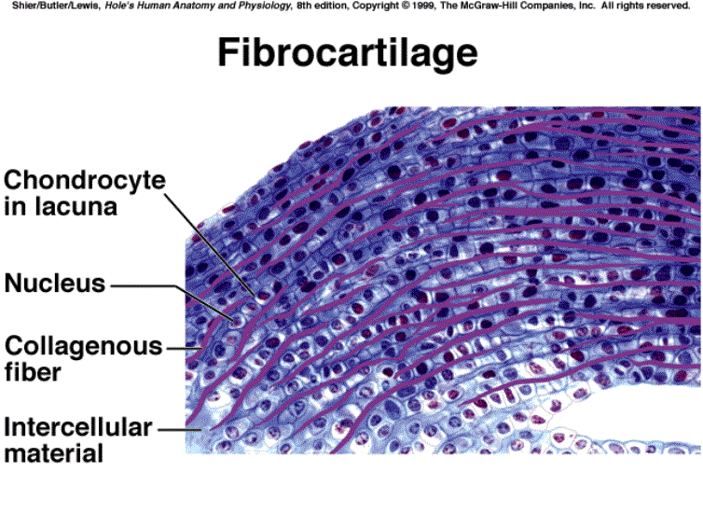


Slide 20
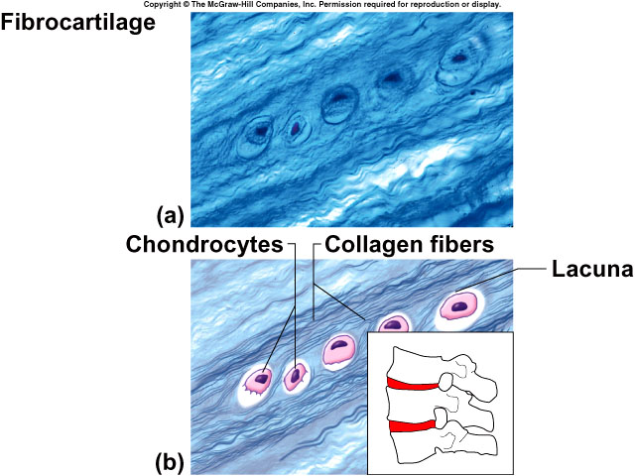

Slide 21
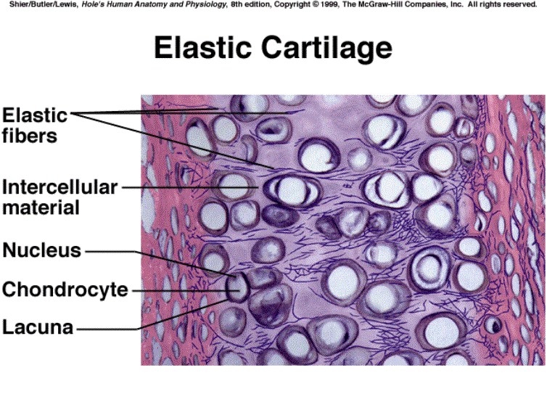


Slide 22
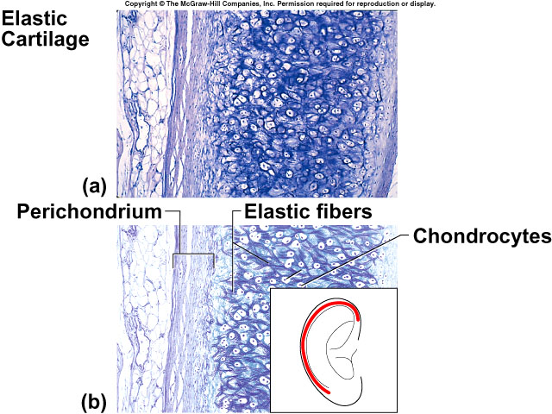

Slide 23
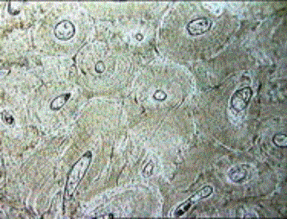
Bone
most rigid connective tissue
supports body structures
contains marrow which forms blood cells
bone cells=osteocytes

Slide 24
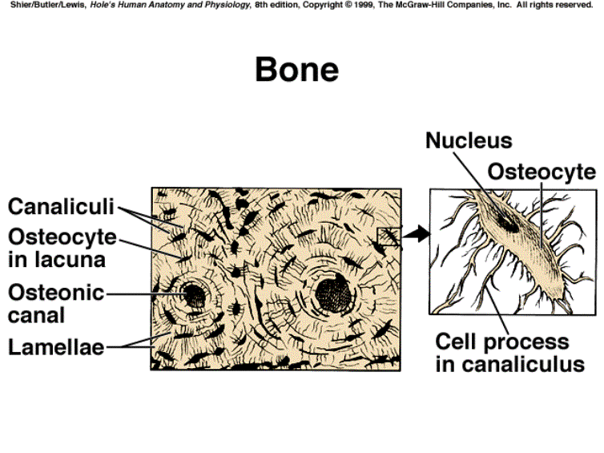

Slide 25
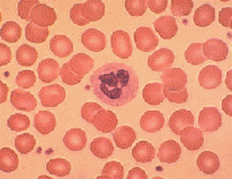
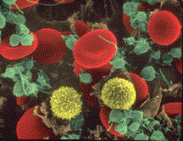
Blood
transports substances between cells
3 components
plasma (matrix)
red blood cells
white blood cells & platelets

Slide 26
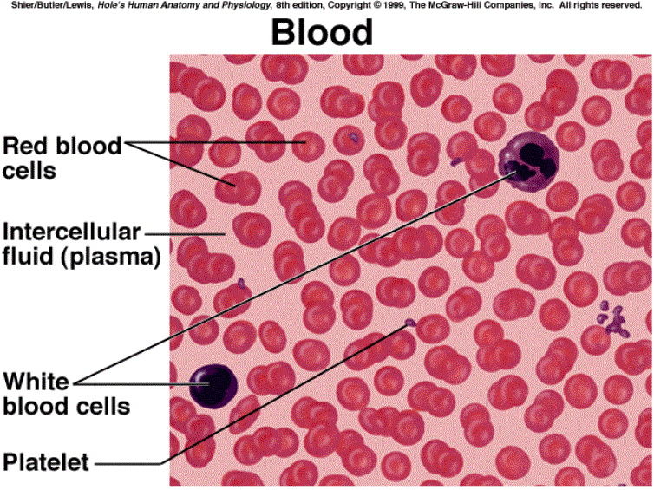

Slide 27
Connective Proper
Loose Tissue – Areolar, Adipose, Reticular

Slide 28
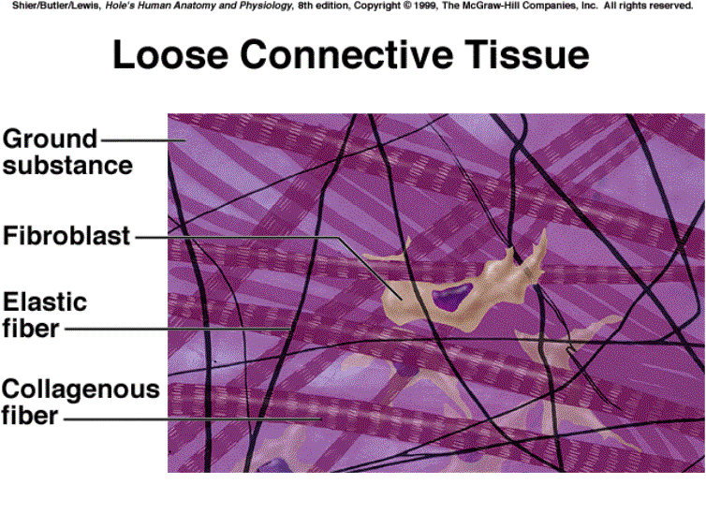

Areolar

Slide 29
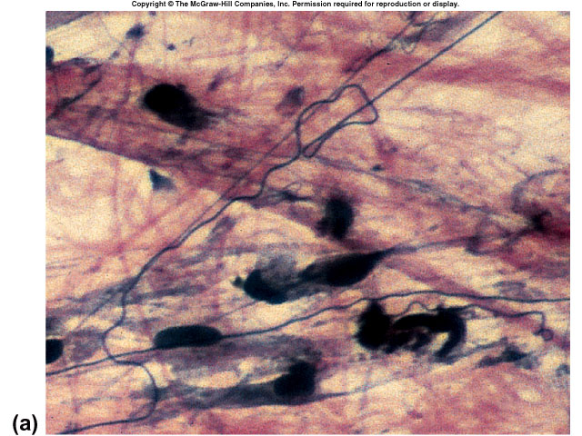
Areolar

Slide 30
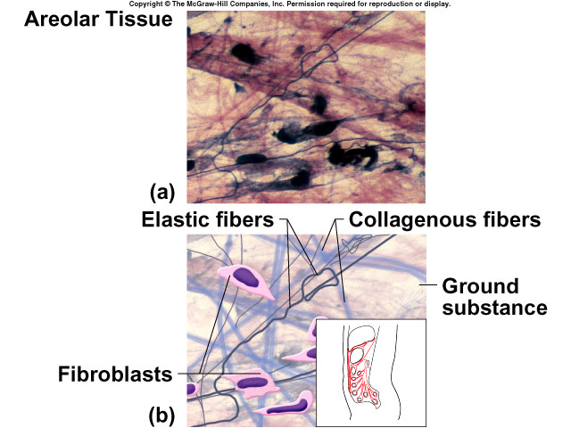

Slide 31
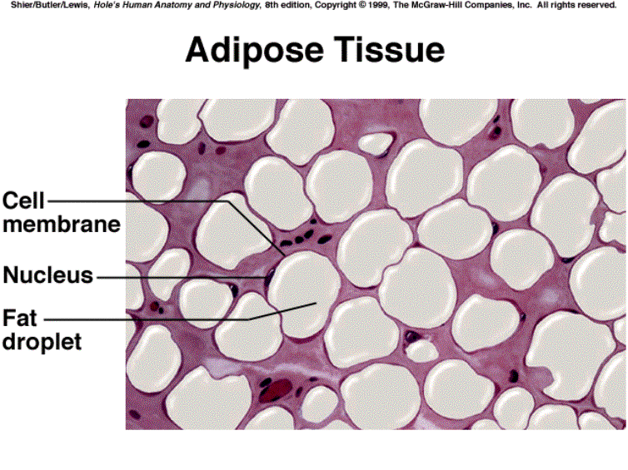


Slide 32
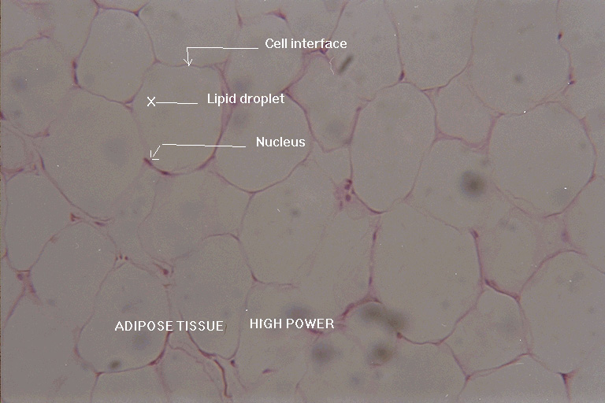
Adipose

Slide 33
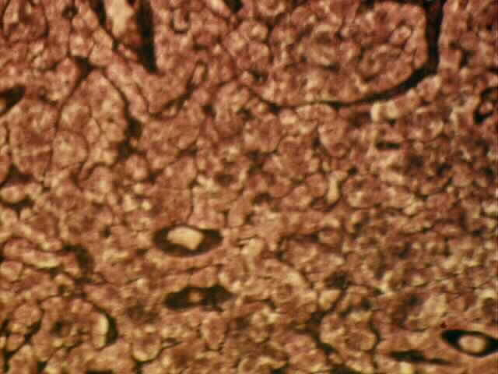
Reticular

Slide 34
Connective Proper
Dense – Regular, Irregular, and Elastic

Slide 35
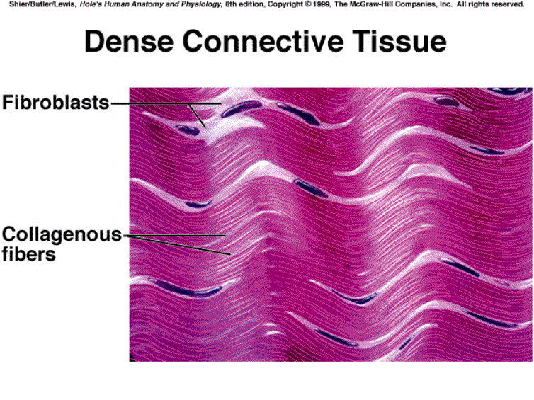


Slide 36
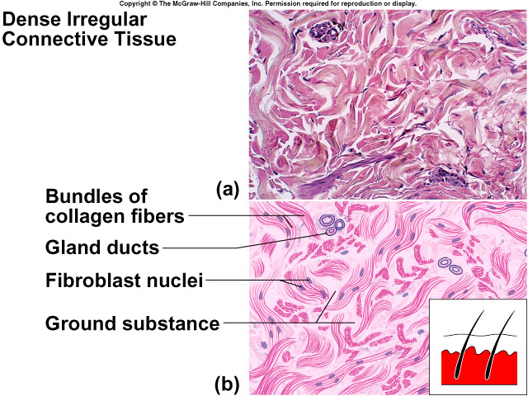

Slide 37
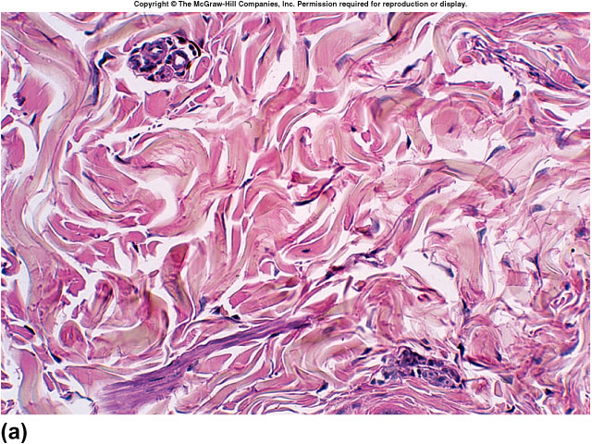

Slide 38
#3 Tissue Type
Muscle Tissue – Skeletal, Smooth, and Cardiac

Slide 39
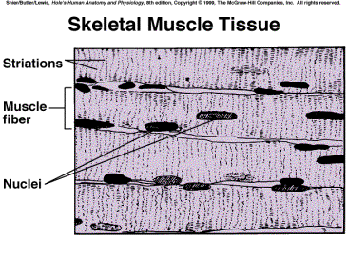
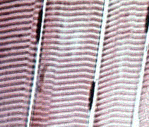
Skeletal Muscle
found attached to bone
cells
voluntarily controlled
rod-shaped cells
striated (light & dark cross markings)
multinucleated

Slide 40
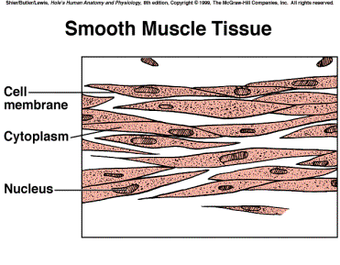
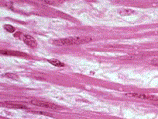
Smooth Muscle
found in walls of hollow organs
stomach
intestines
bladder, etc.
Cells
involuntarily controlled
spindle-shaped cells
no striations-”smooth”
mono-nucleated

Slide 41
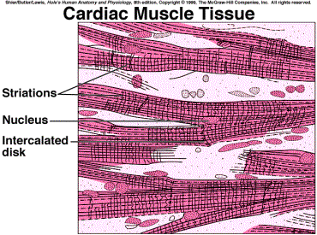
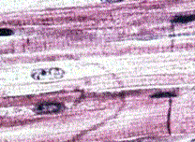
Cardiac Muscle
found only in heart cells
involuntarily controlled
rod-shaped cells but branched
striated (light & dark cross markings)
1-2 nuclei
intercalated disk = intercellular junction

Slide 42
#4 Tissue Type
Nervous Tissue

Slide 43
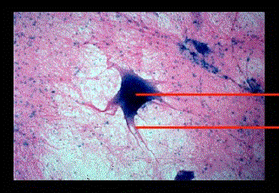
Nervous Tissue
Found in brain, spinal cord, & nerves
2 types of cells
Neuron
sensitive to certain types of changes in their surroundings
communicate with various parts of the body
Neuroglia
support and bind neurons, phagocytosis, supply nutrients via blood vessels

Slide 44
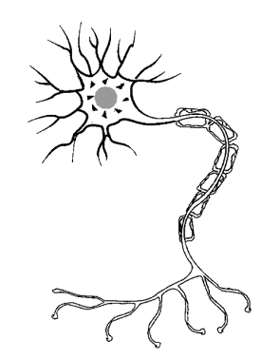
Draw the Basic Parts of a Neuron
Dendrites
Nucleus
Axon
Draw an arrow indicating the direction an electrical impulse travels
dendrite
nucleus
axon

Slide 45
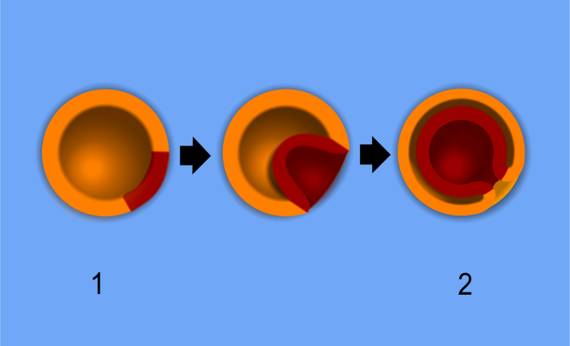
Origins of tissues
Ectoderm, Mesoderm, Endoderm

