Slide 1
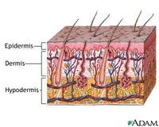
Integumentary System
Epidermis
Dermis
Hypodermis

Slide 2
Functions of the skin
Barrier
Water
Bactericidal conditions (acid mantle, dry, oil)
UV
Fat-soluble vitamins can be absorbed (A, D, E, K); poisons
Vitamin D synthesis
Sensory
Heat/cold
Pressure
Touch
Texture
Injury
Vibration

Slide 3
Functions of the skin
Thermoregulation
Receptors tell hypothalamus to constrict blood vessels to cool; dilate to warm the skin
Social functions
Goosebumps – piloerector muscle contracts, pulling follicle; traps air (but not effectively)

Slide 4
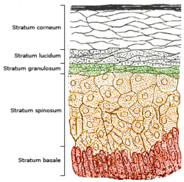
Epidermis

Slide 5
Epidermis
Layers (deep to superficial) – each has keratinocytes
stratum basale
- mitosis layer – new cells
- melanocytes – melanin
- Merkel cells – touch
stratum spinosum
- keratinocytes – bridge to one another by desmosomes
- Langerhans cells – present pathogen to immune system

Slide 6
Epidermis
stratum granulosum
2-5 keratinocyte layers & waterproofing layer
grainy cell layer
stratum lucidum
eleidin – immature form of keratin
clear cell layer
stratum corneum
< 30 layers of cells
exfoliation/desquamate

Slide 8
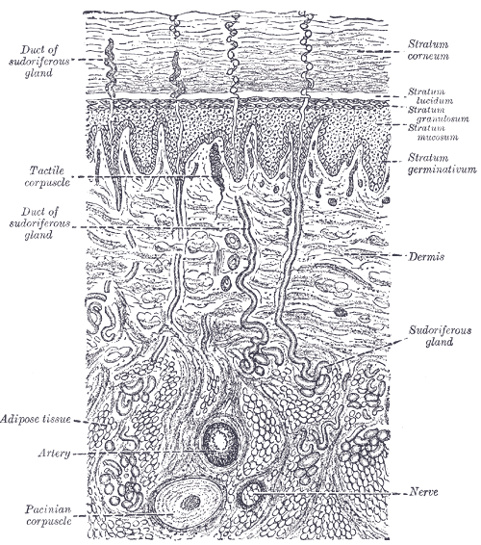
Dermis Structures

Slide 9
Dermis
Layers
papillary – areolar tissue; immunity
Meissner’s corpuscles – pain & touch
reticular – dense irregular connective tissue
Pacinian corpuscles – pressure sensor
Ruffini corpuscle – stretch, heavy touch
stretch marks – tears in collagen fibers

Slide 10
Pruney fingers
The wrinkles that occur in skin after prolonged exposure to water are sometimes referred to as pruney fingers or water aging. This is a temporary skin condition where the skin on the palms of the hand or feet becomes wrinkly.
In recent past the common explanation was based on water absorption in the keratin-laden epithelial skin when immersed in water;[6], this caused the skin to expand, resulting in a larger surface area and forcing it to wrinkle. Usually the tips of the fingers and toes are the first to wrinkle because of a thicker layer of keratin and an absence of hairs which secrete the protective oil called sebum.
In 1935, Lewis and Pickering already found that the skin in the median nerve distribution failed to wrinkle in patients with median nerve palsy. This suggested a mechanism other than simple water absorption. Recent research shows that wrinkling is related to vasoconstriction [7][8]. Water probably initiates the wrinkling process by altering epidermal electrolyte homeostasis as it diffuses into the porous skin of the hands and soles via their many sweat ducts. Altered epidermal electrolyte homeostasis would lead to a change in membrane stability of the surrounding dense network of nerve fibers and trigger increased vasomotor firing with subsequent vasoconstriction. Vasoconstriction, through loss of volume, leads to negative digit pulp pressure resulting in a downward pull on the overlying skin, which wrinkles as it is distorted [9].
This insight resulted in bedside tests for nerve damage and vasoconstriction. For instance a patient with Diabetic neuropathy caused by Diabetes mellitus will have a different finger wrinkling pattern than a healthy subject. Wrinkling is often scored with immersion of the hands for 30 minutes in water or EMLA cream with measurements steps of 5 minutes, and counting the number of visible wrinkles in time. Not all healthy persons have finger wrinkling after immersion, so it would be safe to say that sympathetic function is preserved if finger wrinkling after immersion in water is observed, but if the fingers emerge smooth it cannot be assumed that there is a lesion to the autonomic supply or to the peripheral nerves of the hand[10].

Slide 11
Cutaneous Glands
sebaceous - holocrine
oil
ceruminous – wax of ear; cerumen
eardrum pliable, waterproofing; bactericidal
mammary – modified apocrine sweat glands

Slide 12
Cutaneous Glands
Sweat (sudoriferous)
Merocrine – most numerous
water producing for coolness
Apocrine – sparse or absent in some ethnicities
milky due to fatty acids
scent glands responding to stress & sexual stimulation
occur in groin, anal region, areola, beard in mature males
still secrete by exocytosis, but larger lumen so called apocrine instead of merocrine

Slide 13
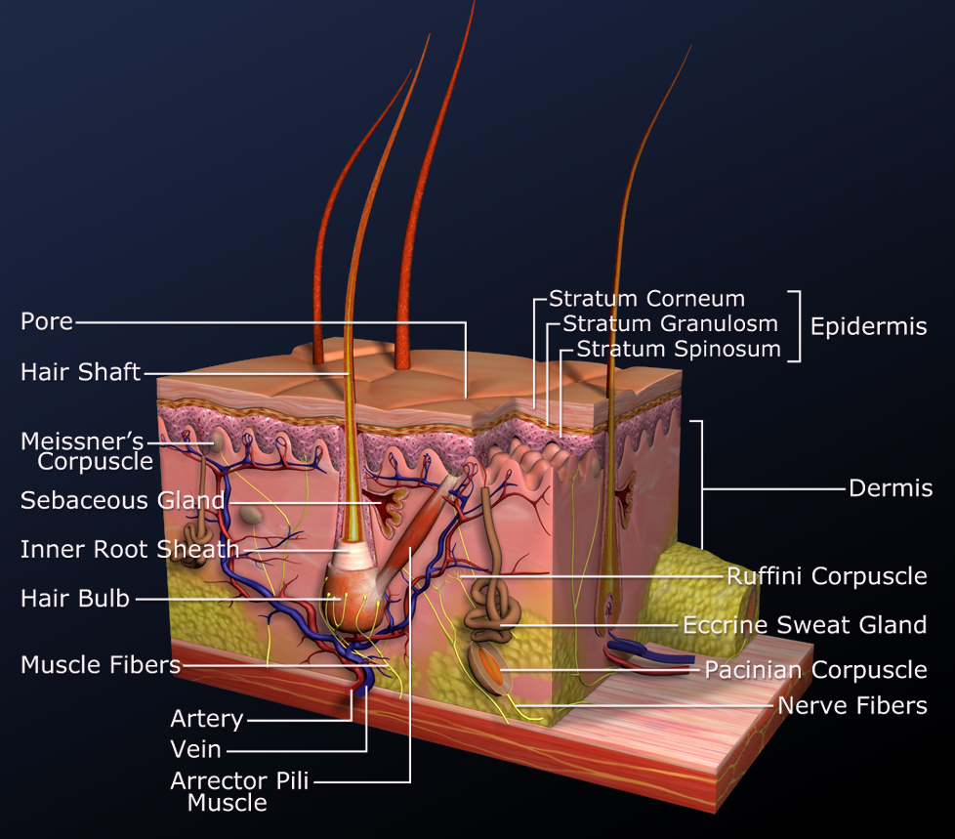
Dermis Structures

Slide 14
Hypodermis
Connects dermis to muscles
Subcutaneous fat

Slide 15
Skin coloration
Normal color controlled by:
hemoglobin
melanin
Carotene

Slide 16
Skin Discoloration
cyanosis – blue; low O2
erythema – red; increased blood flow
jaundice – yellow; bilirubin buildup (hemoglobin destruction) & liver doesn’t dispose it
bronzing – “tan”; Addison disease = adrenal cortex hormone deficiency
pallor – pale; low blood flow
albinism – white; lack of melanin
hematoma - bruise

Slide 17
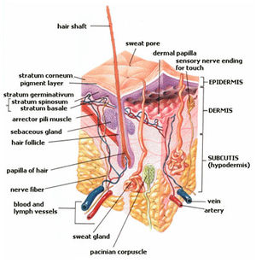
Integumentary System Review

Slide 18
Common Skin Disorders

Slide 19
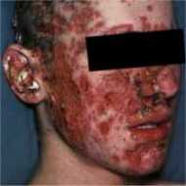
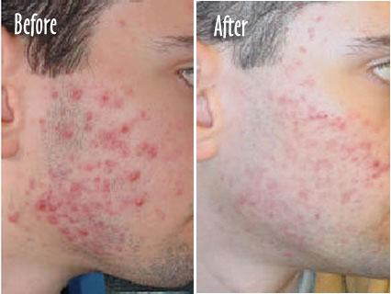
Acne

Slide 20
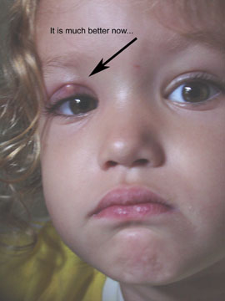
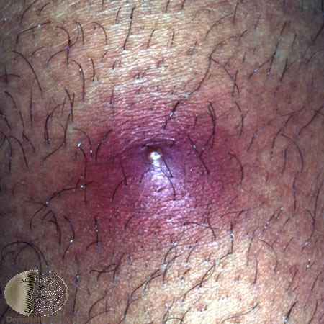
Boil

Slide 21
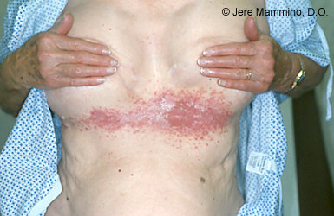
Bacterial Intertrigo

Slide 22
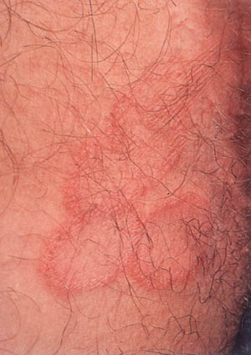
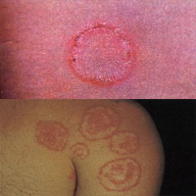
Ringworm

Slide 23
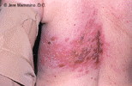
Shingles

Slide 24
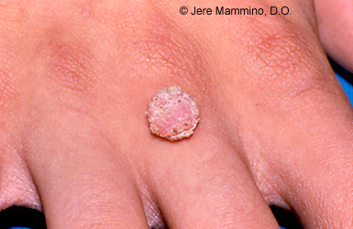
Warts

Slide 25
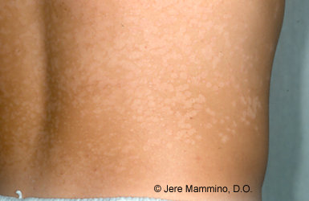
Tinea versicolor

Slide 26
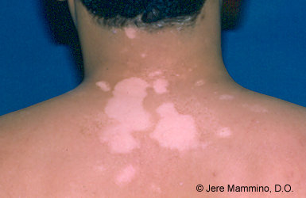
Vitiligo

Slide 27

Vitiligo: Winnie Harlow

Slide 28
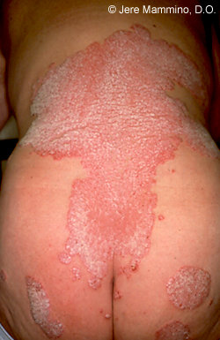
Psoriasis

Slide 29
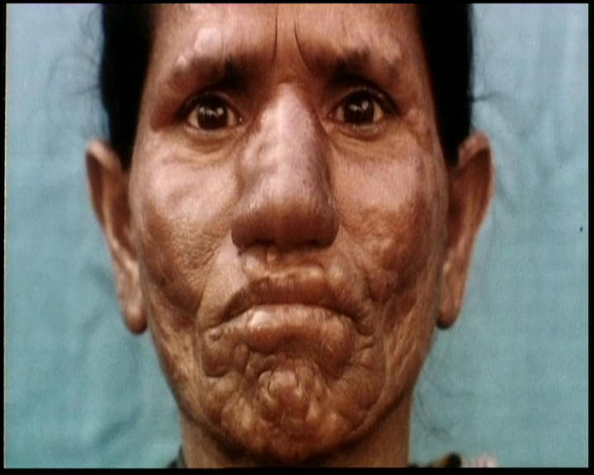
Leprosy

Slide 30
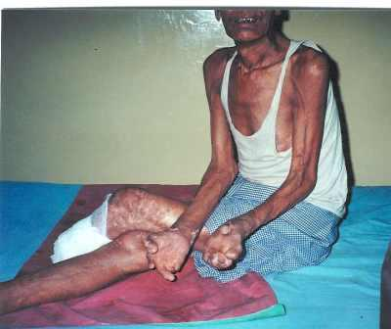
Leprosy

Slide 31
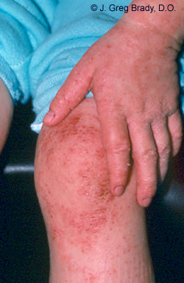
Eczema

Slide 32
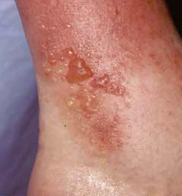
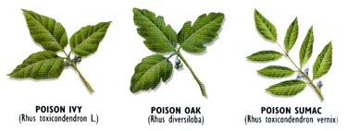
Poison Ivy

Slide 33
Uncommon skin disorders

Slide 34
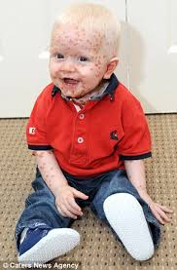
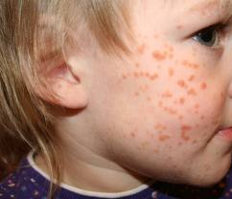
Langerhans Cell Histiocytosis

Slide 35
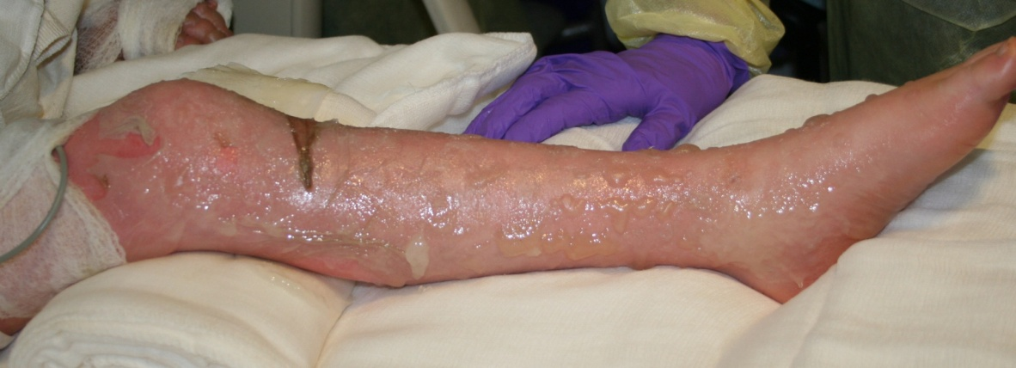
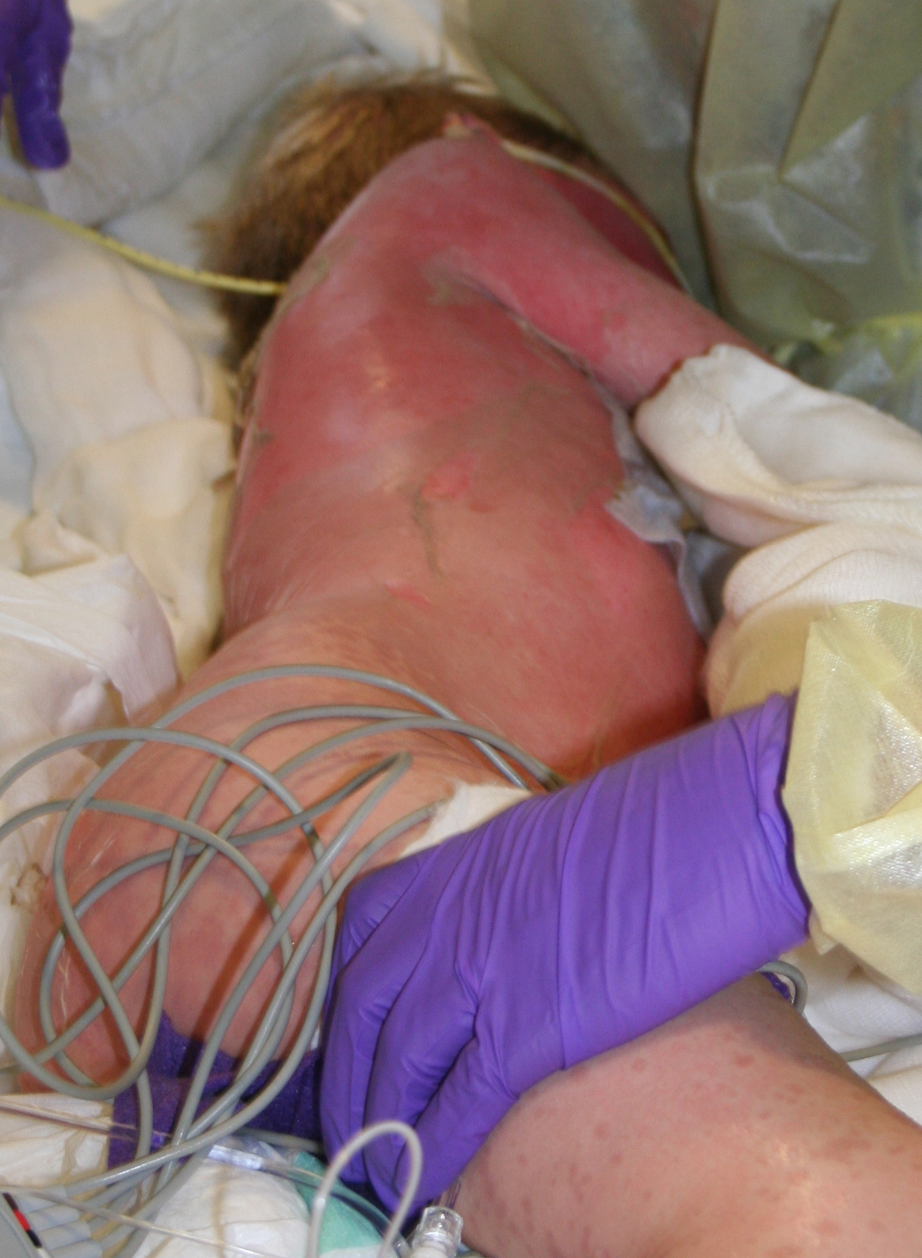
Toxic Epidermal Necrolysis

Slide 36
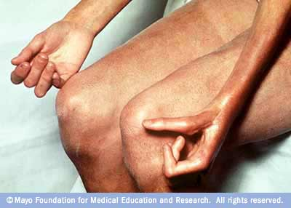
Scleroderma

Slide 37
Other skin concerns
Cancer
Basal cell
Squamous cell
Malignant melanoma
Burns (old classification)
1st degree
2nd degree
3rd degree

Slide 38
Skin Cancers
What is Cancer?

Slide 39
Learn the ABC’s!
Asymmetry: half the mole looks different from the other half
Border: the edges of the mole are irregular or ragged
Color: moles are non-uniform in color, and
Diameter: normal moles are typically smaller than six millimeters (a quarter inch) in diameter. Melanomas are generally bigger, although recently doctors have seen melanomas between three and six millimeters in diameter.
Elevation

Slide 40
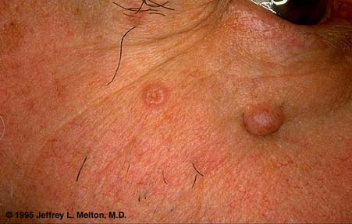
Basal cell carcinoma

Slide 41
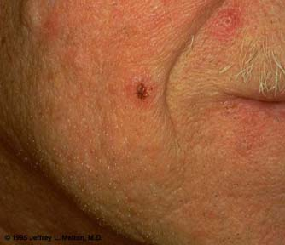
Basal cell carcinoma

Slide 42
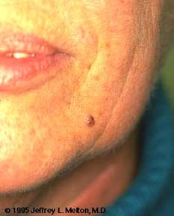
Basal cell carcinoma

Slide 43
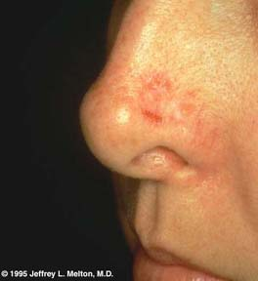
Basal cell carcinoma

Slide 44
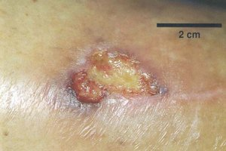
Squamous cell carcinoma

Slide 45
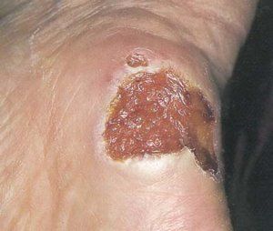
Squamous cell carcinoma

Slide 46
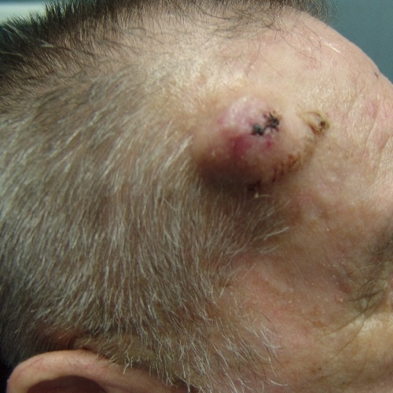
Malignant melanoma

Slide 47
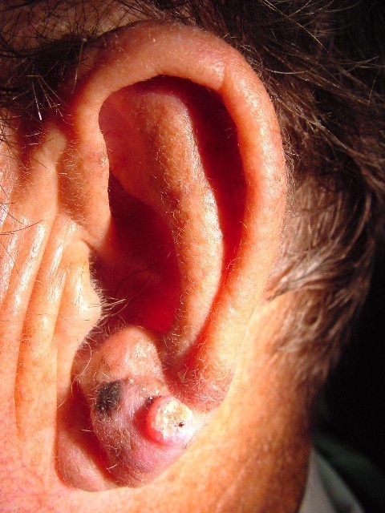
Malignant melanoma

Slide 48
Burn Classification

Slide 49
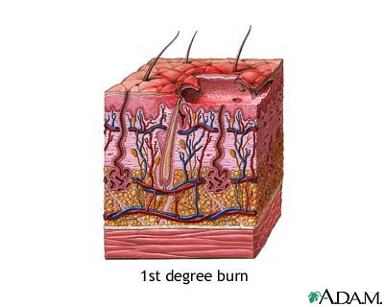

Slide 50
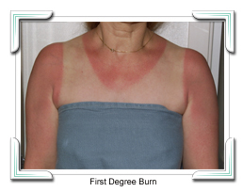
1st degree burn

Slide 51
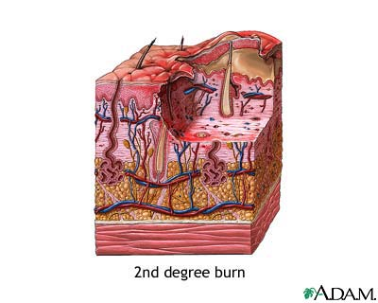

Slide 52
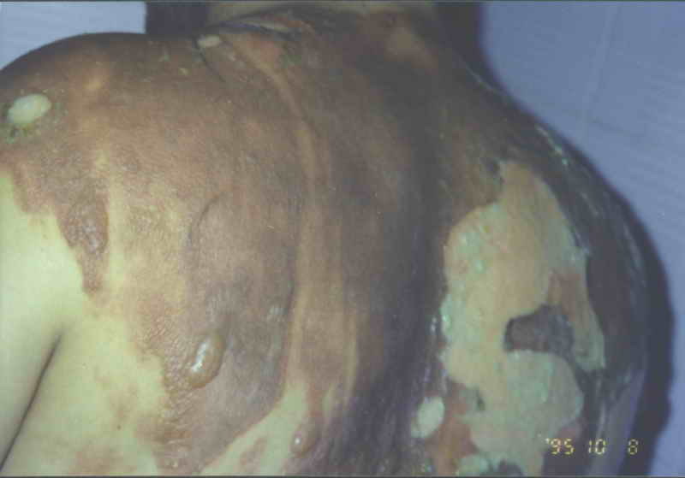
2nd degree burn

Slide 53
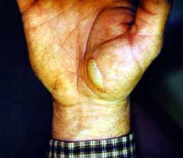

Slide 54
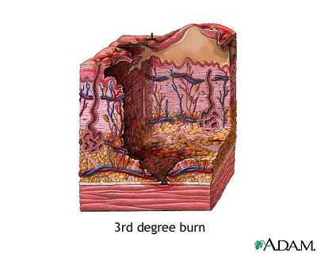

Slide 55
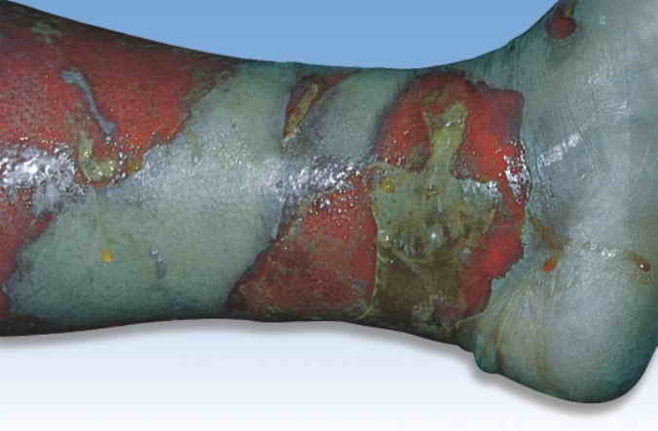
3rd degree burn

Slide 56
