Slide 1
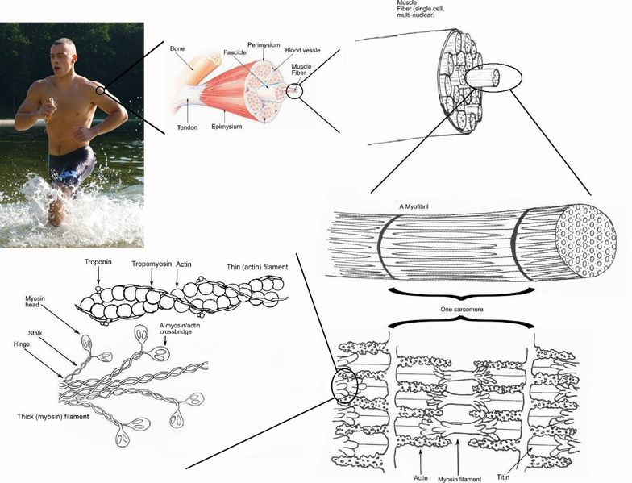
Skeletal Muscles
Chapter 9

Slide 2
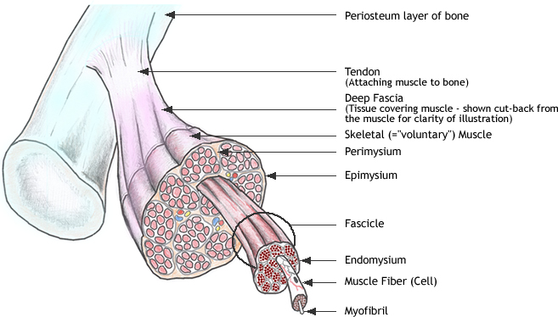
Skeletal Muscle Structure

Slide 3
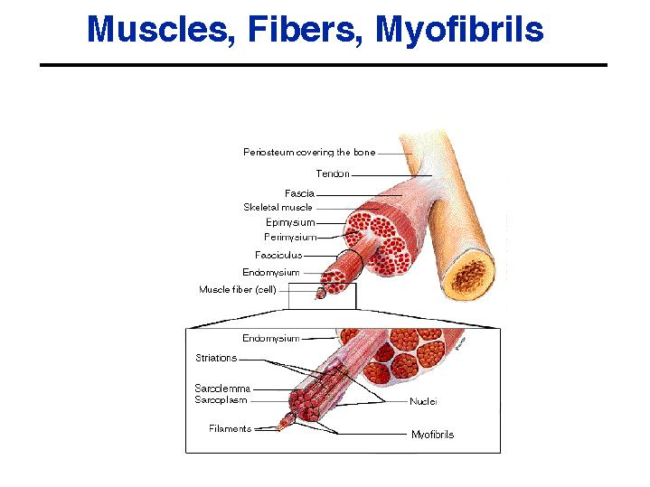

Slide 4
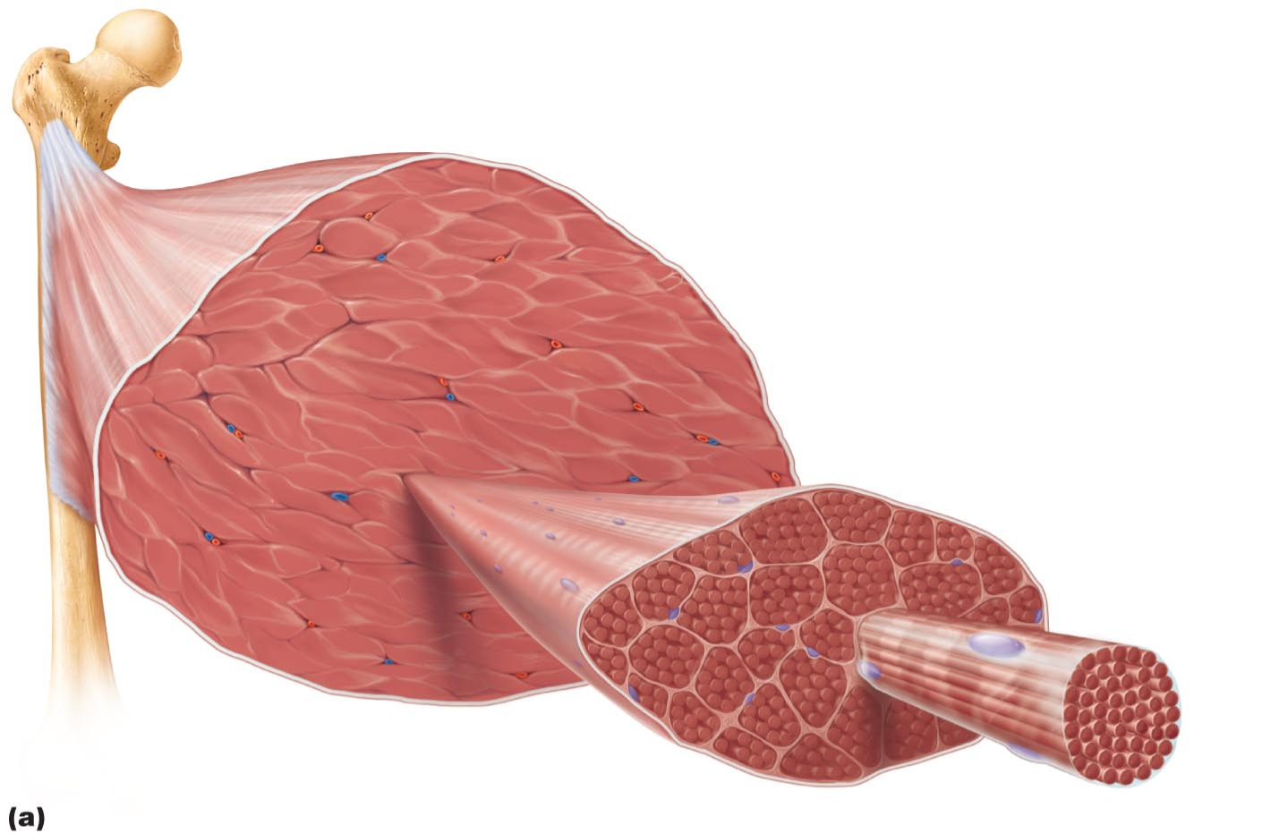

Slide 5
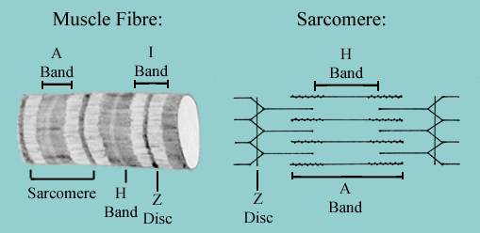
Sarcomere

Slide 6
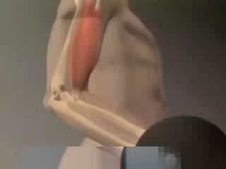
Structure review
muscle structure animation

Slide 7
Muscle Structure Quiz
#4
#9
#2
#10) Basic fundamental unit of a skeletal muscle?
#1
#3 – inner covering
#5 – outer covering; #6 structure
#8) Name the 2 components
#7

Slide 8
Muscle Structure Quiz Answers
1. Fascicle
2. Perimysium
3. Endomysium
4. Fascia
5. Sarcolemma/
Sarcoplasmic Membrane
6. Fiber
7. Myofibril
8. Myofilaments – Actin & Myosin
9. Epimysium
10. Sarcomere

Slide 9
Nerve-Muscle Relationship
Motor neurons
somatic nerves – voluntary (skeletal)
motor unit
nerve fiber
all fibers (interspersed) it affects
result – weak universal contraction
“work in shifts”
all or none response

Slide 10
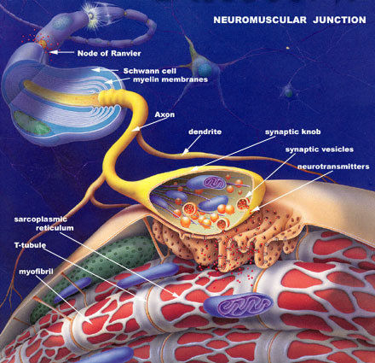
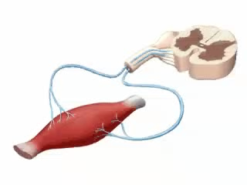
Nerve-Muscle Relationship
neuromuscular junction
axon terminal
synapse/synaptic cleft
motor end plate – depression in sarcolemma
muscle fiber nucleus
action potential video

Slide 11
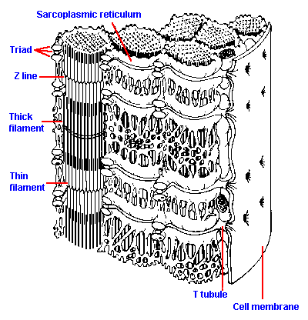
Myofiber structure
Sarcoplasmic reticulum
Triad
Z line
Thick filament
Thin filament
T Tubule
Sarcoplasmic Membrane

Slide 12

Sliding filament theory
Firing a muscle fiber
1) electrical signal sent from brain
2) calcium ions cause release of acetylcholine (ACh)
3) ACh goes into synapse
4) muscle fiber receptors cause ion imbalance (Na, K) through
T-tubules
5) Ca ²⁺allowed in, binds to troponin → tropomyosin
6) active sites on actin exposed, myosin forms cross-bridges
action potential video

Slide 13
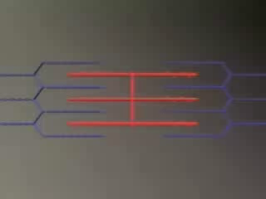
Sliding filament theory
7) ATP causes myosin heads to contract, “power stroke”
8) more ATP causes heads to release “recovery stroke”
9) nerve impulse stops
10) ACh broken down – acetylcholinesterase AChE
11) Ca reabsorbed by reticulum from troponin – stored in
vesicles with calsequestrin
12) Tropomyosin is covered up again, keeping myosin
from bonding; muscle relaxes
atp power/recovery stroke animation

Slide 14

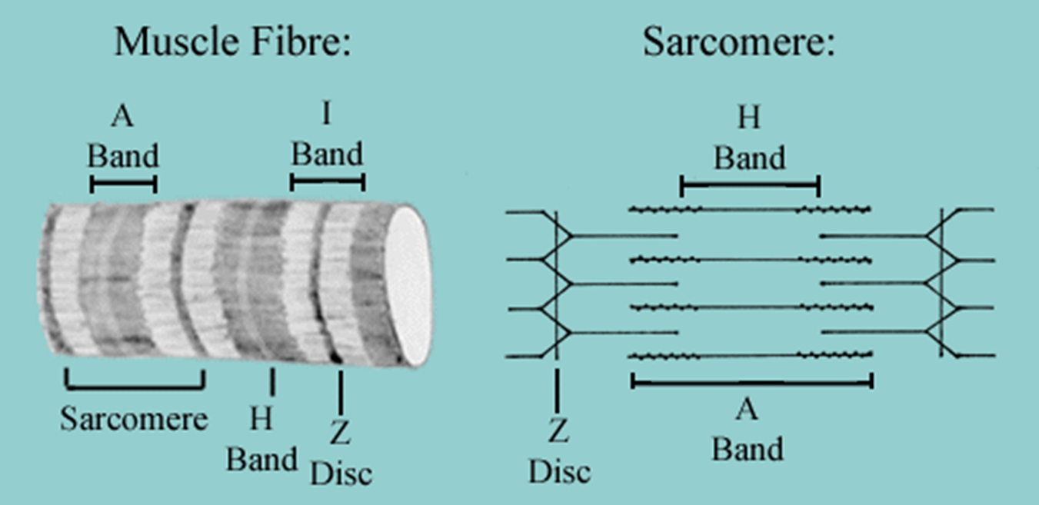

Slide 15


Slide 16
Stages of Contraction
Threshold – amount of voltage req’d to release Ca
Latent period – delay for tropomyosin, etc (2 msec)
Contraction phase
Relaxation phase (7 – 10 msec)

Slide 17
Twitch Strength
Twitch – low stimulation, full relaxation between
Treppe – moderate stim, full relaxation, stronger twitches
Incomplete tetanus – wave summation stimulation (adding on to last before relaxation can occur), stronger twitches
Complete tetanus – 40/50 stimuli per second, twitches fuse into prolonged contraction
Twitch experiment

Slide 18
Types of Contraction
Isometric – no length change
Isotonic – muscle shortens
Concentric – maintains tension throughout contraction
Eccentric – muscle lengthens as it maintains tension

Slide 19
Oxygen Debt
Oxygen used to make ATP from glycogen
oxidizing lactic acid if not enough O2
fast-twitch muscles
fast processing, low endurance
slow-twitch muscles
slow processing, high endurance
intermediates

Slide 20
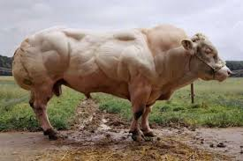
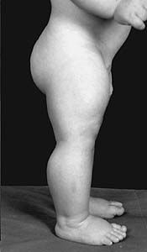
Muscle Disorders
Cramps
Fibromyalgia – general disorder causing pain/tenderness, also caused by physical/emotional trauma or medications
Atrophy – inactivity causing muscle loss – 3% per day if bed rest
Hypertrophy – building muscles due to use or hormone disorder

Slide 21
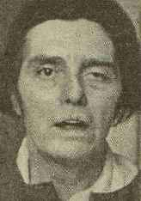
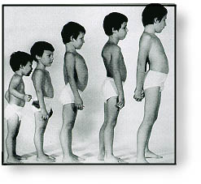
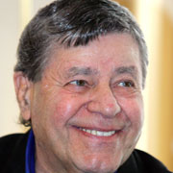
Muscle Disorders
Myositis – muscle inflammation due to infection
Muscular dystrophy – genetic, muscles break down and replaced by fat
Myasthenia gravis – ACh receptors attacked, muscles become less sensitive, cause drooping (face)

Slide 22
Essay Preparation
All or none response
Sliding filament theory (contracting/relaxing muscle)
Skeletal muscle composition – bundles & coverings
Sarcomere – draw, label, discuss

