Slide 1
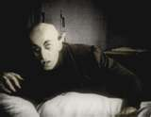

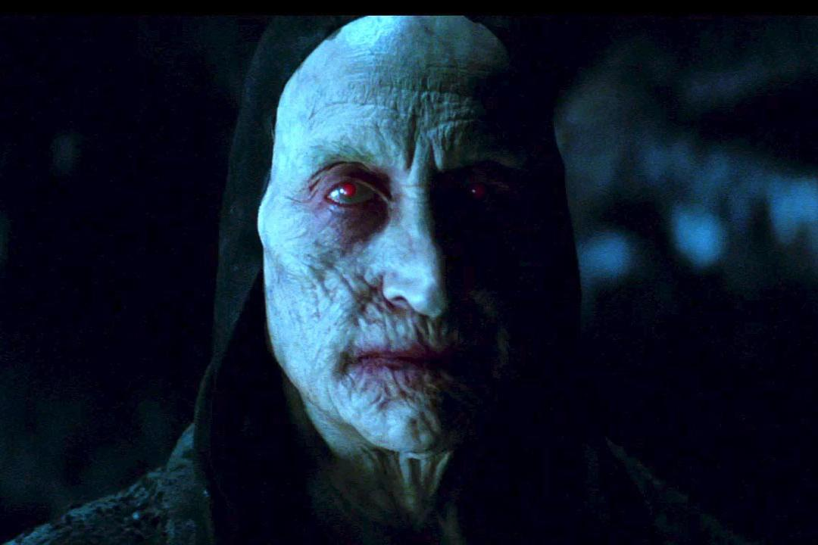
Blood Notes!
Chapter 14

Slide 2
Items on test – essay
1) Hematocrit
2) Blood types & compatibility
3) White blood cells (function/appearance)
4) Blood pressure (sphygmomanometer)
5) EKG/ECG
6) Classifying WBC by microscope slide

Slide 3
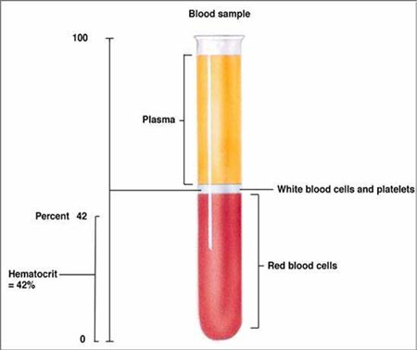
Hematocrit
55%
<1%
45%

Slide 4
White Blood Cells (WBC)
Normal %
Describe appearance of nucleus
List function
An increase indicates?

Slide 5
Granulocytes

Slide 6
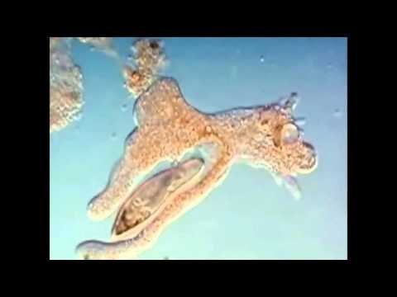
Neutrophil
Lobes 3 or 5
Neutrophils in action

Slide 7
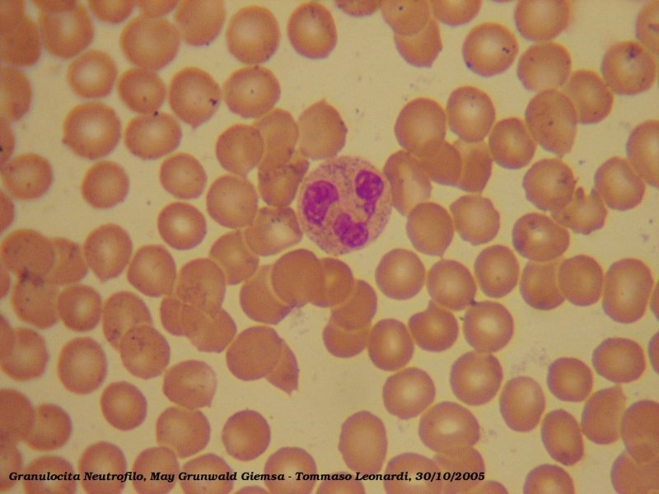
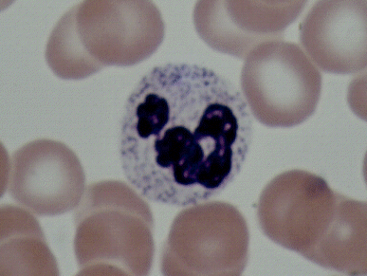

Slide 8
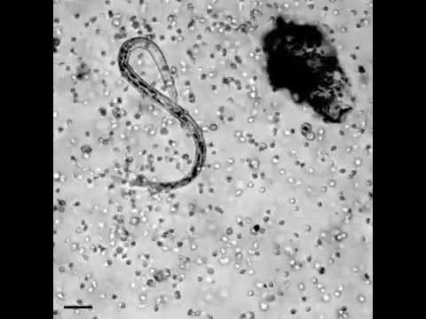
Eosinophil
Usually 2 lobes, connected by thin strand
Eosinophils in action

Slide 9
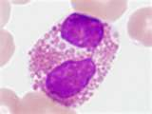
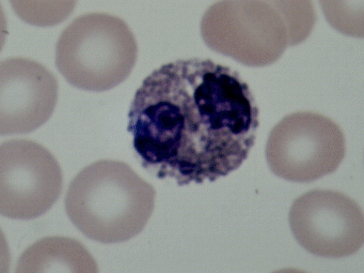

Slide 10
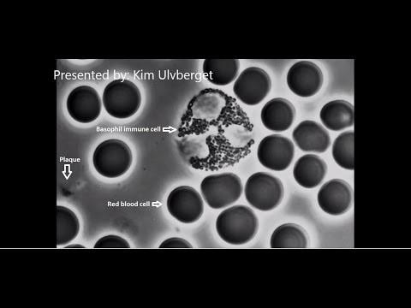
Basophil
Entire cell filled by nucleus OR
nothing but grains seen
Basophils in action

Slide 11

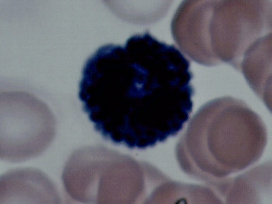

Slide 12
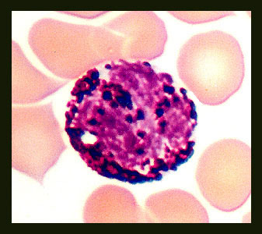
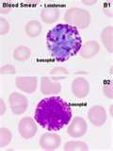

Slide 13
Agranulocytes

Slide 14
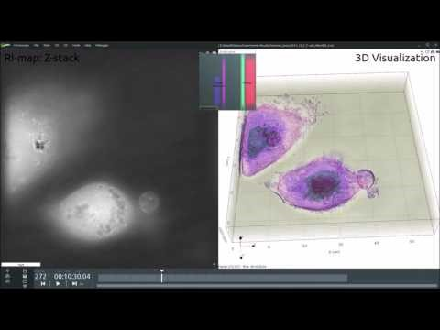
Lymphocyte
Look for most of cell to be filled BUT there will be one small region that is clear
Lymphocytes in action

Slide 15
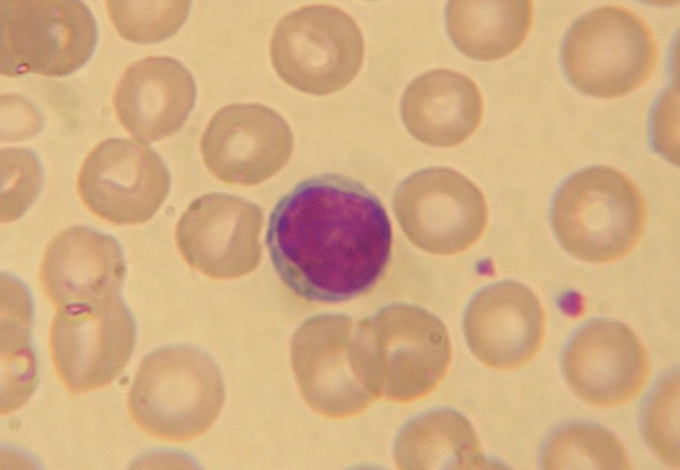
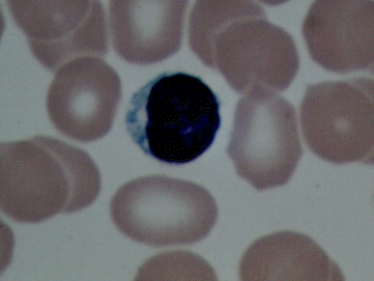

Slide 16
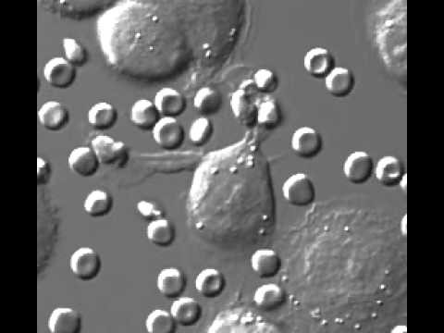
Monocyte
Nucleus is usually horseshoe shaped
Width is constant – no constrictions!
Monocyte in action

Slide 17
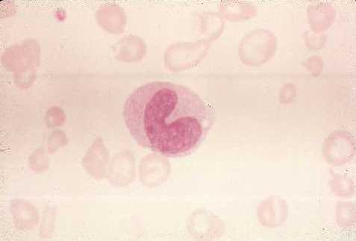
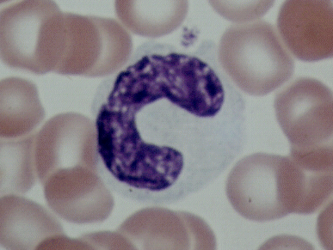

Slide 18
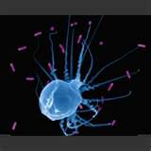

Slide 19
Blood typing notes
1) Blood types (what it truly means)
2) To whom one can donate blood (and why?)
3) What type one can accept blood (and why?)

Slide 20

Blood Types

Slide 21
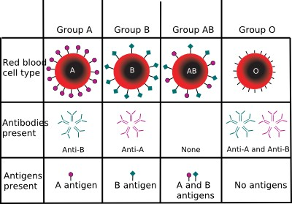
Blood types – antigen vs. antibody

Slide 22
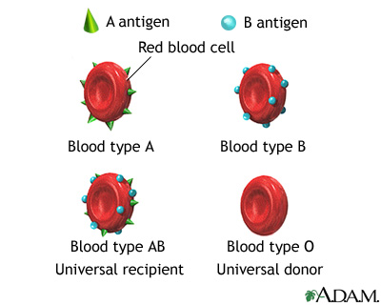

Slide 23
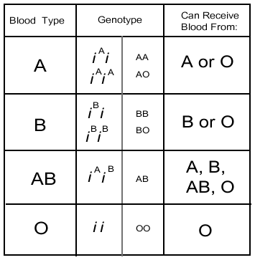
What type of blood can one receive?

Slide 24
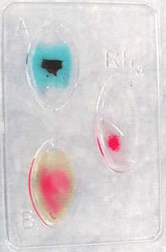
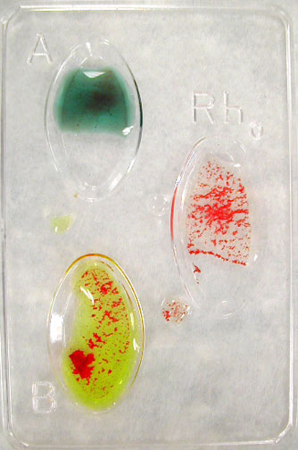
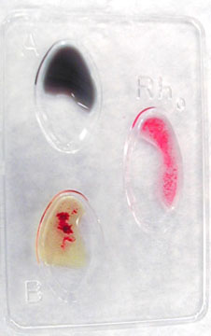
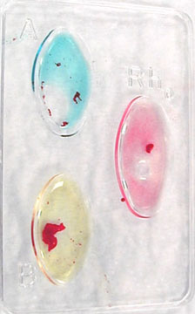
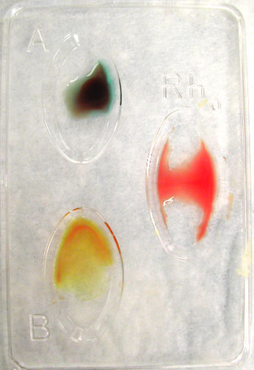
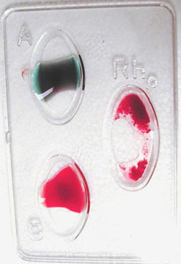
A+
B+
B+
AB+
O-
O+

Slide 25
Ready to save a life?
Blood typing game

Slide 26
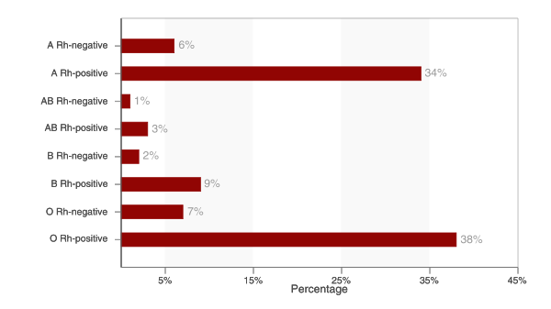
US Blood Type Distribution

Slide 27
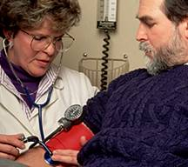
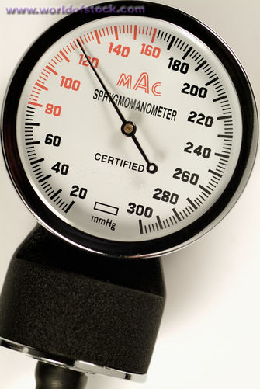
Sphygmomanometer use…

Slide 28
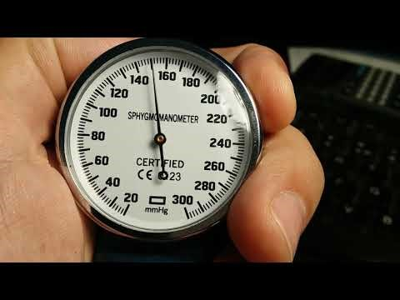
Blood pressure: how to work, what to look/listen for, what #’s mean…
How to measure blood pressure

Slide 29
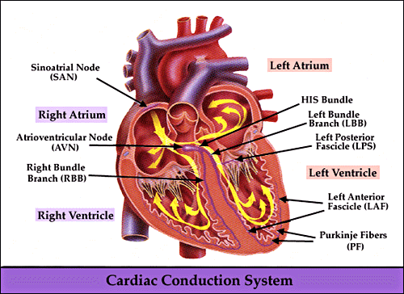
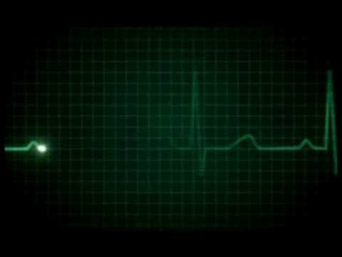
ECG - Electrocardiogram
Electrical nodes inserted in key points of heart
ECG video

Slide 30
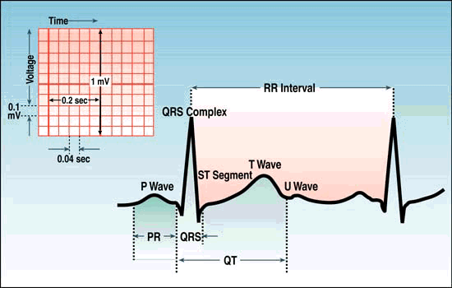
Normal ECG readout

Slide 31
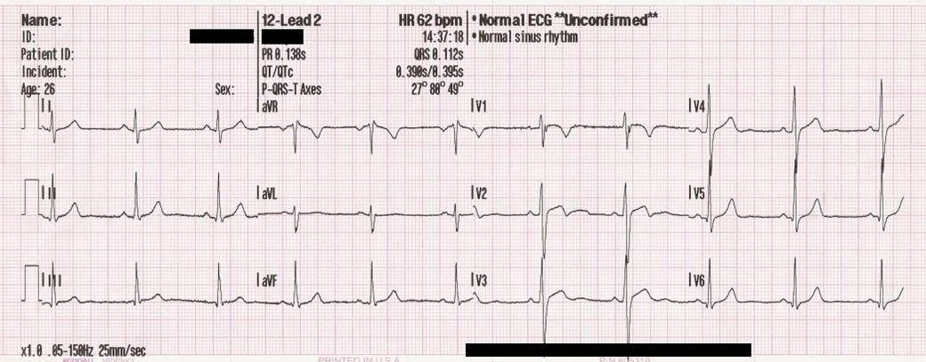
LOOK TO THIS LINE

Slide 32
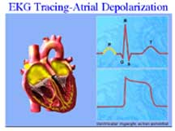
P Wave
Electrical stimulus for the contraction of the atria

Slide 33
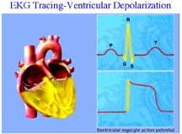
QRS Complex
Electrical stimulus for the contraction of the ventricles

Slide 34
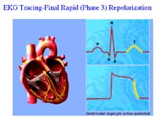
T Wave
Electrical stimulus for the relaxing of ventricles and atria

Slide 35
Sample ECG readouts
ECG rhythm practice

