Slide 1
Chapter 18 The Digestive System

Slide 2
Overview of topics
General anatomy & digestive processes
Mouth through esophagus
Stomach – mechanical & some chemical digestion
Liver, gallbladder & pancreas – accessory organs
Small intestine - chemical digestion & absorption
Large intestine – water
Anus

Slide 3
Digestive Functions
Ingestion = intake of food
Digestion = breakdown of molecules
- mechanical (chewing, grinding)
- chemical (enzyme action)
Absorption = uptake nutrients into blood/lymph
Defecation = elimination of undigested material

Slide 4
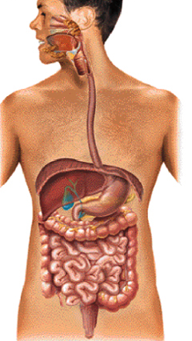
Subdivisions of the Digestive System
Digestive tract (GI tract)
30 foot long tube extending from mouth to anus
Accessory organs
teeth, tongue, liver, gallbladder, pancreas, salivary glands

Slide 5
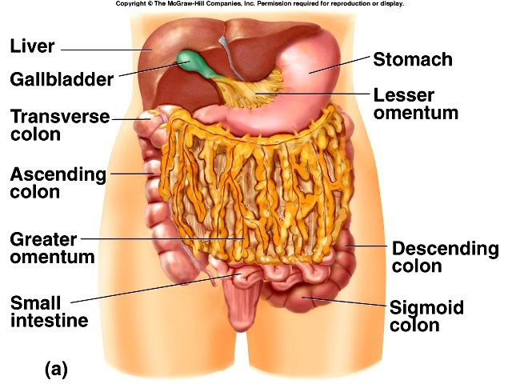
Lesser & Greater Omentum
Lesser attaches stomach to liver
Greater covers small intestines like an apron

Slide 6
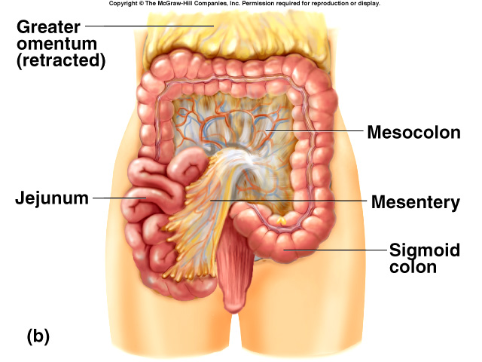
Mesentery and Mesocolon
Mesentery of small intestines holds many blood vessels
Mesocolon anchors the colon to the back body wall

Slide 7
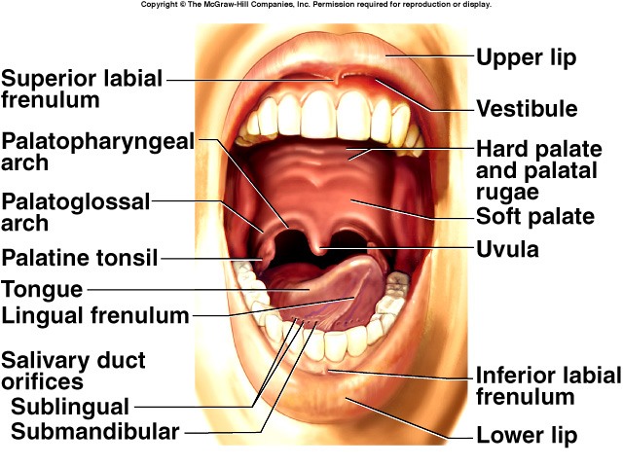
The Mouth or Oral Cavity

Slide 8
The Mouth or Oral Cavity

Slide 9
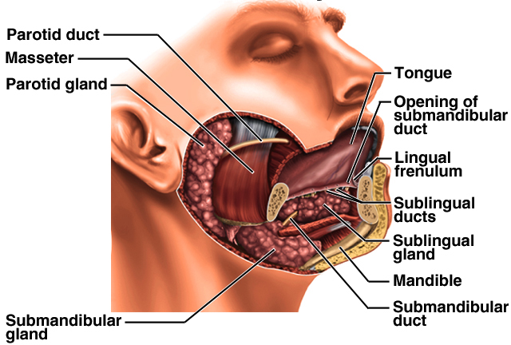
Salivary Glands
Small intrinsic glands found under mucous membrane of mouth, lips, cheeks and tongue -- secrete at constant rate
3 pairs extrinsic glands connected to oral cavity by ducts
parotid, submandibular and sublingual

Slide 10
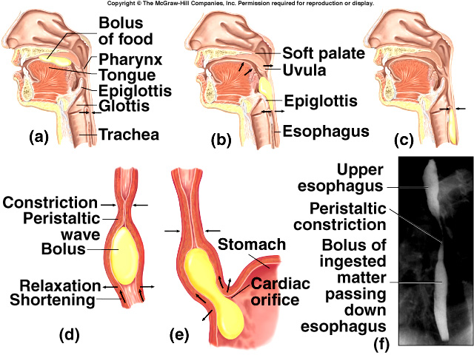
Swallowing

Slide 11
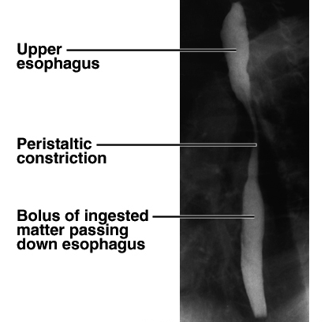
X ray of Swallowing in Esophagus

Slide 12
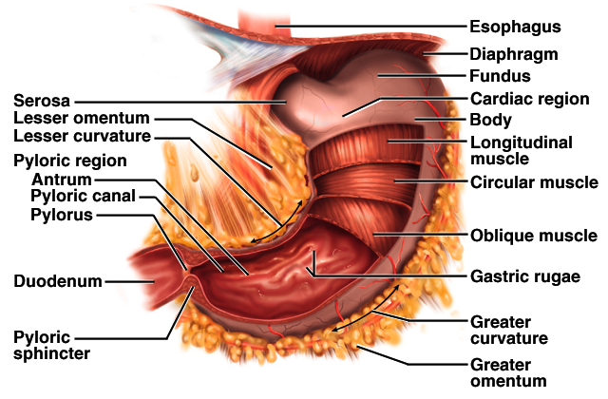
Gross Anatomy of Stomach
Notice: bulge of fundus, narrowing of pyloric region, thickness of pyloric sphincter and greater & lesser curvatures

Slide 13
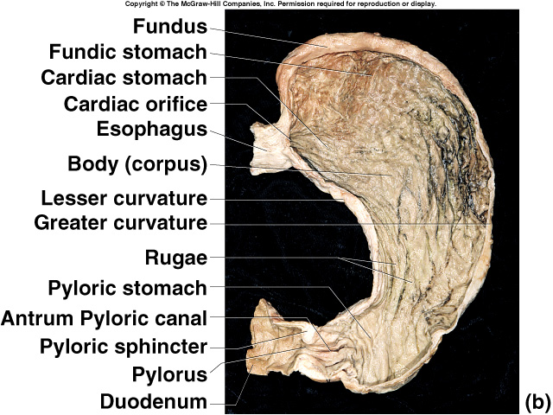
Gross Anatomy of the Stomach

Slide 14
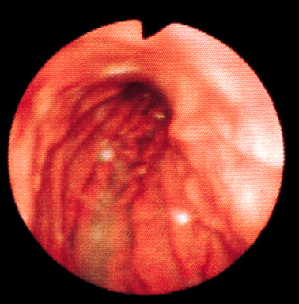
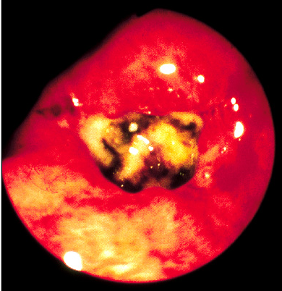
Healthy Mucosa & Peptic Ulcer

Slide 15
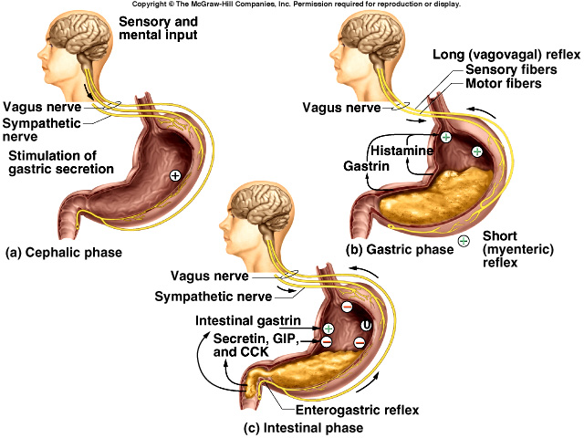
Regulation of Gastric Secretion

Slide 16
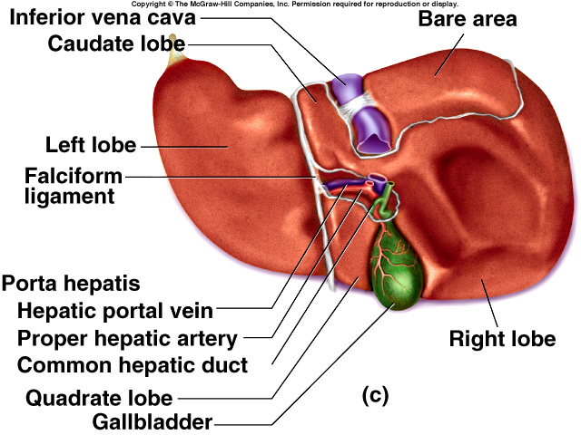
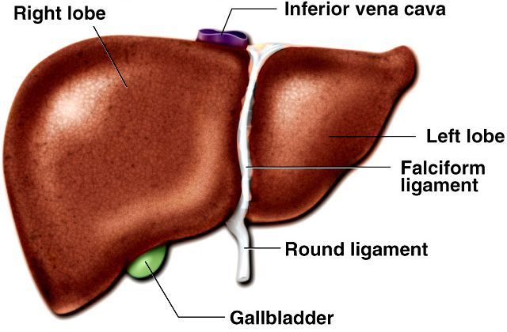
Gross Anatomy of Liver
3 lb. organ located inferior to the diaphragm
4 lobes -- right, left, quadrate & caudate
falciform ligament separates left and right
round ligament is remnant of umbilical vein
Gallbladder adheres to ventral surface between right and quadrate lobes

Slide 17
Inferior Surface of Liver

Slide 18
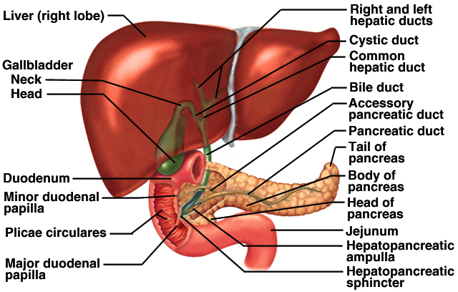
Ducts of Gallbladder, Liver & Pancreas

Slide 19
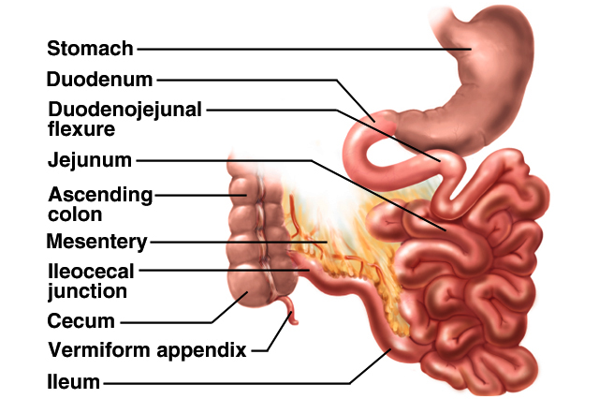
Small Intestine
Nearly all chemical digestion and nutrient absorption occurs in the small intestine

Slide 20
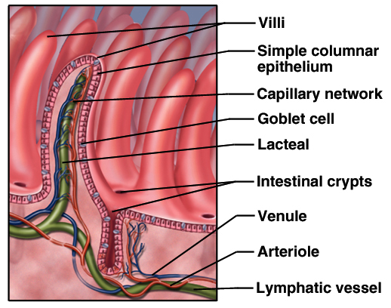
Large Surface Area of Small Intestine
Circular folds (plicae circularis) up to 10 mm tall
involve only mucosa and submucosa
chyme flows in spiral path causing more contact
Villi are fingerlike projections 1 mm tall
contain blood vessels & lymphatics (lacteal)
nutrient absorption
Microvilli 1 micron tall
brush border on cells
brush border enzymes for final stages of digestion

Slide 21
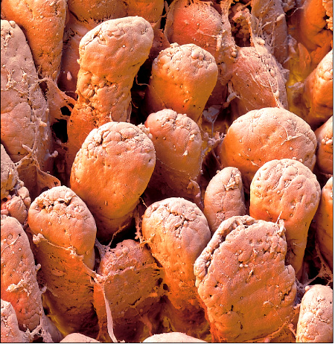
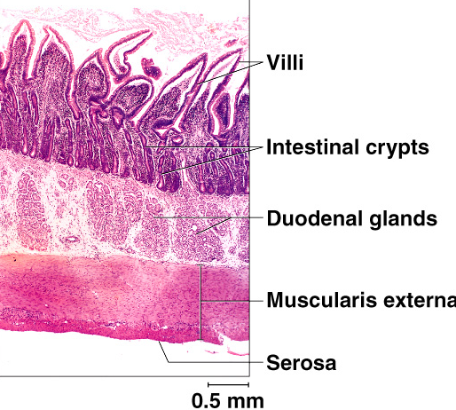
Intestinal Villi
Villi of Jejunum Histology of duodenum

Slide 22
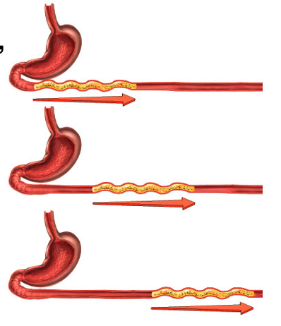
Peristalsis
Gradual movement of contents towards the colon
Begins after absorption occurs
Migrating motor complex controls waves of contraction
second wave begins distal to where first wave began

Slide 23
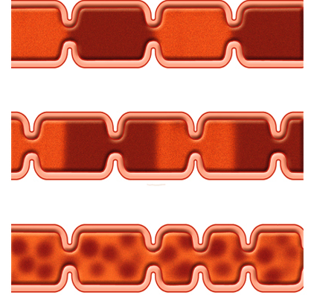
Segmentation in the Small Intestine
Purpose of segmentation is to mix & churn not to move material along as in peristalsis

Slide 24
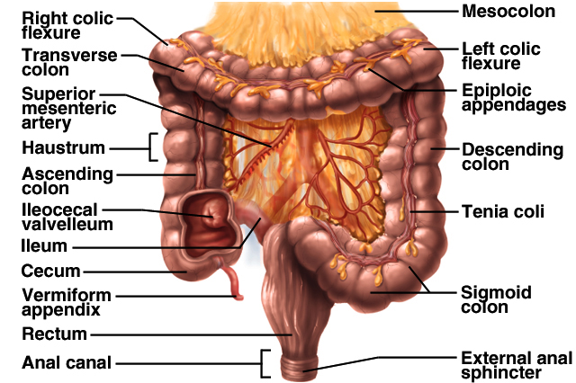
Anatomy of Large Intestine

Slide 25
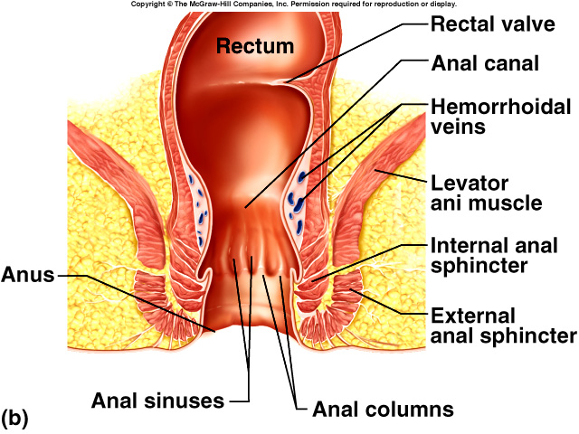
Anatomy of Anal Canal
Anal canal is 3 cm total length
Anal columns are longitudinal ridges separated by mucus secreting anal sinuses
Hemorrhoids are permanently distended veins

Slide 26
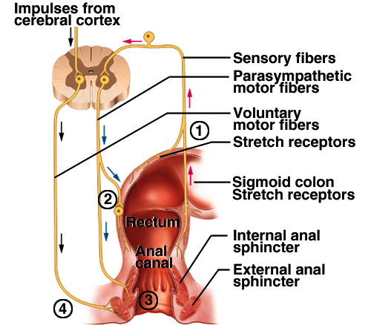
Neural Control of Defecation
1. Filling of the rectum
2. Reflex contraction of rectum & relaxation of internal anal sphincter
3. Voluntary relaxation of external sphincter

Slide 27
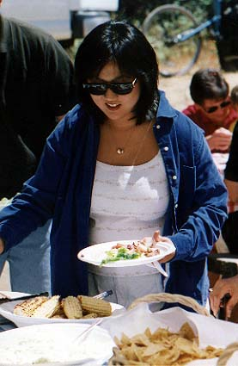
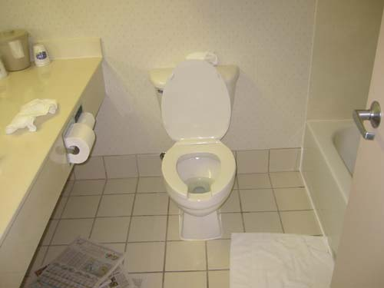
To Sum It All Up…
Molly the Marshmallow

