Slide 1
Upper Veins Dissection

Slide 2
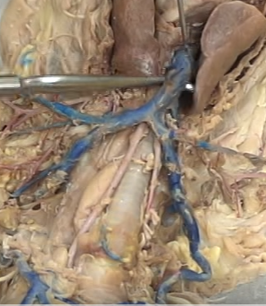
Superior Vena Cava

Slide 3
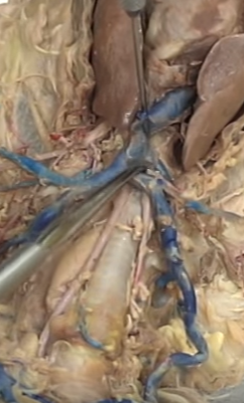
Azygous (may be higher or lower)

Slide 4
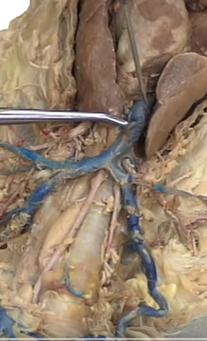
Internal Mammary
(look for the nub)

Slide 5
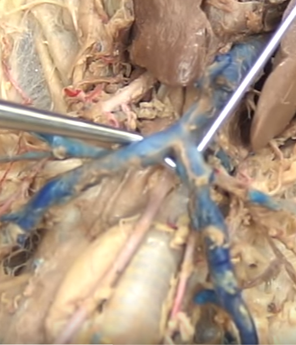
Brachiocephalics

Slide 6
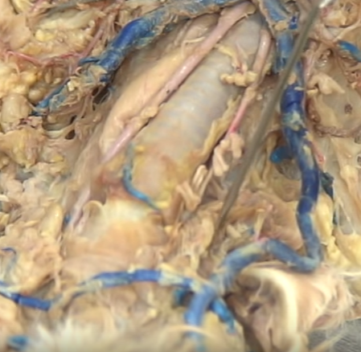
Internal Jugular
(where it should be)

Slide 7
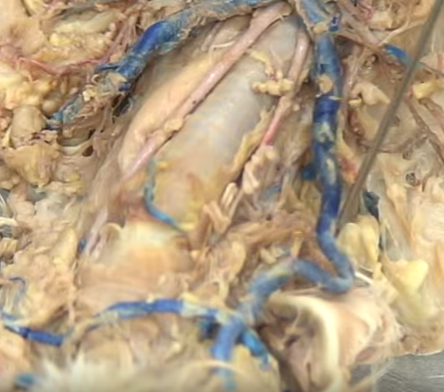
External Jugular

Slide 8
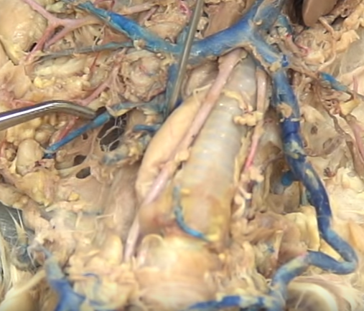
Transverse Scapular (comes off External Jugular)

Slide 9
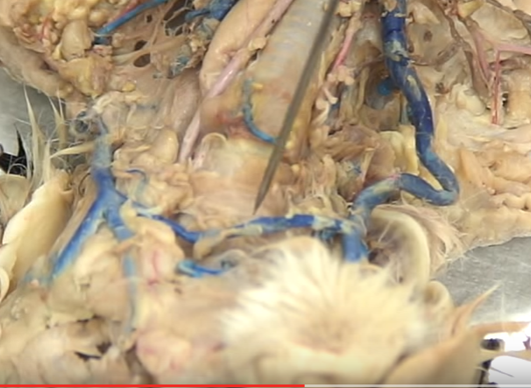
Transverse Jugular

Slide 10
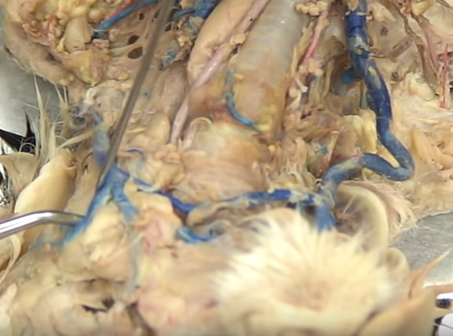
Posterior Facial

Slide 11
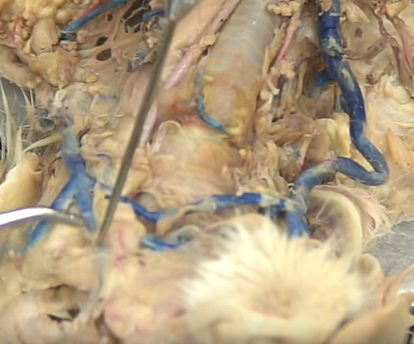
Anterior Facial

Slide 12
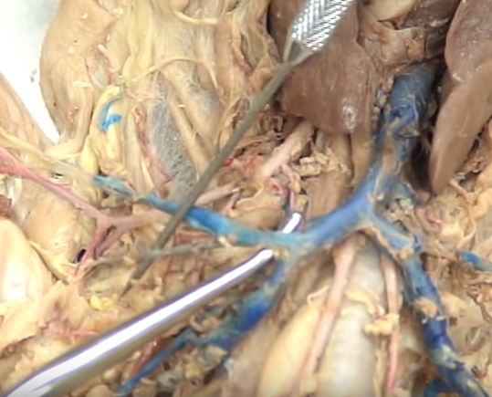
Subclavian

Slide 13
Subscapular

Slide 14
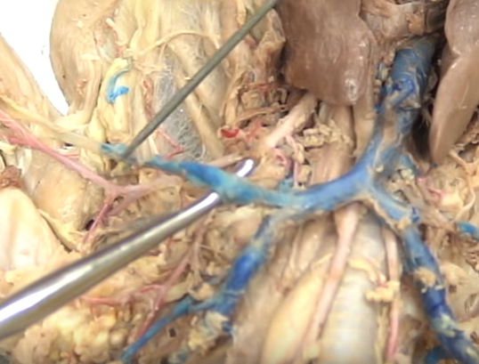
Axillary (runs from subscapular to circumflex)

Slide 15
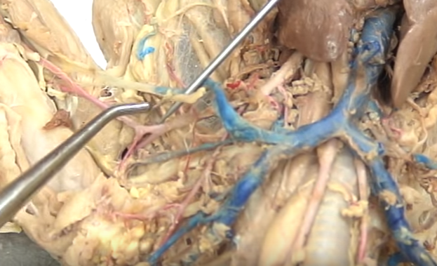
Anterior Humeral Circumflex

Slide 16
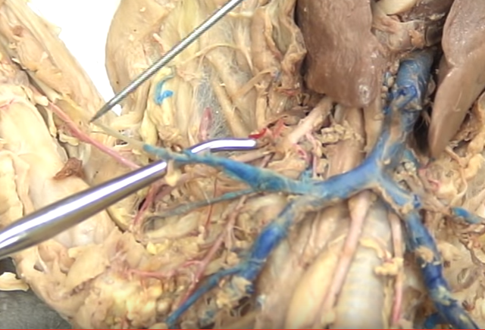
Brachial (runs from Circumflex to elbow split)

Slide 17
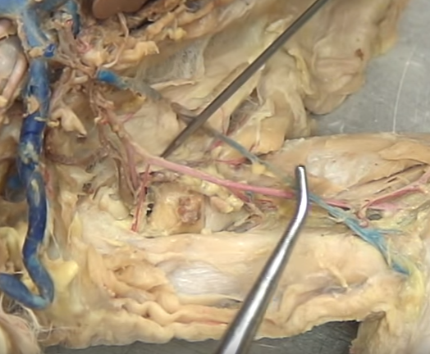
Brachial (runs from Circumflex to elbow split)

Slide 18
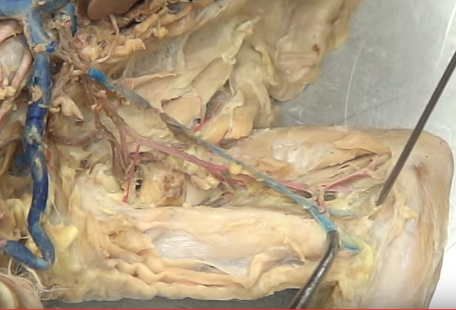
Radial (thumb side) Ulnar (pinky side)

