Slide 1
Upper Arteries Dissection

Slide 2
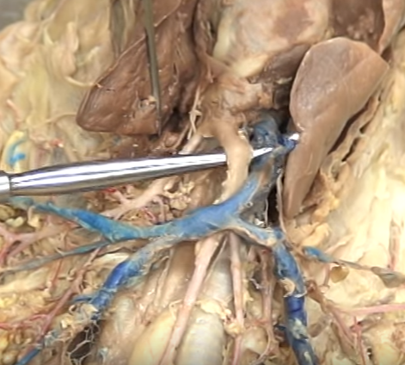
Brachiocephalic

Slide 3
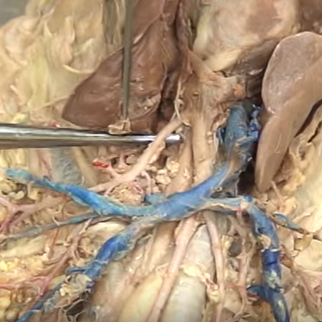
Left Subclavian

Slide 4
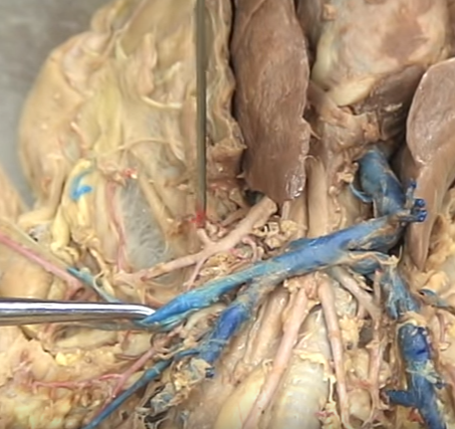
Right Subclavian

Slide 5
Right
Left
Common Carotids

Slide 6
Internal Mammary

Slide 7
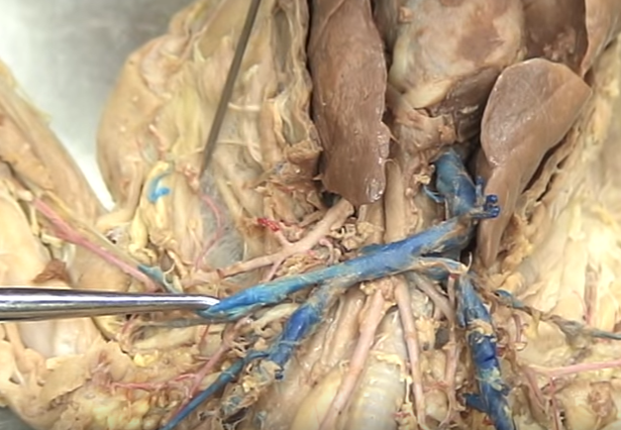
Long Thoracic

Slide 8
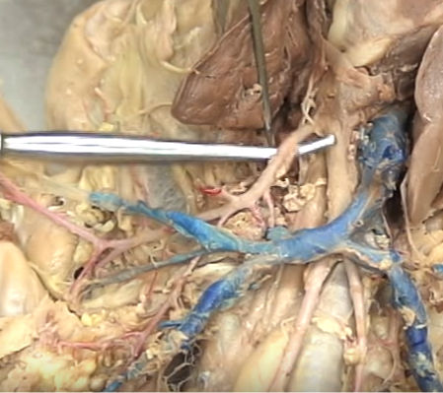
Vertebral

Slide 9
Costocervical

Slide 10
Thyrocervical

Slide 11
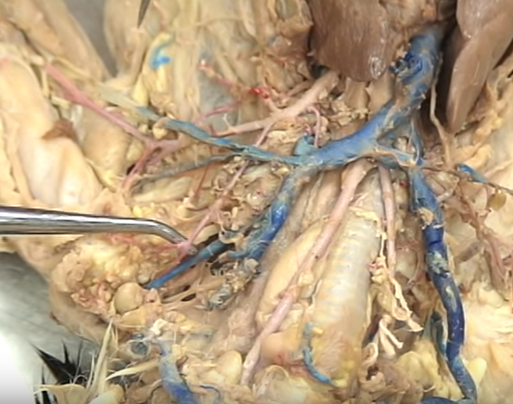
Transverse
Scapular

Slide 12
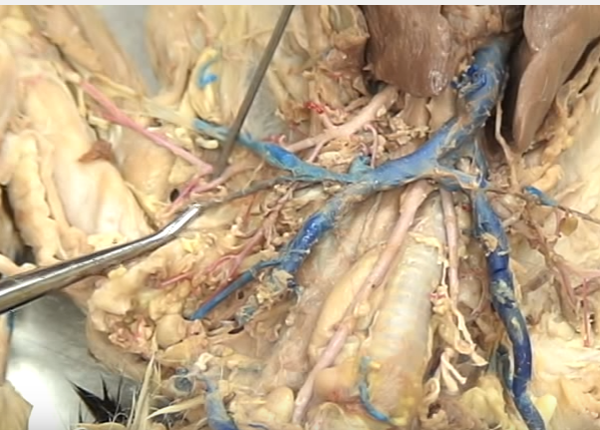
Subscapular (follow the vein!)

Slide 13
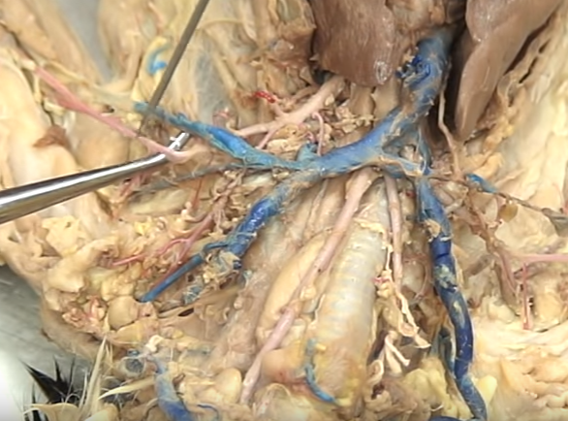
Axillary (after subsclapular)

Slide 14
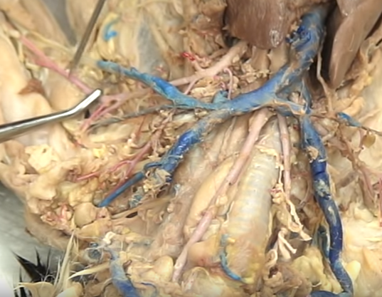
Anterior Humeral Circumflex

Slide 15
Brachial

Slide 16
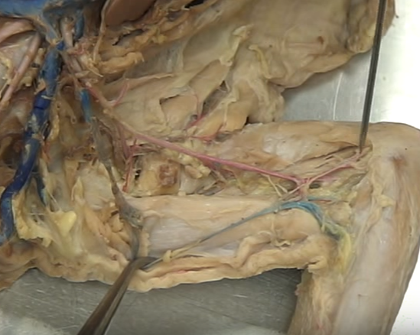
Radial (thumb side) Ulnar (pinky side)

