Slide 1
Kidney Dissection & Urinary System

Slide 2
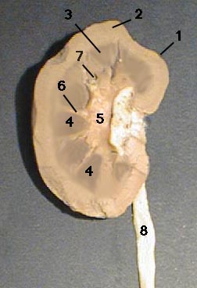
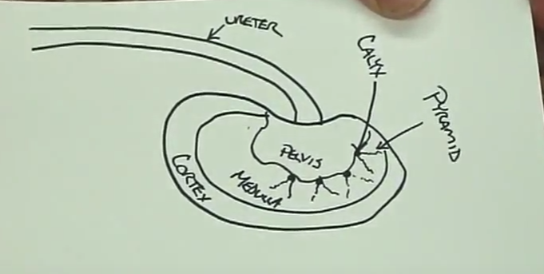
Kidney Diagram

Slide 3
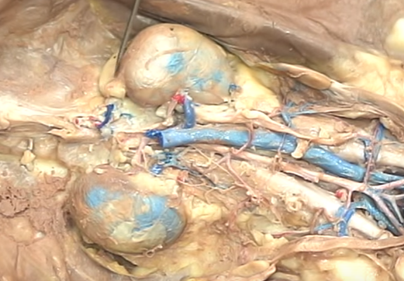
Adrenal (Suprarenal) Gland: makes adrenaline

Slide 4
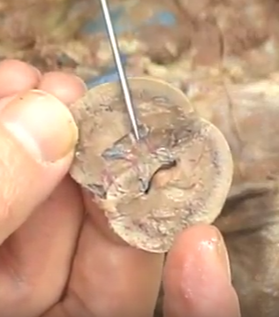
Renal Pelvis: collects urine from pyramids

Slide 5
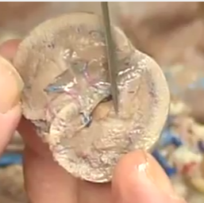
Renal Pyramid: collection of nephridia (cells) to filter out urine within the renal medulla

Slide 6
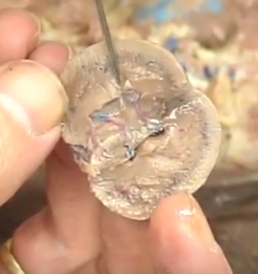
Renal Calyx (holes): opening out of pyramid, draining into renal pelvis

Slide 7
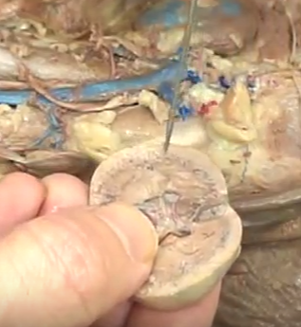
Renal Cortex (light region): metabolism

Slide 8
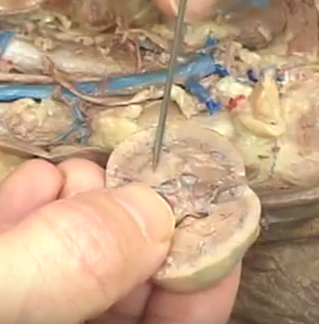
Renal Medulla (darker region): made of nephridia (cells), filters urine

Slide 9
Ureter: brings urine from renal pelvis to urinary bladder

Slide 10
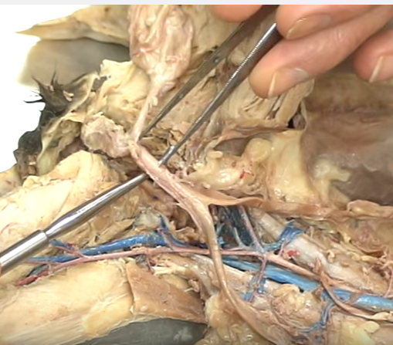
Urinary Bladder: stores urine

Slide 11
Urethra: brings urine to the outside

