Slide 1
Respiratory System Dissection

Slide 2
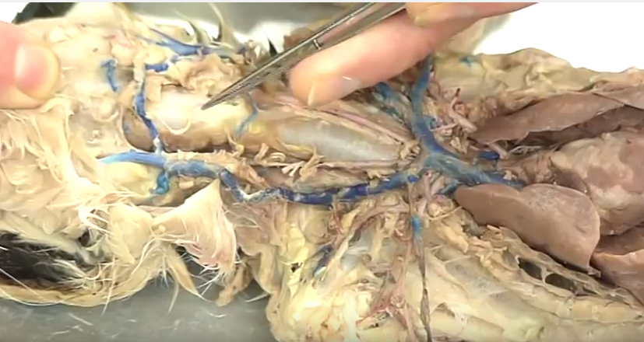
Larynx (region): houses vocal cords

Slide 3
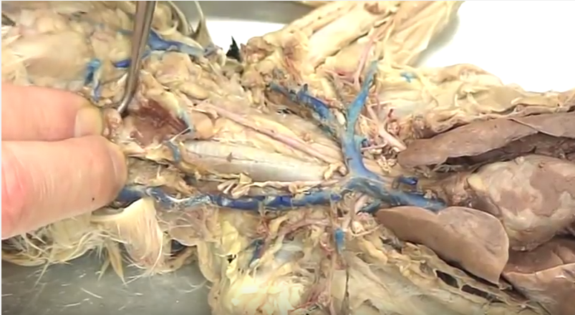
Vocal Cords (internal flaps): vibrate for vocalization

Slide 4
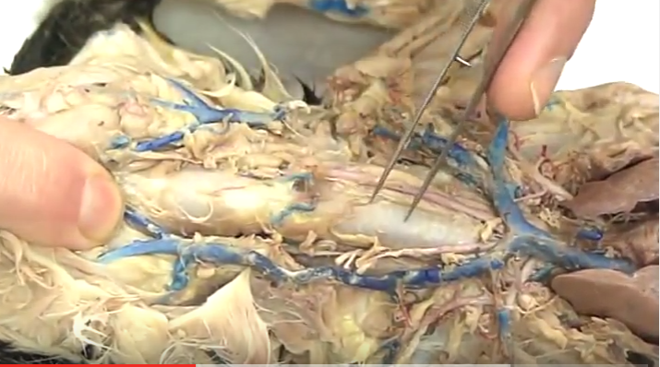
Trachea: air to lungs

Slide 5
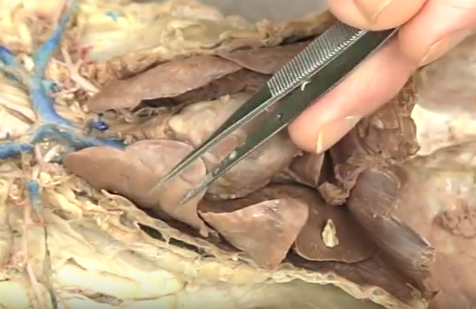
Apical Lobe of Lung: respiration/gas exchange

Slide 6
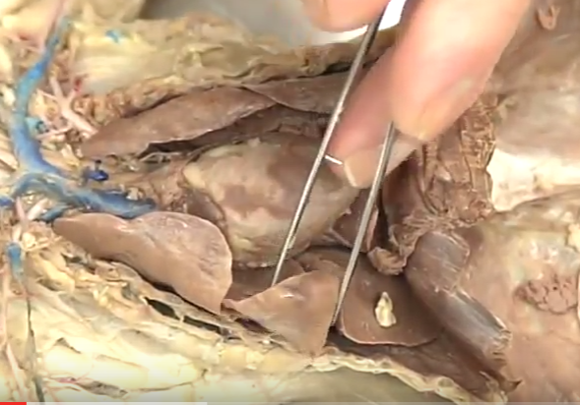
Cardiac Lobe of Lung : respiration/gas exchange

Slide 7
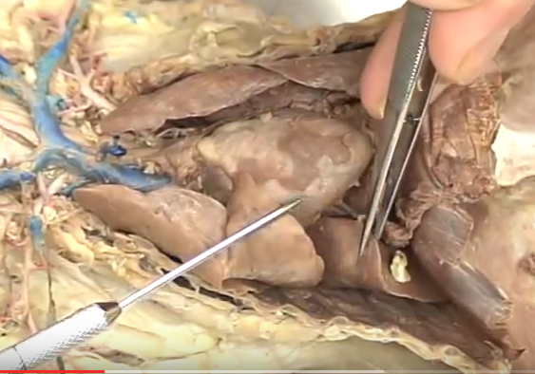
Diaphragmatic Lobe of Lung : respiration/gas exchange

Slide 8
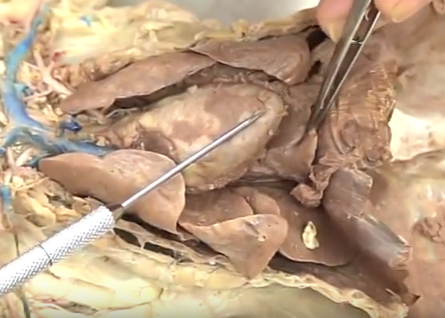
Intermediate Lobe of Lung : respiration/gas exchange

Slide 9
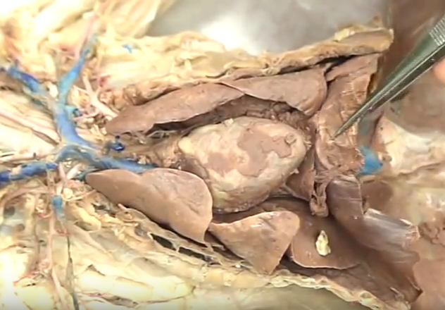
Diaphragm: muscle for breathing

