Slide 1
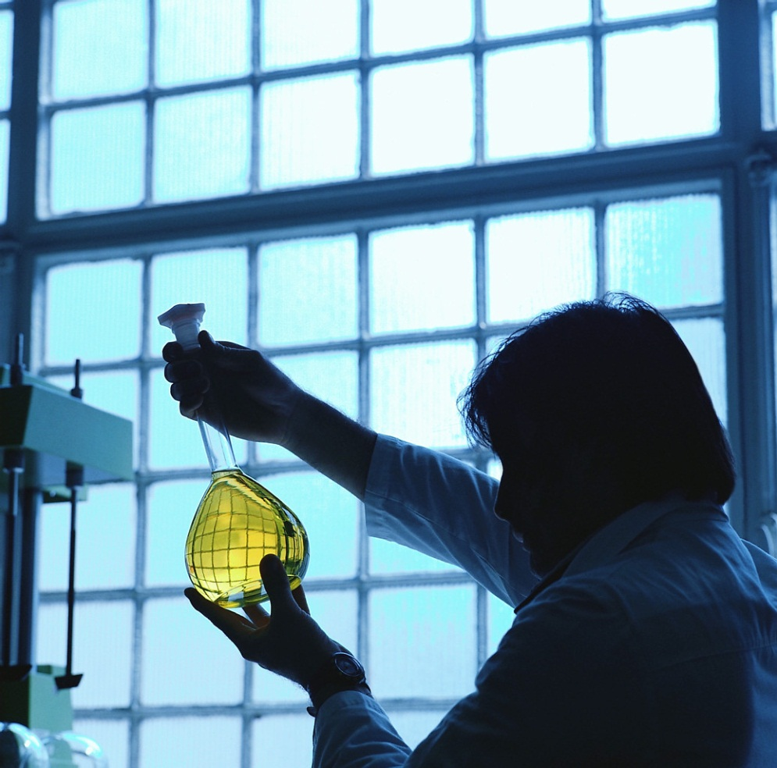
Matter and Change
Chapter 2

Slide 2
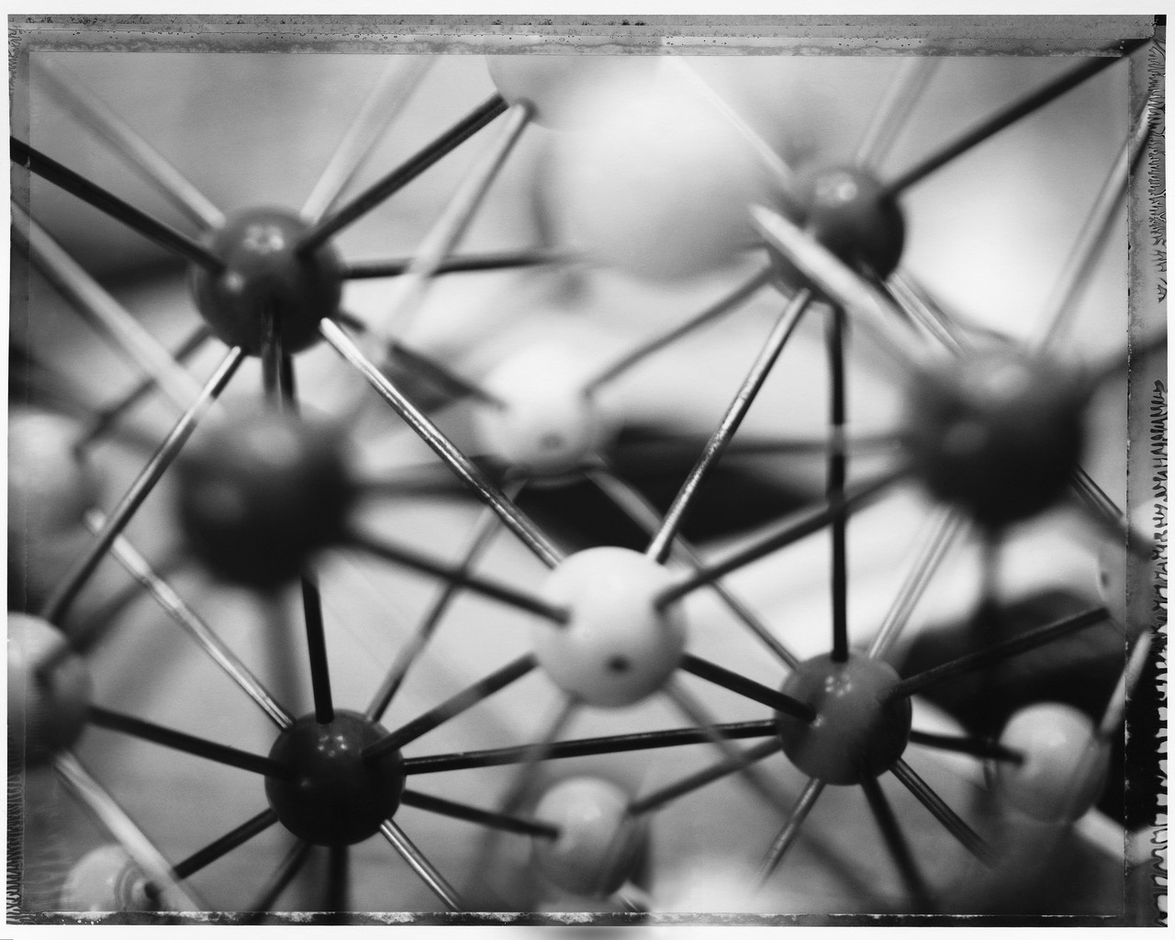
Matter
Definition
Substance – uniform and definite composition; only 1 kind of matter
Physical properties
Color
Solubility
Odor
Hardness
Density
Melting point
Boiling point

Slide 3
Matter (continued)
States of matter
Solid – definite shape & volume
Liquid – flowing, fixed volume, assumes shape of container
Gas – state at room temperature; Vapor – liquid/solid at room temp, assumes volume, shape of container
Physical changes
Ask: is it still the same, only different in size, etc?

Slide 4
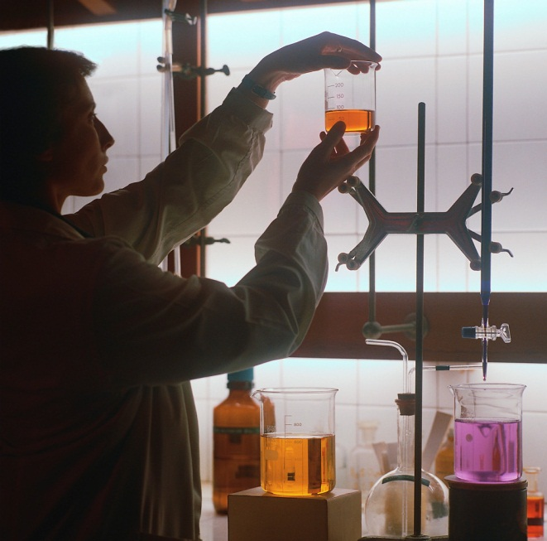
Mixtures – 2+ substances
Classifying
Heterogeneous – “bits” scattered throughout
Homogeneous – uniform throughout; solutions
Phases – separate different parts, only one in homogeneous
Separating mixtures
Physical methods – sifting, magnetism, etc.
Distillation for liquids – boiling points
Chromatography – dyes vs. inks, pigments, etc.

Slide 5
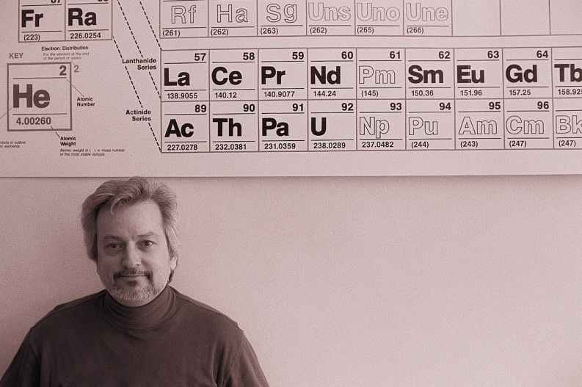
Elements & compounds (cmpds)
Element – one substance, cannot be broken down
Cmpds – 2+ elements chemically combined, can be broken down; may look like a homogeneous mixture
Symbols – 1 or 2 letters (now 3)
1st letter capital, 2nd lower
derived from Latin/Greek, place of discovery, honor scientist, etc.

Slide 6
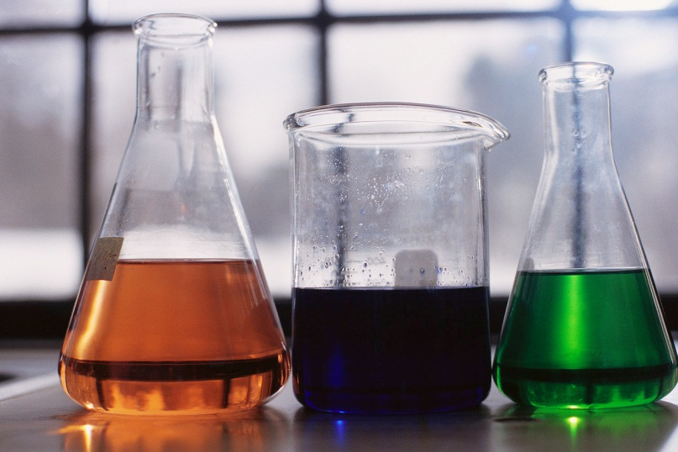
Chemical reactions (rxns)
Reactants → Products
Based on chemical properties, must be a chemical change
Ask: is it different/new?
Indications of chemical change
Heat/cold
Light
Color/odor
Gas emitted
Conservation of mass - Quantity of matter is the same on both sides

