Slide 1

Scientific Measurement
Chapter 3

Slide 2
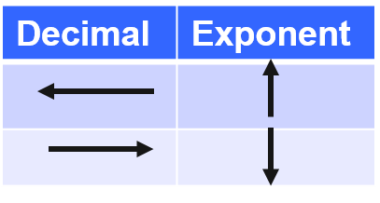
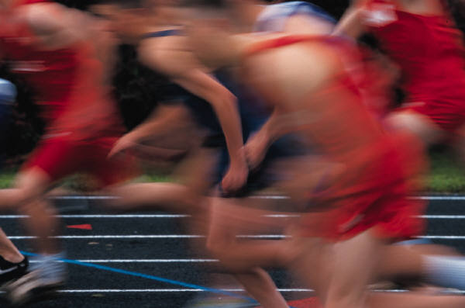
Importance of measurement: WHY BOTHER???
We deal with small numbers!!! Track, horse races, etc.
Qualitative vs. quantitative measurements
Qualitative = descriptions, non-numerical
Quantitative = measurements, numerical and units
Scientific notation EX: 6.59 X 10³ or 6.59 X 10⁻³
Number greater than or equal to one, less than 10
Exponent positive or negative
Rules
multiplication/division – deal with the coefficients 1st, then add/subtract exponents.
addition/subtraction – make the exponents the same first (violate rule for n between 1 – 10), then just worry about coeffients

Slide 3
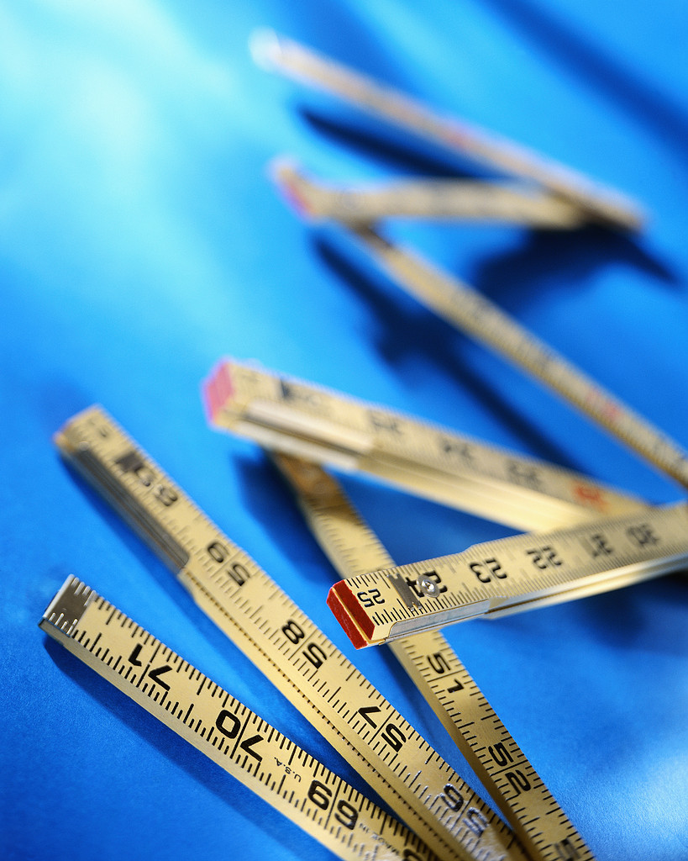
Uncertainty in measurements
Accuracy – how close a measurement is to “correct”
Precision – how close measurements are to each other
Accepted value (theoretical or book value) – “correct” value
Experimental value – actual value obtained
Error = experimental value – accepted value; will be positive or negative depending on relationship to accepted value
Percent error = | error___| X 100%
accepted value

Slide 4
Significant figures – all measured values PLUS an estimated number
Every nonzero digit is significant: 117
Rightmost zeroes in decimals are not placeholders, significant: .907000 (you can’t get rid of them in sci notation)
Zeroes between nonzeroes are significant: 907
Leftmost zeroes in decimals are placeholders, not significant: .000907 (you can get rid of them in sci notation)
Rightmost zeroes of understood decimals are placeholders, not significant: 907,000
Infinite significant digits
counted objects: 23 students
defined quantities: 60 seconds in 1 minute

Slide 5
Rounding – using significant figures in calculations
look at each number, find out the least # of significant digits; round to that # and add zeroes.
If # is less than 5, drop it; greater, round up
RULES:
Addition/subtraction
answer rounded to least number of decimal places
Multiplication/division
answer rounded to least number of significant digits

Slide 6
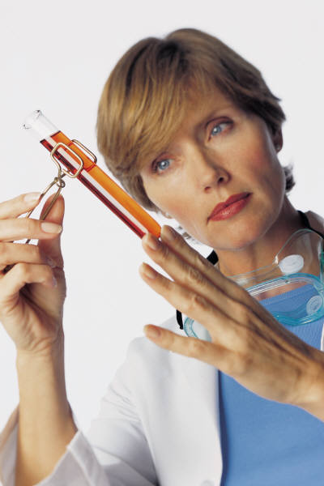
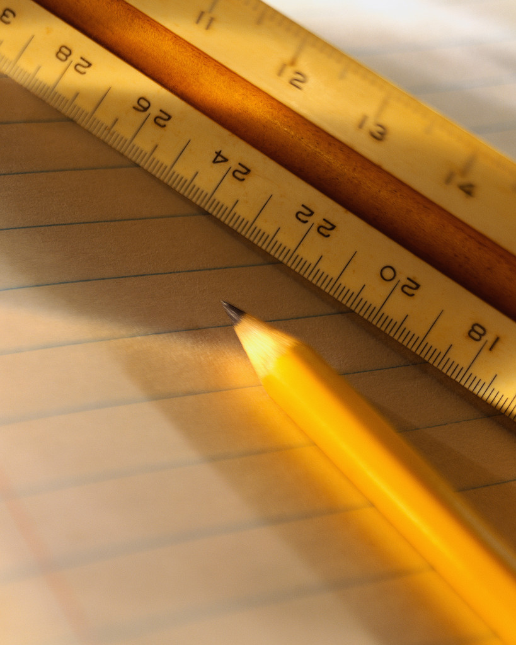
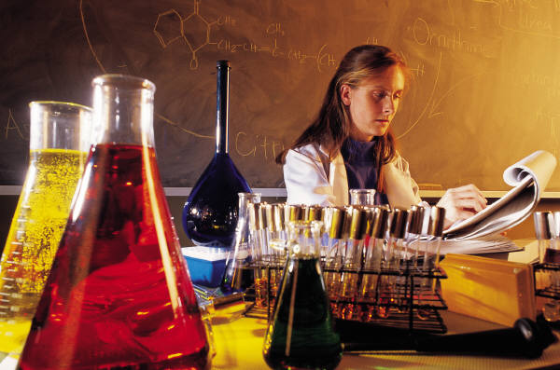
SI system
Length = meter
Volume = m³ (or L = dm³)
Mass = kilogram
Density = g/cm³
Temperature = Kelvin
Time = second
Pressure = pascal (or atmospheres, mm mercury)
Energy = joule (or calories)
Amount of substance = mole
Luminosity = candela
Electric current = ampere

Slide 7
Prefixes
mega (M) = 10⁶
kilo (k) = 10³
Hecto (h) = 10²
Deka (D) = 10¹
deci (d) = 10⁻¹
centi (c) = 10⁻²
milli (m) = 10⁻³
micro (u) = 10⁻⁶
nano (n) = 10⁻⁹
pico (p) = 10⁻¹²

Slide 8

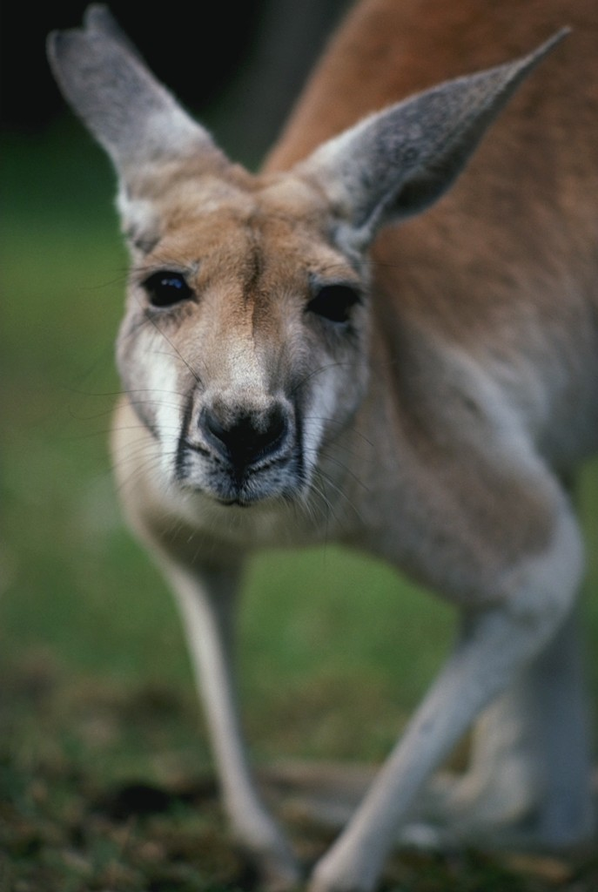
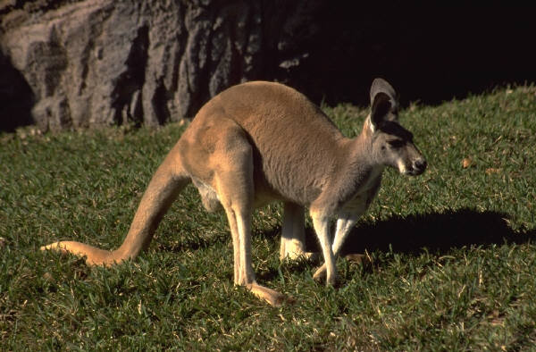
As the saying goes…
Kanga r o o s | Hopping | Down t h e | Mountain | drinking | chocolate | mi l k

Slide 9
Convert:
15 grams to kilograms
0.37 milligrams to Hectograms
7.43 centigrams to Dekagrams
8.4 micrograms to kilograms

Slide 10
Conversions
1 L = 1000 mL = 1 dm³
1 cm³ = 1 mL
weight – force of gravity on an object
mass – amount of matter in an object

Slide 11
Definitions
density = mass/volume
specific gravity = density of substance/density of water (which is 1 g/cm³)
used as a comparison to water, determines integrity of substance
car battery
blood disease detection
transmission fluid
temperature
Kelvin scale based on absolute zero K = ⁰C + 273
Celsius scale based on freezing water ⁰C = K – 273

Slide 12
Review for Test
Terms – matching with definition
Converting decimal to sci. notation
Significant figures – rounding, etc
Metric conversions
Density formula – finding mass, volume
Temperature conversion – C⁰ to K, K to C⁰

