Slide 1
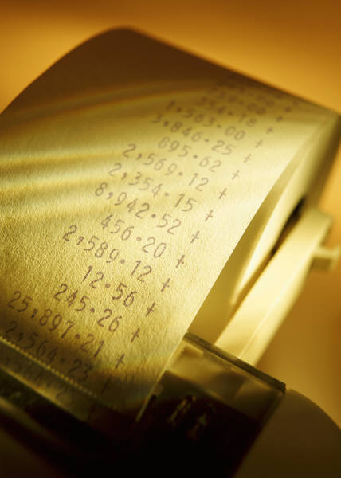
Problem Solving in Chemistry
Chapter 3
Extension

Slide 2
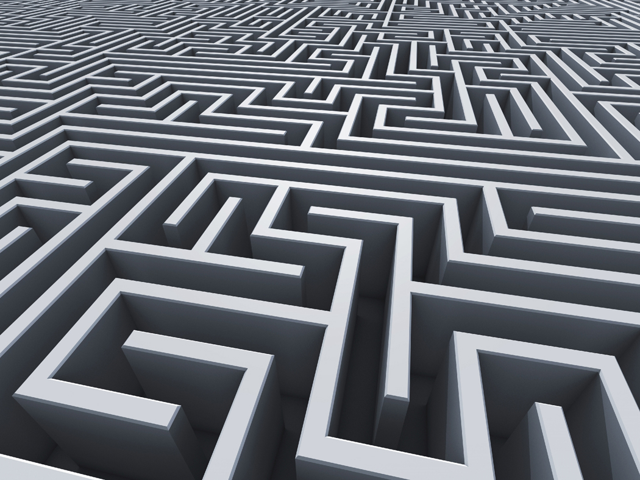
What do I do now?
  Technique
    Analyze
      list knowns, unknowns
      apply conversions
    Calculate
      solve by addressing the units – don’t memorize the technique!
      unknown label should be only remaining
    Evaluate
      does it make sense?

Slide 3
What do I do now? Examples
What is the mass, in grams, of a piece of lead that has a volume of 19.84 cm³? (density of lead = 11.4 g/cm³)

Slide 4
What do I do now? Examples
What is the volume, in cubic centimeters, of a sample of cough syrup that has a mass of 50.0 g? (density of syrup = .950 g/cm³)

Slide 5
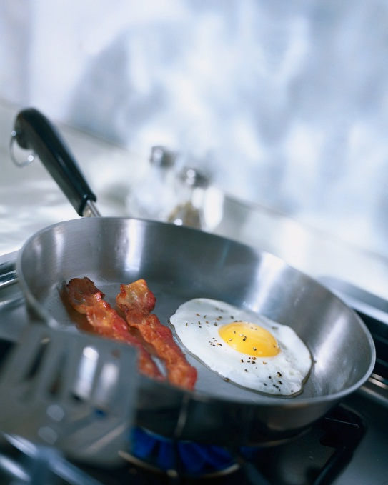
Conversion factors – using common conversions (1 kg = 1000 g)
Example #1
If 2 teaspoons of chili powder are needed to make a 10 serving chili recipe, how many teaspoons should be added to serve a crowd of 600?

Slide 6
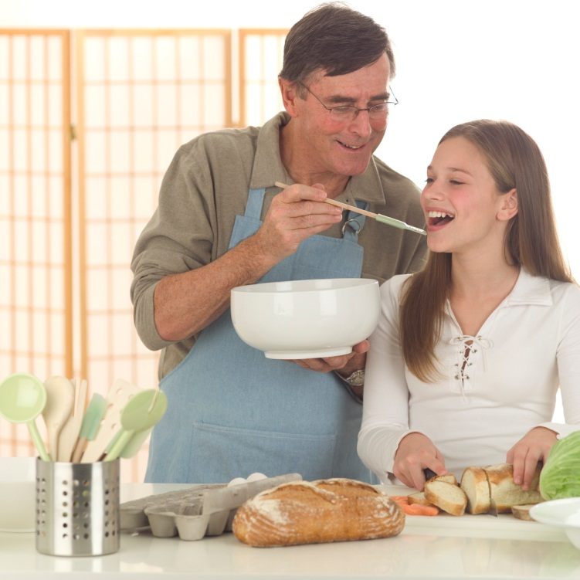
Example #2
How many cups are in this number of teaspoons of chili powder? (3 tsp = 1 tblspn, 16 tblspn = 1 cup)

Slide 7
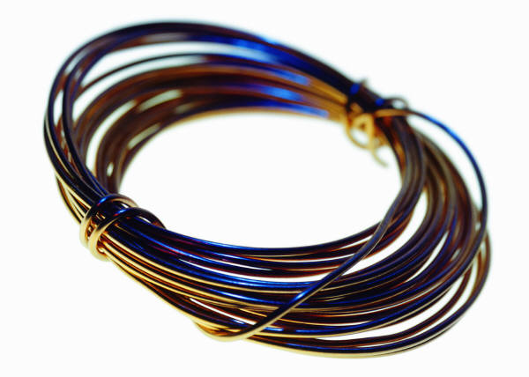
Example #3
How many students can obtain a wire sample of copper if each student needs 1.84 grams and the spool has a mass of 50.0 grams?

Slide 8
Example #4
Express 750 dg in grams.

Slide 9
Example #5
What is the volume of a pure silver coin that has a mass of 14 grams? (density of Ag = 10.5 g/cm³)

Slide 10
Example #6
What is .073 cm in micrometers?

Slide 11
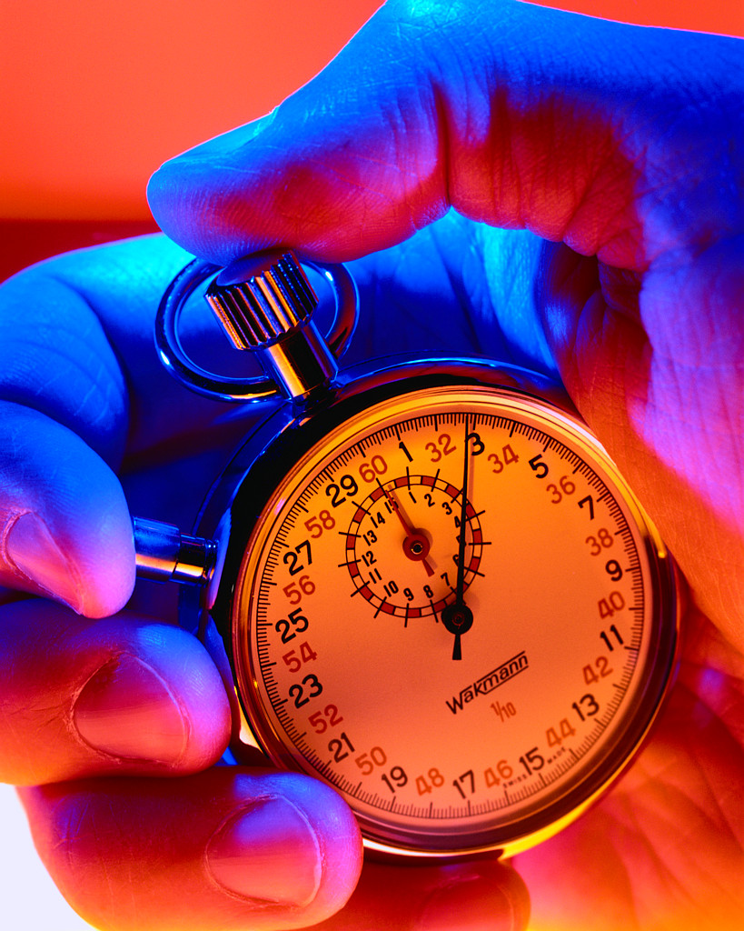
Example #7
How many seconds are in one day?

Slide 12
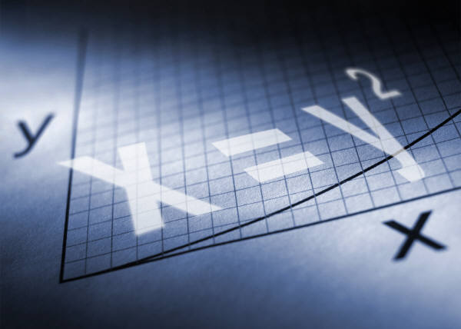
Dimensional analysis – using conversion units (dimensions) to arrive at an answer
    Use the factor-label technique!
    Avoid “chicken-scratch” math!
    Your labels will bring you through the process to your answer

Slide 13
Dimensional Analysis - Examples
“Firkins” worksheet!

Slide 14
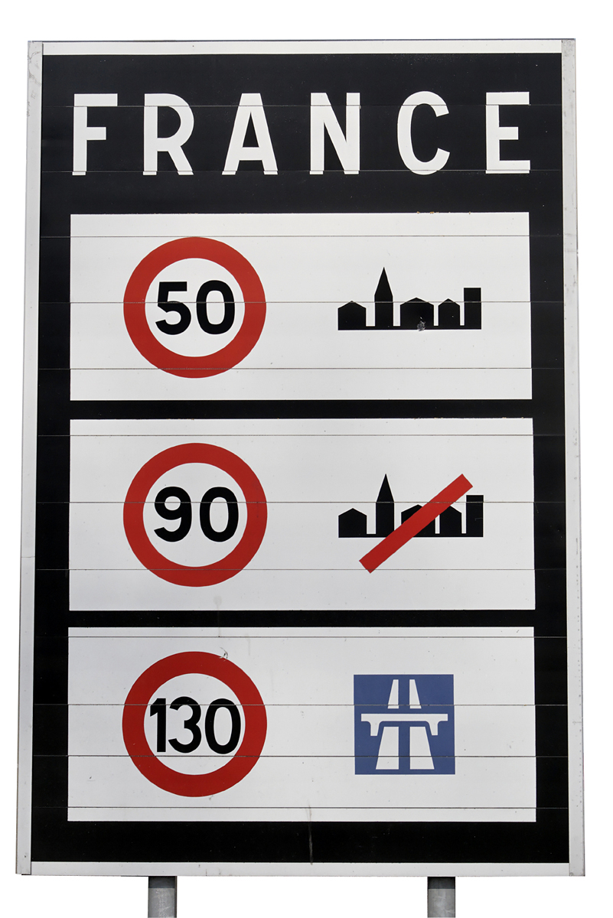
More complex problems
If you are traveling at a rate of 40 km/hr, how many meters have you gone in 30 seconds?

Slide 15
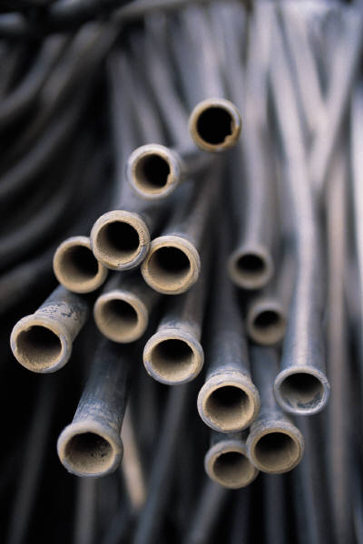
Dimensional Analysis - Examples
The density of manganese is 7.21 g/cm³. What is the density of Mn in kg/m³?

Slide 16
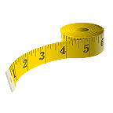
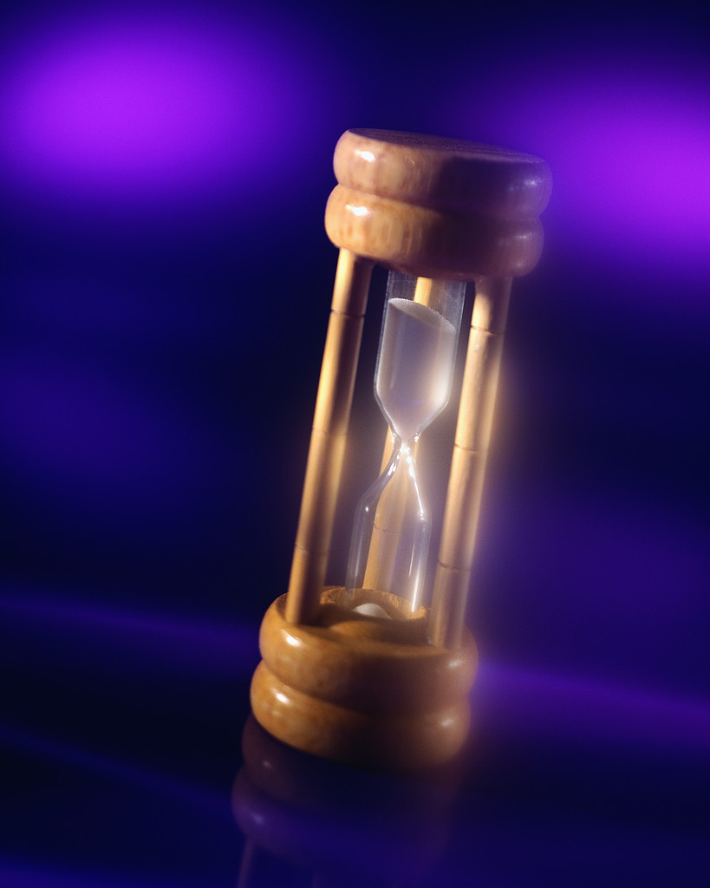
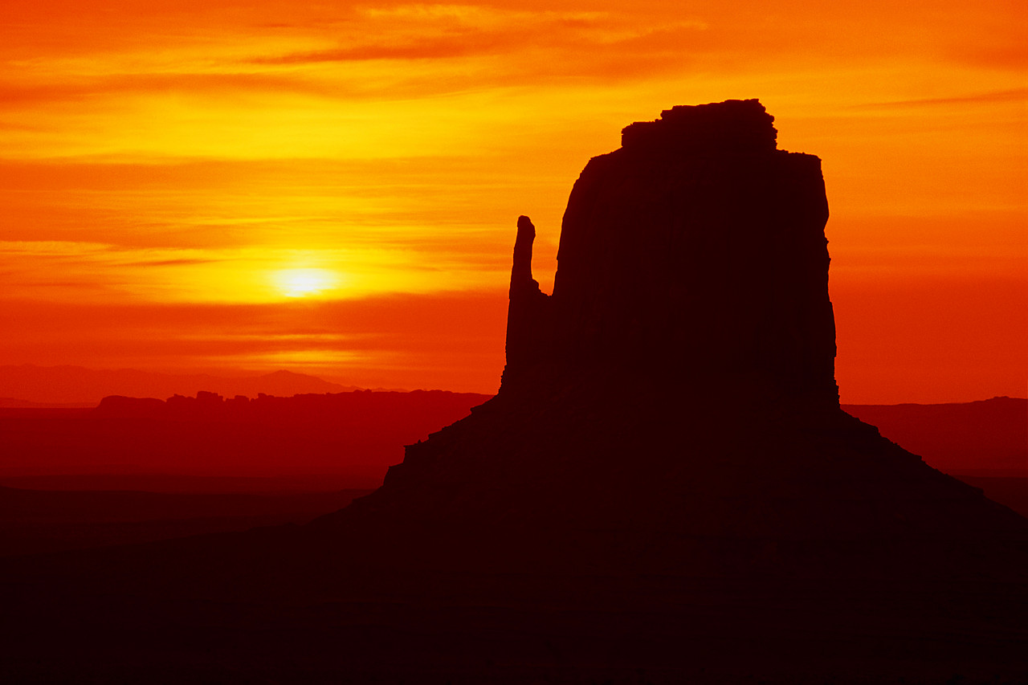
More complex problems
If the sun is 150 million km from earth, how many hours does it take for its light to reach us?
  Speed of light = 3.00 X 10⁸ m/sec

Slide 17
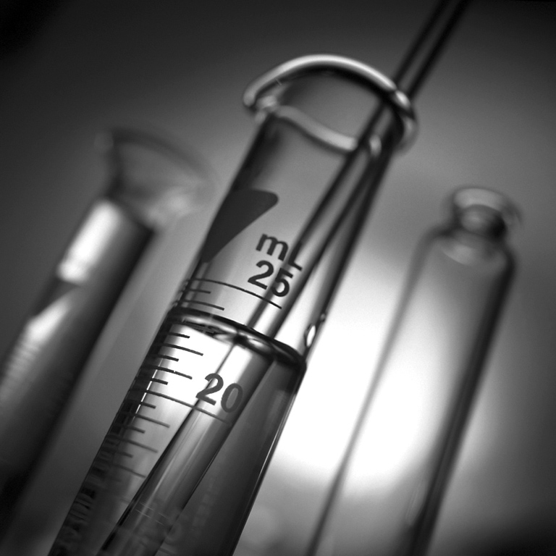
More complex problems
Express 2.5 g/cm³ in kg/dm³

