Slide 1
ATOMIC STRUCTURE AND THE PERIODIC TABLE
CHAPTERS 4 & 6

Slide 2
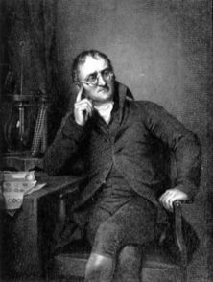
Atoms - Early models
Democritus vs. Aristotle
Dalton & his laws
all elements are composed of indivisible atoms
each element is made of its own unique atom
atoms of different elements can combine in simple, whole-number ratios to form compounds
chemical rxns occur when atoms are separated, joined, or rearranged; one element’s atoms are never changed into another element’s atoms

Slide 3
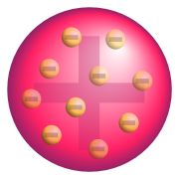
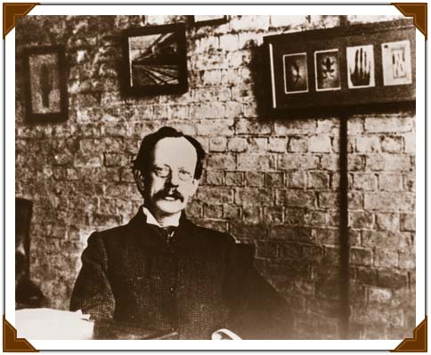
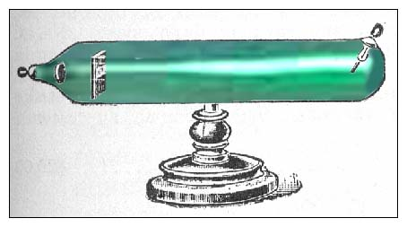
Atoms - Early models
Electrons
discovered by J. J. Thomson in 1897
show that atom is made of subunits
cathode ray tube (p. 109, 110)
Atom – plum pudding model

Slide 4
Atoms – Early Models
Protons & neutrons
must be present; four reasons on page 107
Goldstein observed particles going opposite direction in cathode ray tube (protons)
Chadwick discovered identity of rest of mass of atom (almost equal to proton) with no charge – neutron

Slide 5
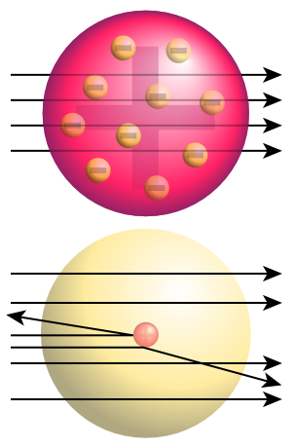
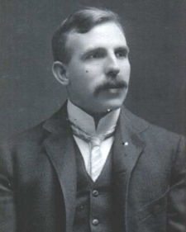
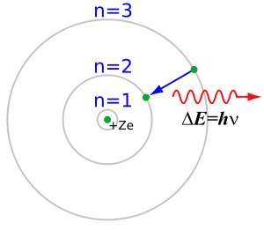
Atoms - Early models
Nucleus
Rutherford’s gold foil experiment
Fired alpha particles at foil, most passed straight through
Some particles deflected, some bounced straight back
New theory; most atom is empty, almost all mass and positive charge is concentrated in center = nucleus
gold foil demo

Slide 6
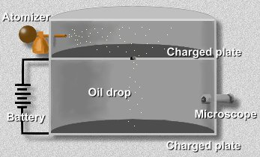
Charge of an electron
Robert Millikan – oil drop experiment
Electron has1 unit of negative charge, mass 1/1840 of total mass of hydrogen (which consists of 1 p+, 1 e⁻)

Slide 7
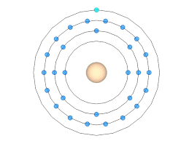
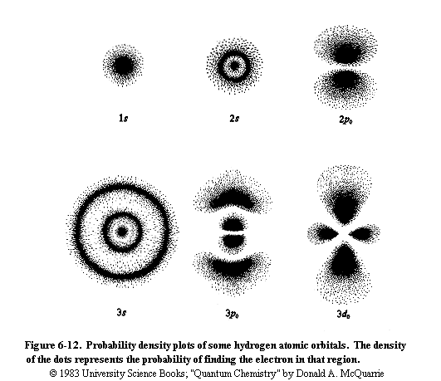
Later Atomic Theory
Bohr's Model
Today’s Model

Slide 8
Atoms – Early Models
Atomic number
number of protons in nucleus
infers # of electrons since atoms have no charge
Atomic mass
total number of protons & neutrons
# neutrons = mass # - atomic number
examples:
Beryllium (Be) atomic # = 4 mass # = 9
Neon (Ne) atomic # = 10 mass # = 20
Sodium (Na) atomic # = 11 mass # = 23

Slide 9
Atoms
Isotopes
diff. forms of same element due to diff # neutrons
same # protons (same element), only # neutrons vary
examples:
Neon-20, Neon-21, Neon-22
Carbon-12, Carbon-13, Carbon-14

Slide 10
Calculating Average Atomic Mass Considering Isotopes
What is the average atomic mass of silicon if 90% has a mass of 28, 8% has a mass of 29, and 2% has a mass of 30?

Slide 11
Atoms
Atomic mass units – comparative scale based around carbon-12
actual mass in grams too small to work with
everything measured in relation to carbon
example: hydrogen 1/12 particles, 1 amu listed on table
.0079 due to isotopes of more mass (average)
if we had 6.022 X 10²³ atoms of an element, amu = grams
(don’t worry about that number for now!)

Slide 12
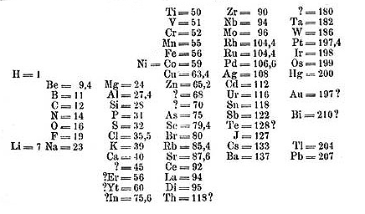
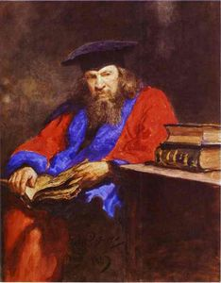
Periodic Table - Development
Mendeleev (mid 1800s)
listed by increasing mass, then grouped similar properties
periodic = repeating (traits repeat, similar elemental traits fall directly under in columns)
only 70 elements discovered at his time, left blank spaces due to traits

Slide 13
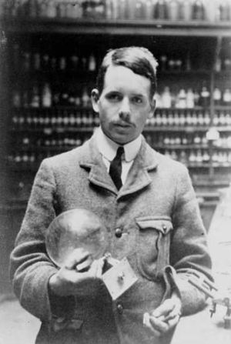
Moseley (1913)
listed by increasing number, not mass
periodic law = elements are arranged in order of increasing #, repetition of traits directly under similar elements

Slide 14
Periodic Table - Modern
placement of atomic #, mass, abbreviation, etc.
horizontal rows = periods (7 total)
vertical columns = group or family (18 total – ignore letters, roman numerals)
Table

Slide 15
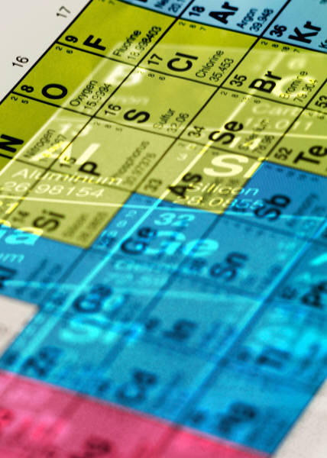
Families
metals
electrical conductivity
ductile
malleable
lustrous
alkali metals
alkaline earth metals
transition metals

Slide 16
Families
nonmetals
poor conductors
nonlustrous
brittle solids/gases, liquids at room temp
chalcogens
halogens
noble gases
lanthanoids
actinoids
metalloids (staircase – down & over, skipping aluminum) – traits of both metals & nonmetals

Slide 17
