Slide 1
ELECTRONS IN ATOMS
Chapter 5

Slide 2
Quantum theory
Explaining where electrons are located
Quantum levels = energy levels
Outer levels are more reactive than inner
Done in multiple ways
Electron configuration
Orbital diagrams
Quantum numbers method
Lewis dot diagram

Slide 3
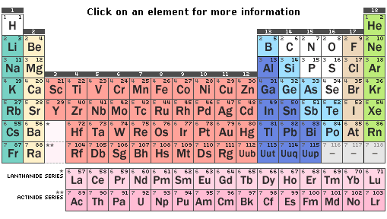
Quantum Theory
Quantum numbers
Principle quantum (n)
Row number → 1 – 7
Sublevel quantum (l)
Column block description → s, p, d, f
Orbital quantum (m)
Orbital = pairs of electrons
s = 1 orbital, p = 3, d = 5, f = 7
Spin quantum (s)
Clockwise spin or counterclockwise

Slide 4
Quantum Theory
Questions
How many sublevels in energy level 1?
How many sublevels in energy level 3? Name them.
How many electrons can energy level 2 hold?
What do the orbitals in energy level 3 look like? (Orbital diagram!)

Slide 5
Electron Configurations
Naming electron position
Includes n, l, m
Use periodic table to name position

Slide 6
Electron Configuration – Arrow Diagram
7s 7p
6s 6p 6d 6f 6g
5s 5p 5d 5f 5g
4s 4p 4d 4f
3s 3p 3d
2s 2p
1s

Slide 7
Electron Configurations
Practice questions!
Chlorine - 17
Copper - 29
Oxygen - 8
Manganese - 25
Einsteinium - 99
Radium - 88

Slide 8
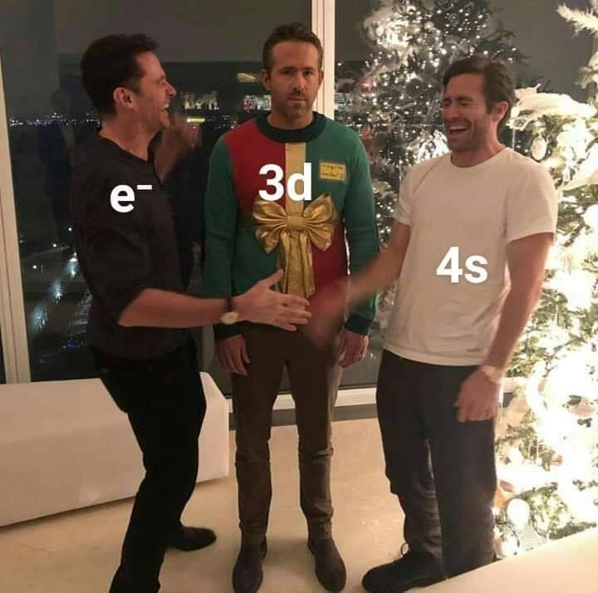

Slide 9
Orbital Diagrams
Based off configurations
Simply draw orbitals and add arrows
Fill orbital, then pair up!
Pauli Exclusion Principle
Example:
Argon
Xenon

Slide 10
Exceptions to the Rules
Full d and f orbitals are most stable
Half-full d and f orbitals are more stable
d and f orbitals missing an electron are unstable
Result: Copper #29
Result: Manganese #25
Result: Samarium #62

Slide 11
Quantum Numbers
1st number → n = energy level (size)
1-7
2nd number → l = sublevel (3D shape)
s = 0, p = 1, d = 2, f = 3
3rd number → m = orbital (3D plane)
start with middle orbital as zero, work out right, then left side
4th number → s = spin
either +1/2 or -1/2
Example: Cobalt

Slide 12

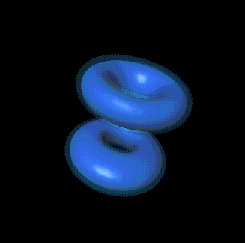
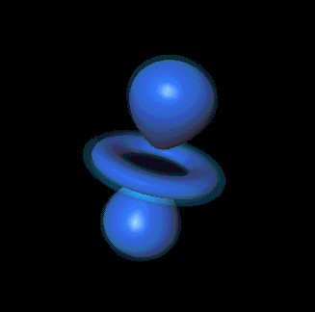
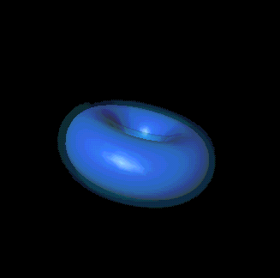

Which element is being described by these quantum sets (if they represent the last filling electron?)
n = 1, l = 0, m = 0, s = -1/2
3, 2, 1, +1/2
4, 2, 2, -1/2
3, 2, 2, +1/2
3, 2, 0, -1/2

Slide 13
Quantum numbers - practice
Identify the element:
(3, 2, 2, -1/2)
(2, 0, 0, +1/2)
(3, 1, 0, -1/2)
(2, 1, -1, +1/2)
Give the quantum number for:
Carbon
Chlorine
Iron
Uranium

Slide 14
Lewis Dot Diagram
Dot = electron in S and P of highest energy level
Example:
Oxygen
Potassium
Chromium
Uranium
Sodium

Slide 15
Shorthand Electron Configurations
[previous noble gas] continue configuration
Example: Calcium
[Ar] 4s²

Slide 16
Practice Time!
Give the electron configuration, orbital diagram, quantum # (final electron), and Lewis Dot diagram for the following elements:
Magnesium - #12
Nickel - #28
Tellurium - #52
Chromium - #24
Gold - #79
Lutetium - #71
Plutonium - #94

