Slide 1
Chemical Quantities
Chapter 10

Slide 2
Meet the Mole!
What is a mole?
Number of particles in a mole
“particles” = atoms, molecules, ions, etc
Avagadro’s # = 6.02 X 10²³
Remember that diatomics don’t exist as atoms, but molecules!
Remember how to do conversions (factor-label method)?

Slide 3


Mole as a Conversion Factor: Mole Island
Volume (gas @
STP)
22.4 L
Mole
Element?
1
Formula mass
6.02 X 10²³
Compound?
Atoms
Mass
Particles
#

Slide 4
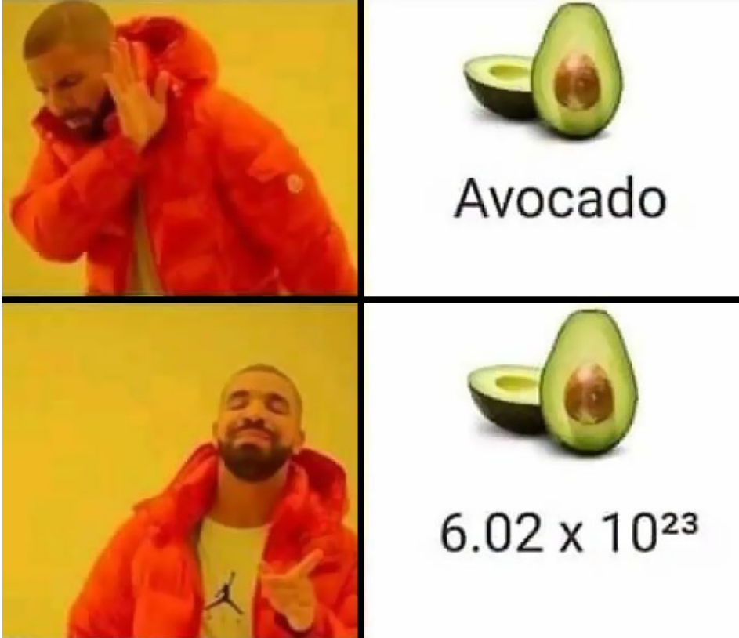
Using the mole - particles
EX: How many moles of magnesium if you have
1.25 X 10²³ atoms of magnesium?
EX: How many atoms in 1.5 moles of zinc?
EX: How many atoms in 2.12 mol of propane (C₃H₈ )?
First solve for the # molecules from moles
Second solve for the # of atoms from molecules

Slide 5
Mass of a Mole
gram atomic mass = atomic mass unit = 1 mole
formula mass of a mole of a compound
simply add up the formula masses
EX: SO₃
1 S @ 32 + 3 O @ 16 = 80 g
EX: (NH₄)₂CO₃ = ?
96 grams
Your book will differentiate between gram molecular mass and gram formula mass (molecular vs ionic).

Slide 6
Determining the grams given moles
EX: How many grams are in 9.45 moles N₂O₃?
find molecular mass 1st!

Slide 7
Determining moles given grams
EX: How many moles are in 92.2 g of
iron (III) oxide?

Slide 8
Volume of a mole of gas
STP = standard temperature and pressure (0⁰C
and 101.3 kPa)
At STP, 1 mole of any gas has a volume of 22.4 L.
EX: What is the volume in mL of .60 mole SO₂ gas at STP?
EX: The density of a gas is 1.964 g/L at STP. What is the molar mass of the compound?
ratio of calculated mass (43.99) grams of gas is about 2:1 to the volume (22.4), so answer makes sense.

Slide 9
Combining the two (mass-volume)
EX: How many grams of NO₂ are in 43 L
@ STP?
can’t go directly from L to grams, so must go L to moles to grams

Slide 10
How about to atoms?
EX: How many atoms are in 43L NO₂ @ STP?
L to moles, moles to molecules, molecules to atoms.

Slide 11
% composition and chemical formulas
% comp
% mass of an element = grams of element/grams of compound
EX: 8.20g Mg combines with 5.40g oxygen to form a compound. What is the % composition of that compound?
Mg = 60.3%, O (not O₂) = 39.7%

Slide 12
% composition and chemical formulas
EX: Calculate the % comp of propane (C₃H₈).
molar mass C₃H₈ = 44.0 g/mol
mass C in 1 mol = 36.0 g
mass H in 1 mol = 8.0 g
% C = 81.8%, %H = 18.2%

Slide 13
% composition and chemical formulas
finding mass using %
EX: what mass of carbon is in 82.0g of C₃H₈?
molar mass C₃H₈ = 44.0 g/mol
mass C in 1 mol = 36.0 g
%C = 81.8% (81.8 g C/100 g C3H8)
82.0g X 81.8/100 = 67.1 g C

Slide 14
% composition and chemical formulas
empirical formulas – lowest whole number formula (reduced)
C₂H₈ → CH₄
May sometimes be already in empirical formula – CO₂

Slide 15
empirical formulas
EX: What is the empirical formula of a compound that is 25.9% nitrogen and 74.1% oxygen?
assume 100 grams!
25.9% nitrogen= 25.9g N X (1 mol N/14 g N) = 1.85 mol N
74.1% oxygen= 74.1 g O X (1 mol O/16 g O) = 4.63 mol O
divide both by the smallest # moles: 1.85/1.85 = 1 N
4.63/1.85 = 2.5 O
can’t have 2.5 mol O, so double both: 2 N, 5 O = N₂O₅

Slide 16
molecular formula
must know the empirical formula AND molar mass first!

Slide 17
molecular formula
EX: What is the molecular formula of a compound whose molar mass is 60.6g and empirical formula is CH₄N?
first determine the mass of the empirical formula
1 C@ 12 = 12
4 H@ 1 = 4
1 N@ 14 = 14
formula mass = 30
second find ratio between molar mass and formula mass
60/30 = 2
IF there is a difference, multiply the empirical formula by that ratio. If the ratio is 1, then empirical formula = molecular formula.
2 (CH₄N) = C₂H₈N₂

Slide 18
empirical & molecular formula calculations
EX: What is the empirical formula of a compound that is a combination of 8.20 g magnesium combined with 5.40 g oxygen?
EX: What is the molecular formula of a compound that is 81.8% C and 18.2% H and has a molar mass of 88 g/mol?

