Slide 1
Chemical Bonding
A little bit of chapters
6, 7, and 8

Slide 2
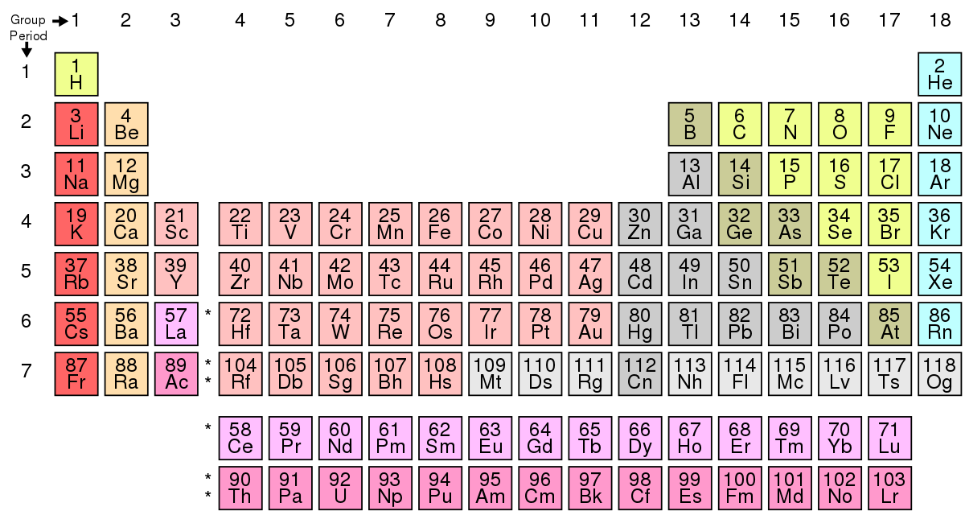
Atomic Size/Radius
Not considering ions!
Decreases across the period (watch for cation/anion switch), increase down the energy levels.
Lab on ionic size trends p. 180

Slide 3
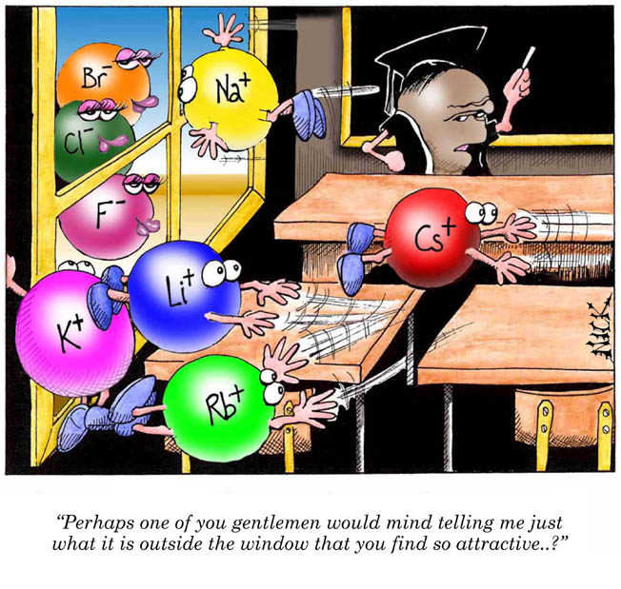
Cartoon courtesy of NearingZero.net

Slide 4
First Ionization Energy
Amount of energy req’d to remove an electron
Increases as you go right
Decreases as you go down

Slide 5
Bond Formation
Electronegativity (electron affinity) – tendency for atoms to attract e⁻ when combined
Increases across the period, decreases down the energy levels
Most active metals = lowest electronegativity values

Slide 6
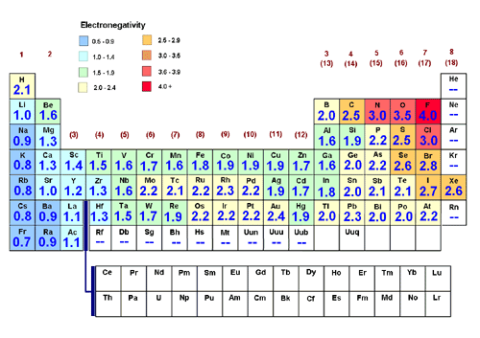
Electronegativity

Slide 7
Bond Strength
The stronger the electronegativity difference, the stronger the bond strength.
e⁻ difference: 1.90; strength = 568.1 kJ/mol
e⁻ difference: 0.01; strength = 298.3 kJ/mol

Slide 8

Bond Character

Slide 9
Bond character
“high” difference = e⁻ is transferred (ionic)
“low” difference = e⁻ is shared (covalent)
Ionic bonds: Covalent bonds:
High melting points Low melting points
Soluble Less soluble
Crystalize Brittle
Conductive Nonconductive

Slide 10
SO WHAT IS “HIGH” OR “LOW”?
Covalent < 1.67 < Ionic

Slide 11
Calculating bond strength
Find the difference in electronegativities!

Slide 12
Calculate:
Mg – O
B – P
Be – Si
C – Na
Li – O
Mg – N
3.44 – 1.31 = 2.13; ionic
2.19 – 2.04 = .15; covalent
1.90 – 1.57 = .33; covalent
2.55 - .93 = 1.62; covalent
3.44 - .98 = 2.46; ionic
3.04 – 1.31 = 1.73; ionic

Slide 13
Van der Waals radius > covalent/ionic radius
Ionic radius
Internuclear dist;
Bond axis;
Bond length
Van der Waals radius
Bond length ~ = sum of individual radii (usually a little less)

Slide 14
Covalent bonds - molecule
Bond axis – line joining 2 nuclei
Bond angle – 3 atoms; angle betw. 2 bond axes
Bond length – distance betw. nuclei in bond axis (varies)
Motions:
Bending
Rotating
Symmetrical stretching
Asymetrical stretching

Slide 15
REMINDER SLIDE: Atomic Size/Radius
Not considering ions!
Decreases across the period, increase down the energy levels.

Slide 16
Particle sizes (now consider ions/bonding)
Ionic radii
Anion (neg) > stable atom
Cation (pos) < stable atom
Add the two up = internuclear distance
Covalent radii
Consider: using diatomic size to predict another compound’s size. Ex: Cl₂ + I₂ → 2 ICl
i.d. Cl₂ = 199 pm; ½ = 99.5
i.d. I₂ = 266 pm; ½ = 133
(99.5 + 133) = 233 pm

Slide 17
Van der Waals radius
Minimum distance of non-bonded atoms
e⁻ clouds repel each other
Greater than covalent radius, for bonded side is sharing e⁻
“squishing” cloud on that side

Slide 18
Summary of radii
Atomic
Measured on atoms in crystals
Ionic
Diff due to gain/loss of e⁻
Covalent
< atomic due to sharing of e⁻
May be > if multiple atoms
Van der Waals
Should be around same as atomic

