Slide 1
Chapter 1
Intro to Anatomy/Physiology

Slide 2
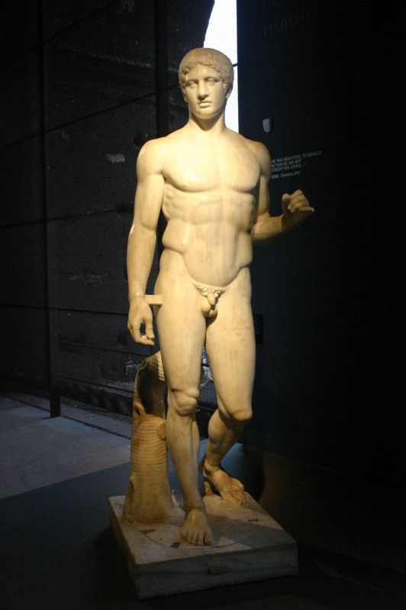
Studying the Human Body
A study of anatomical relationships
  Doryphoros (Roman)
    “Spear Bearer”
    ~1st century B.C.
    Body dimensions modeled off of hand

Slide 3
The number phi
The Golden Number

Slide 4
Medieval Medical Illustrations

Slide 5
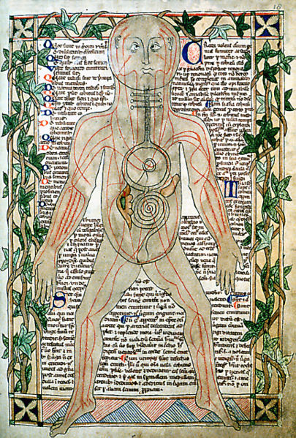
Circulatory System

Slide 6
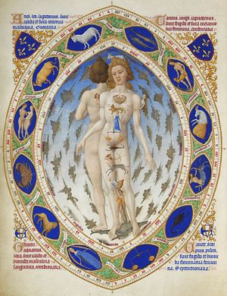
Regional Ailments - Causes

Slide 7
The Book That Fixed Anatomy: De Humani Corporis Fabrica by Andreas Vesalius
Revolutionizing Anatomy
Andreas Vesalius (1514 – 1564)
Publishes “De Humani Corporis Fabrica” (On the Fabric of the Human Body) in 1543
Operating theater

Slide 8
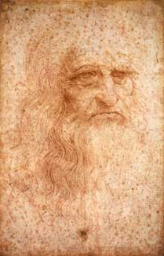
Leonardo daVinci
The true first revolutionist?
1452 - 1519

Slide 9
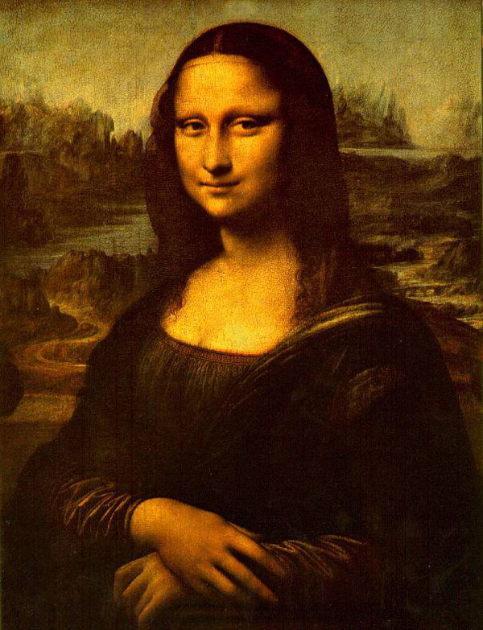

Slide 10
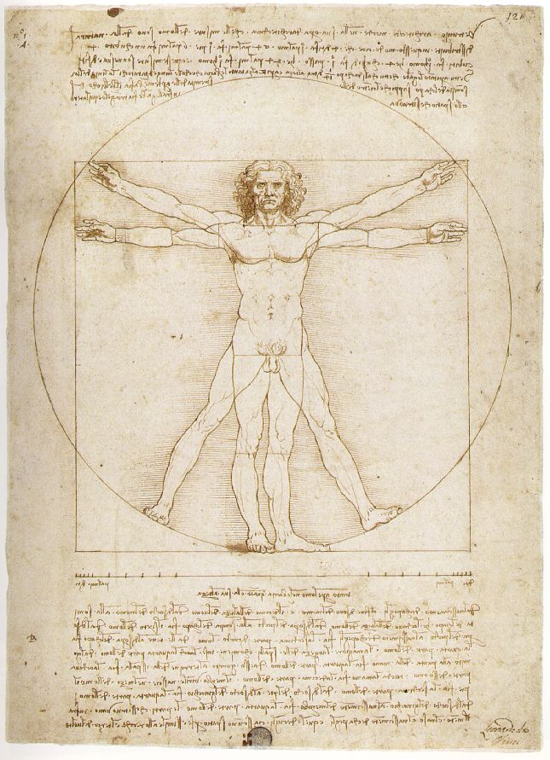

Slide 11
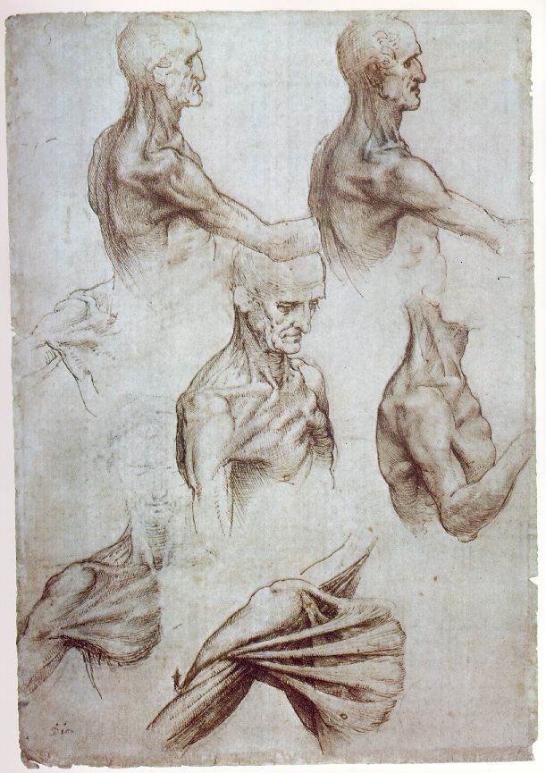

Slide 12
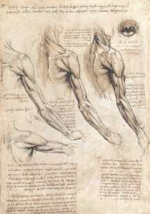

Slide 13
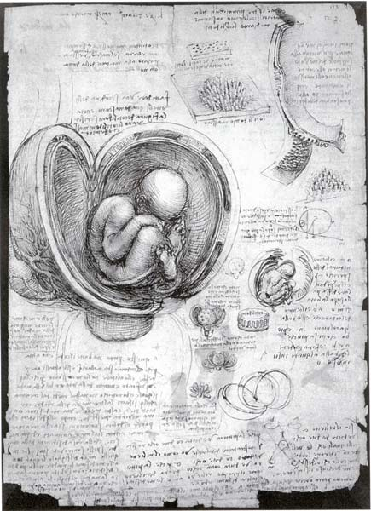

Slide 14
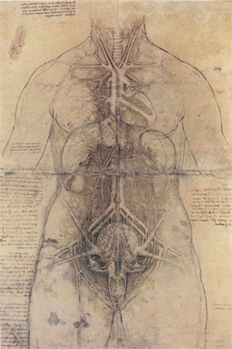

Slide 15
Definitions: ANATOMY & PHYSIOLOGY
ANATOMY
  Study of body structures and the relationships of its parts
From two Greek words:
  ana=up
  tomos(temos)= cutting
PHYSIOLOGY
  Study of the functions of a living organism and its parts
From two Greek words:
  physis =nature
  logos=science/ study

Slide 16
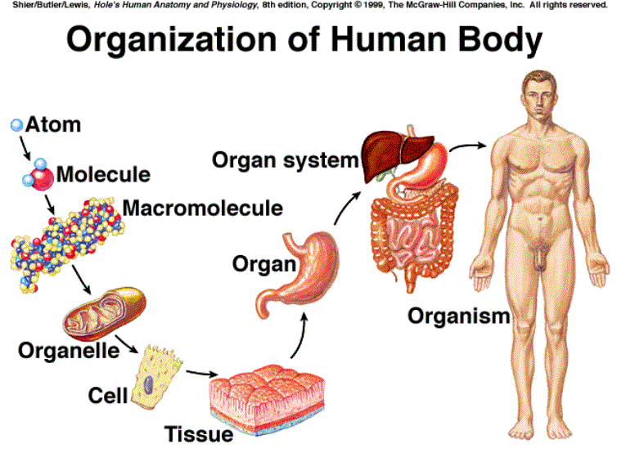

Slide 17
Types of Anatomy
Gross – large structures (no microscopes)
Systemic – how we will study cats
Regional – parts of one structure
Cystology – cells
Microscopic – 3 different views (lat, long, trans)

Slide 18
Types of Anatomy
Developmental – egg to death
Embryology – egg to birth
Pathology – diseases
Radiology – X rays
Physiology – how an organ fxns

Slide 19
Anatomy studies life
Maintenance
Movement
Responsiveness
Digestion
Metabolism
Excretion
Reproduction
Growth

Slide 20
Homeostasis…….
The maintaining of a stable internal environment through feedback.
Homeostatic mechanism: an analogy
  A thermostat signals an air conditioner and furnace to turn on or off to maintain a relatively stable room temperature

Slide 21
Feedback
Negative
Positive
Is stimulatory
Amplifies the change that is occurring
Tends to produce destabilizing effect & disrupt homeostasis
EX: childbirth
Is inhibitory
Stabilizing
Produces an action opposite of the stimulus or initial conditions
More common
EX: ♥ rate,temp, breathing, glucose

Slide 22
Directional Terms

Slide 23
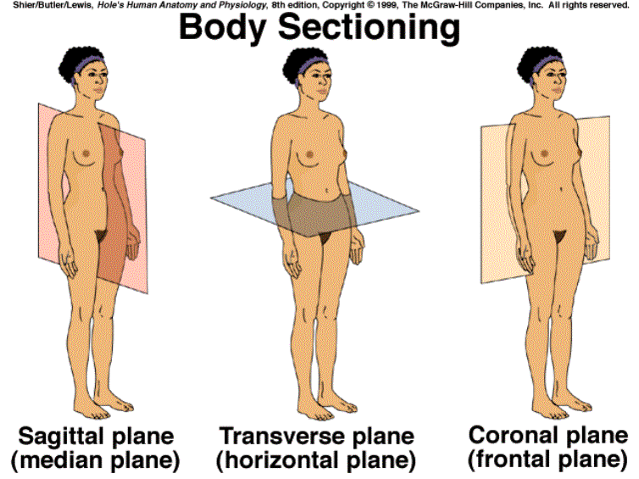


Body Planes

Slide 24
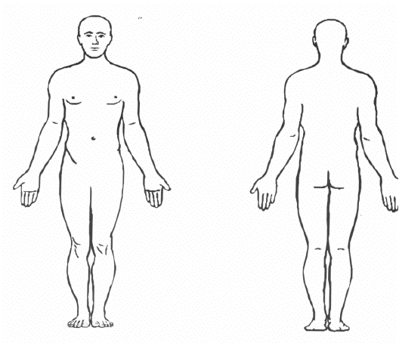


Superior
Proximal
Distal
Lateral
Medial
Inferior

Slide 25
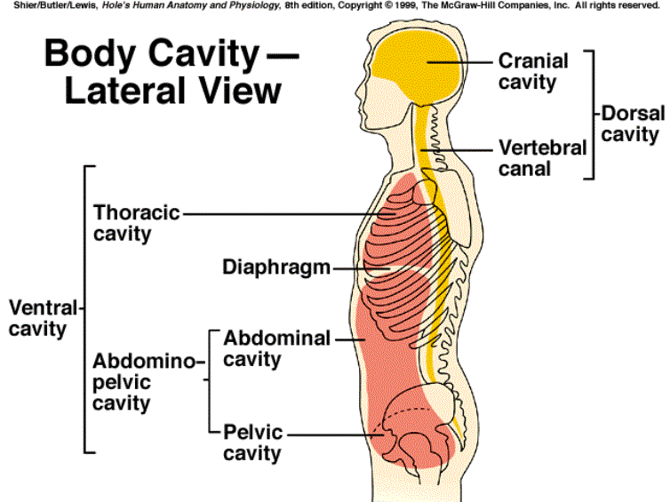

Slide 26
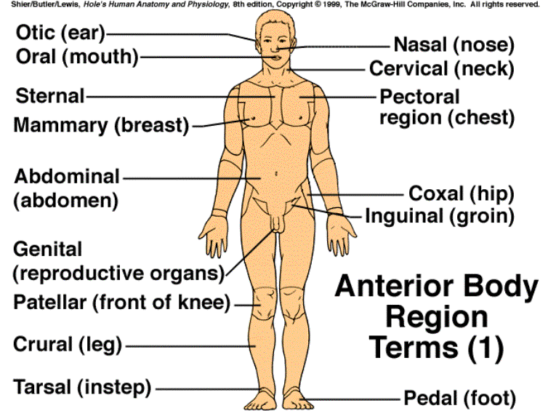

Slide 27
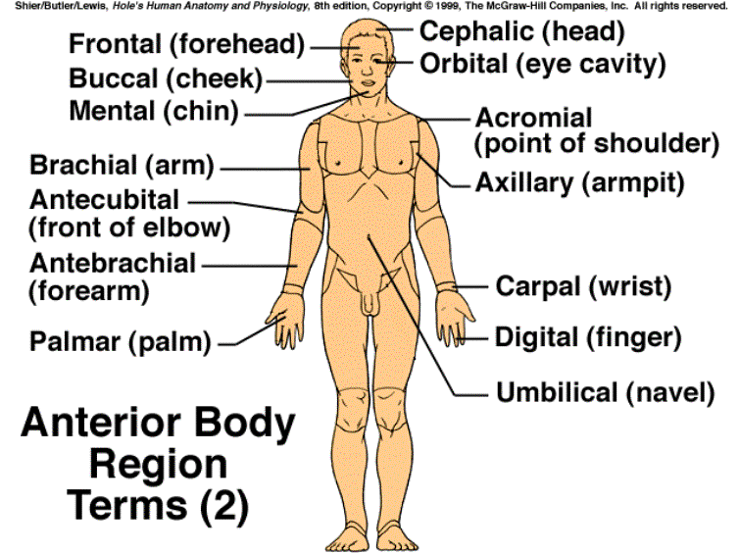

Slide 28
