Slide 1
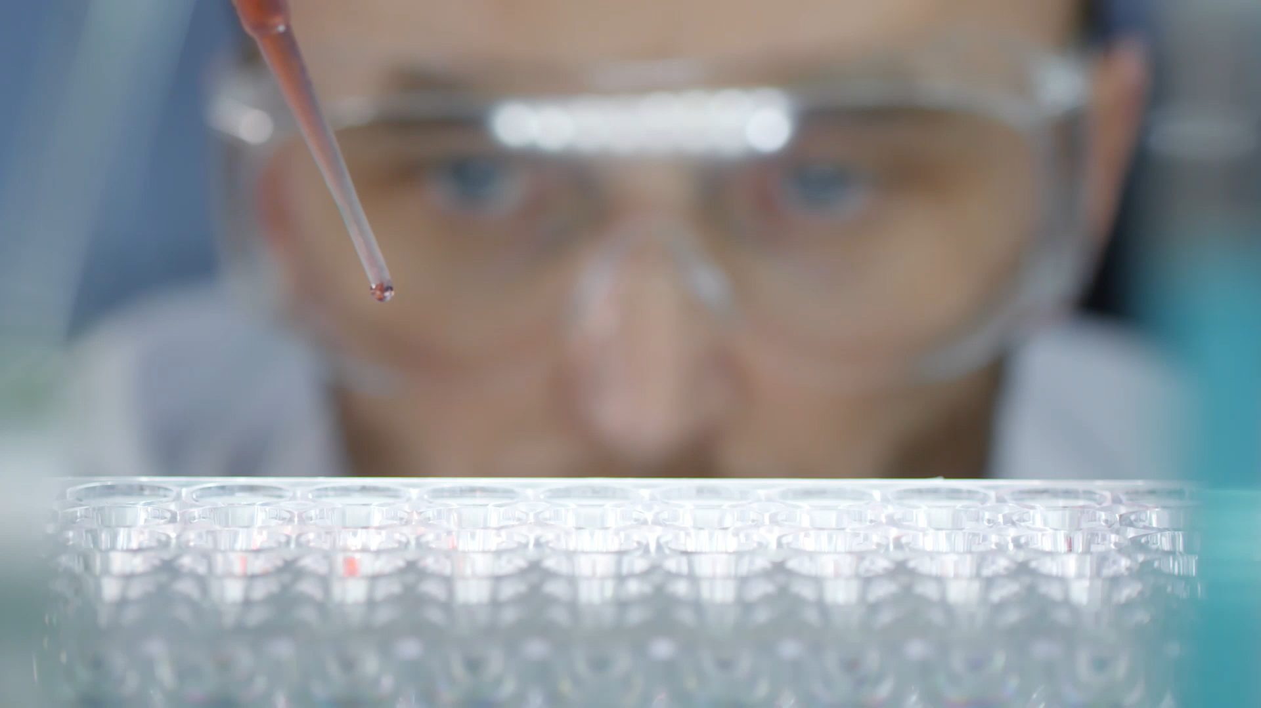
Permanganate Determination of the Iron Sample
Titration method to determine molar concentrations

Slide 2
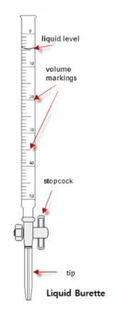
Burette/buret
Pro Tips:
Before you start, BE SURE that the stopcock is perpendicular to the cylinder! Titrant will pour out before you are ready if you forget.
Fill titrant to ABOVE the zero mark! Titrant won’t be in the tip of the burette and we need to have a way to fill it before we begin.
Use a spare container to drain titrant to load the tip. Drain liquid level down to zero or below prior to starting.
DON’T FORGET TO RECORD YOUR STARTING VOLUME!!!

Slide 3
Burette/buret
Pro Tips:
Prior to start, use white paper under your flask. This allows you to see the color change easier.
Open the stopcock using VERY small twists. Solutions come out fast and you need to control the volume carefully.
5 second rule! Your titration is complete when the color of the titrant persists for 5 seconds while being continuously stirred.
Don’t forget to subtract! Your ending volume needs to reflect where you started as well!

Slide 4
Math rules
Your volume needs to go one level past the level of graduations! Estimate the last value.
When using volume to determine molarity of solution, remember to convert to liters!
Stoichiometry is often used to determine the molar concentrations – be sure to start with a balanced equation when converting from one reagent to the other.

