Slide 1
Solutions & IMFs
Unit 6 Notes

Slide 2

Chapter 11, Section 1: Expressions of concentrations
Remember: solute – gets dissolved; solvent – does the dissolving; solution = solute + solvent
Expressions of concentration
1.00 grams of ethanol (C₂H₅OH) is dissolved in 100 grams of water (assume the density of the solution is 1 g/mL). Express the concentration of this solution in terms of:
Molarity (M) = moles solute Mass % = mass of solute X 100%
liters of solution mass of solution
Mole fraction = mole A Molality (m) = moles solute
(mole A + mole B) kg of solvent

Slide 3
Chapter 11, Section 1: Expressions of concentrations
EX 1: A 1.5-liter solution of a 4.25 M LiCl₂ solution is produced. If the density of the solution is
1.126 g/mL, calculate the: a) mass %, b) molality, and c) mole fraction of the solution.
EX 2: The electrolyte in automobile lead storage batteries is a 3.75 M sulfuric acid solution that
has a density of 1.230 g/mL. Calculate the a) mass %, b) molality, c) mole fraction of the
sulfuric acid.
EX 3: Common commercial acids are sold with certain properties. For sulfuric acid they are:
H₂SO₄ density = 1.84 g/cm³ mass % = 95
Calculate the a) molarity, b) molality, c) mole fraction of the solution.

Slide 4
Chapter 11, Section 1: Expressions of concentrations
Dilutions – are problems that require you to produce a certain concentration. They are of two types:
Solid dilutions –
Liquid dilutions - M₁ ∙ V₁ = M₂ ∙ V₂

Slide 5
Chapter 11, Section 1: Expressions of concentrations
Assignment #1: Problems 1-5

Slide 6
Chapter 11, Section 1: Expressions of concentrations
Introduction to Beer’s Law video
Pre-lab instructions
Lab: Beer’s Law
Quiz: Expressions of concentrations
AP conclusion questions

Slide 7
Chapter 11, Section 2: Colligative properties and van’t Hoff factors
Colligative properties: are properties determined by the number of particles, not the type or chemistry of the solute.
Boiling point elevation - ΔT_{b} = K_{b} ∙ m ∙ i
K_{b} = boiling point constant (0.51⁰C/m for water) m = molality of solution
Freezing point depression - ΔT_{f} = K_{f} ∙ m ∙ i
K_{f} = freezing pt constant (1.86⁰C/m for water)
m = molality of solution

Slide 8
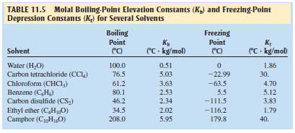
Chapter 11, Section 2: Colligative properties and van’t Hoff factors
EX 7: Calculate the boiling point elevation and freezing point depression of a solution that contains 2.0 grams of sucrose (C₁₂H₂₂O₁₁; molar mass = 343 grams) in 100 grams of solution.
The van’t Hoff factor (i) – is the effect an ionic solute has on the colligative properties of a solution.
EX 8: Calculate the boiling point elevation and freezing point depression of a solution that contains 2.0 grams of NaCl (molar mass = 58.5 grams) in 100 grams of solution.

Slide 9
Chapter 11, Section 2: Colligative properties and van’t Hoff factors
EX 9: A solution is prepared by dissolving 18.0 grams of a nonvolatile solute in 150.0 grams of water. The resulting solution was found to have a boiling point of 100.34⁰C. Calculate the molar mass of glucose.
EX 10: What mass of ethylene glycol (C₂H₆O₂; molar mass = 62.1 g/mol), the main component in antifreeze, must be added to 10.0 liters of water to produce a solution for use in a car radiator that freezes at -23.3⁰C? Assume the water density is 1 g/mL.
EX 11: A chemist is trying to identify a human hormone by determining its molar mass. A sample with a mass of 0.546 grams is dissolved in 15.0 g of benzene and the freezing point depression was determined to be 0.240⁰C. Calculate the molar mass of the hormone.

Slide 10
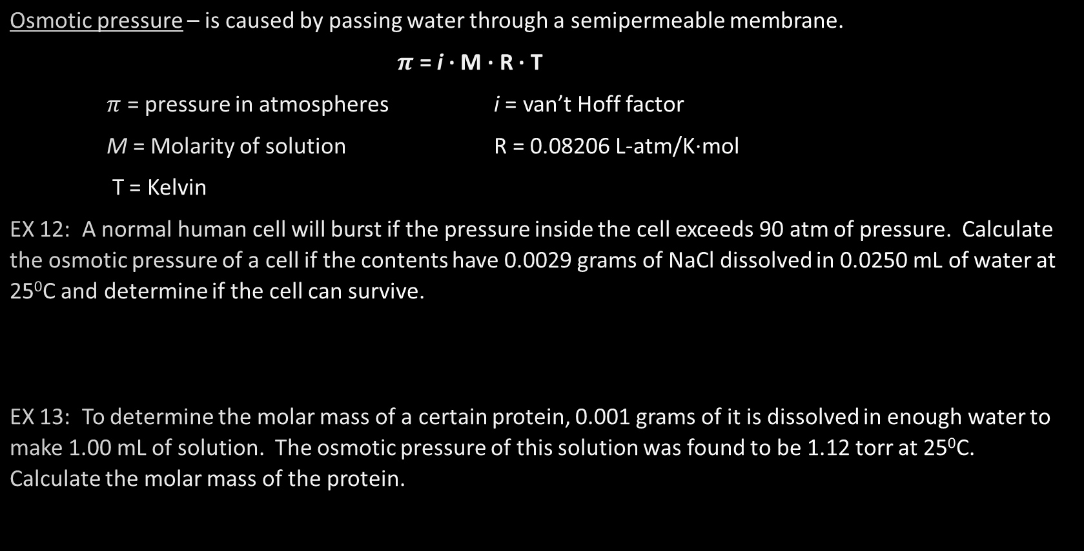
Chapter 11, Section 2: Osmotic pressure
Osmotic pressure – is caused by passing water through a semipermeable membrane.
$π$ = i ∙ M ∙ R ∙ T
$π$ = pressure in atmospheres i = van’t Hoff factor
M = Molarity of solution R = 0.08206 L-atm/K∙mol
T = Kelvin
EX 12: A normal human cell will burst if the pressure inside the cell exceeds 90 atm of pressure. Calculate the osmotic pressure of a cell if the contents have 0.0029 grams of NaCl dissolved in 0.0250 mL of water at 25⁰C and determine if the cell can survive.
EX 13: To determine the molar mass of a certain protein, 0.001 grams of it is dissolved in enough water to make 1.00 mL of solution. The osmotic pressure of this solution was found to be 1.12 torr at 25⁰C. Calculate the molar mass of the protein.

Slide 11
Chapter 11, Section 2: Colligative properties and van’t Hoff factors
Assignment #2: Problems 1-7
Lab: Freezing point depression

Slide 12
Chapter 11, Section 3: Pressure of solutions with Raoult’s Law and
Pascal’s Law
Raoult’s Law: describes that the presence of a nonvolatile solute lowers the vapor pressure of a solution.
P_{solution} = X_{solvent} ∙ P⁰_{solvent} X_{solvent} = mole fraction of solvent
P⁰_{solvent} = vapor pressure solvent
Equilibrium vapor pressure – pressure of a liquid in equilibrium with its vapor
Liquid + energy vapor
Boiling liquids are dependent on their equilibrium vapor pressure
Pascal’s law – pressure on the surface of a liquid acts the same throughout the liquid

Slide 13
Chapter 11, Section 3: Pressure of solutions with Raoult’s Law and
Pascal’s Law
EX 4: Calculate the vapor pressure at 25⁰C for a solution prepared by dissolving 158.0 grams of table sugar (C₁₂H₂₂O₁₁ = 342 g/mole) in 643.5 cm³ of water. At 25⁰C the density of water is 0.9971 g/cm³ and the vapor pressure is 23.76 torr.
EX 5: A mixture of 10 mL of octane (C₈H₈, density = 0.75 g/mL) at a pressure of 150 torr and 15 mL butane (C₄H₁₀, density = 0.98 g/mL) at a pressure of 100 torr is mixed in a closed container. Calculate the a) vapor pressure of the solution, and b) mole fraction of the two gases in the vapor.
EX 6: Predict the vapor pressure of a solution prepared by mixing 35.0 grams of solid Na₂SO₄ (molar mass = 142 g/mole) with 175 grams of water at 25⁰C. (Vapor pressure of water @ 25⁰C = 23.76 torr)

Slide 14
Chapter 11, Section 3: Pressure of solutions with Raoult’s Law and
Pascal’s Law
Assignment #3: Problems 1-4

Slide 15
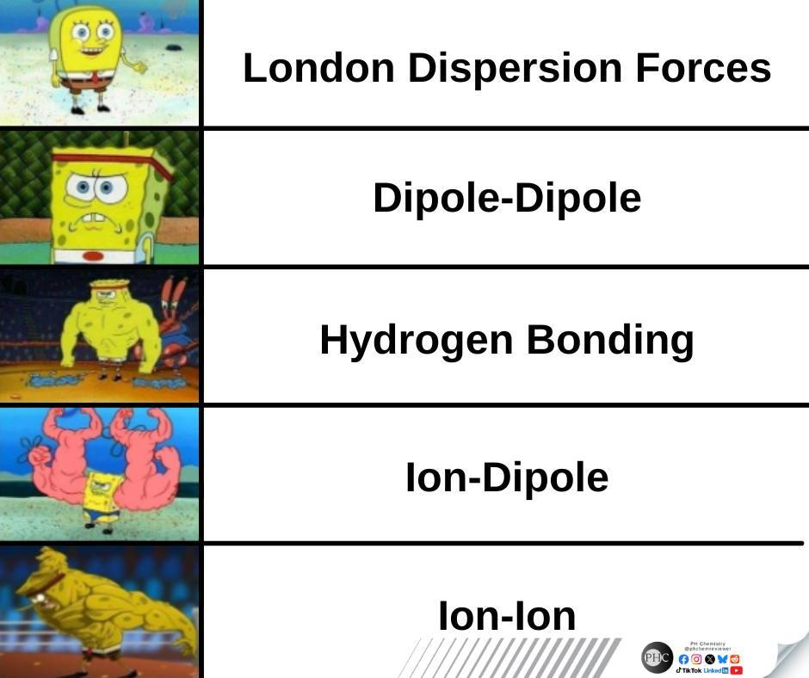
Chapter 11, Section 4: Intermolecular Forces (IMFs)
Intermolecular and Intramolecular bonds
3 common intramolecular forces
1)
2)
3)
List these forces from weakest to strongest:
3 common intermolecular forces
1)
2)
3)
List these forces from weakest to strongest:

Slide 16
Chapter 11, Section 4: Intermolecular Forces (IMFs)
Hydrogen bonding, dipole-dipole forces, London dispersion forces
List the intermolecular forces present in CH₃OH, Ar, Ne, CH₃OCH₃ and then rank them from lowest to highest boiling point.

Slide 17
Chapter 11, Section 4: Intermolecular Forces (IMFs)
What determines the strength of the following forces
Dipole-dipole forces Hydrogen bonding forces London dispersion forces
Draw a picture of an ion-induced dipole:
Draw a picture of a dipole-induced dipole:
Identify the main type of intermolecular force in the following:
Ne _________ KCl _________ BCl₂ _________ C₂H₆ _________
NH₃ _________ PH₃ _________ NaCl in water _________
Which of the following molecule pairs are NOT involved in hydrogen bonding?
1) HCOOH, H₂O 2) H₂O, NH₃ 3) CH₃OH, CH₃COOH 4) H₂ and I₂
Which of the following molecules interact primarily through London-dispersion forces?
1) SO₂ 2) CCl₄ 3) CH₂Cl₂ 4) H₂S

Slide 18
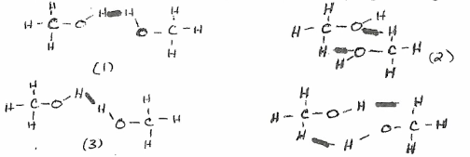
Chapter 11, Section 4: Intermolecular Forces (IMFs)
Draw diagrams showing 3 molecules of carbon dioxide in the state of matter indicated
below in the box. On the diagram, show where the intermolecular and intramolecular forces
are.
Which of the following drawings best represents hydrogen bonding in methanol, CH₃OH

Slide 19
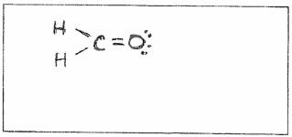
Chapter 11, Section 4: Intermolecular Forces (IMFs)
The complete Lewis-dot diagram of methanol is shown in the box below. Molecules of methanol can form hydrogen bonds with water. In the box below, draw a water molecule in a correct orientation to illustrate a hydrogen bond between a molecule of water and the molecule of methanol. Use a dashed line to represent the hydrogen bond.

Slide 20
Chapter 11, Section 4: Intermolecular Forces (IMFs)
Intermolecular forces wksht
Dr. Baxley’s intermolecular forces wksht

Slide 21
Chapter 11– Unit wrap-up
Review problems
NMSI problems

