Slide 1
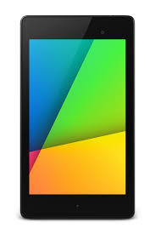
Nexus 7 Tablet
New Setup

Slide 2
Power on Device
Hold power button for
about 5 seconds until the
word Google appears on
the screen.
Top button (power)

Slide 3
Standard Navigation Buttons
Previous Screen (back)
Remove keyboard
(back arrow points down)
Power
Volume Control
Home
Recent apps

Slide 4
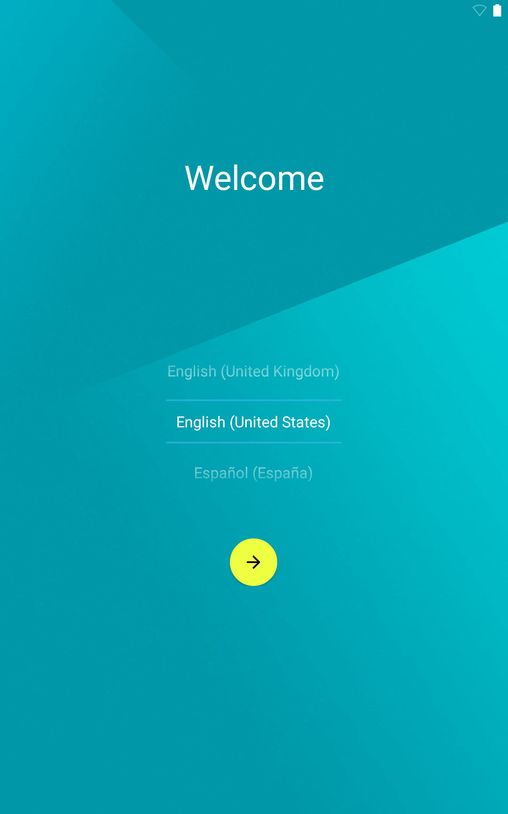
Choose Language
Choose the language that you would like.
Touch the arrow.

Slide 5
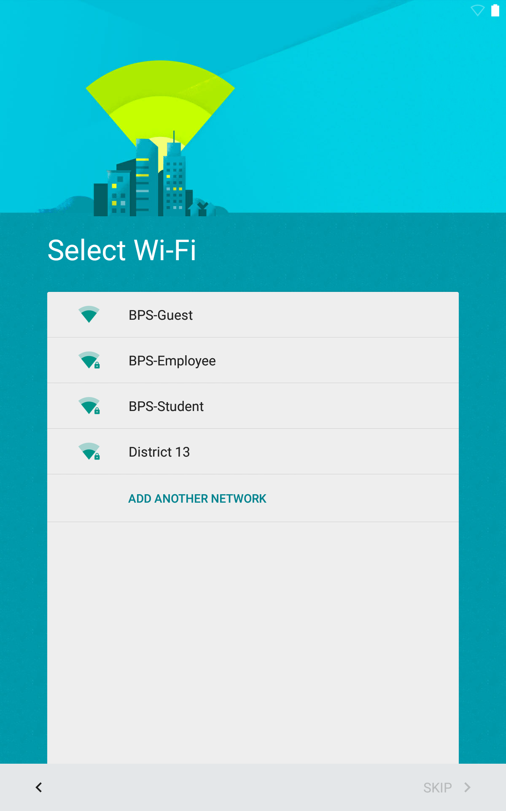
Select Wireless
Select to connect to guest wireless

Slide 6
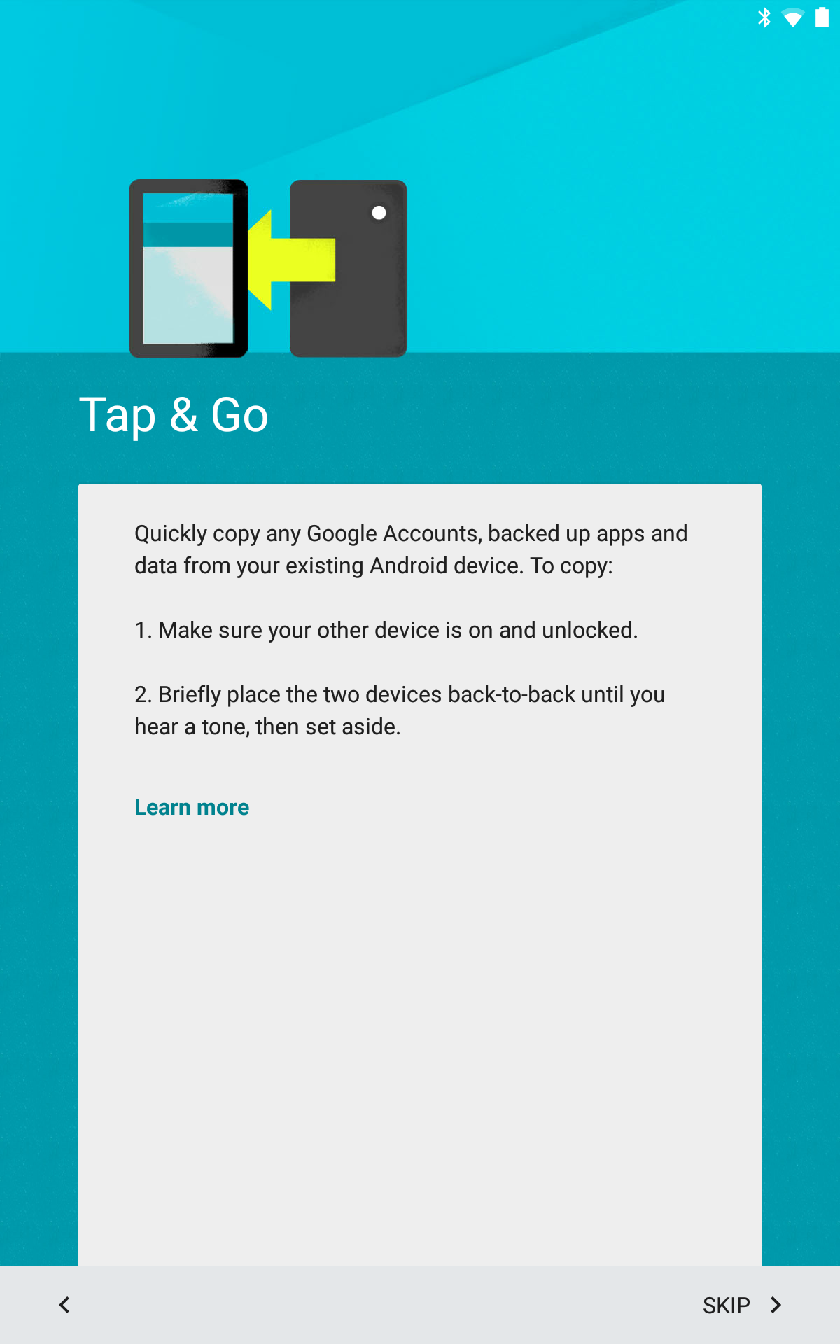
Tap & Go
This step is for moving
information from an existing tablet.
Skip.

Slide 7
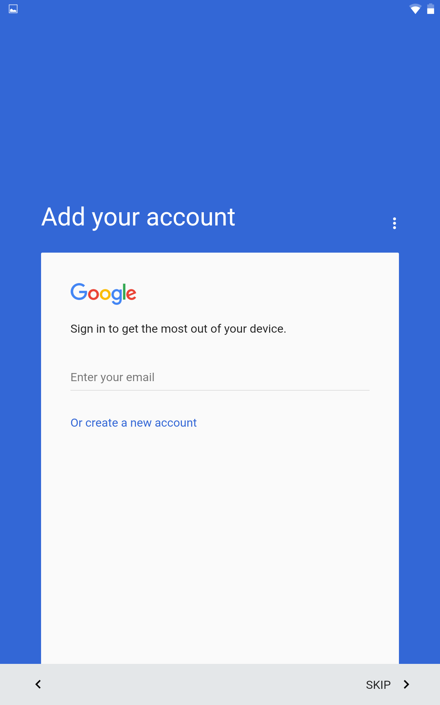
Please skip initial Google sign-in
Please do not sign in to Google yet. We will
complete this step later.

Slide 8
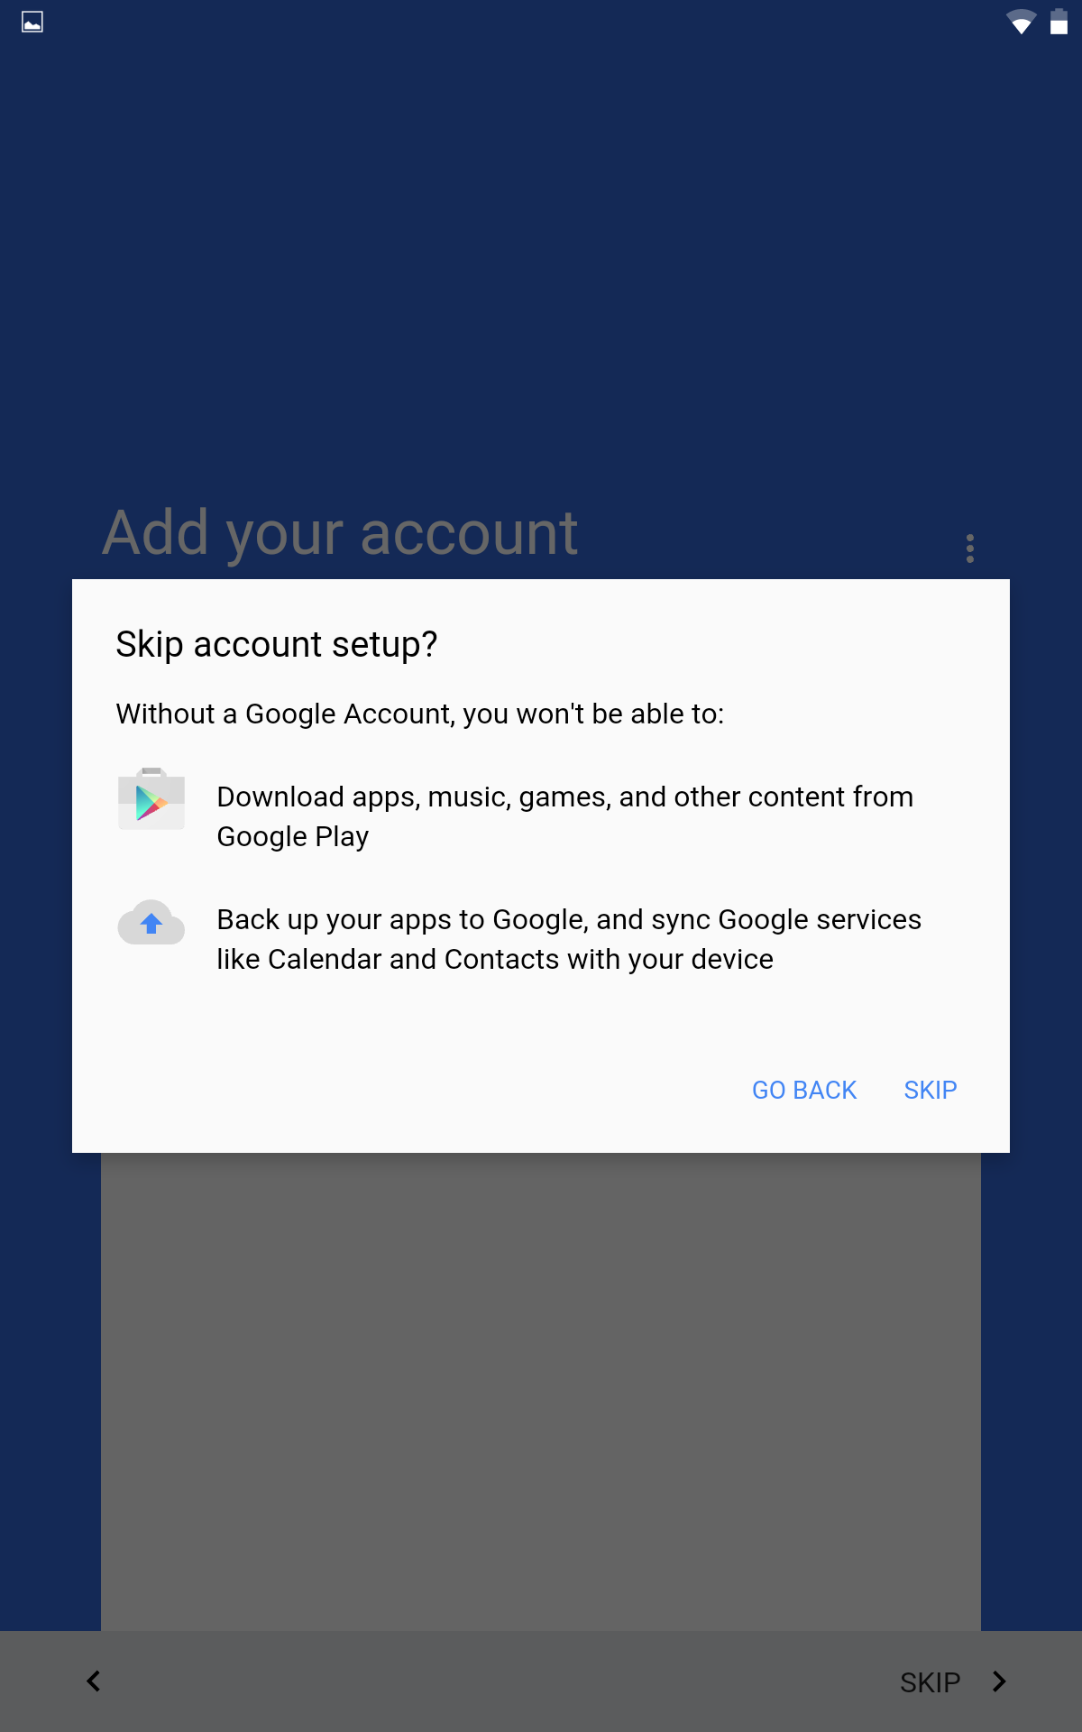
Confirm Skip
This window wants us to confirm we are skipping
the Google sign in.

Slide 9
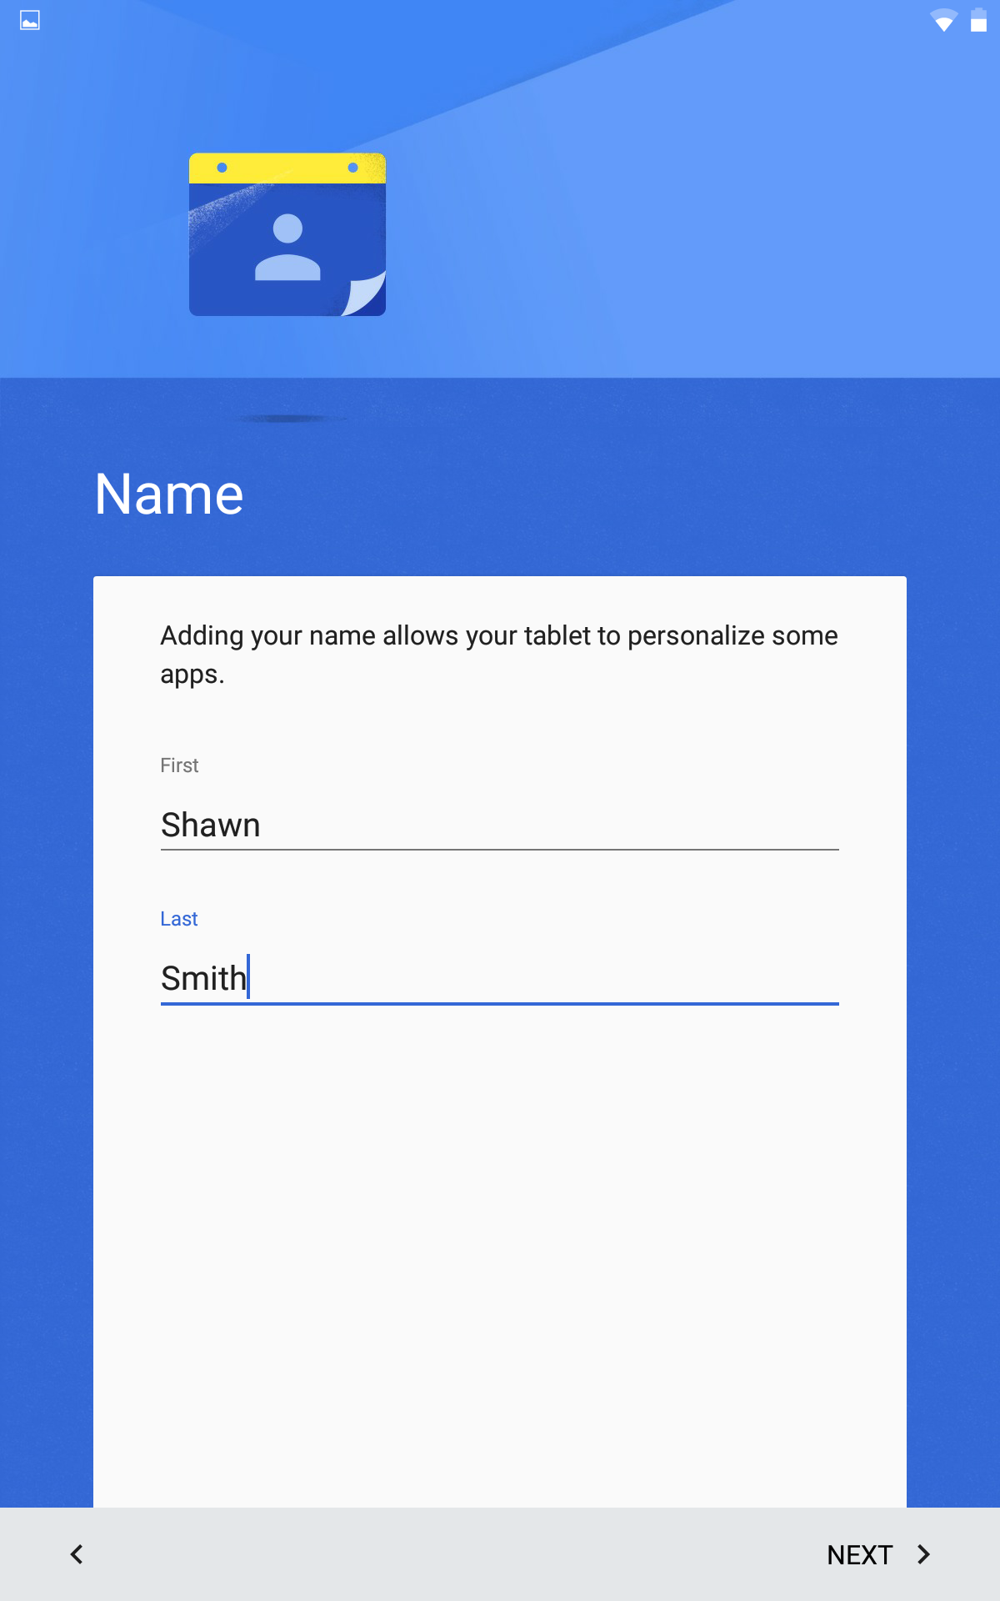
Enter Your User Name
This will be the name used to identify users on
the device. This will be important to devices that
will have more than one user.

Slide 10
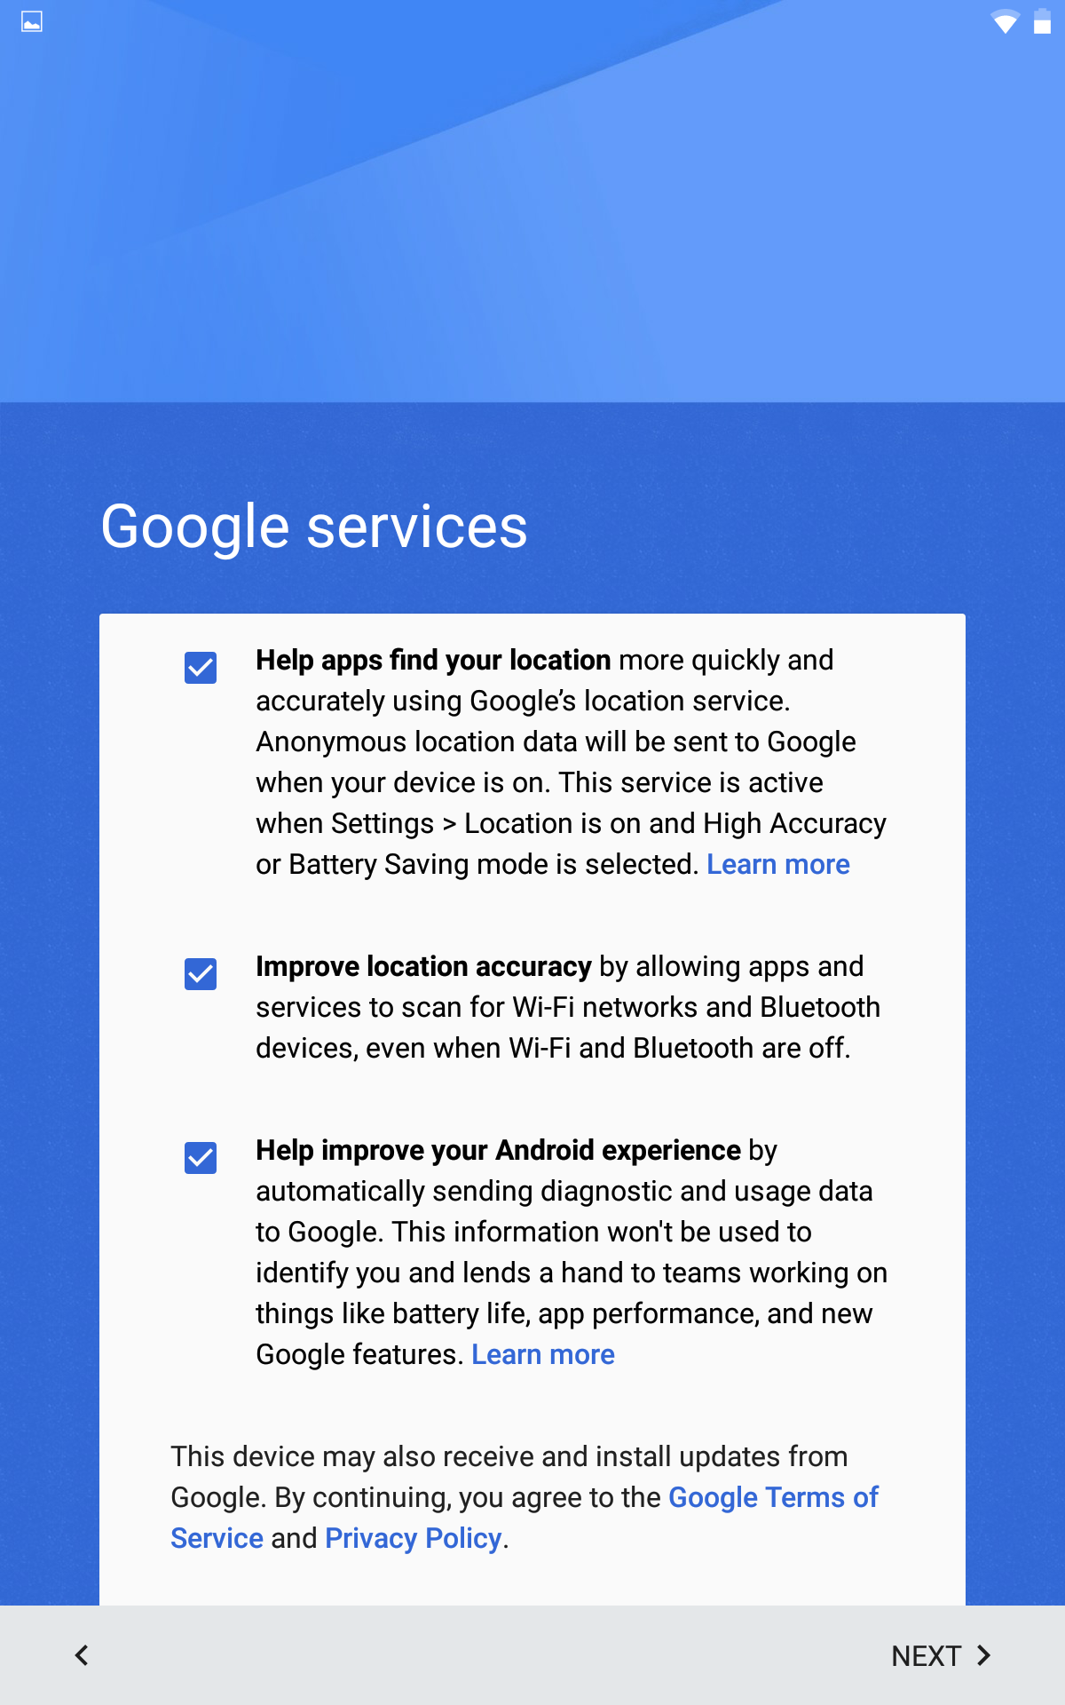
Google Services
Uncheck All three options for google services.

Slide 11
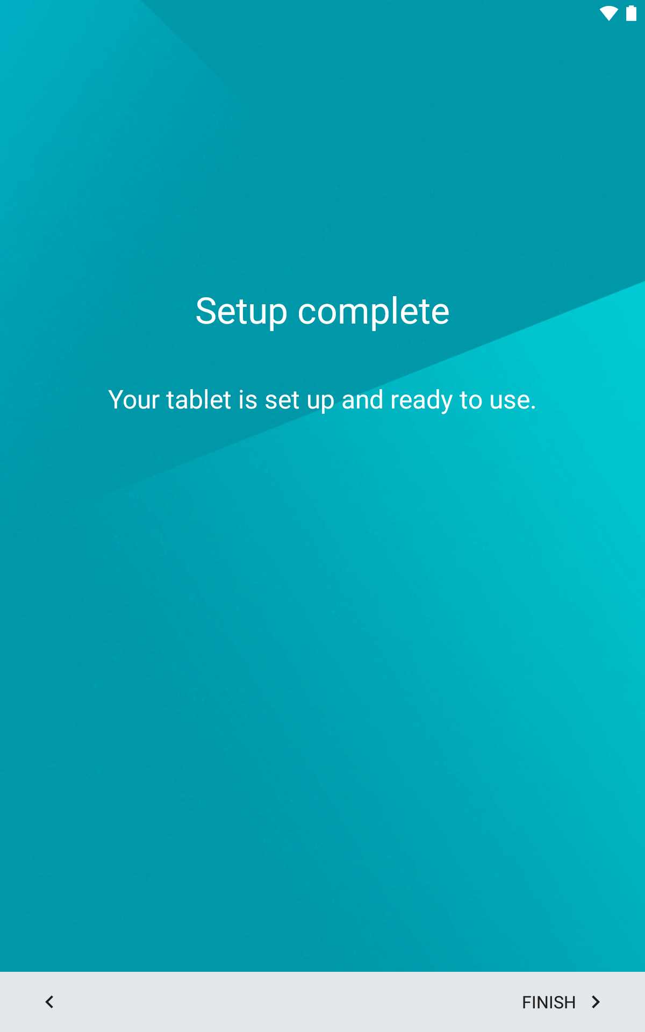
Setup Complete
This screen may not appear,
please move to the next slide.
Touch finish.

Slide 12
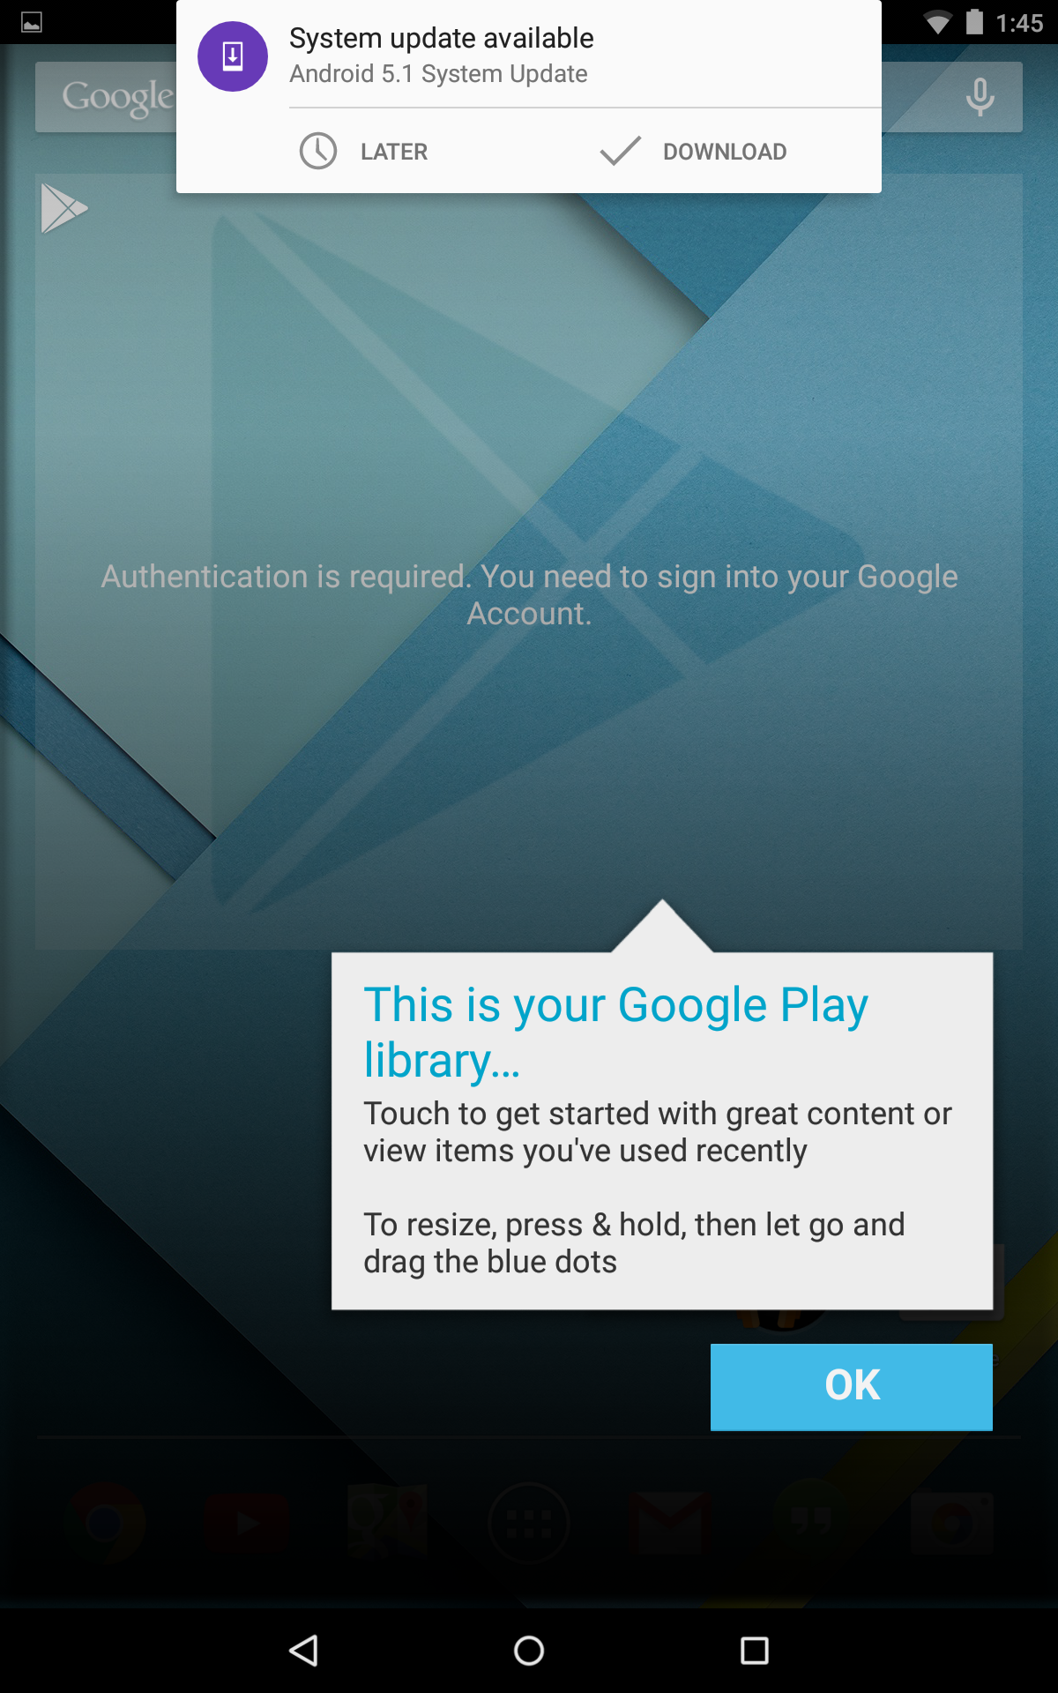
System update
System update are important,
please make sure you plug in
your device and run the update
when it is convenient.
Please select later for now.

Slide 13
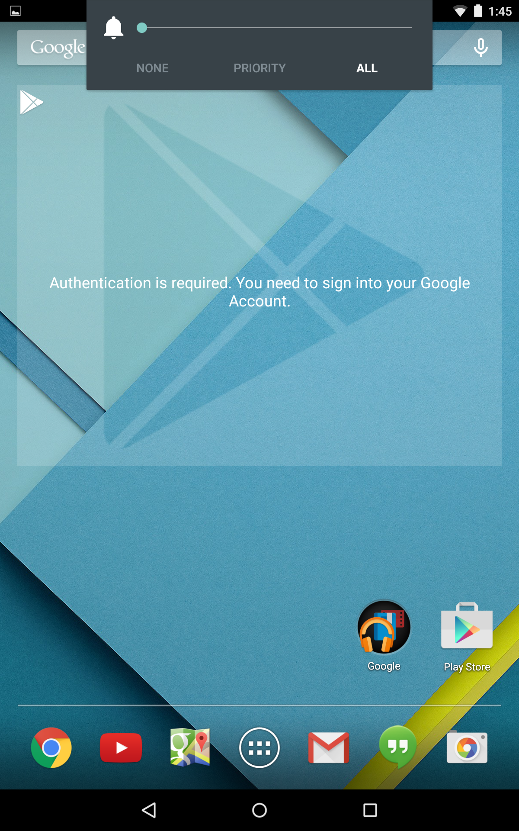
Set up Email
Touch the Gmail icon to begin.

Slide 14
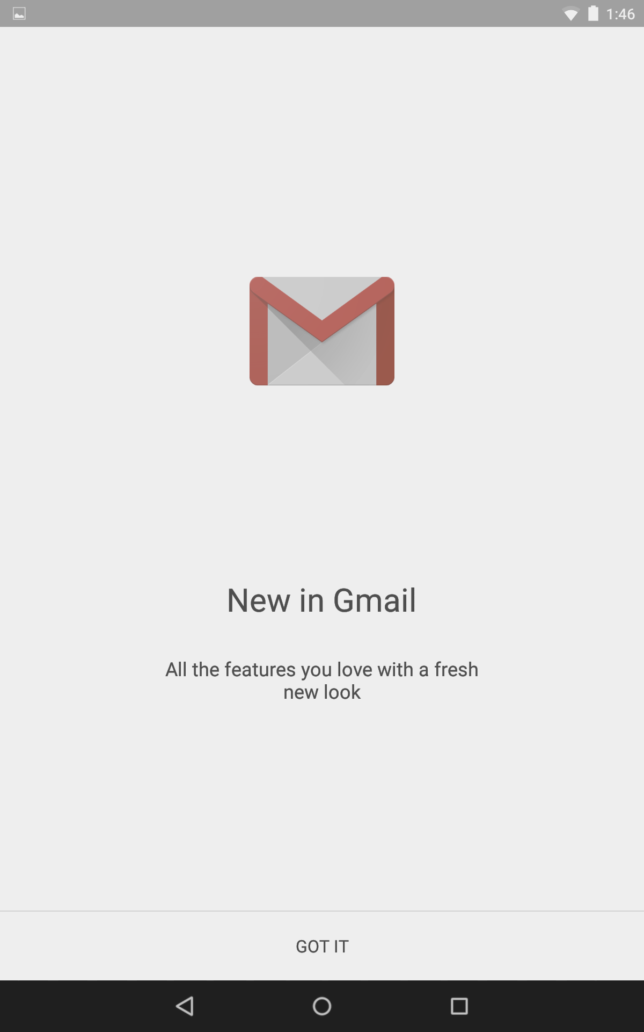
Got it!
Touch GOT IT to move on
Add an email address.

Slide 15
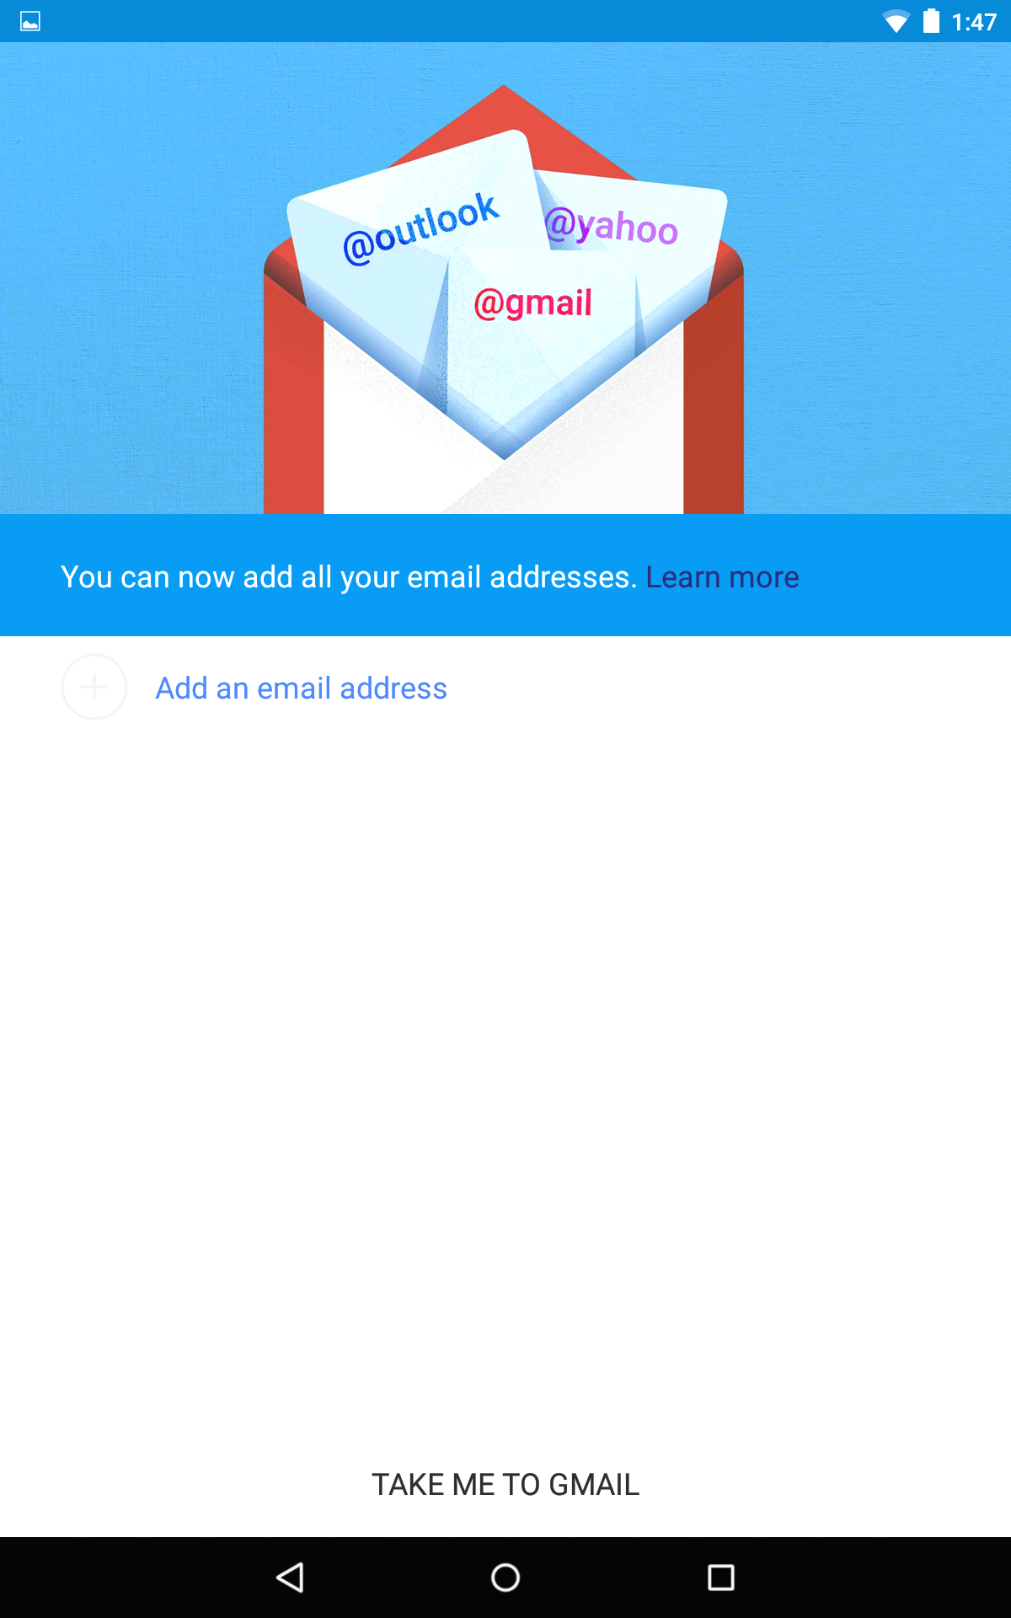
Add BPS email
Touch add and email address.

Slide 16
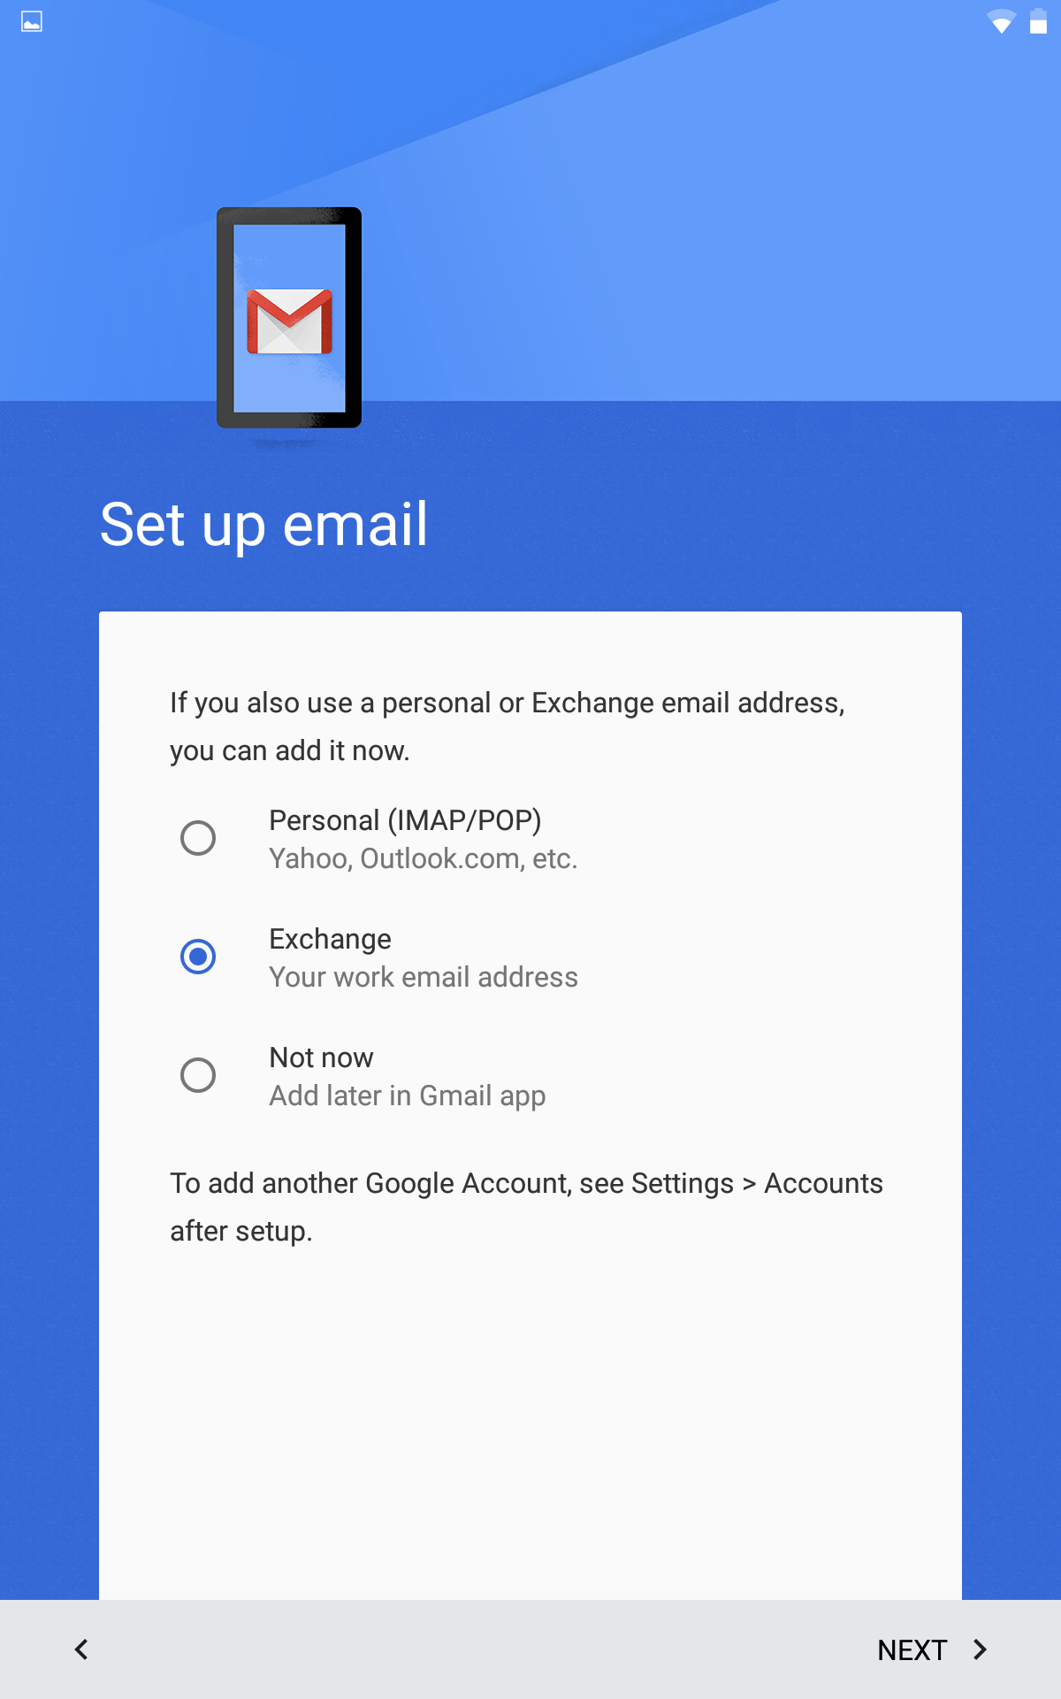
Exchange Email
Select Exchange email type.
Next

Slide 17
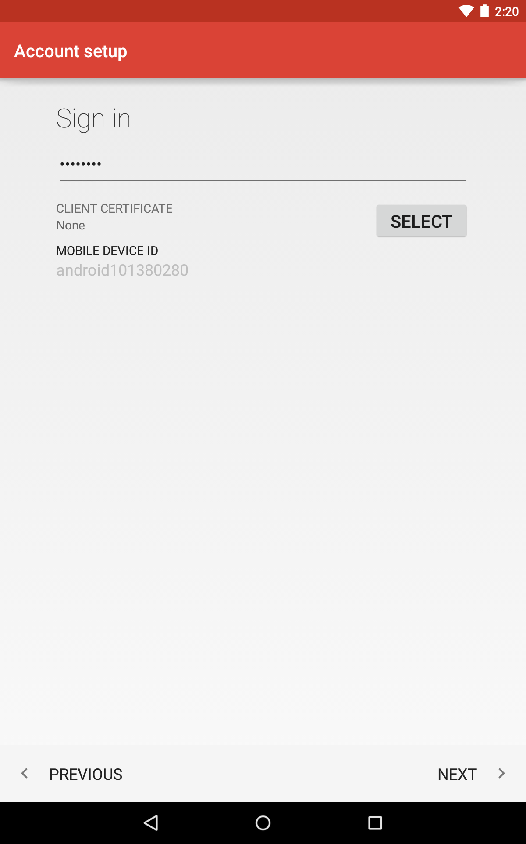
Account Setup
Enter Bismarck Public
Schools email address.
Enter email password.
Next.
Do not use the select button

Slide 18
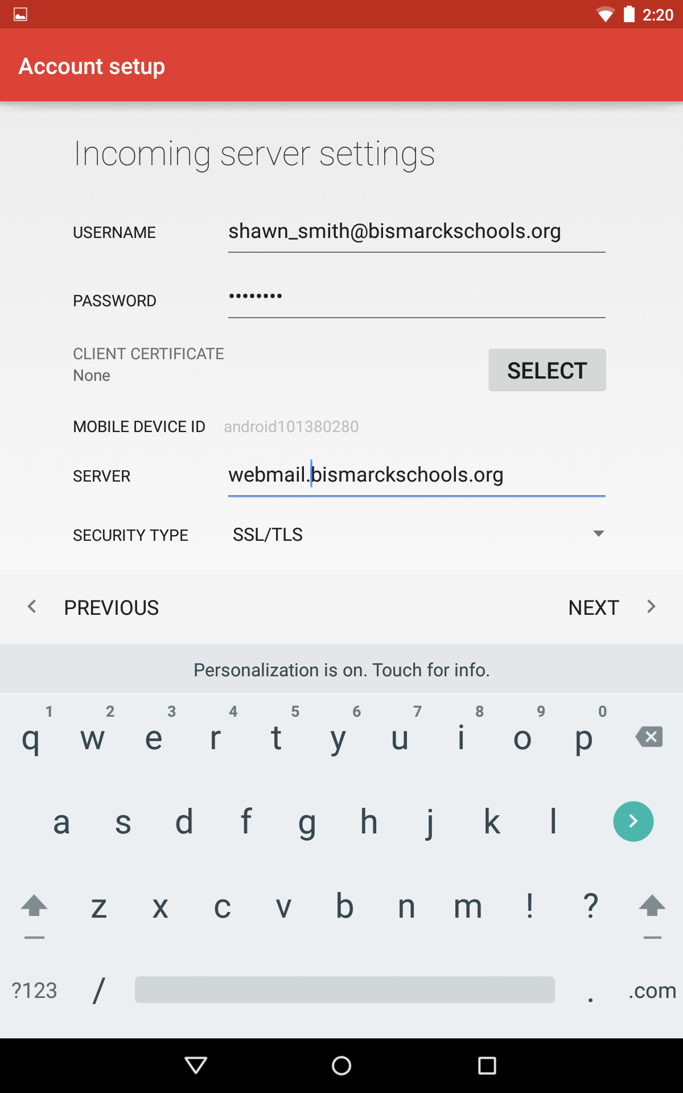
Change the Server Address
Add webmail to the server URL.
Next.

Slide 19
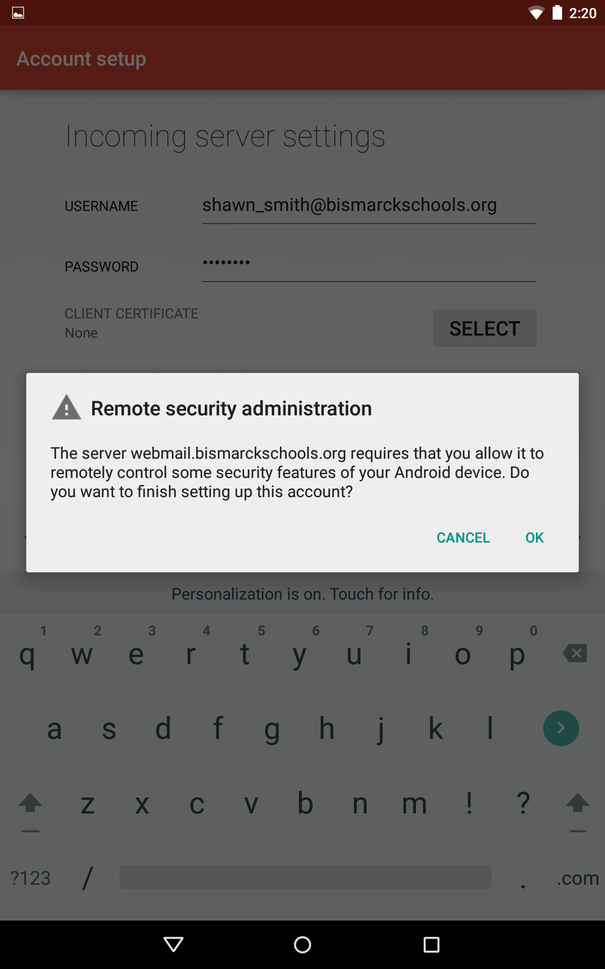
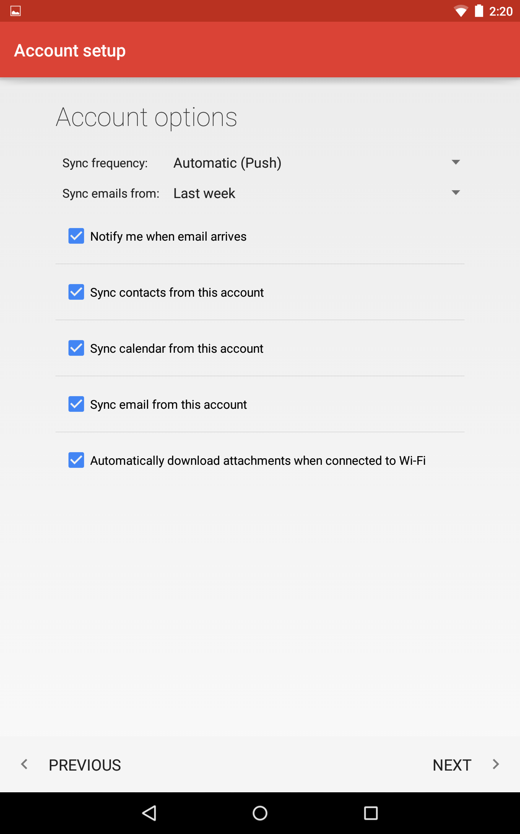
Allow remote security
administration.
Make sure all account
options are selected.

Slide 20
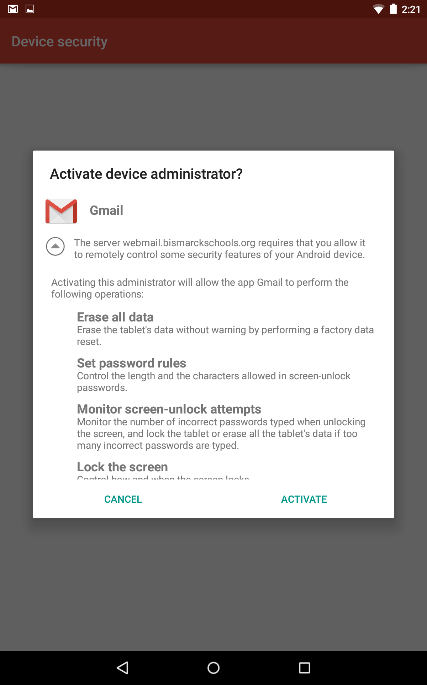
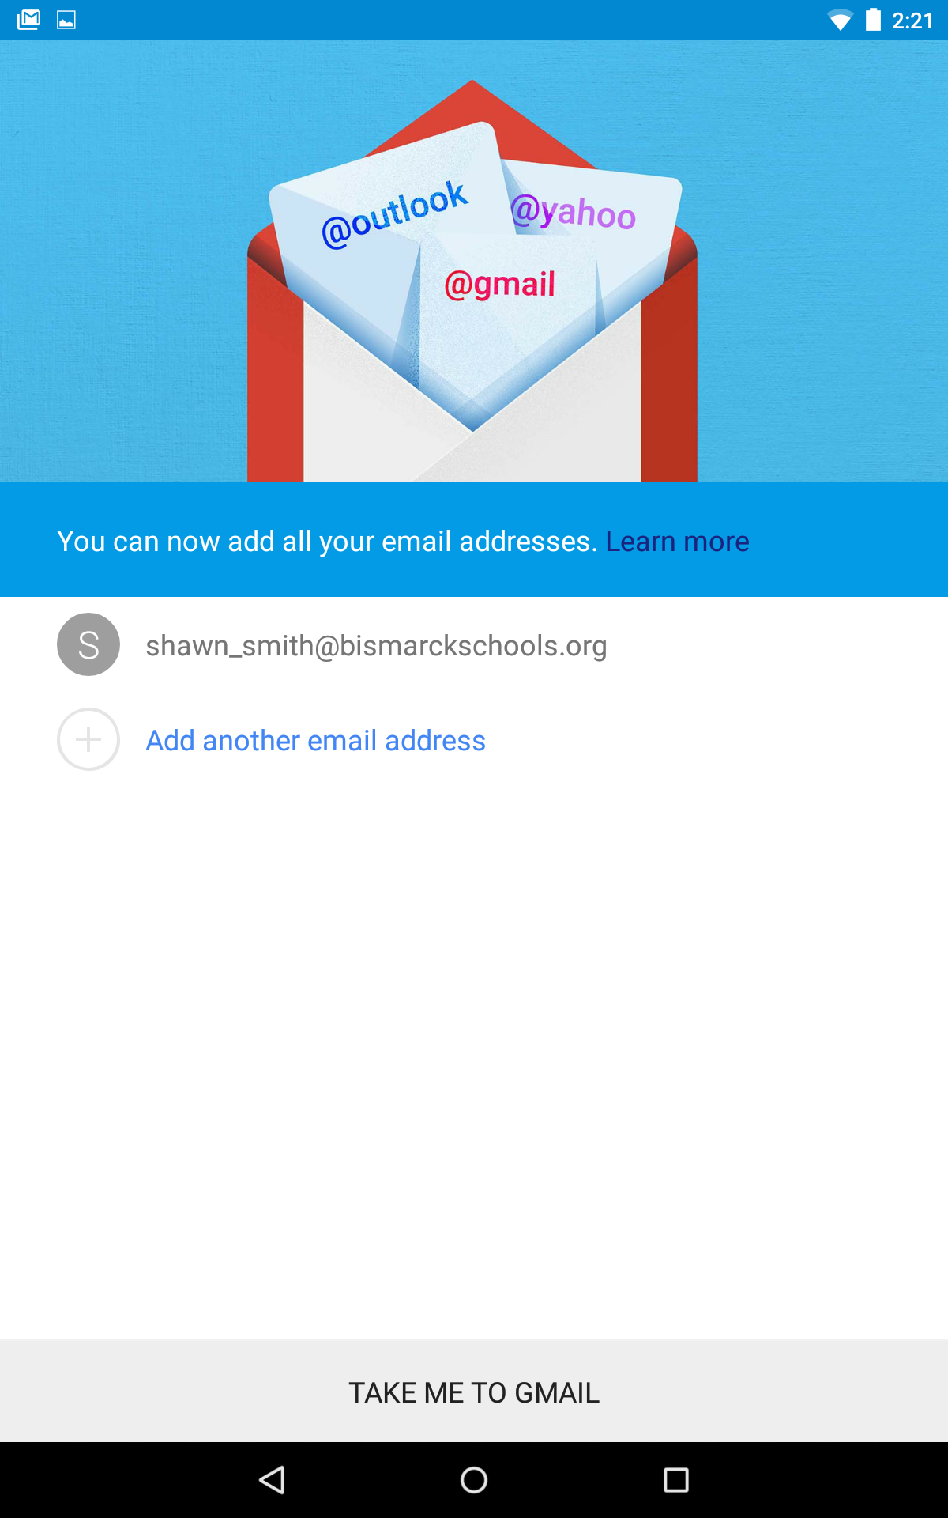
Device admin
Activate device
administrator.
Take me to Gmail.

Slide 21
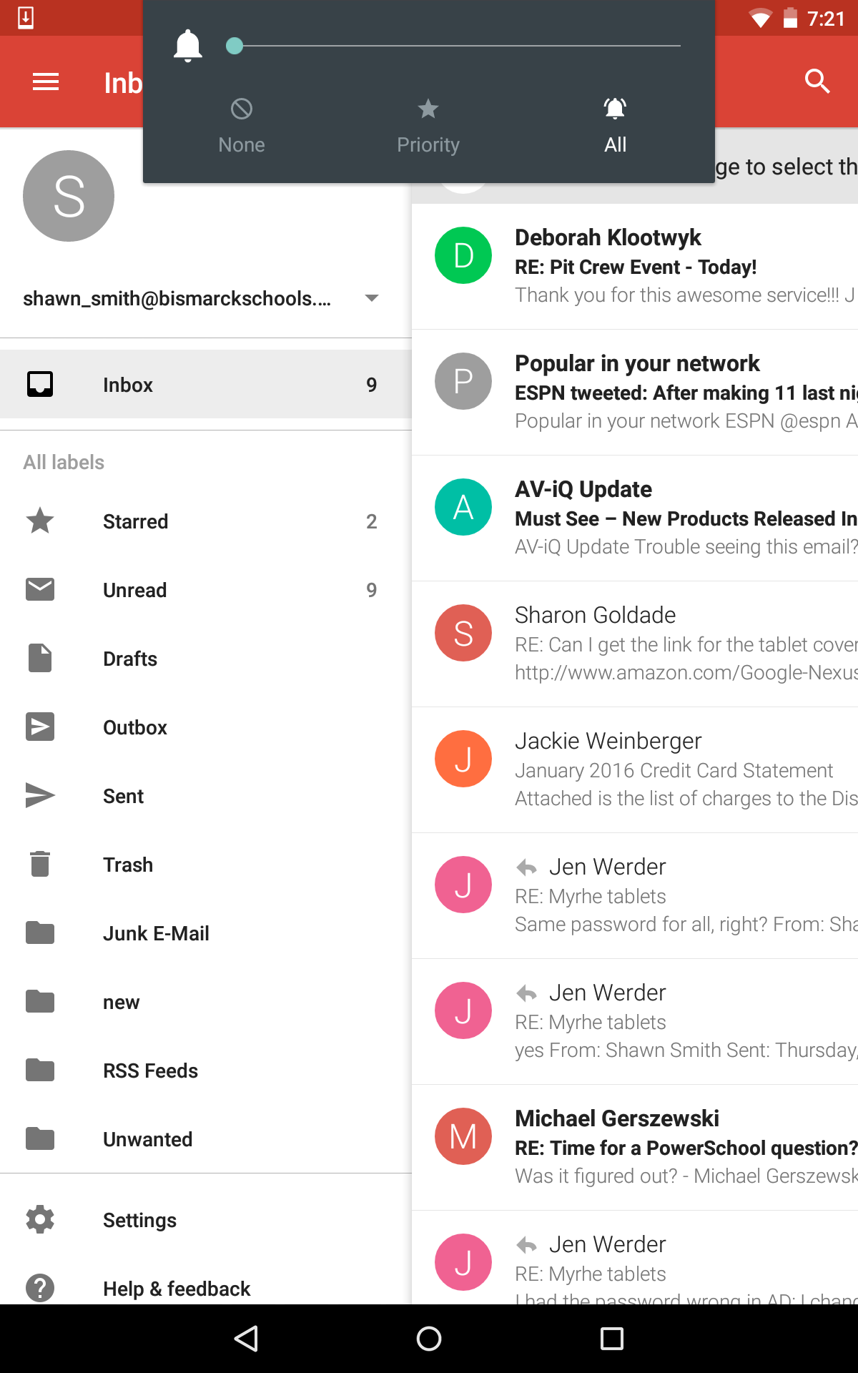
Touch The Home Button
Touch the home button to exit
the email application.

Slide 22
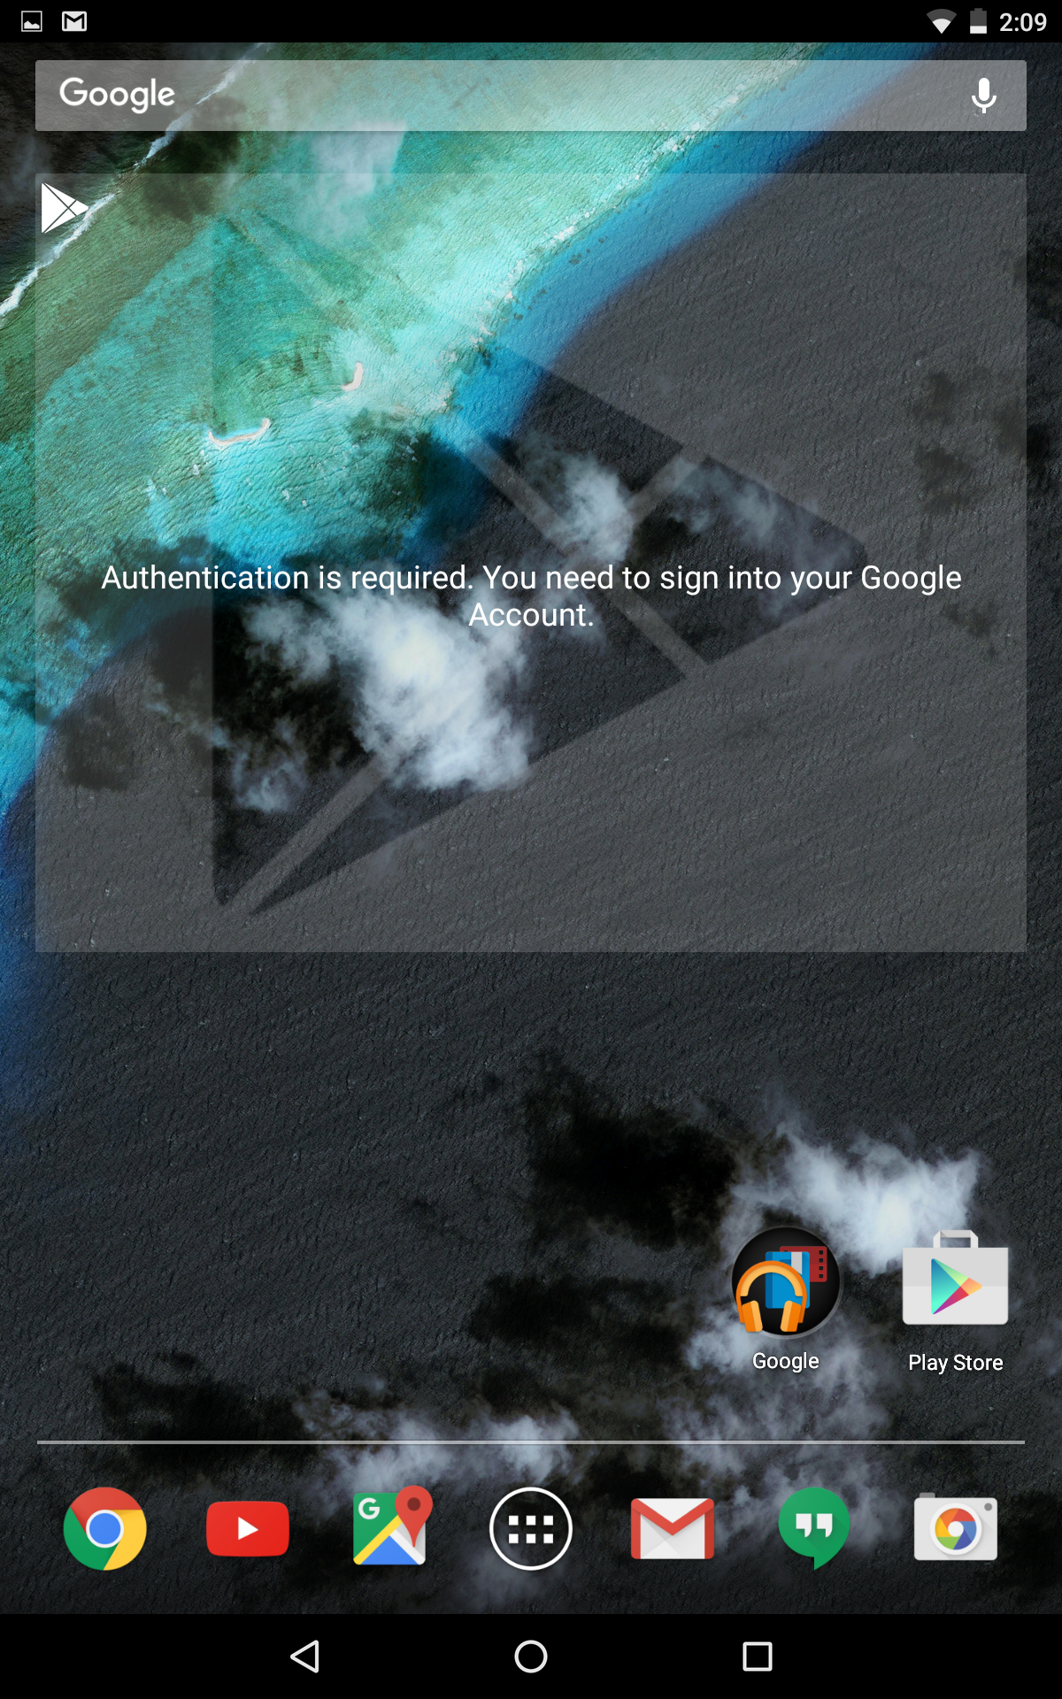
Sign in to google
Touch the box to authenticate to your
Google account.

Slide 23
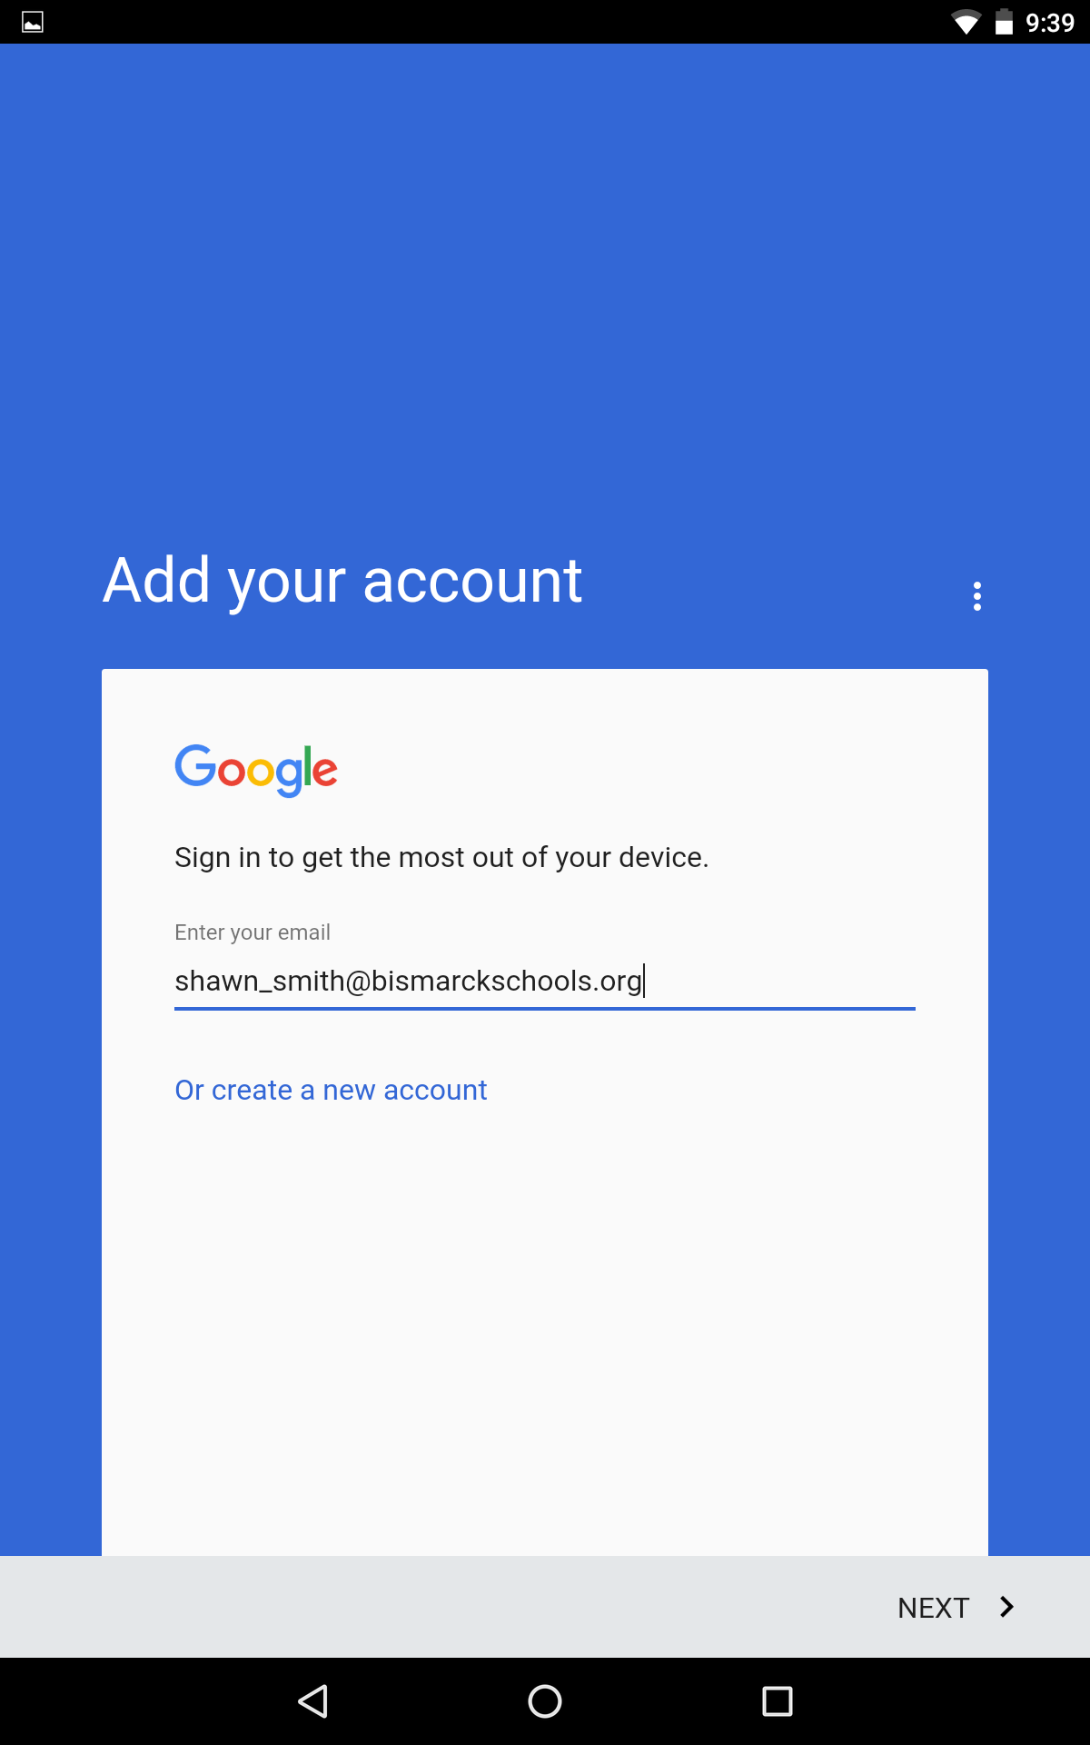
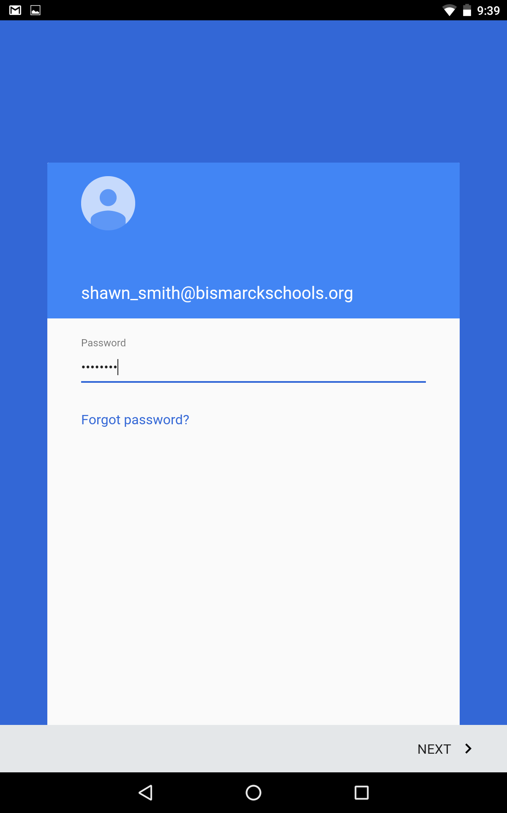
Sign in to Google
Sign in to your Google
account with your BPS email
and password.
Next. Next.

Slide 24
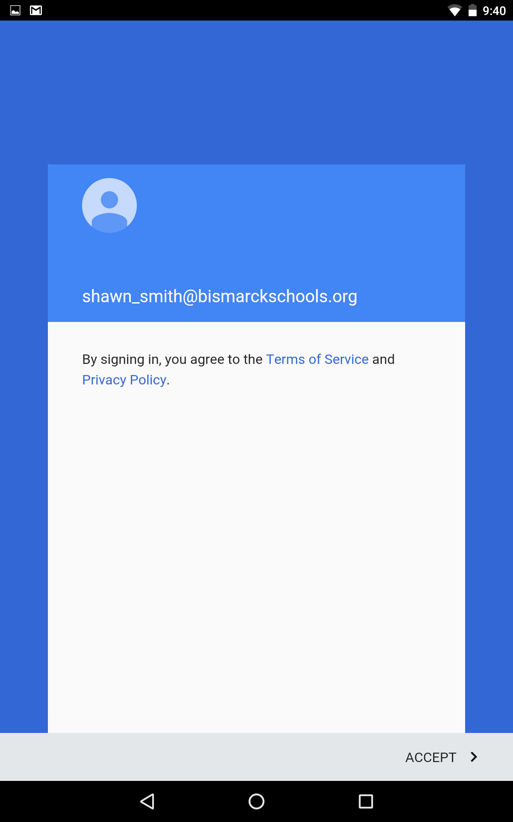
Accept Privacy Policy
Accept the BPS privacy policy

Slide 25
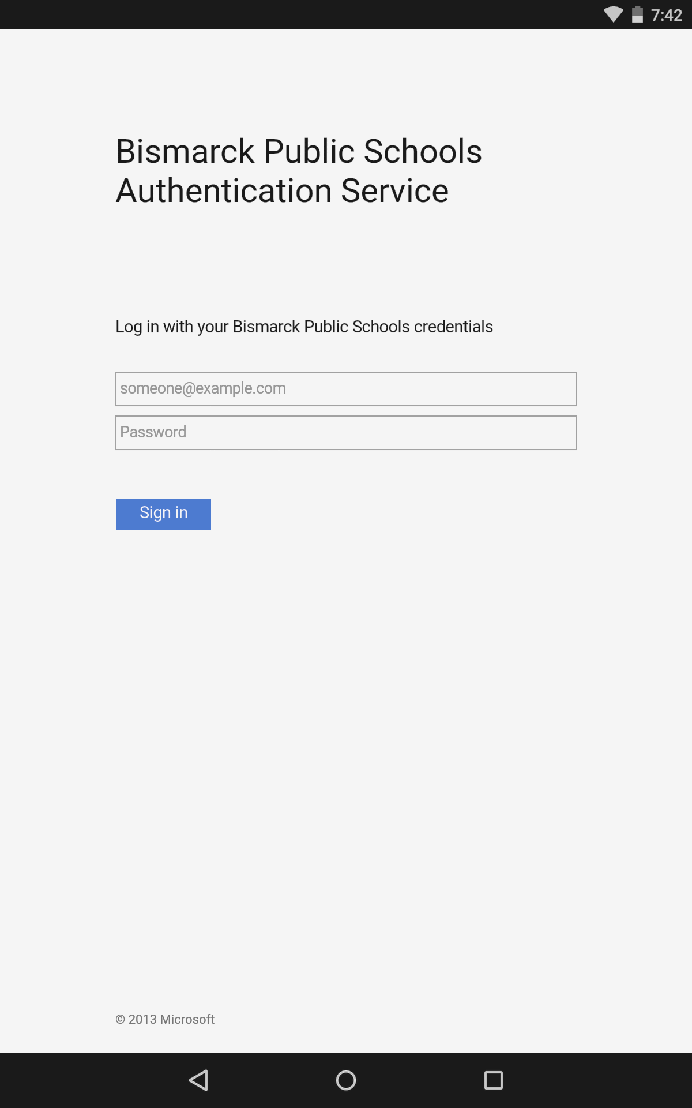
BPS Authentication Service
Enter Firstname_Last and password.

Slide 26
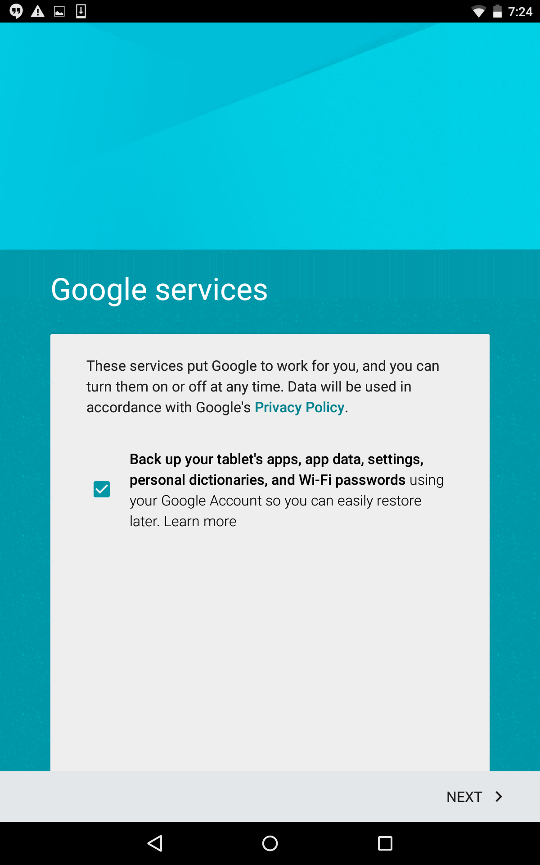
Google Services
Uncheck the box for Google services

Slide 27
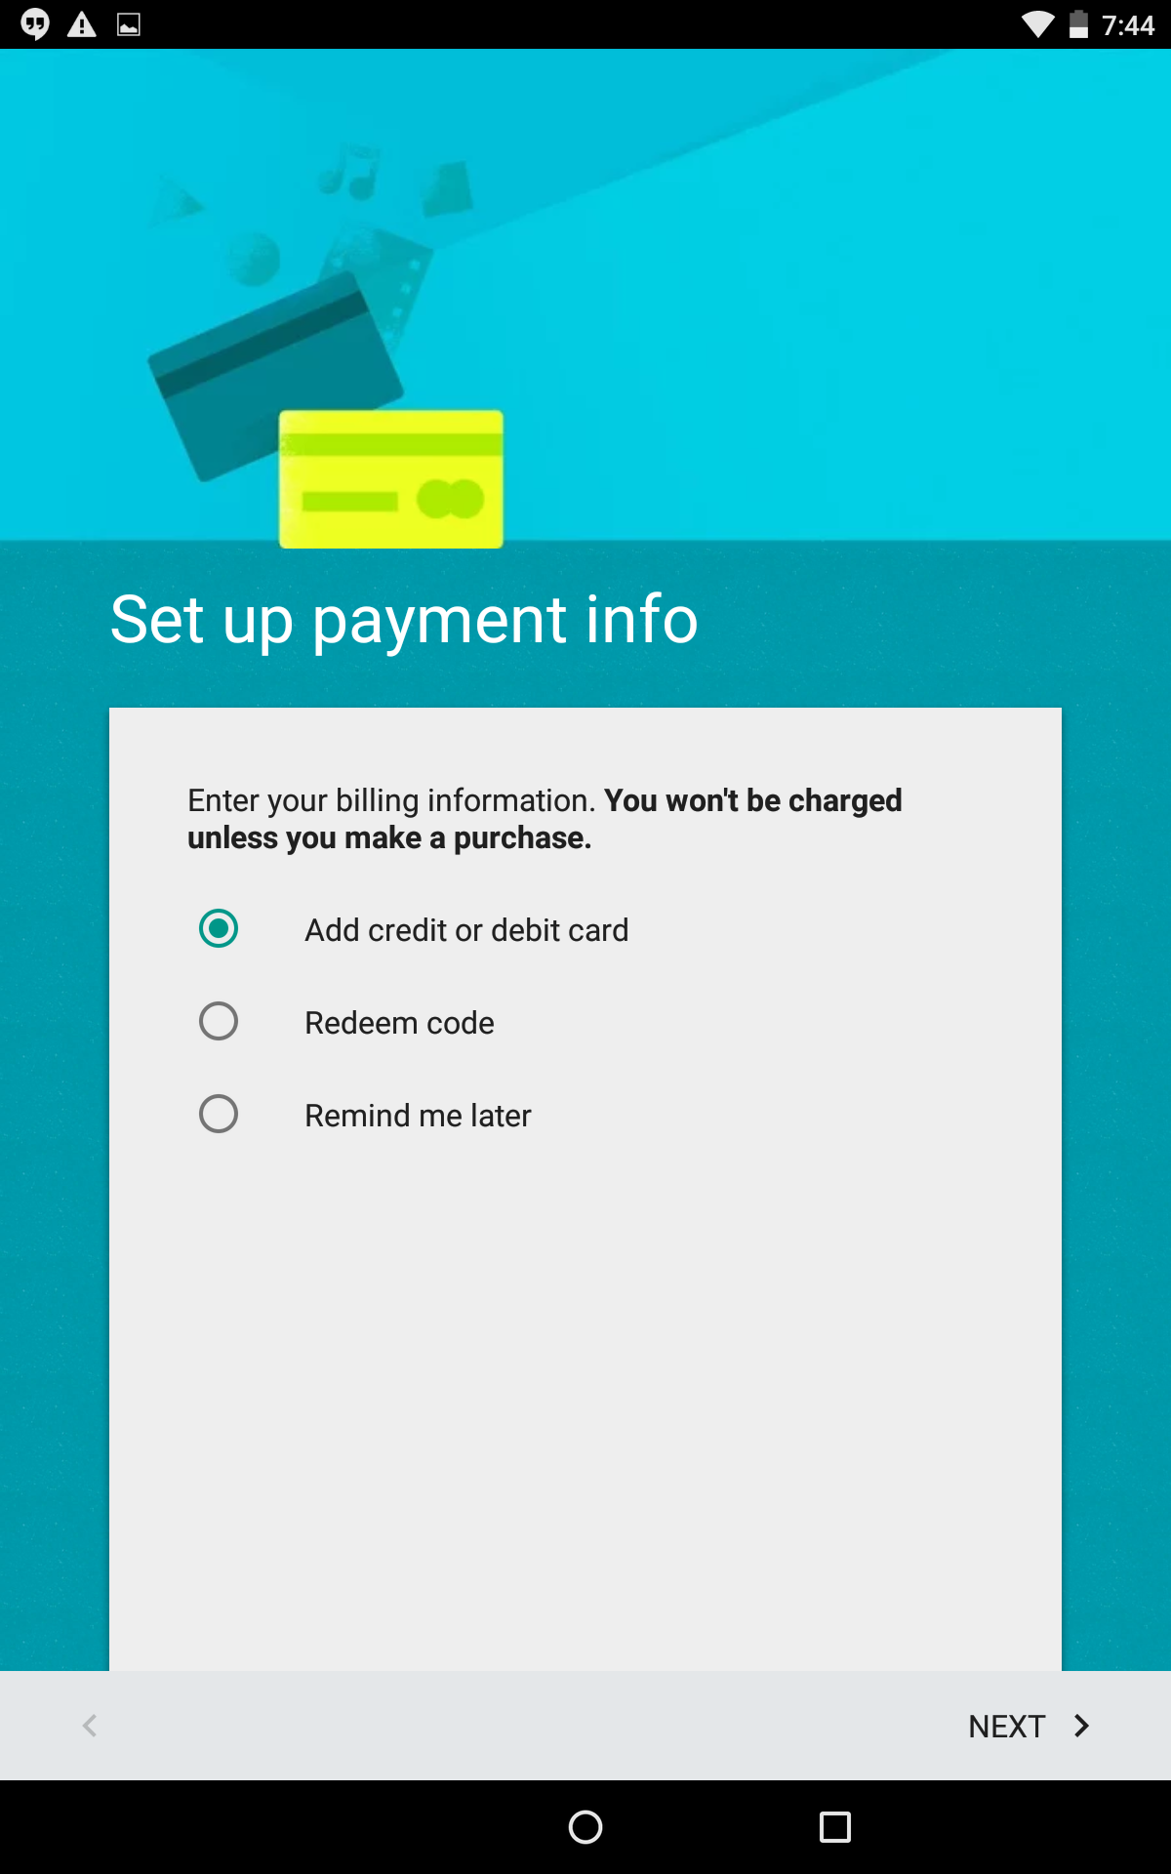
Setup Payment Info
Remind me later.

Slide 28
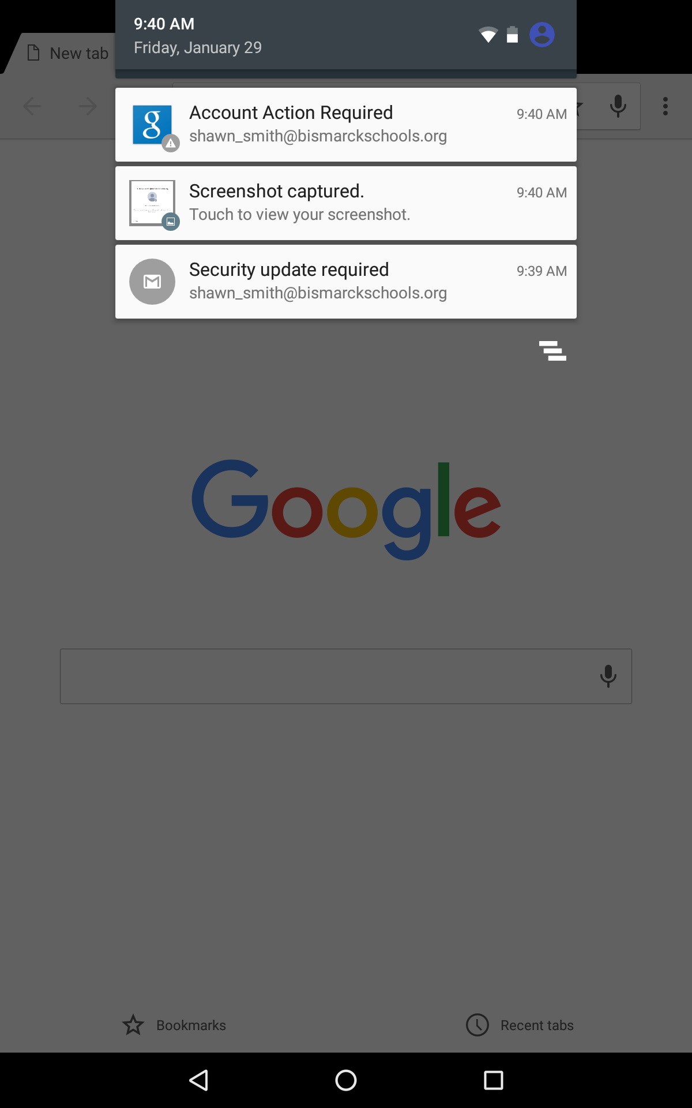
Account action
Swipe
down
Select this option
Account action required.
This step will allow the device to
enable security policies required
by the BPS domain. This option can be found
by swiping down from the top of the tablet.

Slide 29
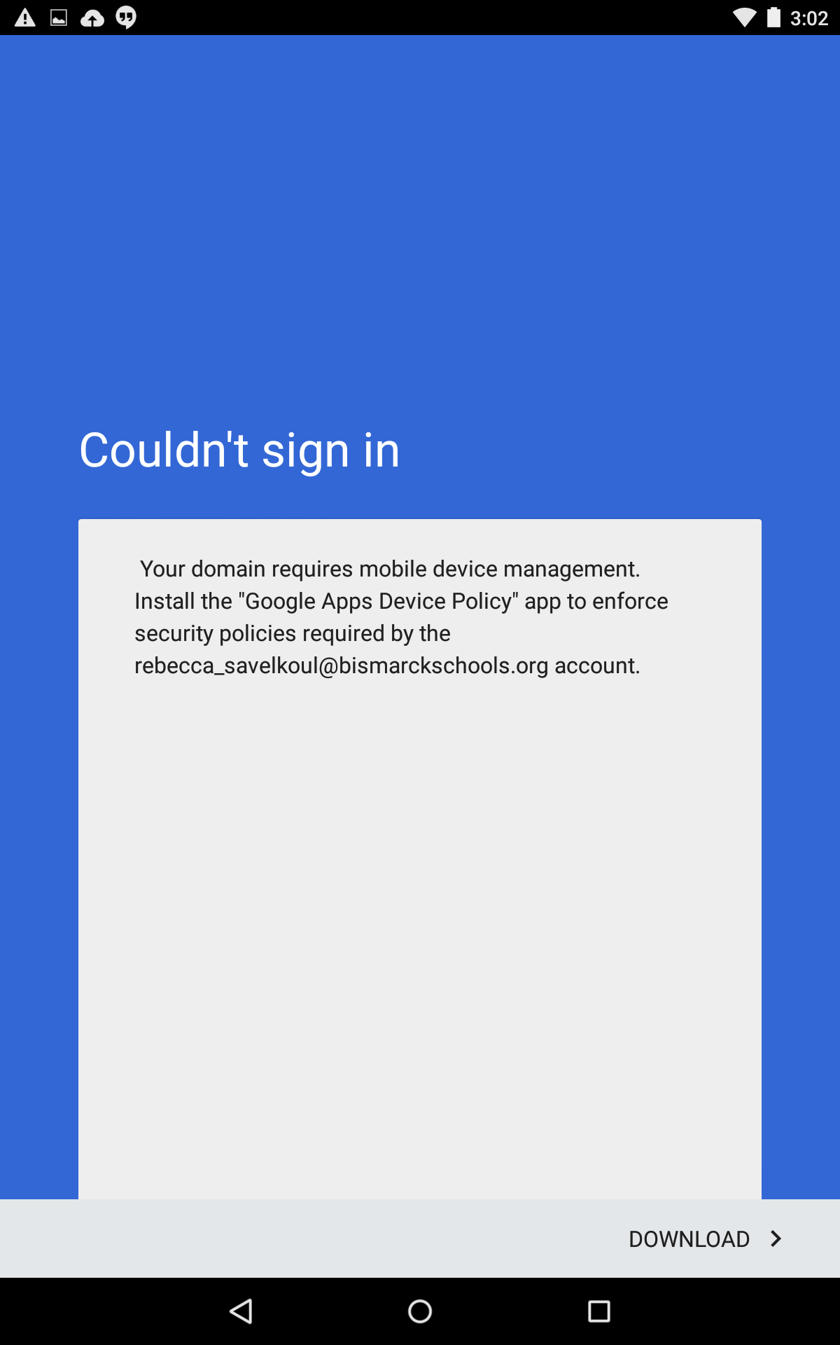
Download Device
Management App
Install the “Google Apps Device Policy” app.
Touch download.

Slide 30
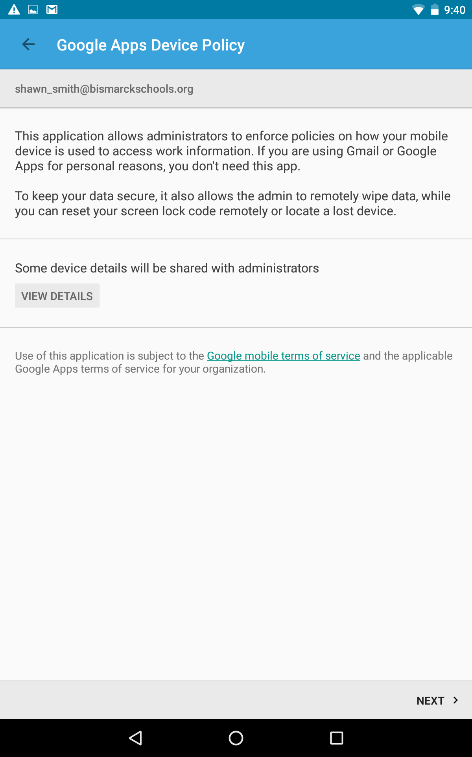
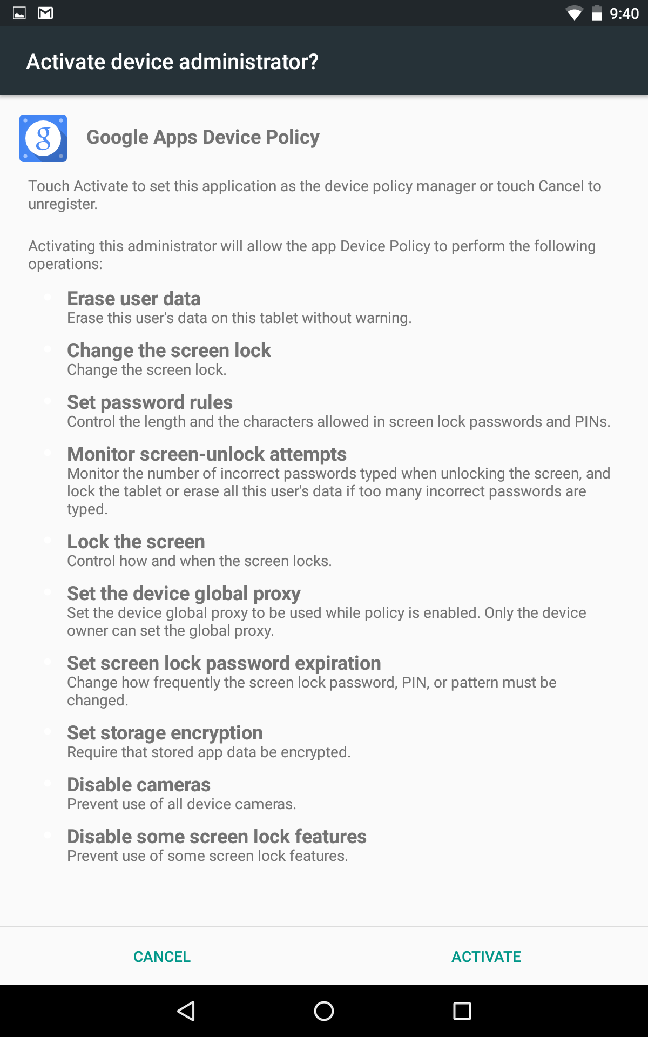
Agree to Policy
Touch next to agree
then activate.

Slide 31
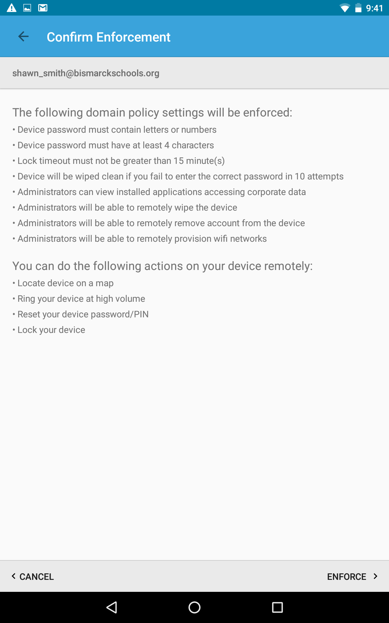
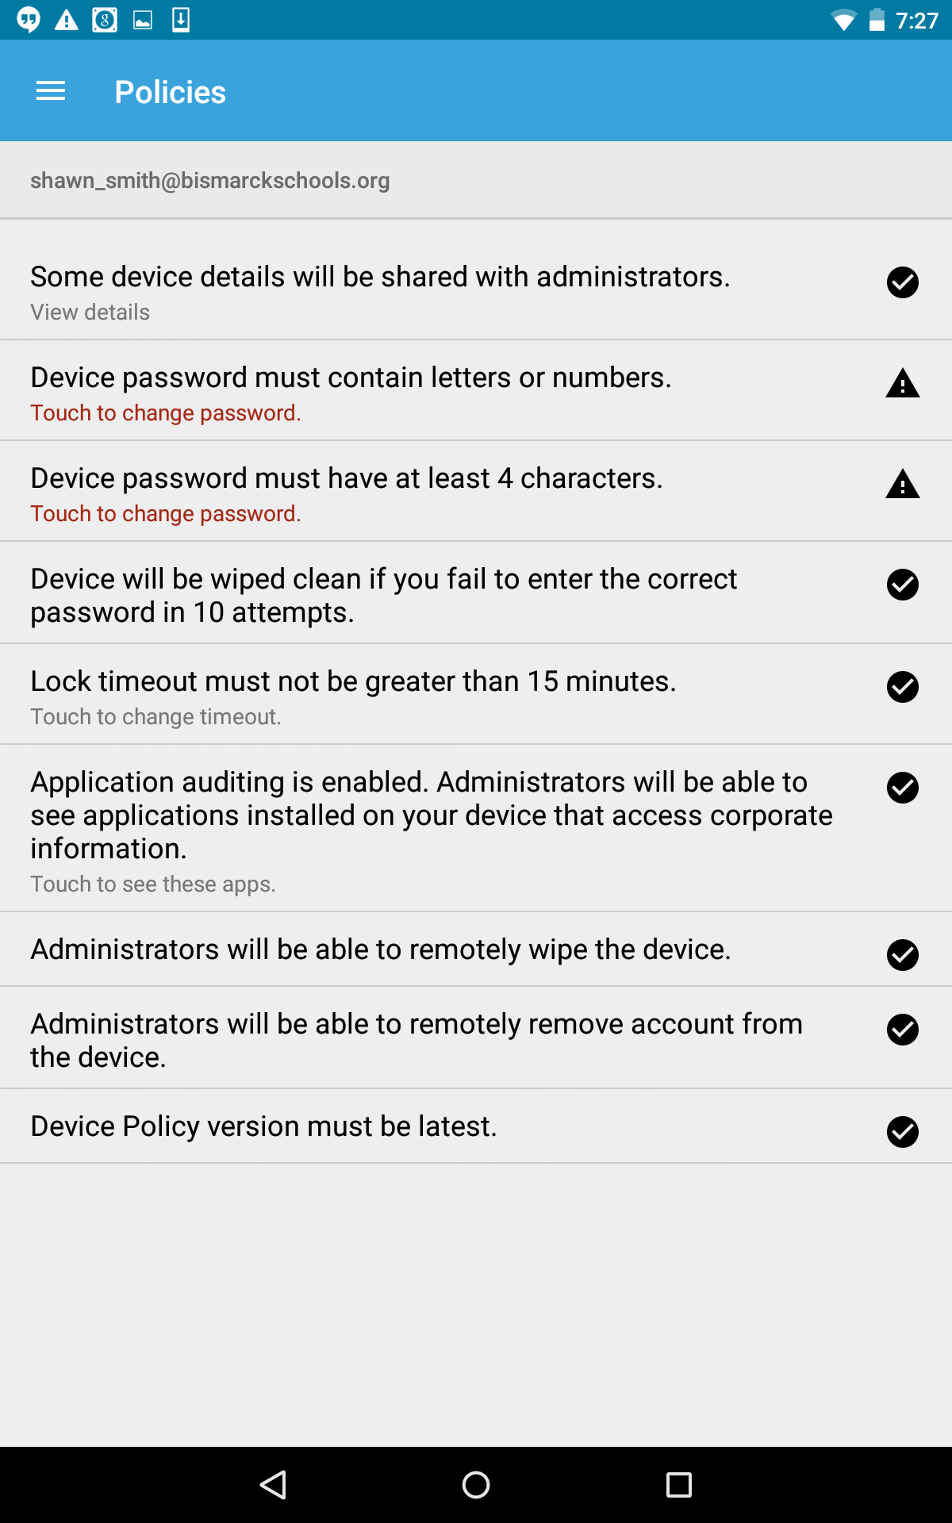
Enforce Policy
Enforce policy
Select option the device
password must have
at least 4 characters.

Slide 32
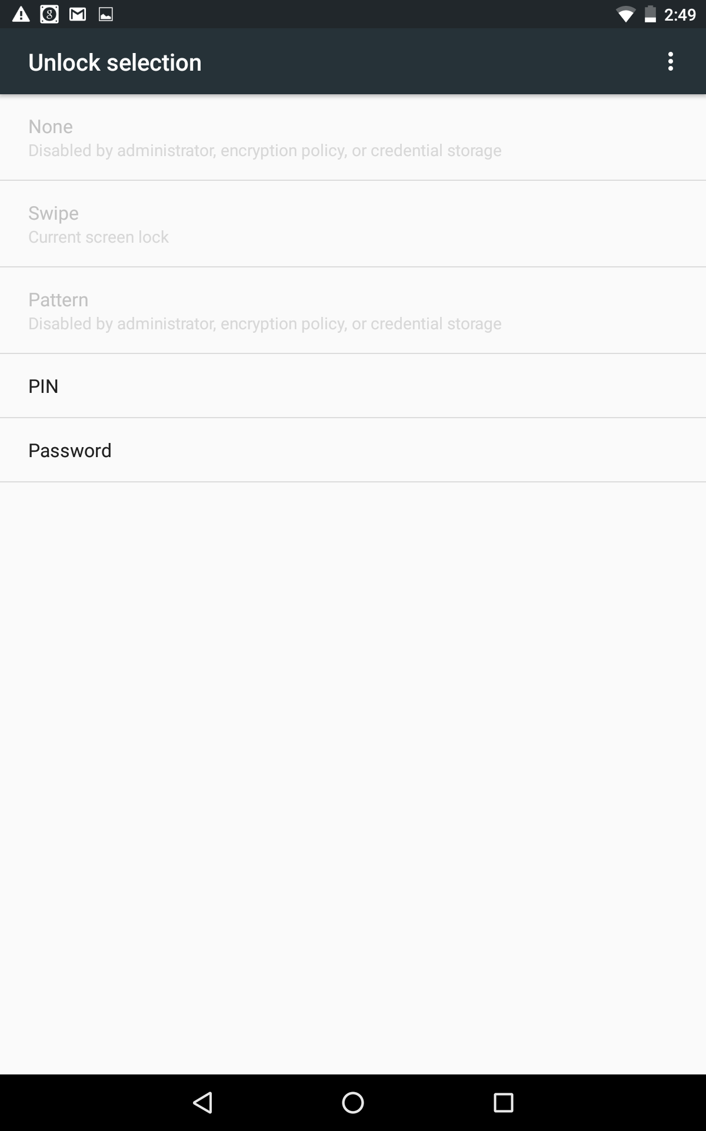
PIN
Enter 4 digit secure PIN twice.

Slide 33
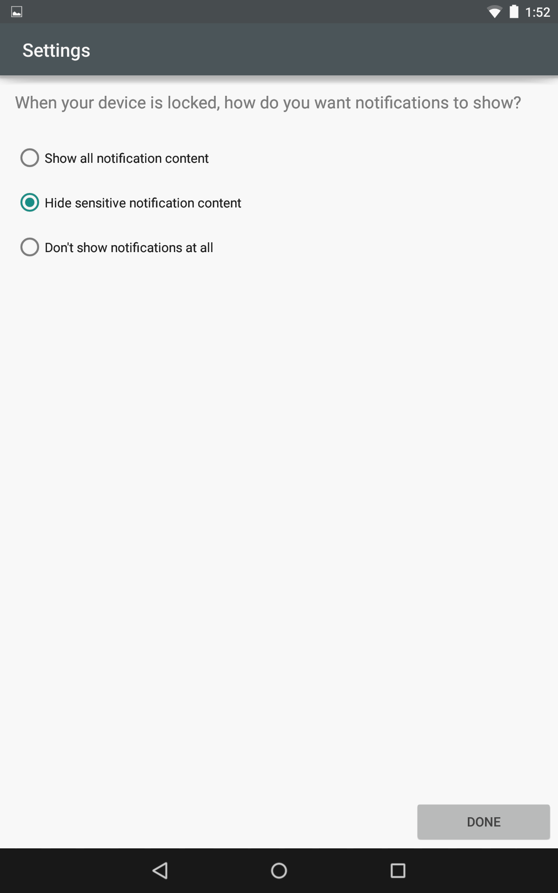
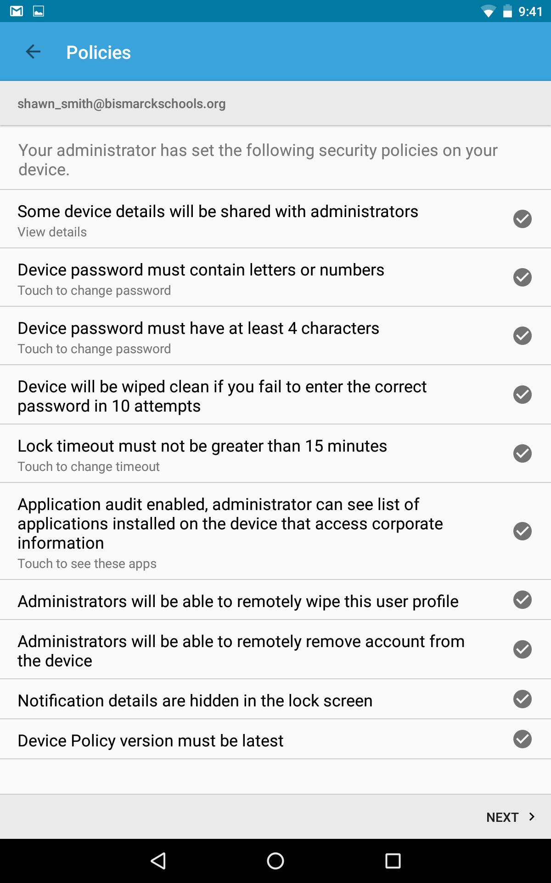
Hide Notifications
Touch the button to hide
sensitive notification content.
Done.
Make sure all policies
are checked.

Slide 34
Policies complete
All policies are marked complete next and done.
Touch home screen icon to return.

